Slide 1
Comparing the Cost and Watershed Impacts of Pre- and Post-Fire Mitigation Actions: a Risk Assessment Case Study
Allison Rhea & Brett Wolk
Colorado Forest Restoration Institute
April 16th, 2024
After the Flames Conference

Slide 2
Context
Complex decisions about how to minimize wildfire risk to forested watersheds
Quantify tradeoffs of management actions so we can better prioritize where & when to deploy them
In alignment with WFMMC Recommendation 35 and PLPG 2024 Farm Bill Recommendations
Case Study: Forests to Faucets Quantitative Wildfire Risk Assessment (following GTR-315 framework and Gannon et al., 2018)
Wildfire risk to critical water infrastructure

Slide 3
Current Conditions
Surface & Canopy Fuels
RUSLE
[Un]burned
FlamMap
Fire Behavior
Terrain Length and Slope
Weather
Veg. Cover
Post-Fire Hillslope Erosion
Soil Erodibility
Rainfall Erosivity
Topography
Hillslope and Channel Transport
Post-Fire Sediment Delivery to Infrastructure

Slide 4
“Bang for the Buck” Treatment Plan
7,841 priority ha

Slide 5
How can we reduce wildfire risk?
Pre-fire
During fire
Post-fire
Fuels Reduction
Aerial Mulching
Process-Based Restoration
Process-Based Restoration
and many more……

Slide 6
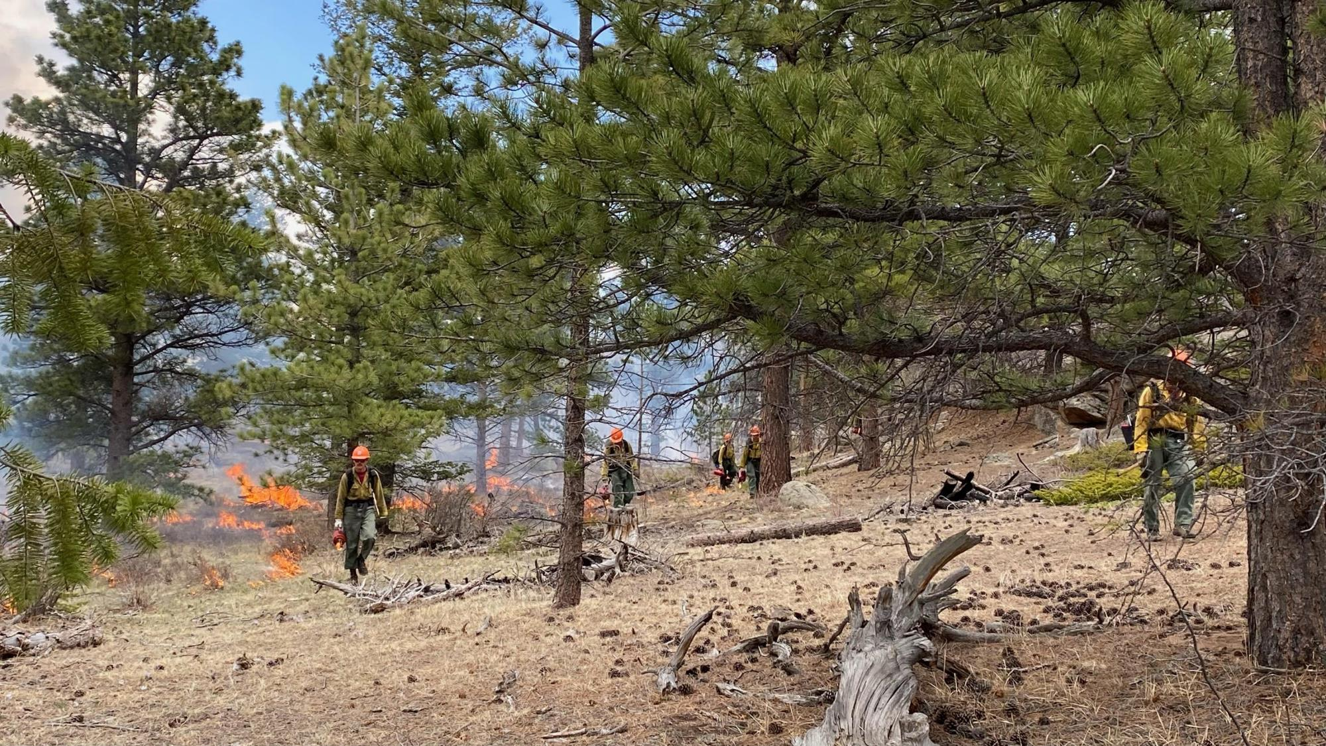
Forest thinning, prescribed fire, and beneficial fire
Reduce severity and watershed impacts of future fires
Only effective if they
Encounter wildfire
Reduce fire severity
Strategically located relative to critical values at risk
Fuels Reduction
Magic Feather RxFire, Credit: Kat Morici

Slide 7
Fuels Reduction
Surface & Canopy Fuels
RUSLE
[Un]burned
FlamMap
Fire Behavior
Terrain Length and Slope
Weather
Veg. Cover
Post-Fire Hillslope Erosion
Soil Erodibility
Rainfall Erosivity
Topography
Hillslope and Channel Transport
Post-Fire Sediment Delivery to Infrastructure

Slide 8
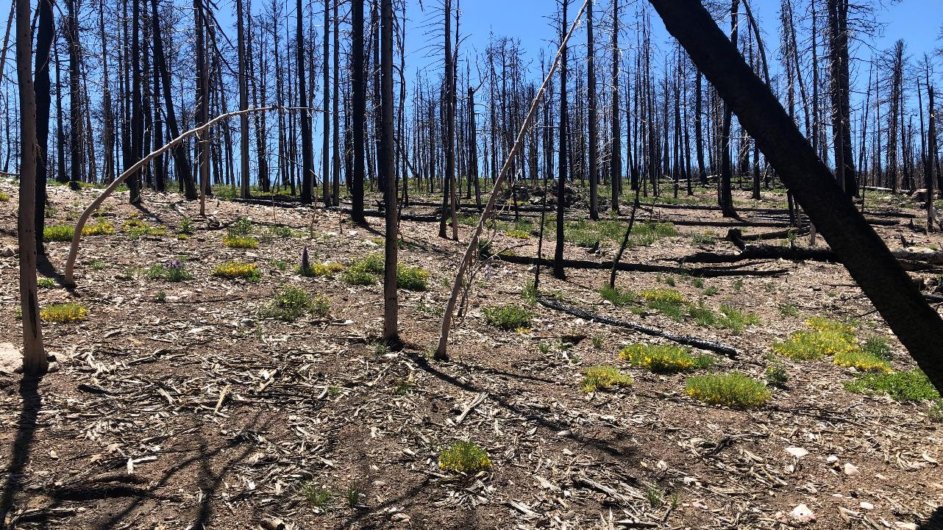
Aerial Mulching
Drop wood shred mulch from helicopter after fire
Stabilize burned hillslopes and prevent erosion
Target steep, severely burned hillslopes near VARs
Bennett Creek, Cameron Peak Fire

Slide 9
Aerial Mulching
Surface & Canopy Fuels
RUSLE
[Un]burned
FlamMap
Fire Behavior
Terrain Length and Slope
Weather
Veg. Cover
Post-Fire Hillslope Erosion
Soil Erodibility
Rainfall Erosivity
Topography
Hillslope and Channel Transport
Post-Fire Sediment Delivery to Infrastructure

Slide 10
Aerial Mulching
- 26% Reduction: average from Cameron Peak Fire monitoring (Kampf et al., in prep)
- 58% Reduction: yr 1 wood mulch effectiveness from lit review (Kampf et al., in prep; Schmeer et al., 2018; Robichaud et al., 2013a; Robichaud et al., 2013b; )
- 68% Reduction: ≥50% mulch cover is needed (Robichaud et al. 2000; Benavides-Solorio and MacDonald 2005; Cerda and Doerr 2008; Prosdocimi et al. 2016; Prats et al. 2016; Girona-Garcia et al. 2021)

Slide 11
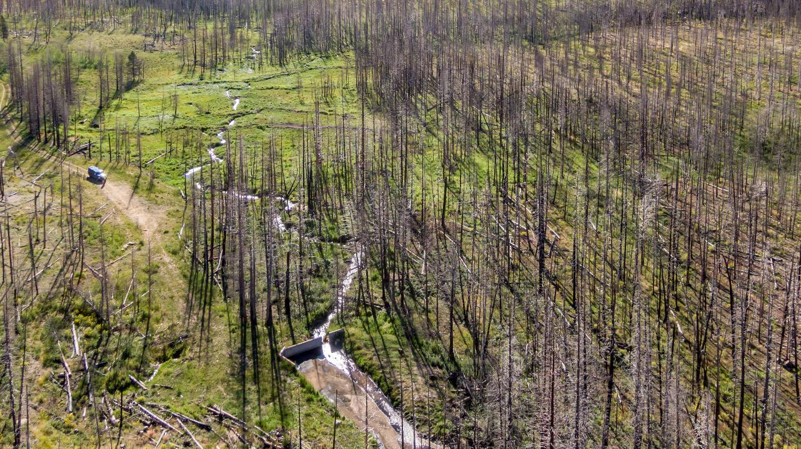
Process-Based Restoration
PALS, BDAs, etc
Re-connect streams with their floodplains
Attenuate flood flows, sediment, debris, and nutrients
Can be applied pre- and post-fire
Upper Elkhorn Creek, Credit: Ayers Associates

Slide 12
Process-Based Restoration
Sediment storage behind individual LTPBR structures (Dunn et al., 2023; Scamardo et al., 2019; Jones et al., in prep)
Avg 7 m³ measured in-channel storage behind individual structures
BDAs’ average 53% residual volume (Dunn et al., 2023)
Avg 14 m³ potential in-channel storage behind individual structures
Potential for sediment deposition and storage on floodplains that is often unmeasured (Jones et al., in prep)
Several thousands m³

Slide 13
Management Action | Cost
Forest Thinning | $2,800/acre + linear increase with slopes >40% and distances from roads > 800 m
Prescribed Fire | Surface fire under 25th %: $900/acre > 250 m from structure, $1,800 when <250 m from a structure Crown fire under 25th %: $2,000/acre > 250 m from structure, $4,000 when <250 m from a structure
Thin + Prescribed Fire | Cost of forest thinning + cost of prescribed fire (≥$3,700/acre)
Aerial Mulching | $2,200/acre + $500-1,000/acre increase in cost for every additional mile from a helicopter landing pad (i.e. rd proxy)
Process-Based Restoration | $1,700/structure ($700-3,500/structure or 26,000-297,000/river mile)

Slide 14
cost-benefit analysis
IF
your objective is reducing sediment delivery to water infrastructure

Slide 15
 |  | Same Acreage |  | Normalized |  | Same Budget
 | Treatment | Δ yield (m³) for 7,841 ha | Total cost ($) for 7,841 ha | Avg. ($/acre) | Avg. ($/m³) | Δ yield (m³) for $30M
Fuels Reduction | Thin | 6,340 | 69,136,097 | 3,568 | 10,905 | 2,751
 | Rx/Benef. Fire | 6,160 | 33,026,693 | 1,705 | 5,362 | 5,595
 | Thin + RxFire | 9,068 | 102,162,690 | 5,273 | 11,267 | 2,663
Aerial Mulch | 26% Effect. | 3,580 | 49,672,093 | 2,564 | 13,876 | 2,162
 | 58% Effect. | 7,986 | 49,672,093 | 2,564 | 6,220 | 4,823
 | 68% Effect. | 9,362 | 49,672,093 | 2,564 | 5,305 | 5,655
Process-Based Restoration | Stored |  |  |  | 255 | 117,713
 | Capacity |  |  |  | 127 | 235,426

Slide 16
Less cost-effective
More cost-effective

Slide 17
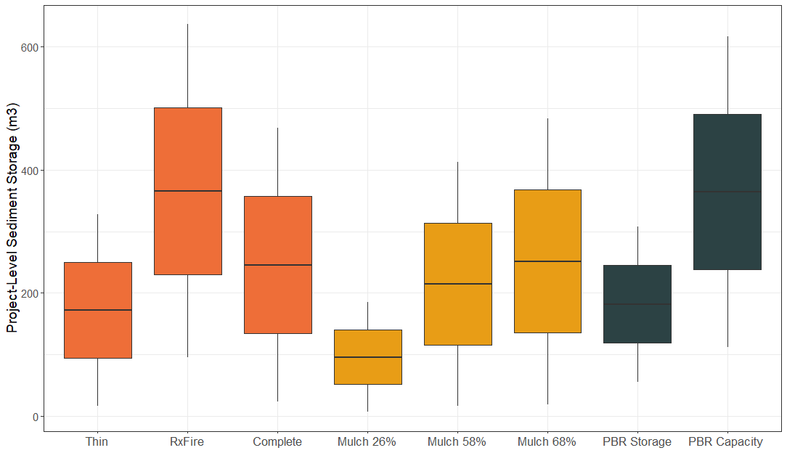
(50-1,000)
(300-2,000)
(50-1,000)
(40-1,000)
(40-1,000)
(40-1,000)
(8-44)
(8-44)

Slide 18
If your objective is sediment reduction…
Prescribed fire or low intensity wildfire benefit source water
Scale-up process-based restoration where it makes sense
Align forest management and PBR
Aerial mulch is cost-effective at higher application rates

Slide 19
Other Considerations
Management Action | Location Certainty | Little-No Maintenance | Change Fire Behavior | Retain Forest | Residence Time
Forest Thinning | Low | Tens of yrs | High | High | High
Rx/Beneficial Fire | Low | Tens of yrs | High | High | High
Aerial Mulching | High | None | Low | Low | High
Process-Based Restoration | High | Annual | Med | Low | Low
Notes:
Dark colors are “good”

Slide 20
Areas for Growth
Cost:
Public full cost accounting of management activities, beyond implementation/construction cost
Design, permitting, materials, monitoring, and maintenance
Quantify co-benefits (e.g avoided reforestation needs) into calculations
Effects:
Impact of slope and % cover on mulch effectiveness
Quantify residual sediment storage capacity and floodplain sediment storage when monitoring PBR/wetland restoration
Characterize residence time of sediment storage

Slide 21
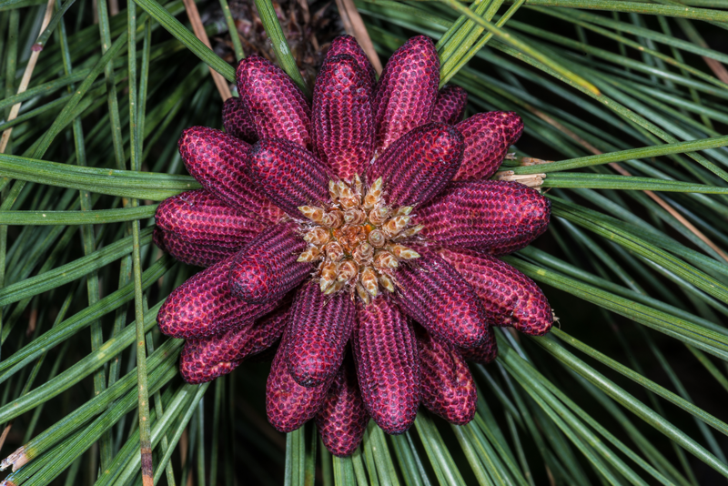
Let’s continue the conversation
Allison.Rhea@colostate.edu

Slide 22
Canopy fuel adjustments by trtmt
Fuel reduction treatments are simulated with proportional adjustments to baseline canopy attributes using mean effect sizes from fuels reduction and forest restoration projects in the western US (Stephens and Moghaddas 2005; Stephens et al. 2009; Fulé et al. 2012; Ziegler et al. 2017; Ritter et al. 2023).
Parameter | Thin | RxFire | Thin + RxFire
Canopy Base Height | 1.3 | 1.09 | 1.3
Canopy Height | 1.3 | 1.13 | 1.3
Canopy Cover | 0.6 | 0.95 | 0.6
Canopy Bulk Density | 0.6 | 0.92 | 0.6

Slide 23
Surface fuel adjustments by trtmt
Change the fire behavior fuel model (Scott and Burgan 2005)
Thin - not alter the fire behavior fuel model
Prescribed fire - shift the fire behavior fuel model to the least intense model in the same category and climate type
Thinning followed by prescribed fire - same effects as prescribed fire only.

Slide 24
Treatment Type | Feasibility | Cost
Thin | No wilderness or upper tier roadless, >10% canopy cover | $2,800/acre base cost + linear increase with slopes > 40% and distances from road > 800 m up to max of $10,000/acre
RxFire | No lodgepole or spruce-fir | Surface fire under 25th %: $900/acre > 250 m from structure, $1800 when <250 m from a structure Crown fire under 25th %: $2000/acre > 250 m from structure, $4000 when <250 m from a structure
Thin + RxFire | No wilderness or upper tier roadless, >10% canopy cover, no lodgepole or spruce-fir | Mechanical thin only $ + RxFire only $ ($3,700 – $10,000)
Patch Cut | No wilderness or upper tier roadless, canopy cover > 10%, only lodgepole and spruce-fir | $2,800/acre base cost + linear increase with slopes > 40% and distances from road > 800 m up to max of $10,000/acre
Mastication | No wilderness or upper tier roadless, >10% canopy cover | $2000/acre + linear increase with slopes > 40%, linear increase with Crown Bulk Density above 50th percentile, and distances from road > 800 m up to max of $10,000/acre

