Slide 1
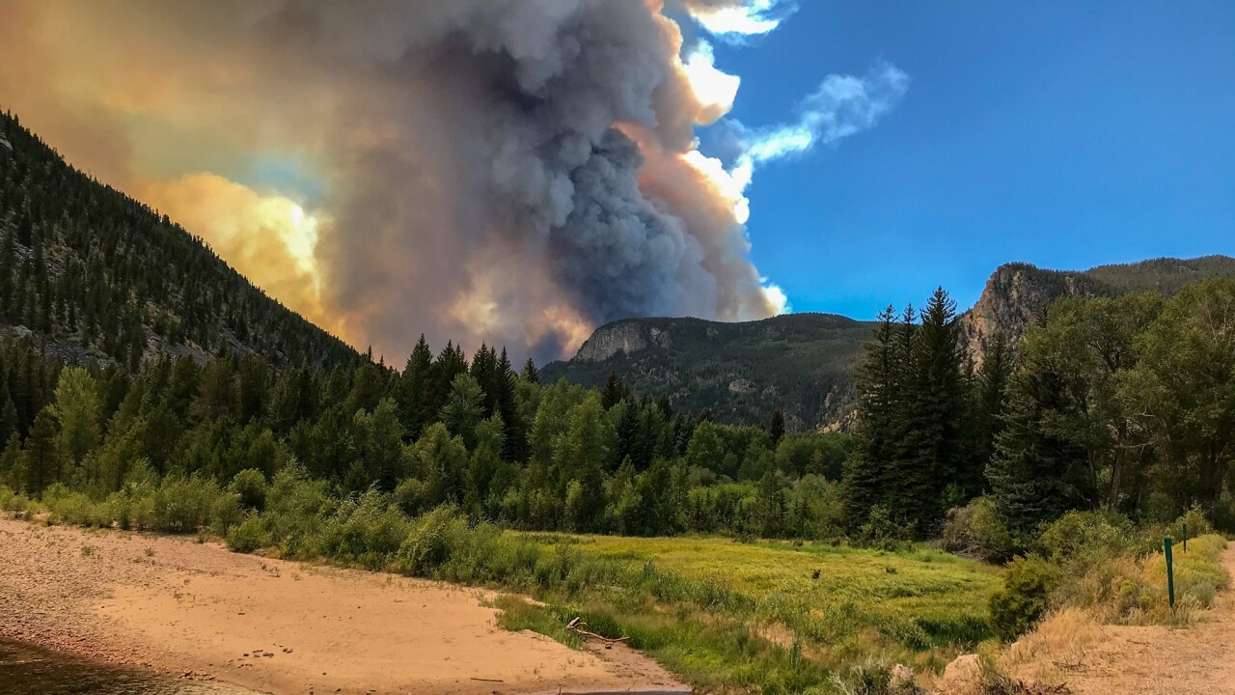
Upper Poudre Canyon Post-Fire Community Hub Lucas Roy and Maya Daurio

Slide 3
Structure – The Poudre Hub
Home Page
Current Conditions
Reducing Risk
Custom resources
Quick links
Fire/weather conditions
Emergency alerts
Wildfire/flooding preparation
Emergency alerts
Funding
Citizen Science
Community Resources
Wildfire Recovery
Mitigation grants and tax credits
Data collection opportunities
Local organizations and support systems
Recovery resources
Flooding and debris flows
Research
Additional Resources
Contacts
Post-fire study sites
Open-source data
Film and other media
Official documents
Phone, email, and websites for important agencies

Slide 4
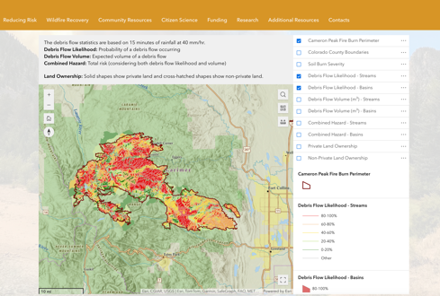
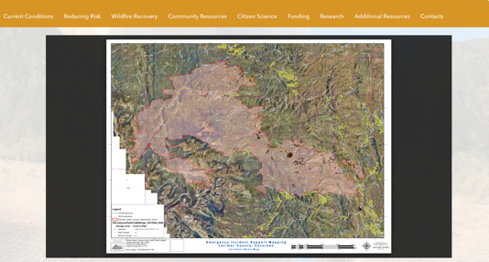
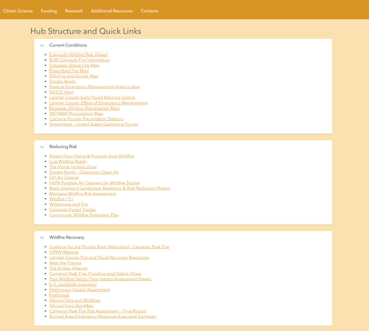
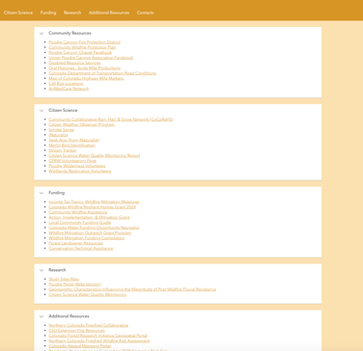
Structure – Home Page
1. StoryMap: Explore photos and videos of the fire
2. Cameron Peak Fire Interactive Map
3. Building damage map
4. Hub structure and quick links

Slide 5
Structure – Home Page
1. StoryMap: Explore photos and videos of the fire
2. Cameron Peak Fire Interactive Map
3. Building damage map
4. Hub structure and quick links

Slide 7
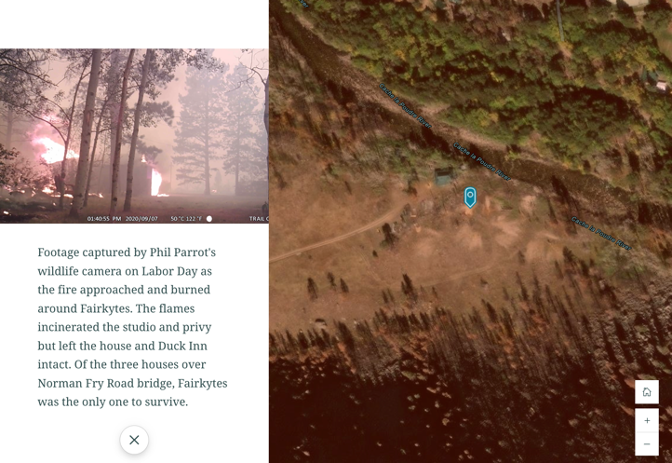
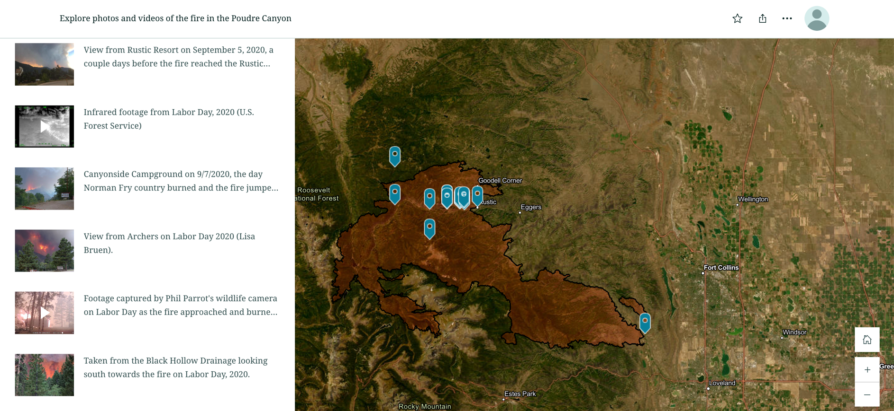

Slide 8
Structure – Home Page
1. StoryMap: Explore photos and videos of the fire
2. Cameron Peak Fire Interactive Map
3. Building damage map
4. Hub structure and quick links

Slide 9
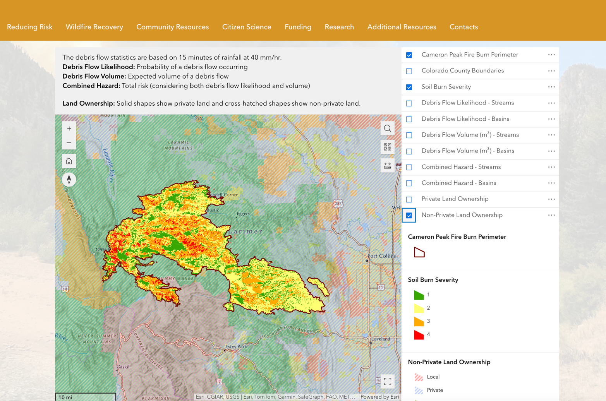

Slide 10
Structure – Home Page
1. StoryMap: Explore photos and videos of the fire
2. Cameron Peak Fire Interactive Map
3. Building damage map
4. Hub structure and quick links

Slide 11
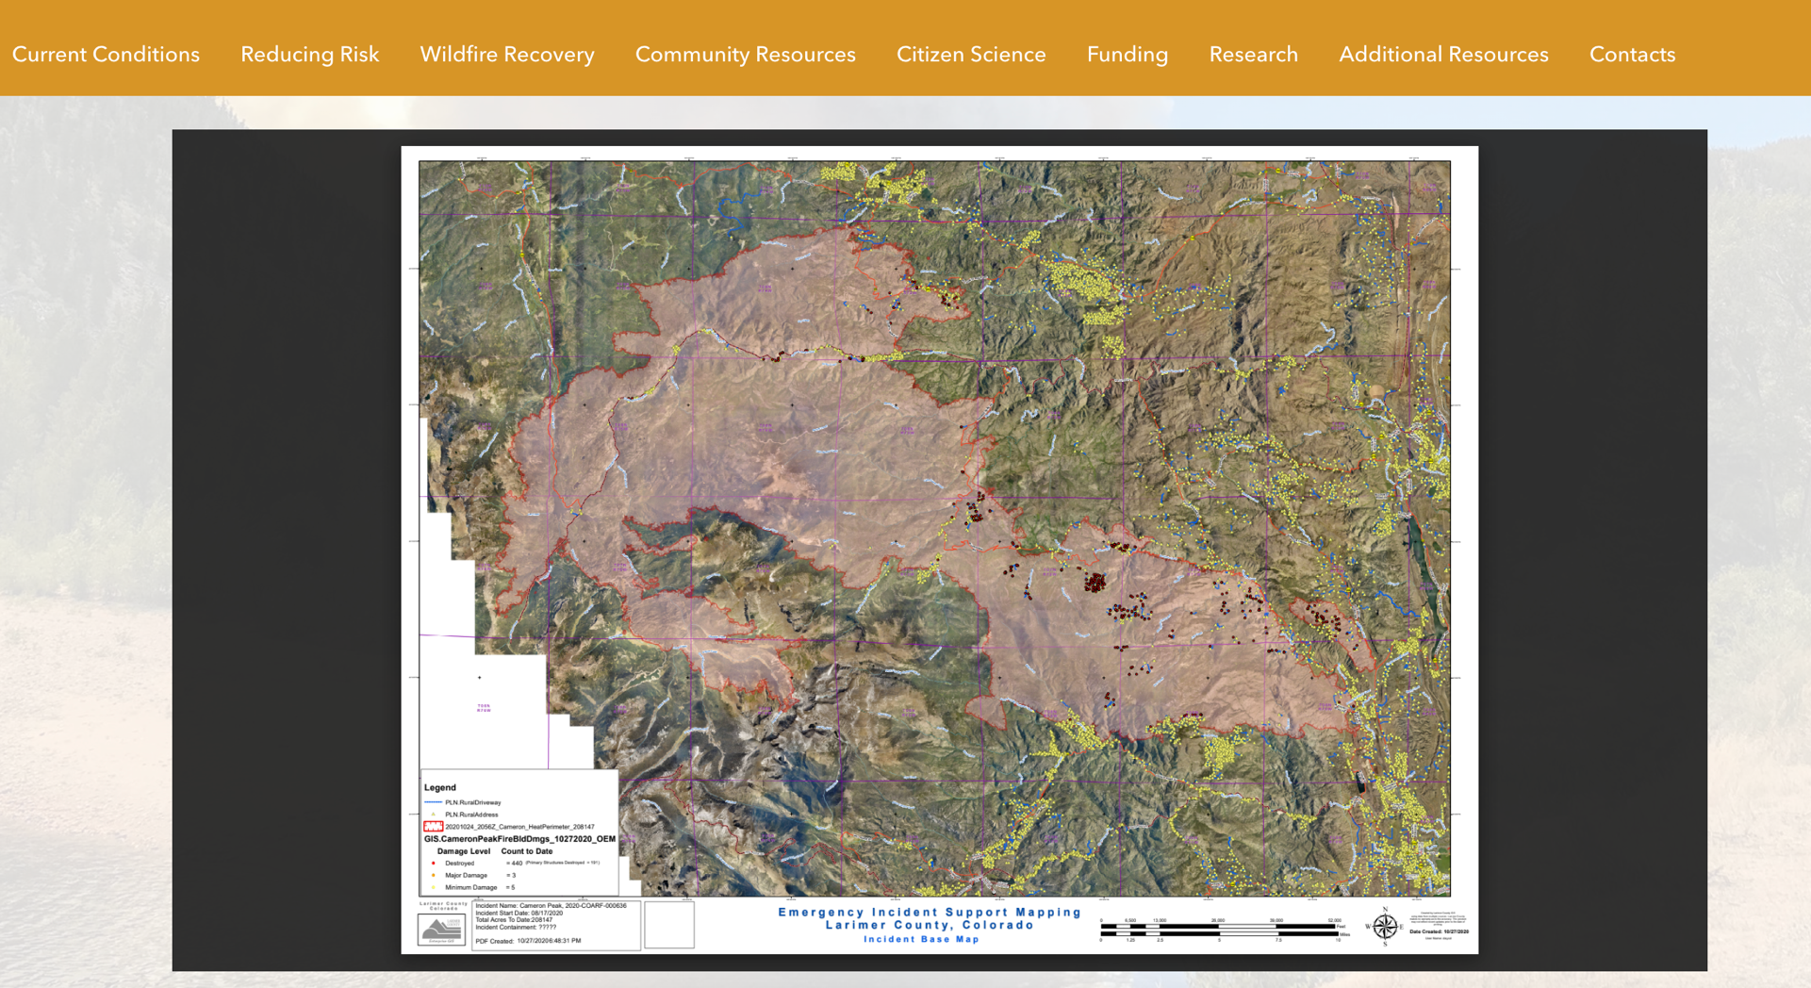

Slide 12
Structure – Home Page
1. StoryMap: Explore photos and videos of the fire
2. Cameron Peak Fire Interactive Map
3. Building damage map
4. Hub structure and quick links

Slide 13
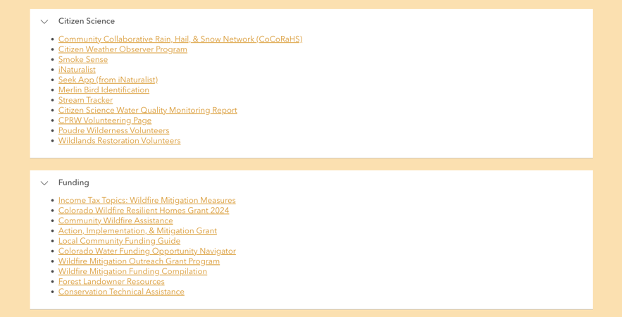
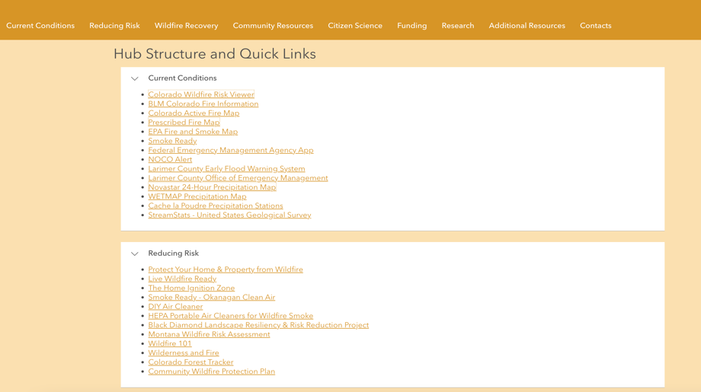
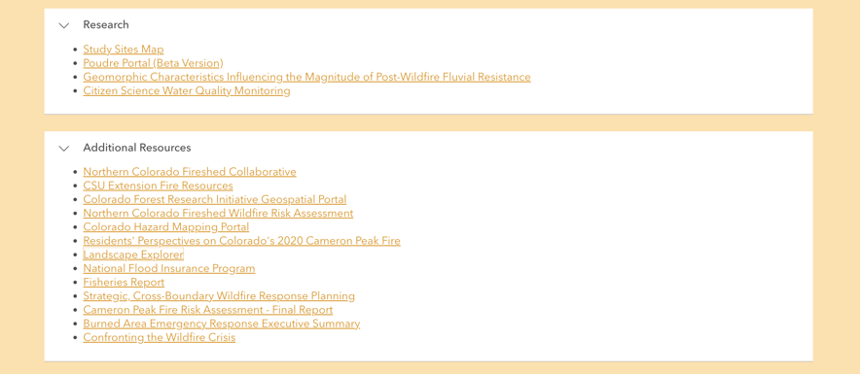
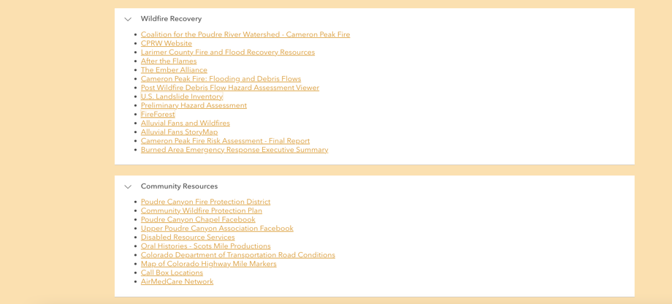
Home Page - Quick Links

Slide 14
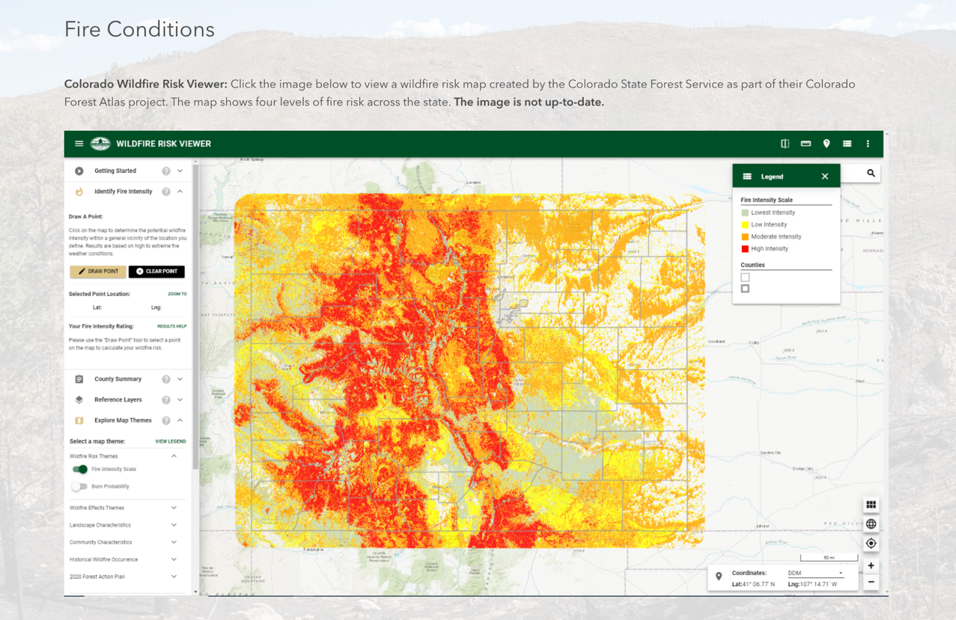
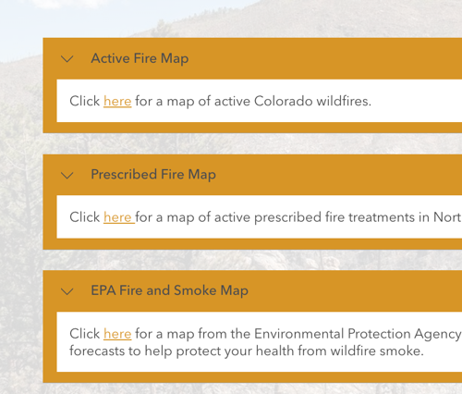
Accordion-style drop down menus
Other included resources:
BLM Colorado fire info
FEMA App
Flood warning
Precipitation map
Colorado State Forest Service wildfire risk viewer

Slide 15
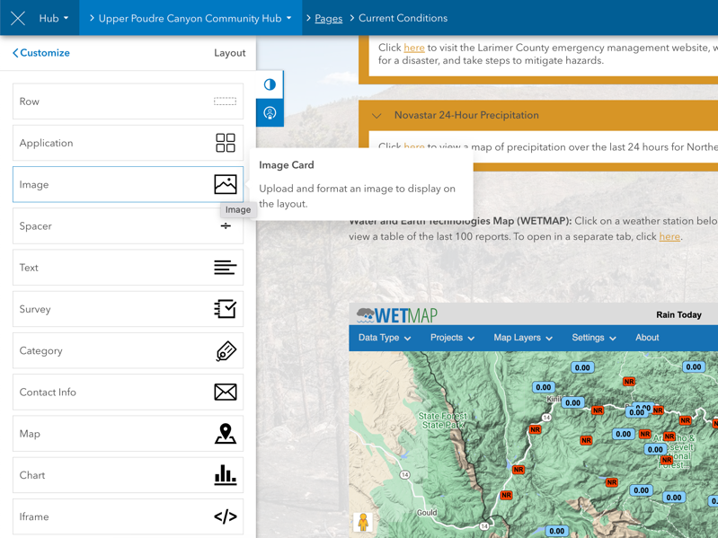
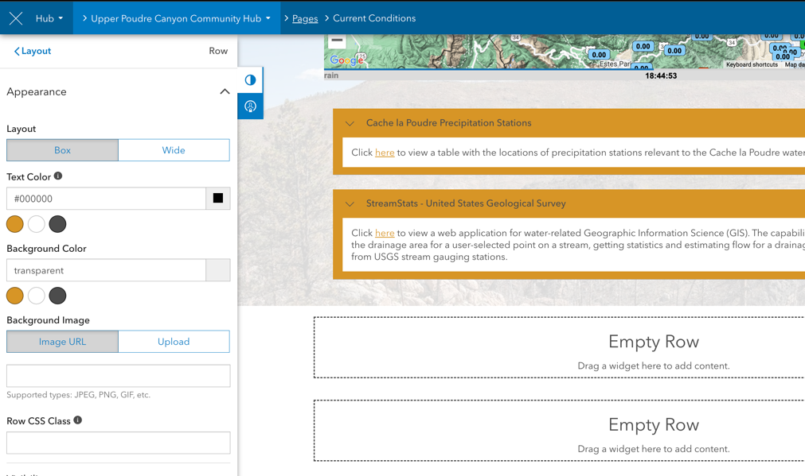
ArcGIS Hub Workflow
Editing ribbon
Click-and-drag templates
Embed other websites
Add pictures
Add ArcGIS Online content
Notes:
Now that we have an overview of what a hub site can look like…

Slide 16
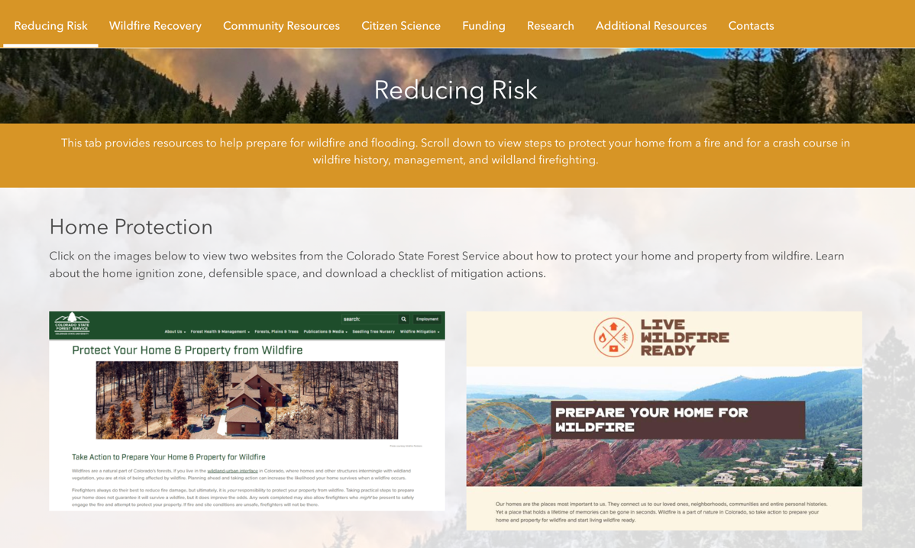
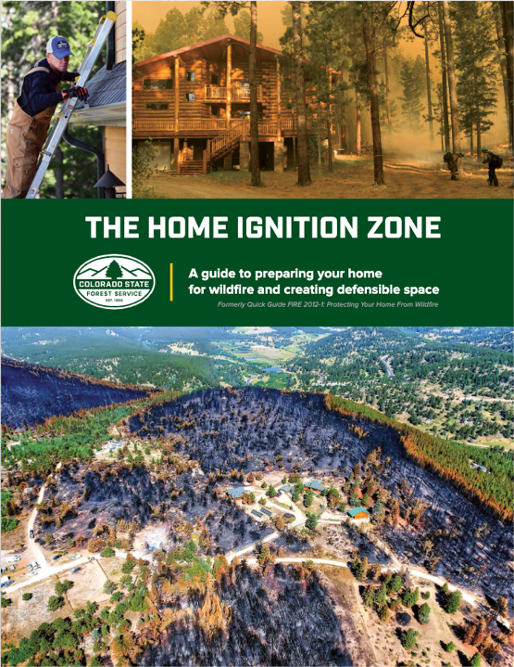
Also included:
Wildfire smoke information
Wilderness and fire StoryMap
Firefighting blog
How wildfire risk is assessed
Black Diamond landscape resiliency project

Slide 17
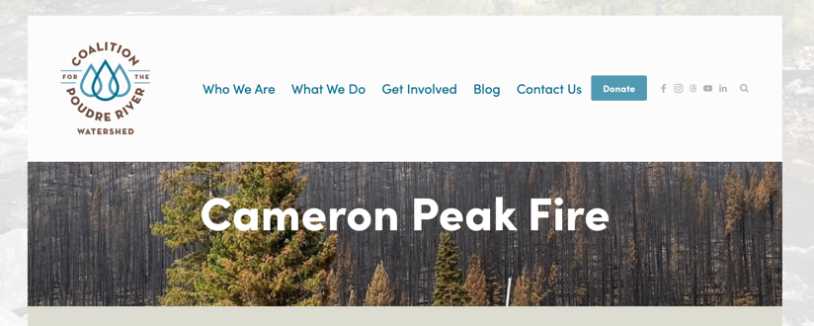
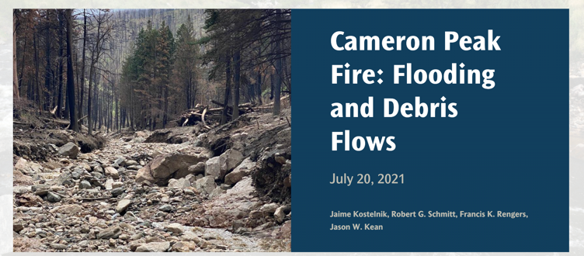
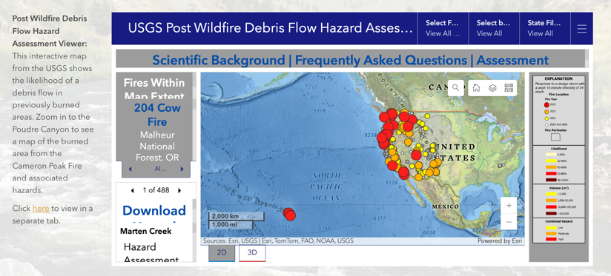
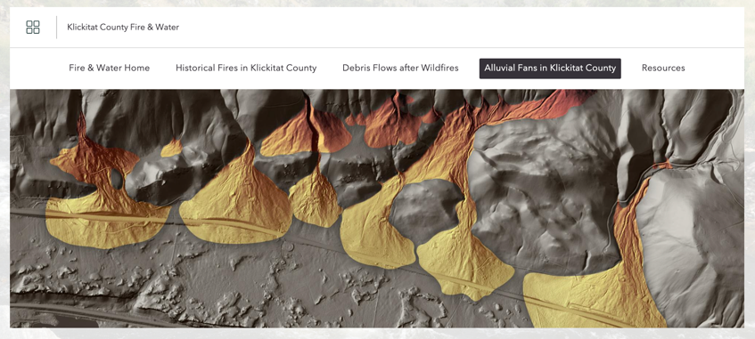
Coalition for the Poudre River Watershed
Debris Flow StoryMap
USGS Post-Wildfire Debris Flow Risk
Alluvial fans StoryMap

Slide 18
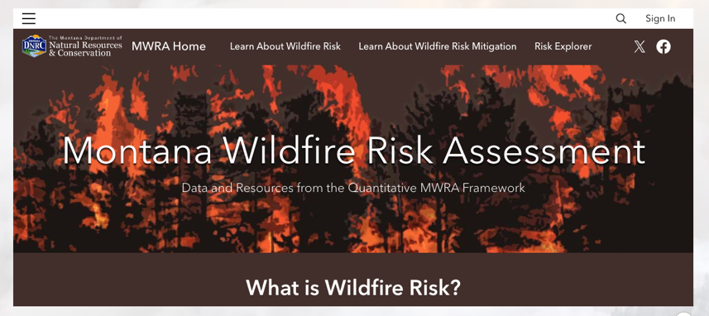
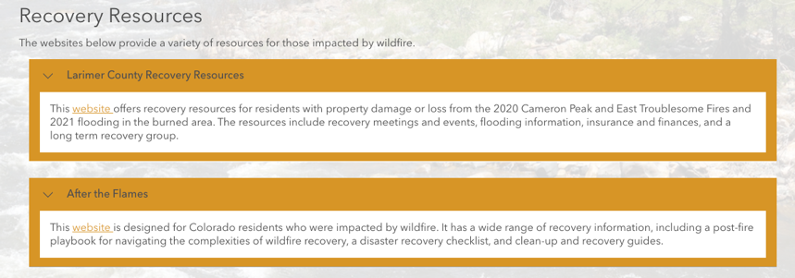
ArcGIS Hub Media Types
Clickable Images
ArcGIS Online content (ex. StoryMaps and Web Maps)
“Accordions”
Documents and websites
Notes:
Now that we have an overview of what a hub site can look like…

Slide 19
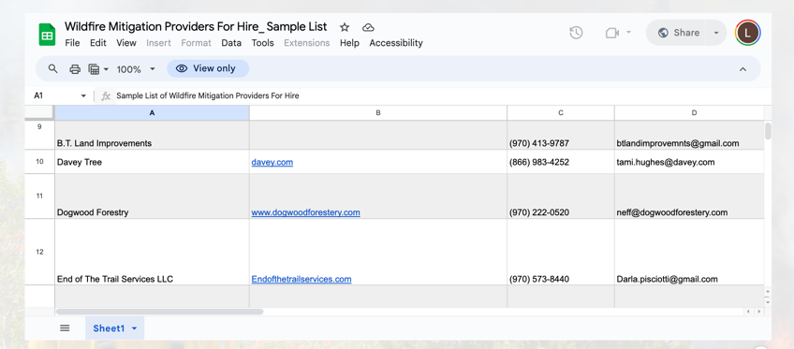
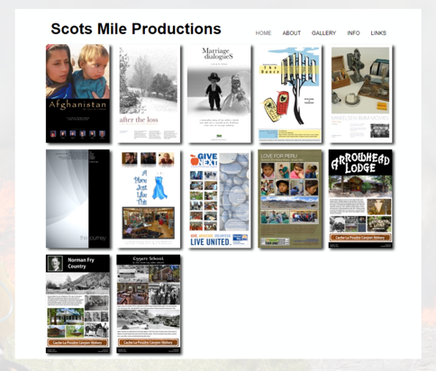
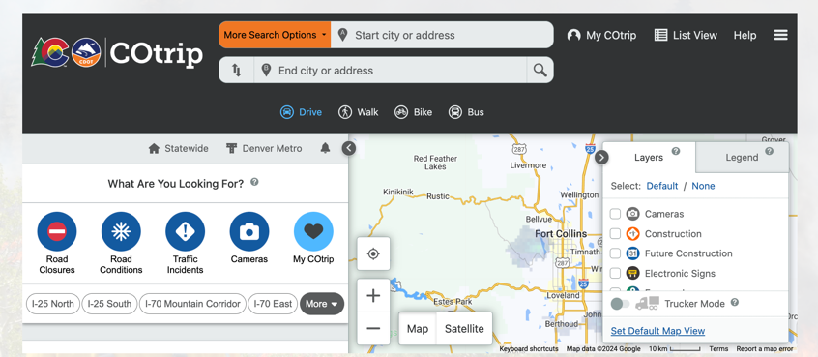
Also Included
Poudre Canyon Fire Protection District
Old Poudre City, Inc.
Poudre Canyon Chapel
Wildfire mitigation providers
Local films
Upper Poudre Canyon Association
Historic Larimer County
Red Feather Historical Society
Wildfire Mitigation Providers
Highway conditions

Slide 20
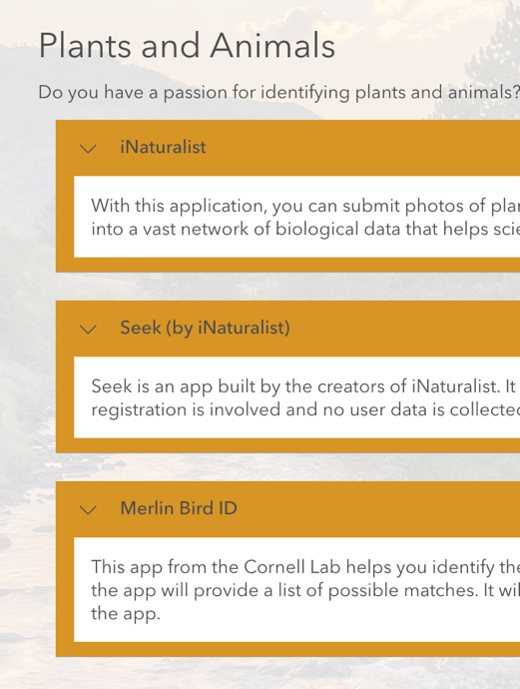
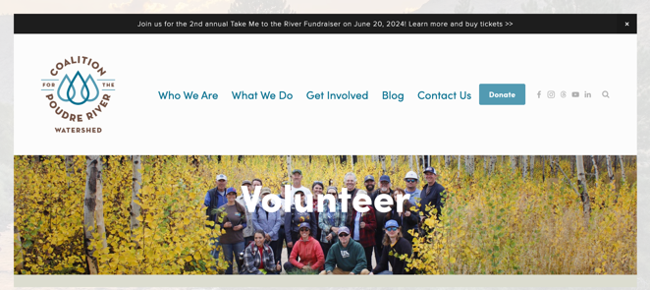
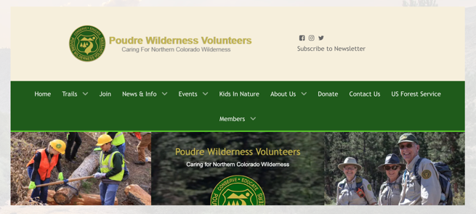
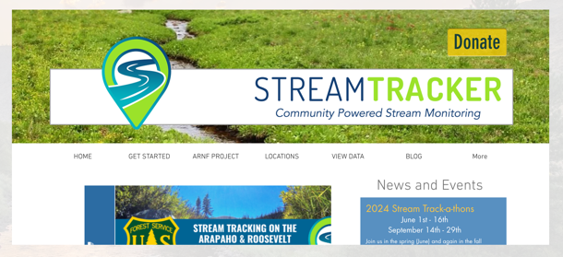
Weather and Hydrology
Plants and Animals
Volunteering
CPRW
CoCoRHaS
Poudre Wilderness Volunteers
Stream Tracker

Slide 21
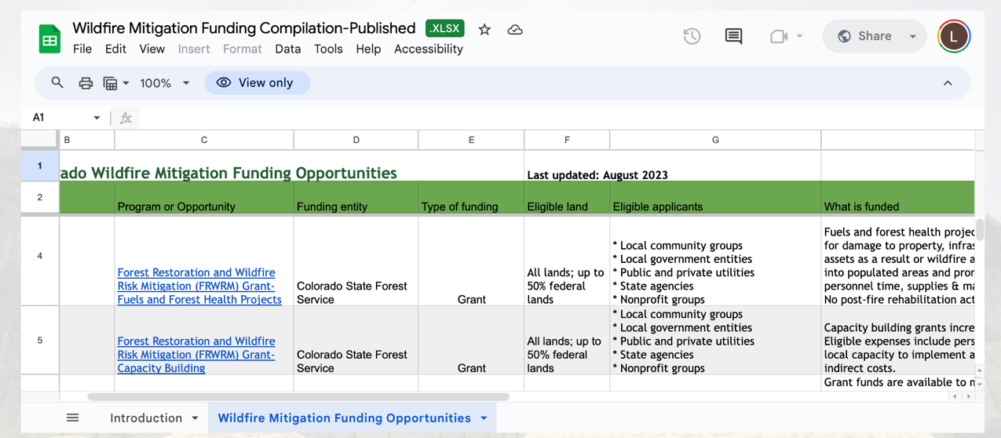
Wildfire mitigation funding compilation
Other resources
Income tax credits
Resilient homes grant
Forest landowner resources
Conservation assistance
Community wildfire assistance
Action, Implementation, & Mitigation Grant

Slide 22
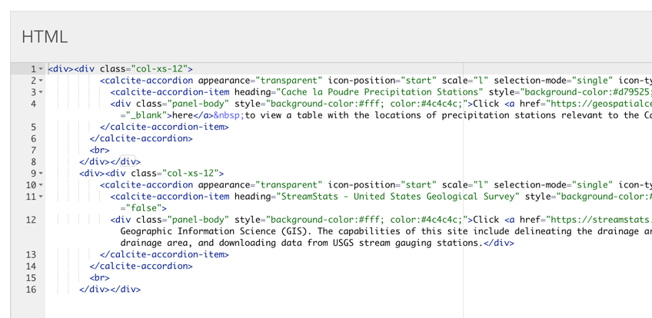
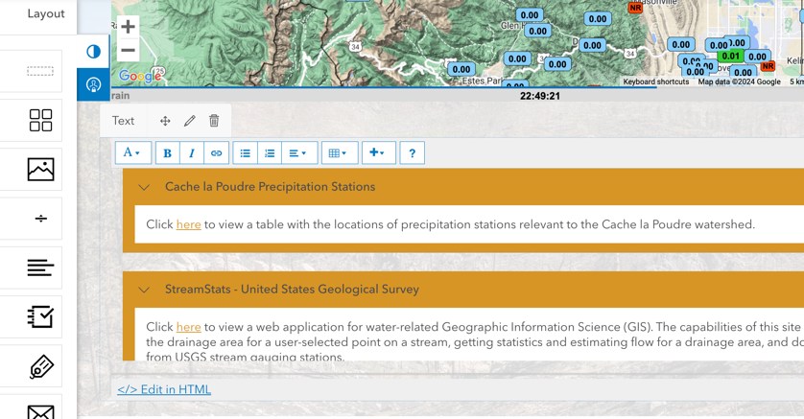
Skills Needed to Build a Hub
Patience!
Compiling data
Altering preexisting HTML code
Website design
Notes:
Now that we have an overview of what a hub site can look like…

Slide 23
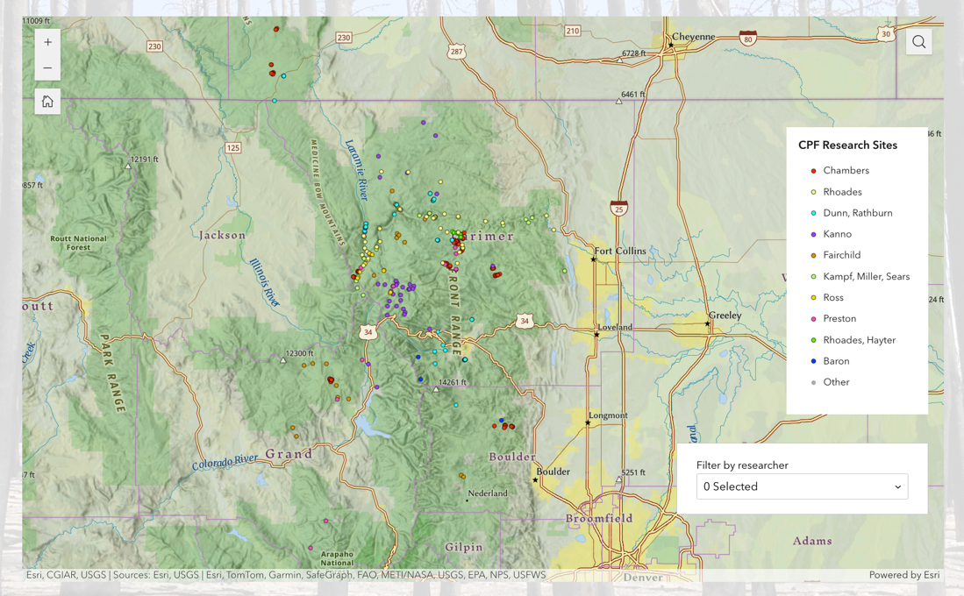
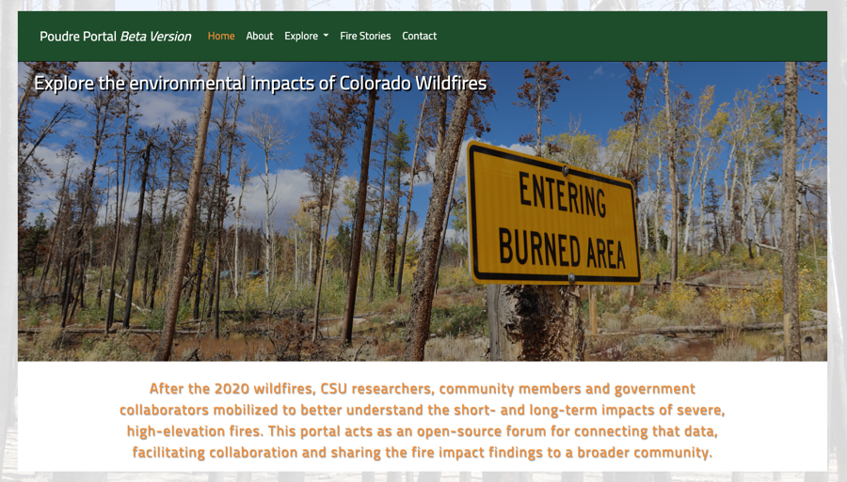
Open-Source Data
Stream data/weather explorer
Precipitation, streamflow, water quality
Snow depth, temperature
Poudre Canyon study sites
Poudre Portal

Slide 24
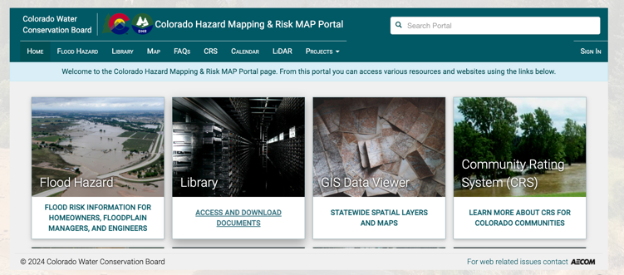
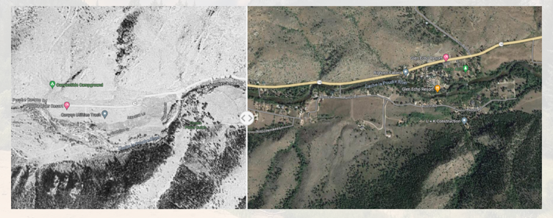
CO Water Conservation Board data portal
Residents’ perspectives on the Cameron Peak Fire
Landscape Explorer
Official Documents
Cameron Peak Fire Risk Assessment (Stantec Consulting Inc.)
Burned Area Emergency Response Summary (US Forest Service)
Confronting the Wildfire Crisis (US Forest Service)

Slide 25
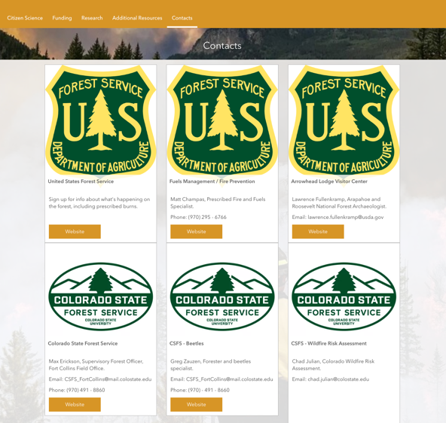
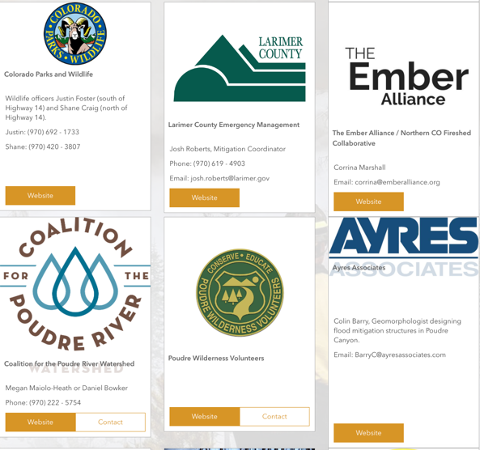
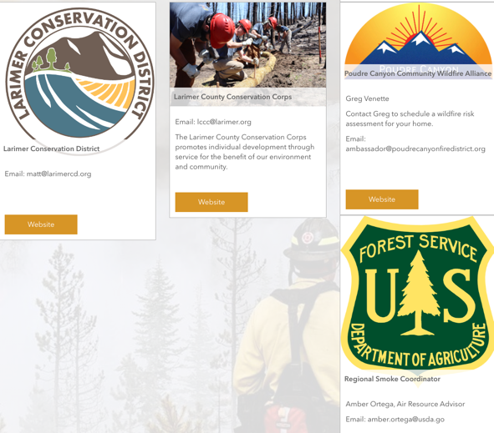
Phone numbers, emails, and websites for sixteen different agencies, companies, and specialists.

Slide 26
Poudre Hub as a Model for Other Communities
Transferrable to Other Places
Home Page – Quick Links
Current Conditions
Reducing Risk
Wildfire Recovery
Citizen Science
Funding
Specific to Poudre Canyon
Home Page – Custom Maps
Community Resources
Research
Contacts
All these pages are easily adaptable to new communities – just keep the structure and switch a few resources!

Slide 27
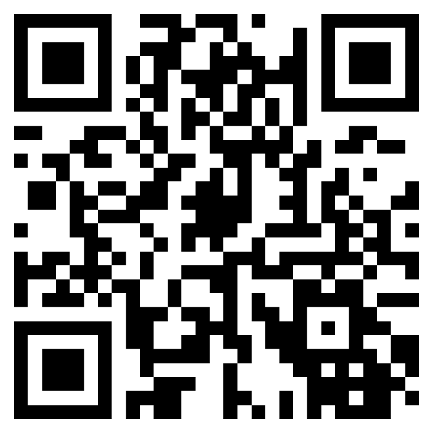
Thank You!
To visit the Upper Poudre Canyon Post-Fire Community Hub, scan this QR code →
Or visit www.poudrecommunityhub.com

