Slide 1
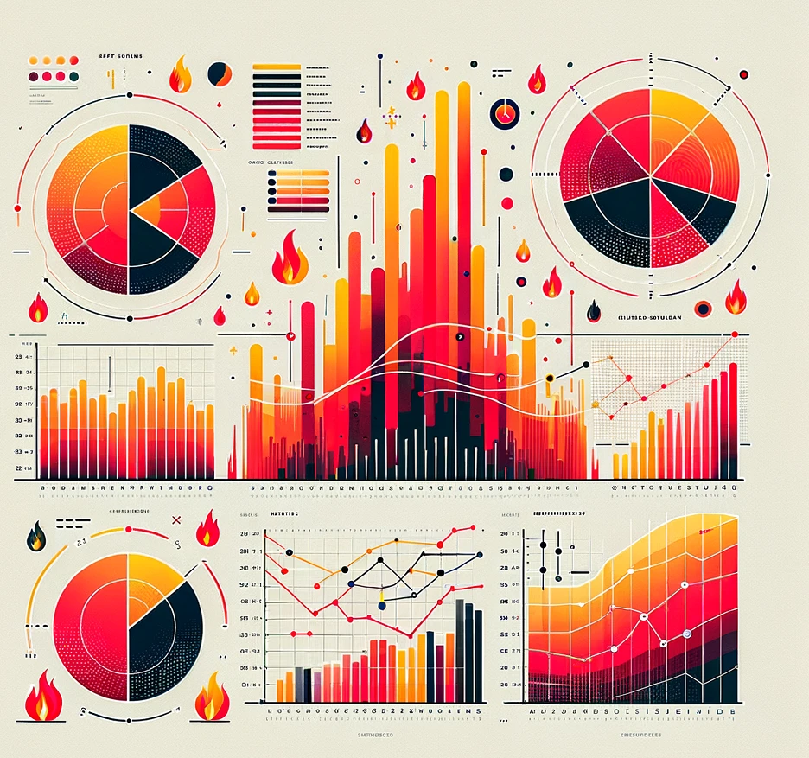
Visualizing Watershed Resilience: Lessons on Post-Fire Stream Impacts & Data Communication Techniques from the Marshall Fire
Lauren Magliozzi, M.S. PhD Candidate, CU Boulder
After the Flames | April 15, 2024

Slide 2
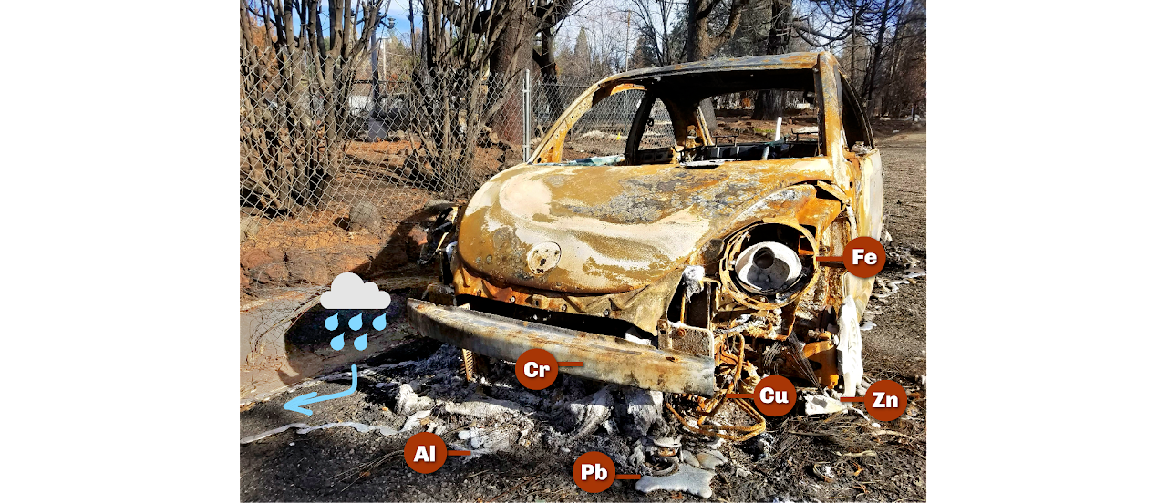
Lauren Magliozzi PhD Candidate
Chapter 1: Wildland-urban interface wildfire increases metal contributions to stormwater runoff in Paradise, California. (Magliozzi et al., 2024)
Chapter 2: Post-Fire Snowmelt Runoff as a Mechanism for Contaminant Mobilization in a Colorado Wildland-Urban Interface Watershed
Chapter 3: Assessing the ecological impacts of a wildland-urban interface fire on water quality and benthic macroinvertebrate communities in a Colorado watershed.
Ch 1 Environmental Processes & Impacts
(Impacts of 2018 Camp Fire)

Slide 3
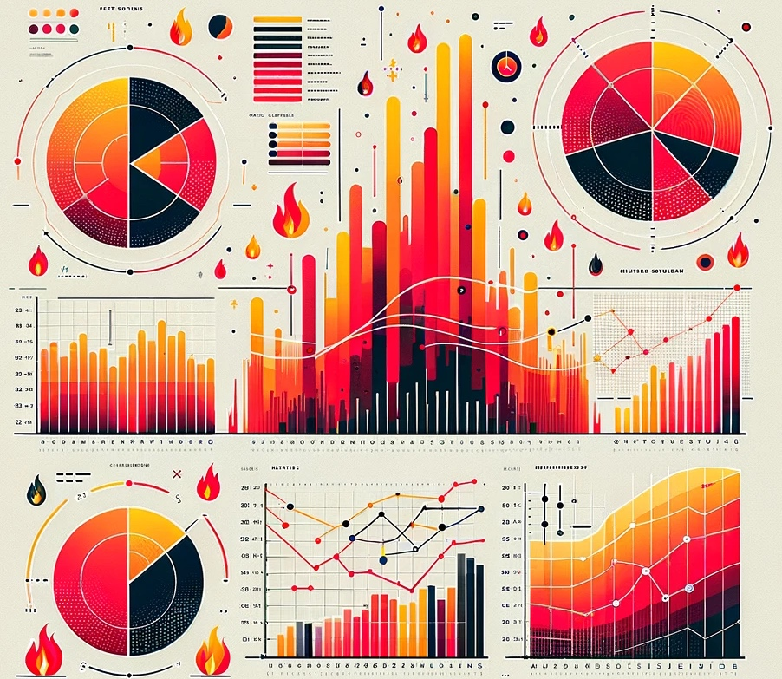
Presentation Overview
Part I: Monitoring impacts of the Marshall Fire on a local watershed
Monitoring project
Results & Conclusions
Part II: Visualizing Data
Considerations
Demonstration & Resources
Brainstorming Session (If Time)

Slide 4
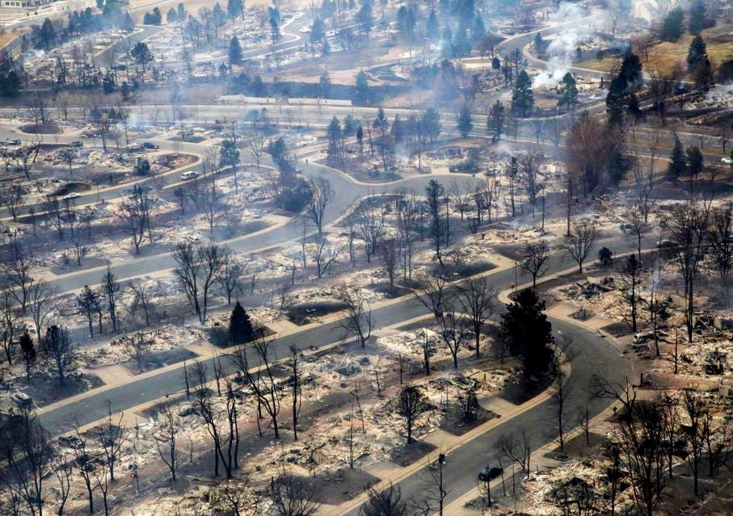
The Marshall Fire Superior, Louisville, Unincorporated Boulder County
Consumed 6,026 acres in <24 hours on December 30, 2021
Wind gusts up to 106 mph
Destroyed 1,084 structures in the wildland-urban interface fire (WUI)
Est. $1B in destruction, costliest fire in CO history
Est. 10th costliest in USA history
forbes.com

Slide 5
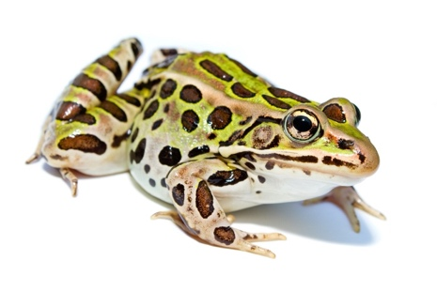
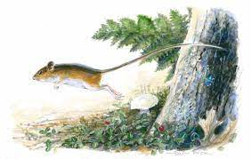
Coal Creek & the Coal Creek Trail Boulder County, CO
5
Coal Creek
Stream & riparian ecosystem in Boulder County that provides habitat for at-risk species:
Northern Leopard Frog
Rana pipiens
CO tier 1 species of greatest conservation need
Coal Creek Trail
14-mile public biking + walking trail along Coal Creek across Boulder County
Connects several open space properties creating a continuous corridor for wildlife & recreation across the county
alltrails.com
Preble’s Meadow Jumping Mouse
Zapus hudsonius preblei
Federal list of threatened species

Slide 6
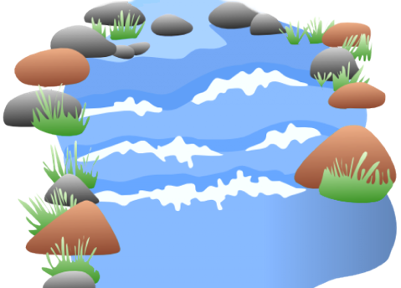
How can wildfires in the WUI impact streams?
6
Trace & Major Metals
Trace Organics
Nutrients, Sediment
Streams &
Riparian
Ecosystems
Impermeable Surfaces (e.g., Storm drains)
recreation agriculture transportation

Slide 7
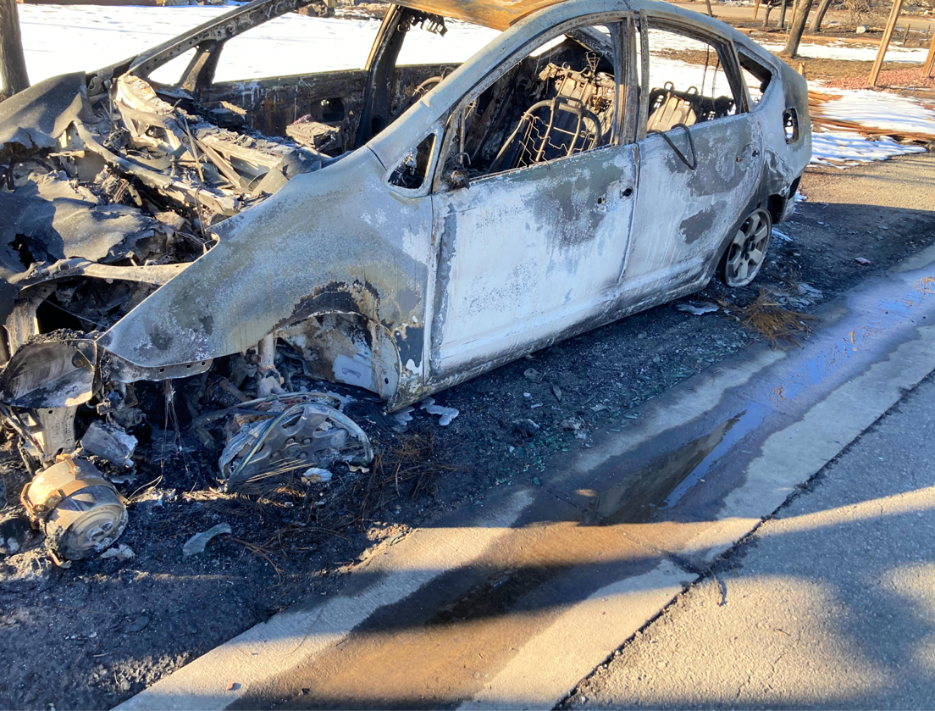
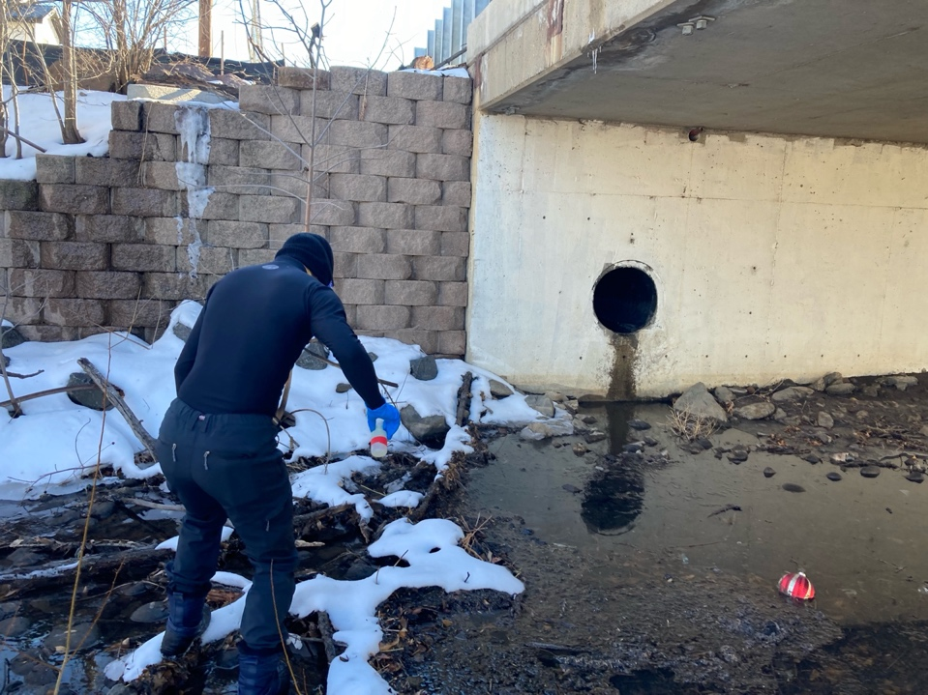
Hydrologically efficient stormwater collection systems
…channeling runoff into creek
1/9/2022, Superior, CO

Slide 8
Ecosystem Health Methods
Water Quality
Methods
Grab sampling during monthly baseflow & precipitation events from Jan 2022 – Dec 2023
Benthic macroinvertebrate (BMI) Surveys
Monthly BMI kick-net surveys conducted during baseflow
Basic water quality parameters and nutrients (pH, conductivity, dissolved organic carbon, anions, total suspended solids, and more)
Index of biotic integrity used to evaluate pollution tolerance of organisms
Major and trace metals (ICP-MS: Al, Fe, Mn, Zn, Cu, Pb, Ni, Cr, and more; filtered and total fractions)

Slide 9
Community Stakeholder Involvement
Project leveraged partnerships with community stakeholders including local land managers, decision makers, and watershed groups
Methods: Hosted monthly stakeholder meetings with updates and results and maintained a public data dashboard
Methods: Organized community outreach events (5+ hosted) and developed an ArcGIS Story Map
Goals: Avoid duplication of effort, target variables & locations of importance to broader community for highest impact
9

Slide 10
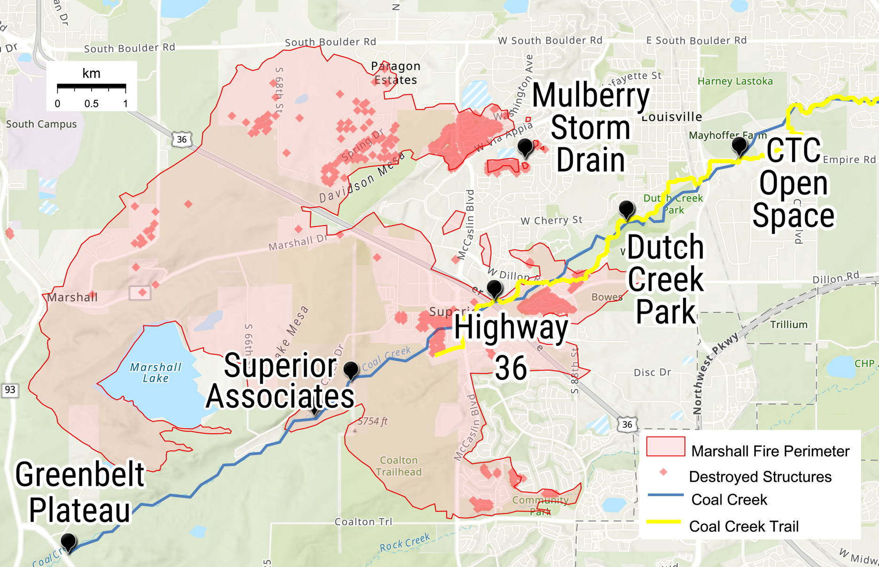
Sampling Locations
Chosen to target two sets of variables:
Burned vs. Unburned
Wildland vs. Urban
Flow
10

Slide 11
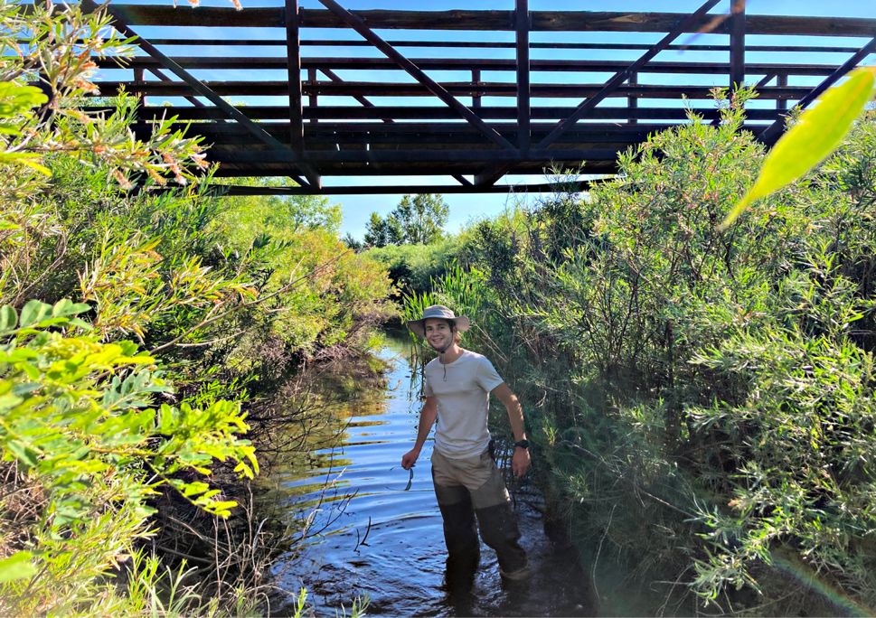
Sampling Locations
Greenbelt Plateau: Upstream unburned wildland site at Greenbelt Plateau Trailhead
11

Slide 12
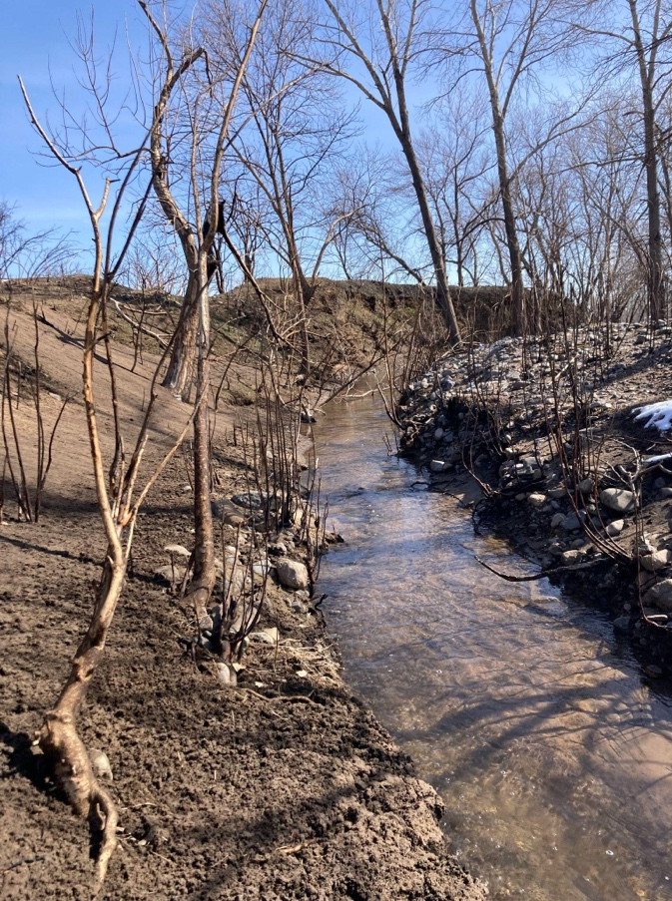
Sampling Locations
Superior Associates Burned wildland site; Northern Leopard Frog habitat
12

Slide 13
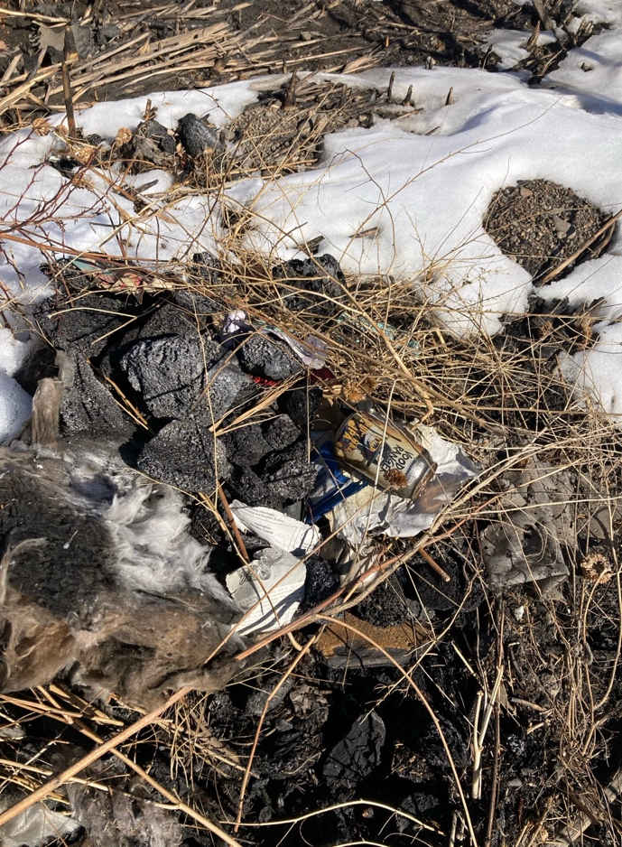
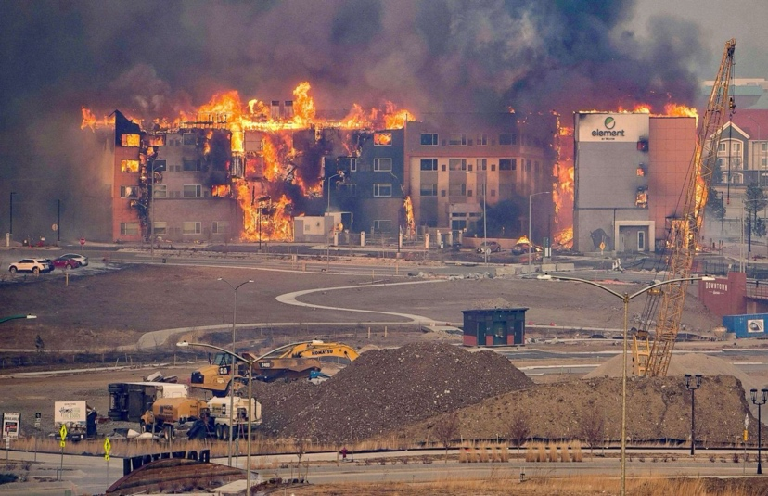
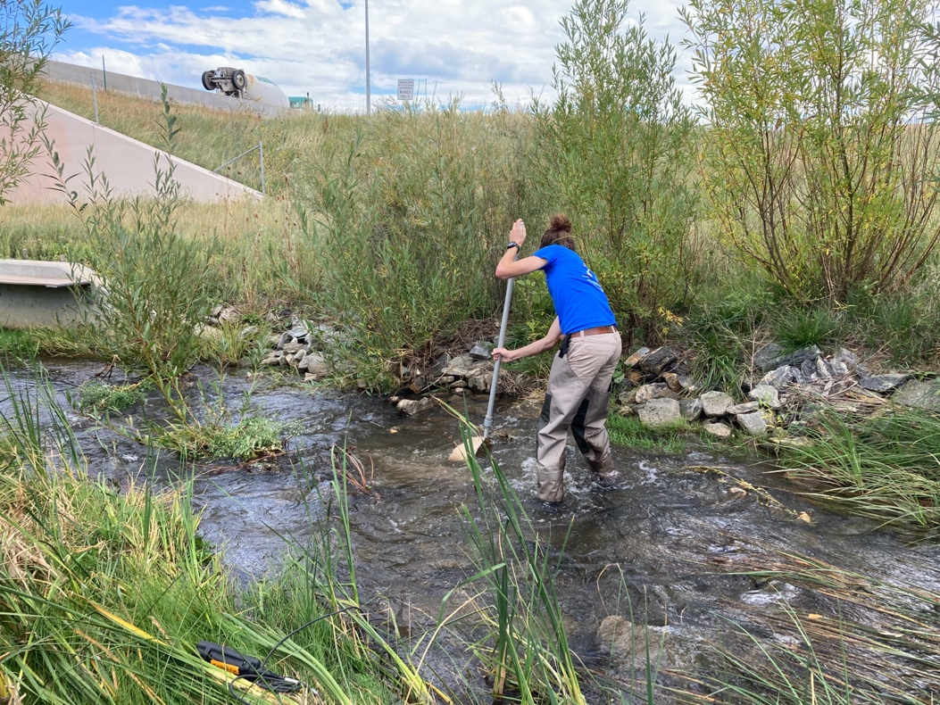
Sampling Locations
abcnews.com
Hwy 36: Burned urban site, next to large burned structure
13

Slide 14
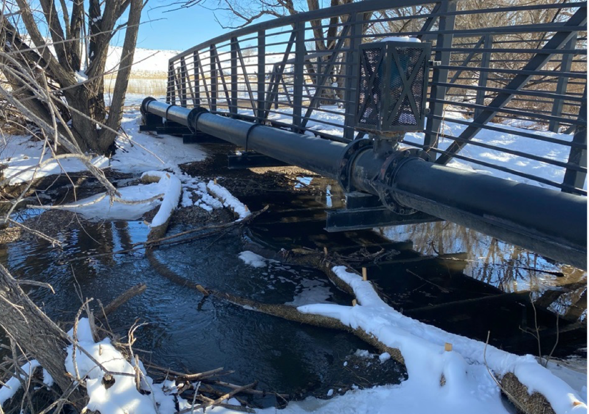
Sampling Locations
Dutch Creek Park: Downstream of heavy urban burn
14

Slide 15
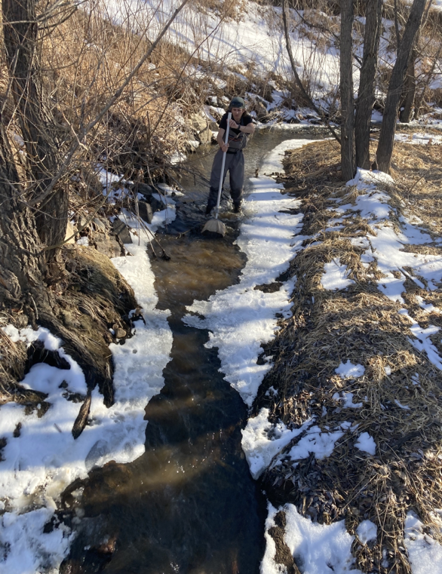
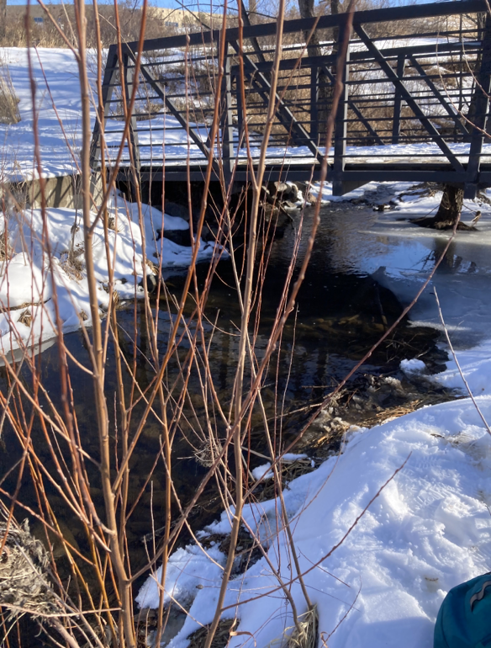
Sampling Locations
Colorado Tech Center (CTC) Open Space: Highly urban area downstream of burn
15

Slide 16
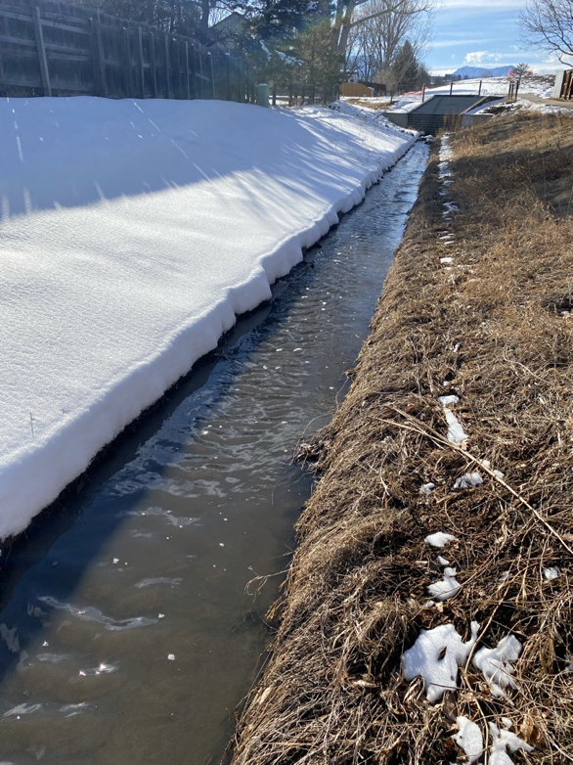
Sampling Locations
Mulberry Storm Drain: Collects runoff from burned urban neighborhoods
16

Slide 17
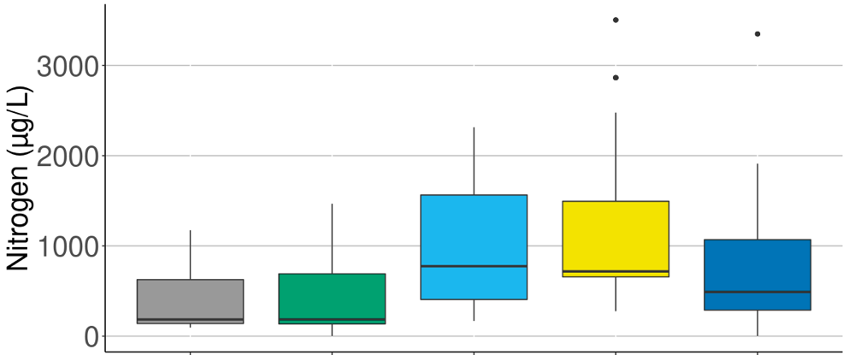
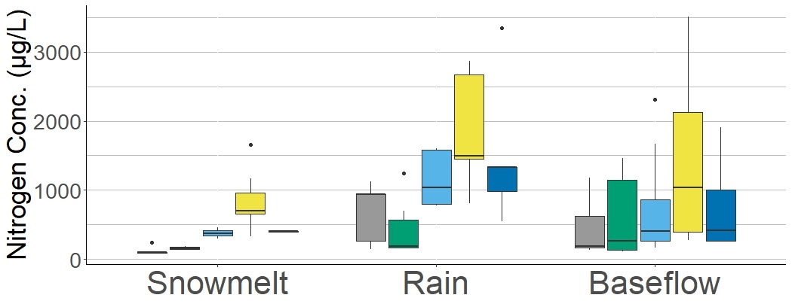
Total Dissolved Nitrogen: Potential urban fire source
17
Selected Results: Total Dissolved Nitrogen in Coal Creek 2022
Low in wildland area
, increased in urban fire corridor
Rain events mobilized wildland source of nitrogen
and then decreased in urban-only reach of stream
→ Total dissolved nitrogen from dominantly burned urban origin
Snowmelt and baseflow conditions reflect this overall trend
Greenbelt
Wildland (unburned)
Superior Associates
Burned Wildland
Hwy 36
Burned Urban
​Dutch Creek Park​
Burned (Fringe) Urban
CTC Open Space
Urban (Downstream)
Flow

Slide 18
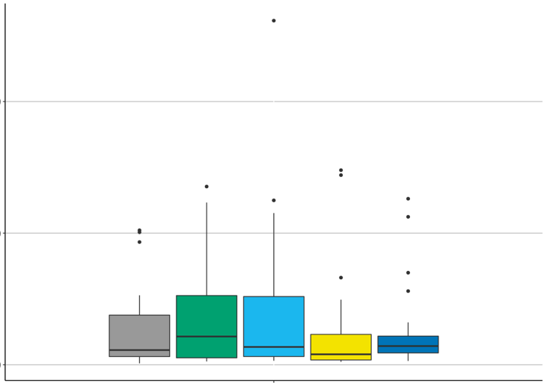
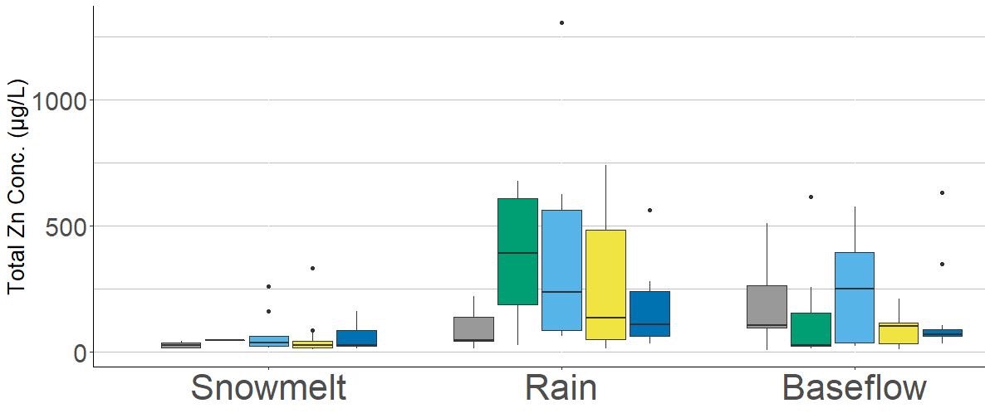
Selected Results: Total Zinc in Coal Creek 2022
Overall
Total Zn: Potential burned wildland & burned urban sources
Rain events show strong burned wildland source
of total Zn
Baseflow shows both a wildland & burned urban source of total Zn
Greenbelt
Wildland (unburned)
Superior Associates
Burned Wildland
Hwy 36
Burned Urban
​Dutch Creek Park​
Burned (Fringe) Urban
CTC Open Space
Urban (Downstream)
Flow

Slide 19
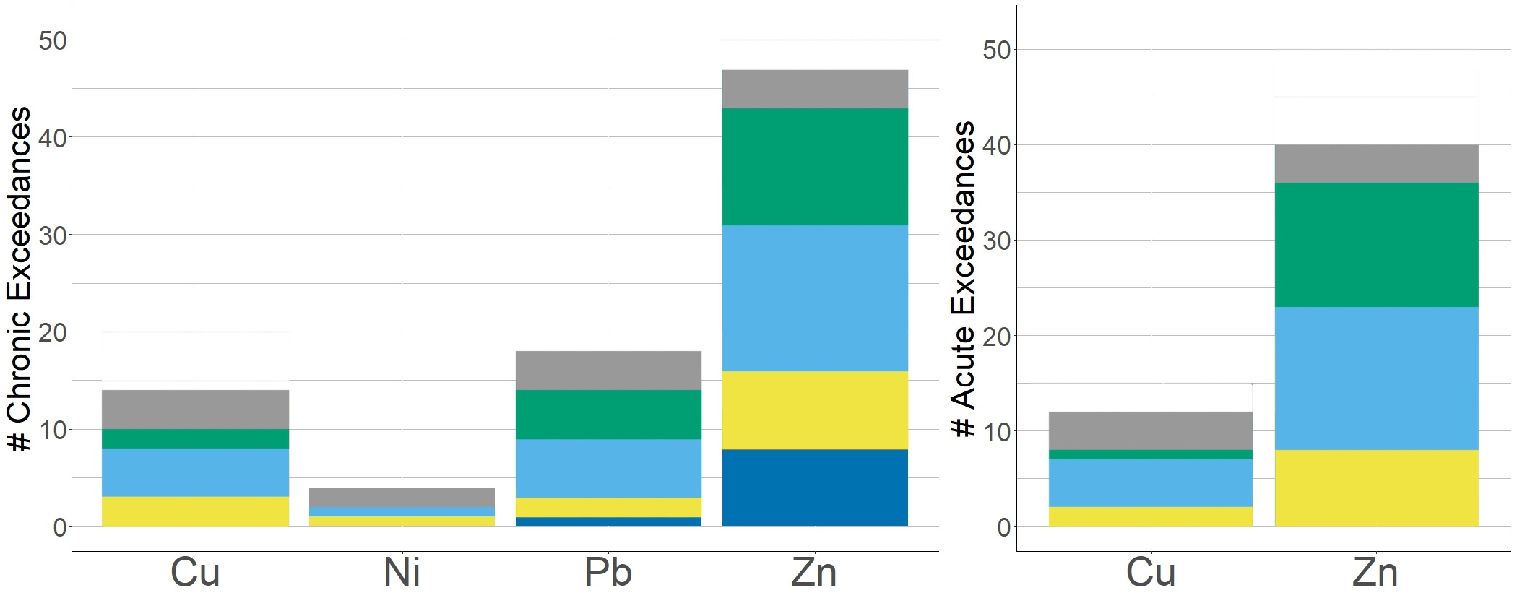
EPA Aquatic Life Recommended Criteria Limit Exceedances in Coal Creek 2022
Chronic: Risk after 4 days of exposure Acute: Risk after 4 hours of exposure
43
39
# of exceedances
downstream of fire
14
10
8
2
Notes:
We also compared our metals data to the EPA aquatic life criteria limit, and so I refer you to these plots which show the number of acute exceedances on the left, and acute limits cause toxicity for organisms that are exposed for an hour or more - and chronic exceedances on the right, which are concentrations that cause toxicity for aquatic life when exceeded for four days or more. I’ve added here the number of exceedances detected downstream of the fire, and you can see that we had exceedances for Cu, Ni, Pb, and Zn, and that the highest number of exceedances in both categories was zinc.
Important to note that the EPA criteria limits do not apply to the Mulberry storm drain but are shown here for broader context

Slide 20
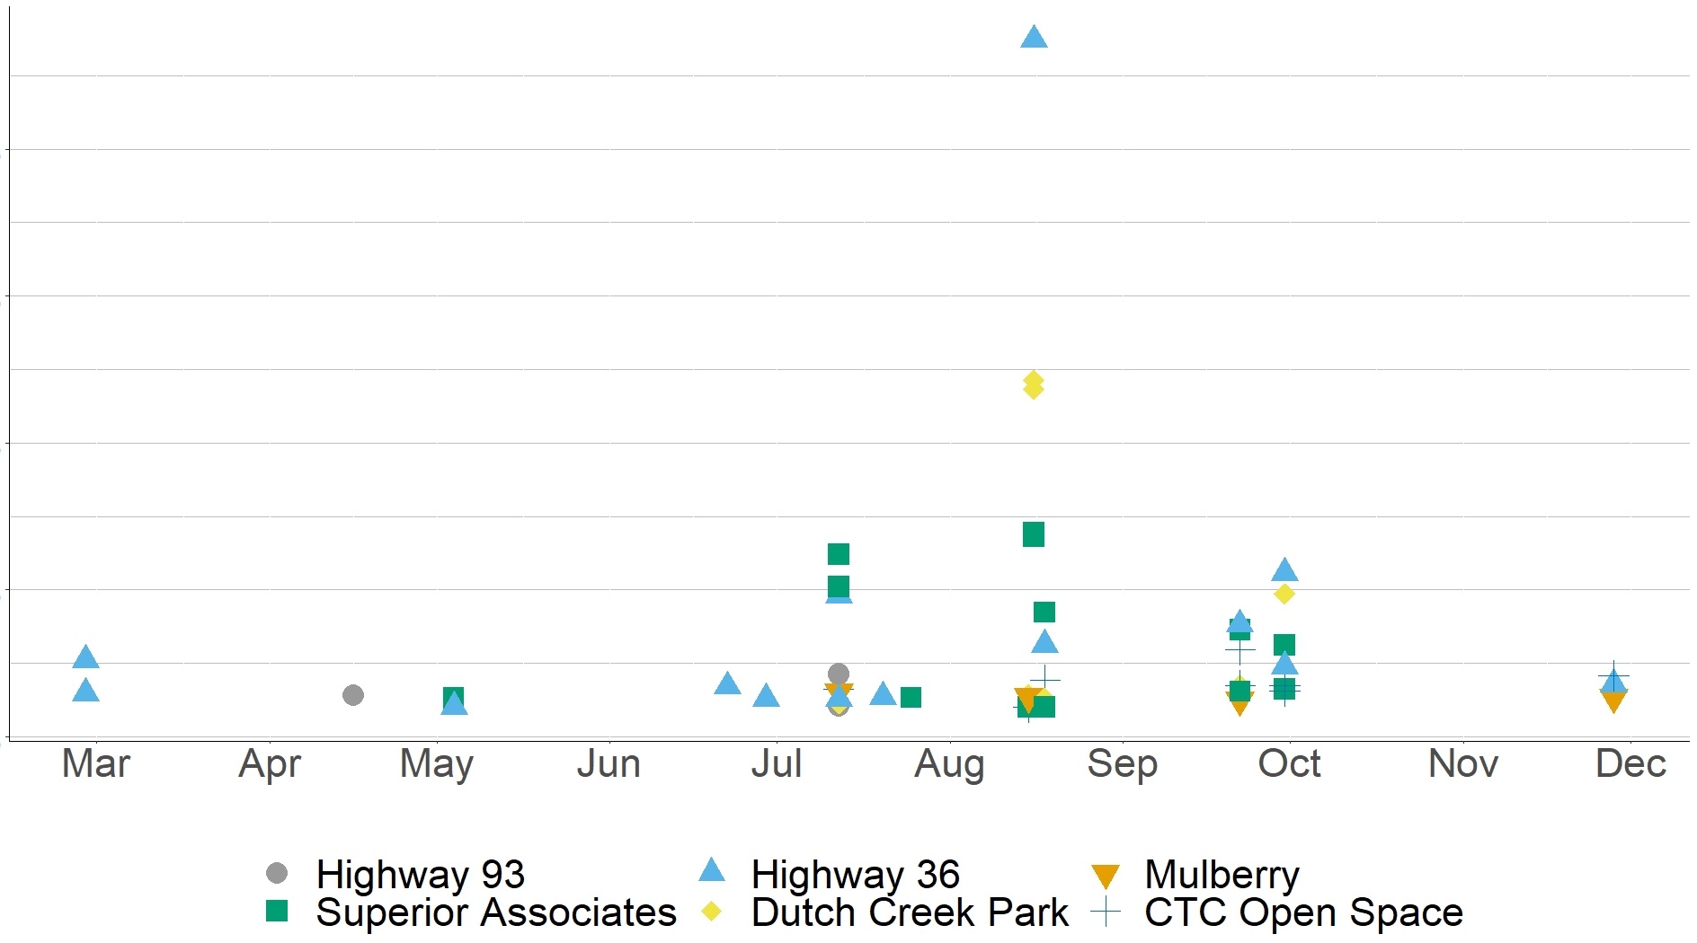
Zinc Exceedances of EPA Aquatic Life Criteria Acute Limit in Coal Creek in 2022
Highest acute Zn exceedances (>20x, >10x) at burned urban sites
Coincided with highest intensity rain event
20x
15x
10x
5x
0x
Likely snowmelt-mobilized urban fire pulse
Exceedances through the end of 2022
Acute Exceedance (#-Fold)
Greenbelt Plateau
20
Notes:
When we look at zinc exceedances in Coal Creek during 2022, we that the creek reached these high concentrations of zinc throughout the year and as late as November. The coordinated debris clean up was implemented from May to August, and the highest acute Zn exceedances of more than 20x the limit, occurred in late August during a high intensity rain event. This shows that contaminants were mobilized into the creek from likely fire sources throughout the year. Using the same approach as the water quality data, we can infer that when exceedances occur in fire-affected areas but not at CTC, we see a likely fire effect.

Slide 21
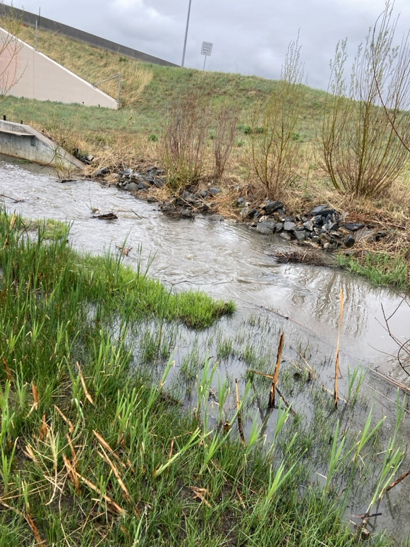
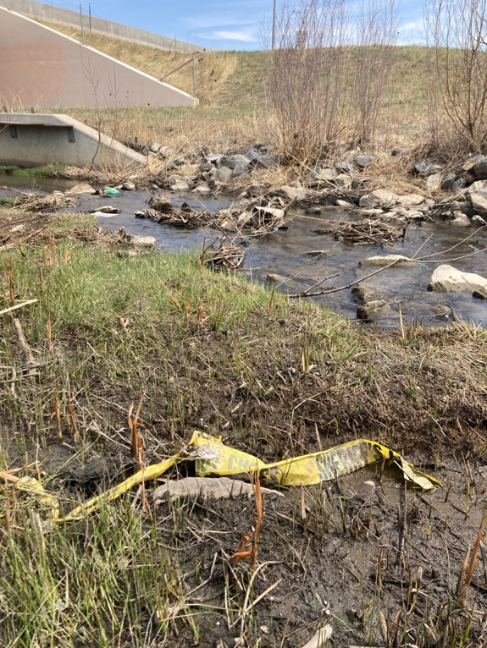
Zinc Exceedances of EPA Aquatic Life Criteria Acute Limit in Coal Creek in 2022
20x
15x
10x
5x
0x
First major rain event of 2022:
Heavy rain May 4th, and some rain every day from May 2nd to May 5th
Acute Exceedance (#-Fold)
April 16, 2022 Highway 36
May 4, 2022 Highway 36
Greenbelt Plateau
21
Notes:
When we look at zinc exceedances in Coal Creek during 2022, we that the creek reached these high concentrations of zinc throughout the year and as late as November. The coordinated debris clean up was implemented from May to August, and the highest acute Zn exceedances of more than 20x the limit, occurred in late August during a high intensity rain event. This shows that contaminants were mobilized into the creek from likely fire sources throughout the year. Using the same approach as the water quality data, we can infer that when exceedances occur in fire-affected areas but not at CTC, we see a likely fire effect.

Slide 22
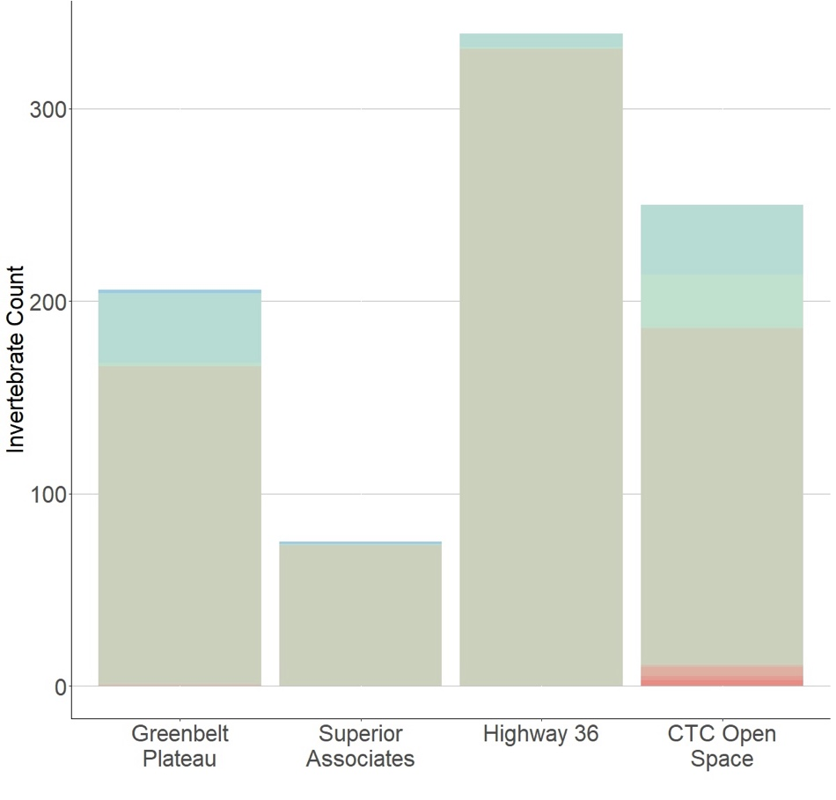
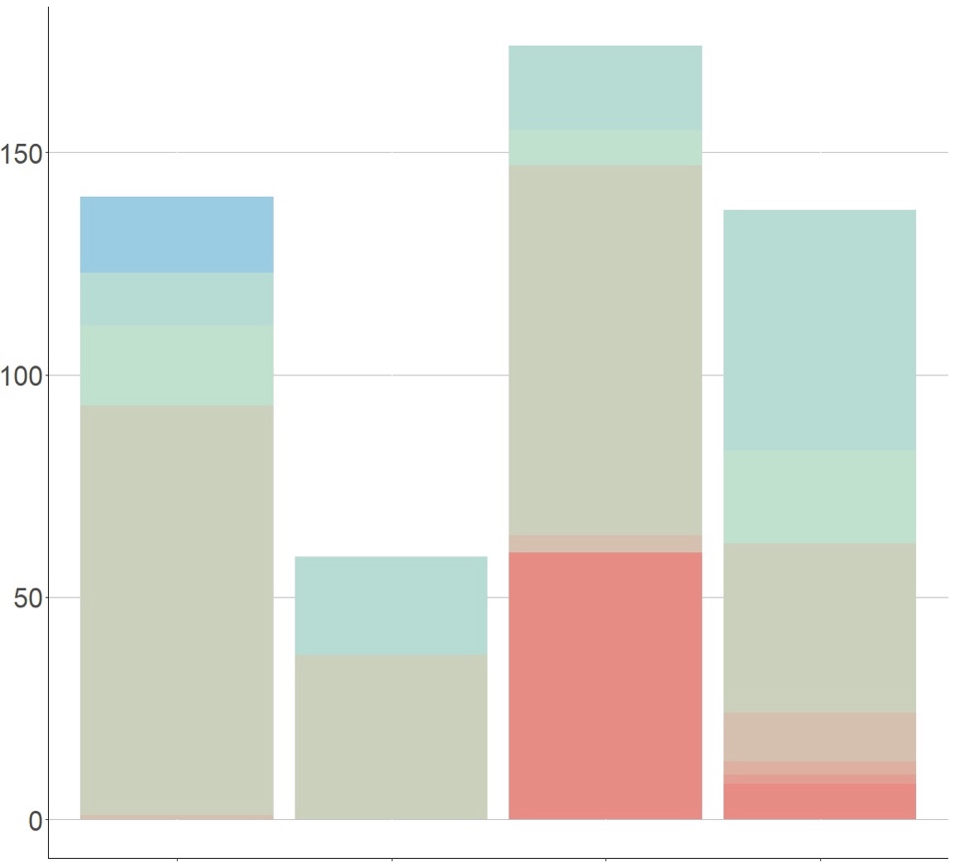
Benthic Macroinvertebrate Count & Index of Biotic Integrity in Early 2022
Most Tolerant of Pollution
April 16, 2022 Two weeks before first major rain
May 18, 2022
Two weeks after first rain
Invertebrate Count
Least Tolerant of Pollution
Greenbelt
Unburned
Superior
Burned Wildland
Hwy 36
Burned Urban
CTC
Urban
Greenbelt
Unburned
Superior
Burned Wildland
Hwy 36
Burned Urban
CTC
Urban
22

Slide 23
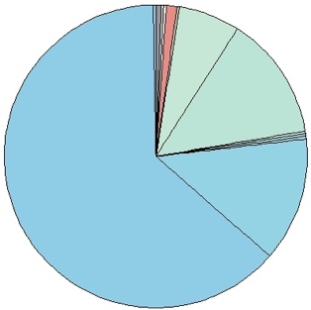
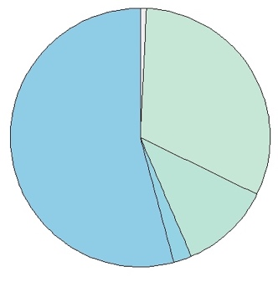
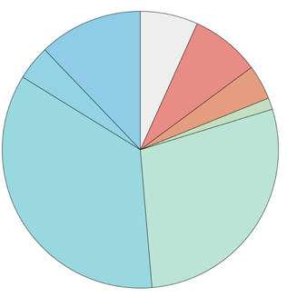
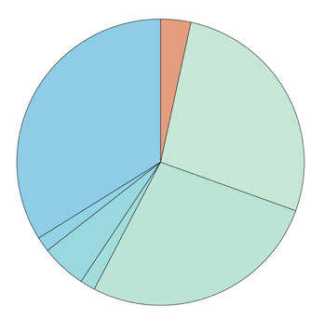
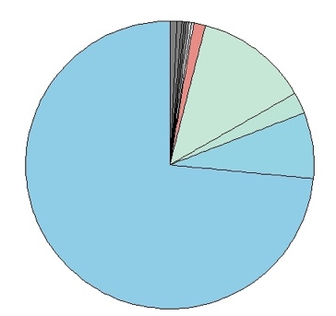
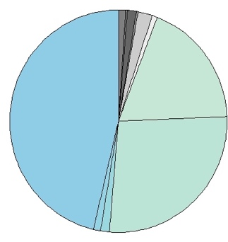
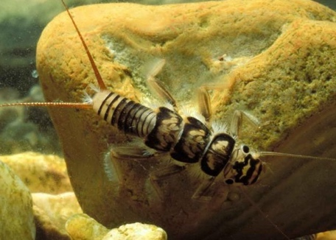
Comparison to Pre-Fire BMI data
2/27
3/12
4/16
5-18
6/22
8-18
9-30
10-30
^{Hwy 36 (Burned, Urban Site)}
Pre-Fire
(Mile High Flood District)
Post-Fire
(This Study)
June 28, 2018
July 12, 2019
June 22, 2022
July 25, 2022
Site 1
Site 2
Higher percentage of pollution-tolerant organisms post-fire
Pre-fire presence of Plecoptera (stonefly) species:
- Indicative of a likely healthy stream pre-fire
23
Lower number of organisms per m² + higher diversity
Presence of plecoptera (stonefly) species indicates likely healthier stream in 2018-2019:
-Stoneflies have no gills on their abdomen, sensitive to reduced DO
-Feed on biolfilm, which may contain metals
-Add photo of plecoptera & some bg maybe, little detail, no gills on their abdomen, more vulnerable to less DO surface area, may take up metals just like an other organism – often shredders, eating bacteria, fungi & algae that may be contamoinated bc they pull metals from the water
# of organisms
per meter²:
0%
354
36%
17%
13%
0%
13%
30%
<1%
264
74
Shannon diversity:
1.20
1.07
1.61
*1 Stonefly found at this site
*1 Stonefly found at upstream Hwy 36 site on this date
*No stoneflies ever found post-fire at this site

Slide 24
Preliminary Monitoring Conclusions
Toxic metals & nutrients in Coal Creek likely contributed by the Marshall Fire
Metals (Cu, Ni, Pb, and Zn) reached levels known to harm aquatic organisms
Some contaminants (e.g. Zn) were mobilized by rainstorms through late 2022
Impacts on the Coal Creek ecosystem includes community ratios characterized by pollution-tolerant species at burned urban sites and compared to historical data
*Without comprehensive historic data, it is difficult to definitively identify sources of contaminants or recovery status of stream

Slide 25
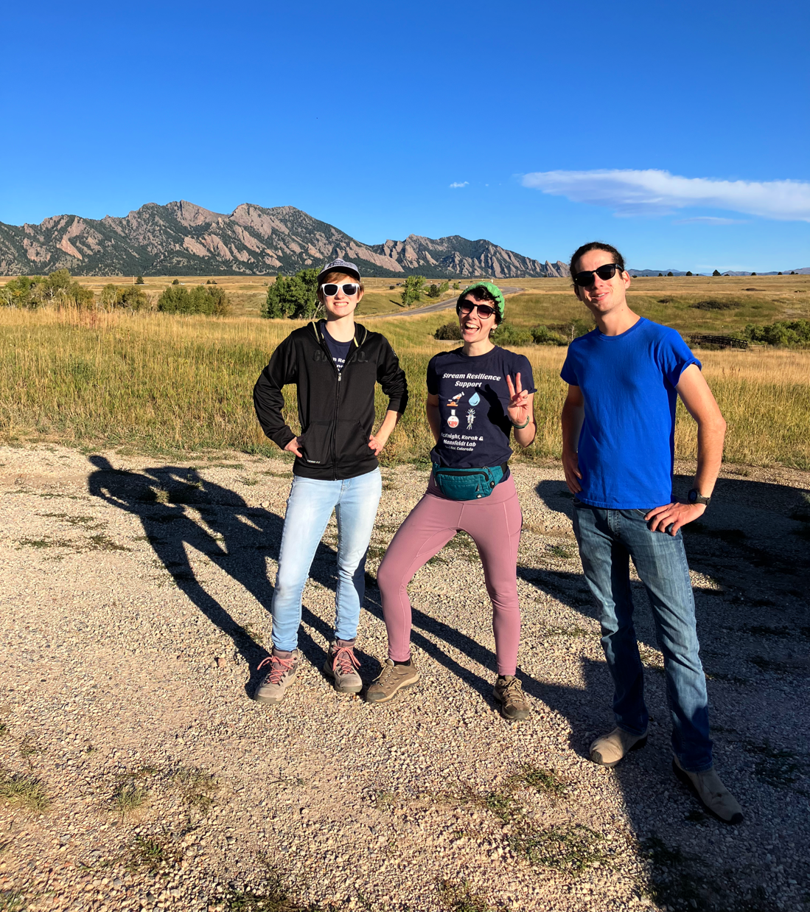
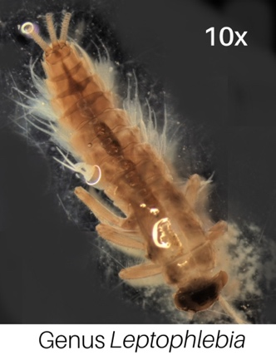
Monitoring Project Accomplishments
17 biological assessments
52 water quality sampling dates
255 water quality samples
8,004 benthic invertebrates
>15,000 field and water quality data points collected (and counting)
Importance of long-term monitoring: Sensitive mayfly Leptophlebia cupida has not been observed in the foothills region since the flooding event in 2013! (Found at reference site in 2023)

Slide 26
Part II. Visualizing Post-Fire Watershed Resiliency
“No Stories Without Numbers, No Numbers Without Stories”
- Dr. Julie Posselt, USC School of Education
AGU Fall Meeting 2023 DEI panel
Notes:
Stories connect people to data in an important way!! Allow us to improve communication and understanding

Slide 27
Why make data public?
Enable evidence-based decision making
Inform policy, prioritize resources, and evaluate recovery efforts
Promote accountability and trust
Enhance community engagement and empowerment
Support impacted communities in making safe decisions
Enable communities to engage in their recovery narrative
Accelerate scientific discovery and understanding
Facilitate collaboration, reproducibility, and validation
Lead to new insights, hypotheses, and solutions
Reciprocity:
Demonstrate transparency, accountability, and public benefit
Ensure equitable sharing of research benefits

Slide 28
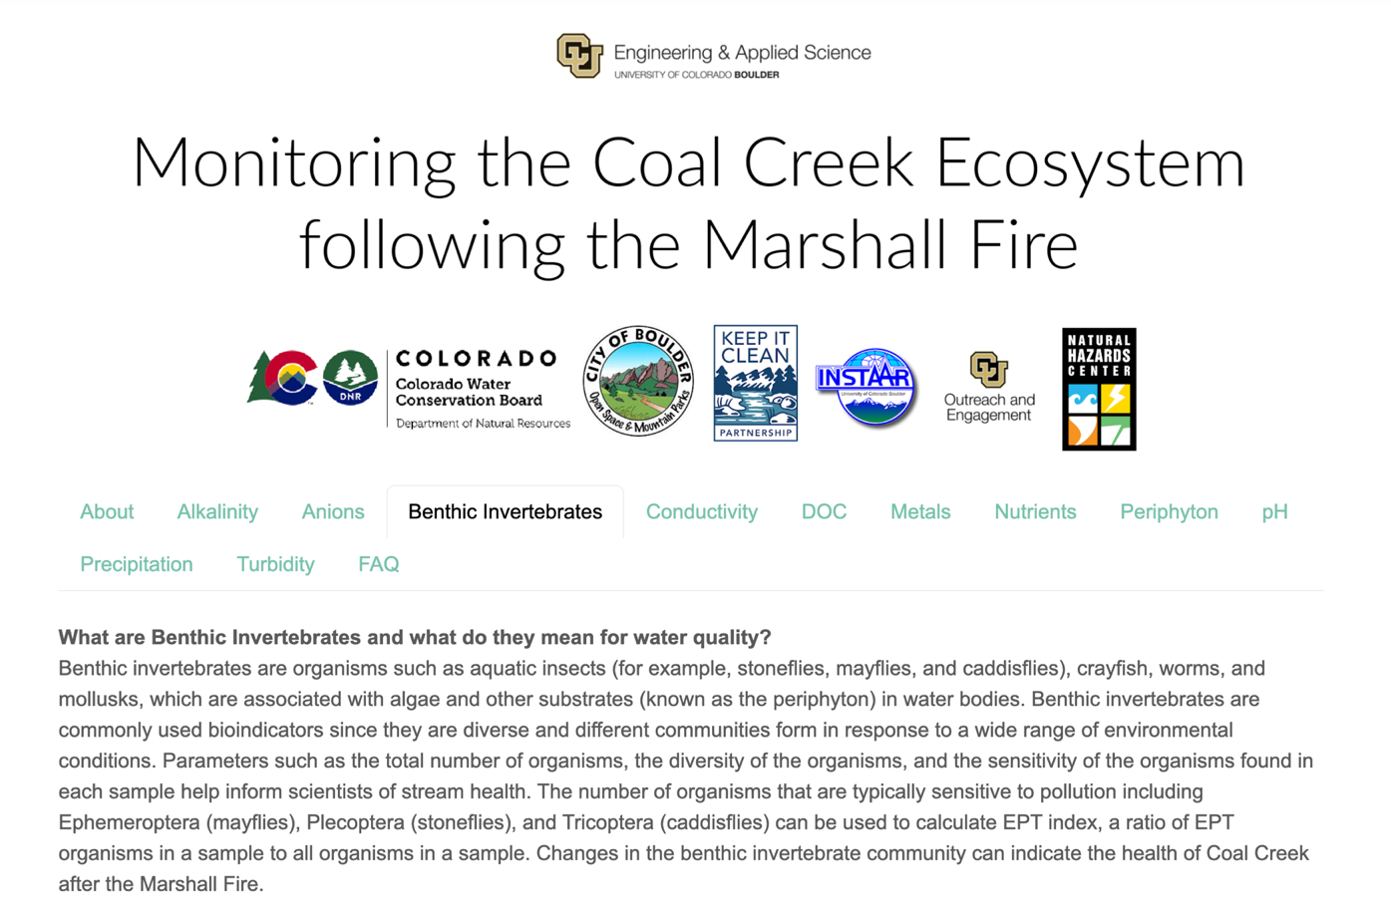
Designing an Effective Data Communication Platform
Who is your audience?
Community members (public), or stakeholders with technical knowledge?
How will it be used?
What context will your audience need to understand your data?
Do you need an FAQ section?
How will you tell the broader story?
Where will it be hosted and advertised?

Slide 29
FAQ’s

Slide 30
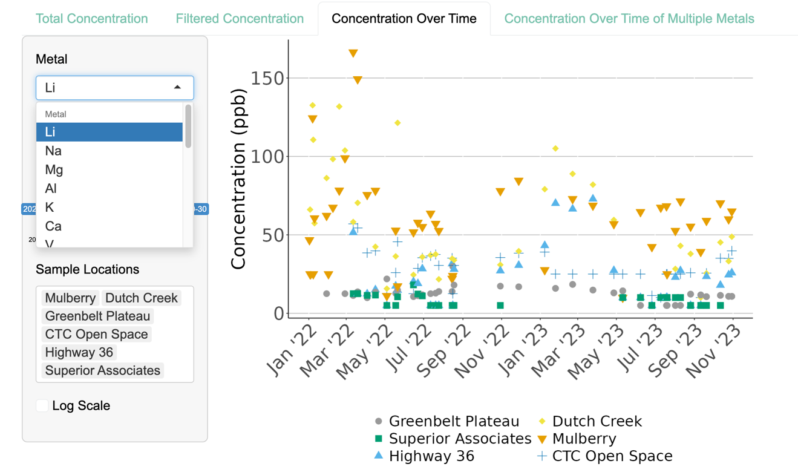
Designing an Effective Data Communication Platform
Focus on the most important metrics & keep it simple
Flexibility: Dynamic tools to visualize parameters, sites of interest, and specific timeframes

Slide 31
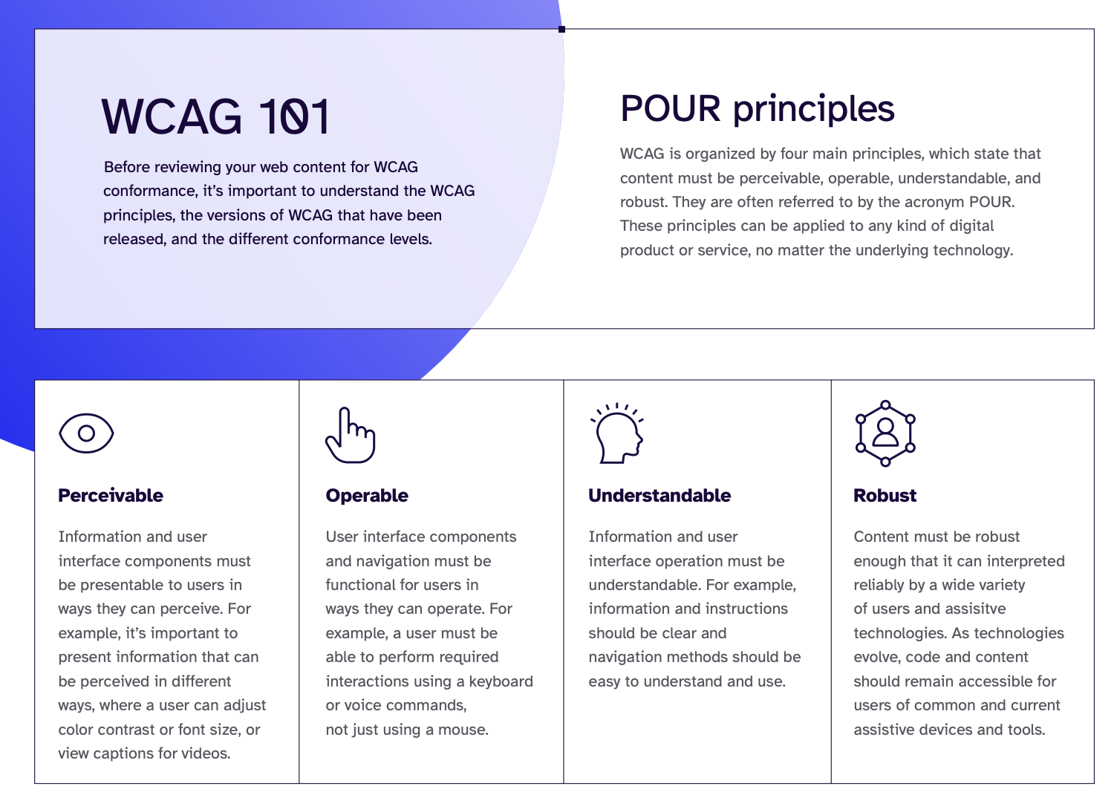
Designing an Accessible Data Communication Platform
Colorblind friendly
Alternative text
Conduct usability testing with diverse users
Adhere to web accessibility guidelines and standards Follow the Web Content Accessibility Guidelines (WCAG)
https://www.levelaccess.com/wp-content/uploads/2024/02/ The-Must-Have-WCAG-Checklist.pdf

Slide 32
Designing an Ethical Data Communication Platform
Consider unintended consequences: Be mindful of how data may inadvertently stigmatize impacted communities
Ethical post-fire data collection
and dissemination:
Always obtain permission
Engage local stakeholders
Involve impacted communities
Respect cultural & ecological sensitivity
Ensure data privacy and security
Environmental Justice

Slide 33
Tools for Telling a Story: ArcGIS StoryMaps & Google Sites

Slide 34
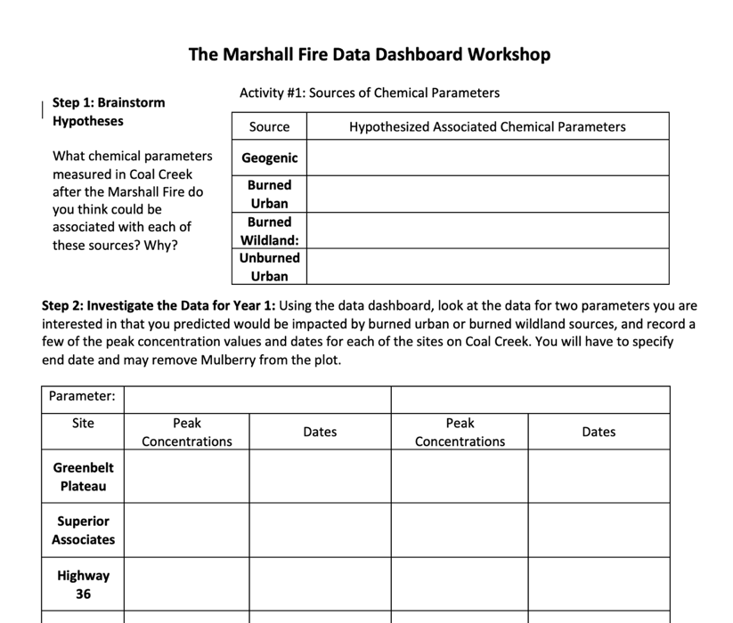
Other uses for Data Dashboards: Educational Modules

Slide 35
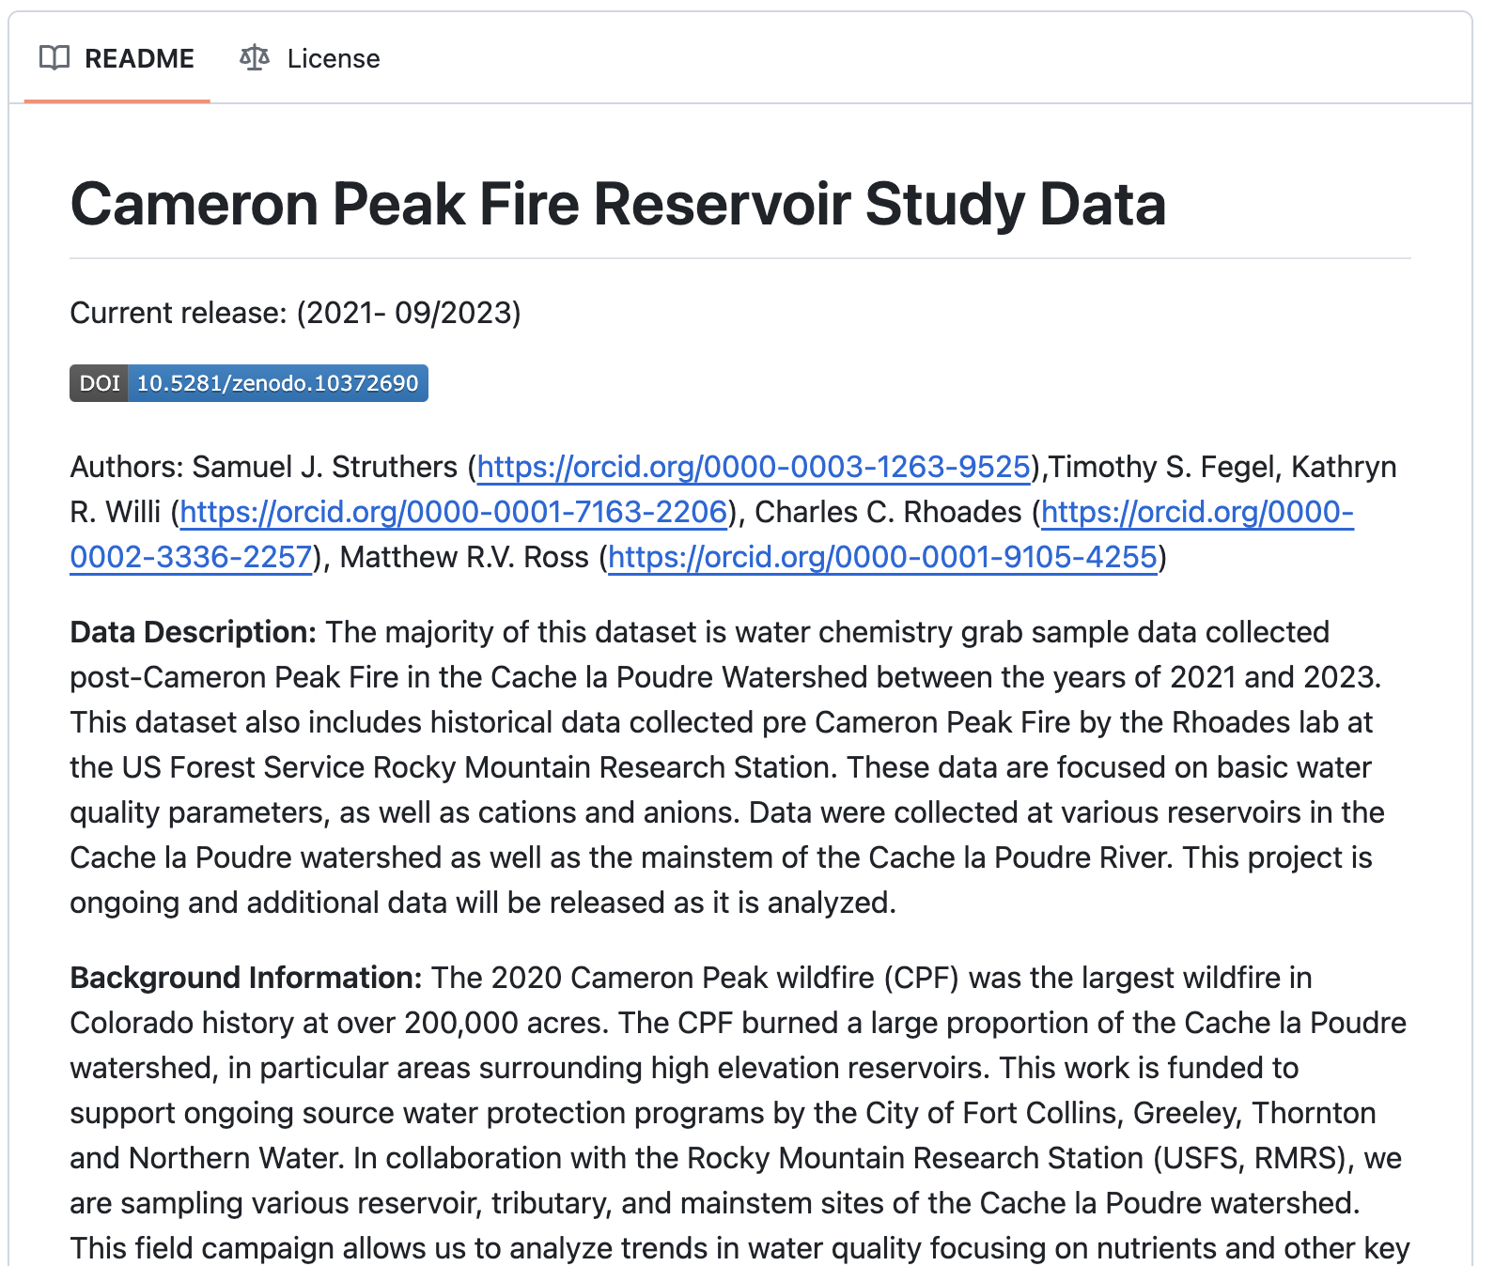
Demo: Open-Source Template for Post-Fire Data Dashboard
Used open-source fire monitoring dataset as demonstration Collected by Dr. Charles Rhoades Group (USFS Rocky Mountain Research Station) after the Cameron Peak Fire
Made public by Dr. Matt Ross, CSU (ROSSyndicate, GitHub)
https://github.com/rossyndicate/CPF_reservoir_study_data/tree/v10.18.23

Slide 36
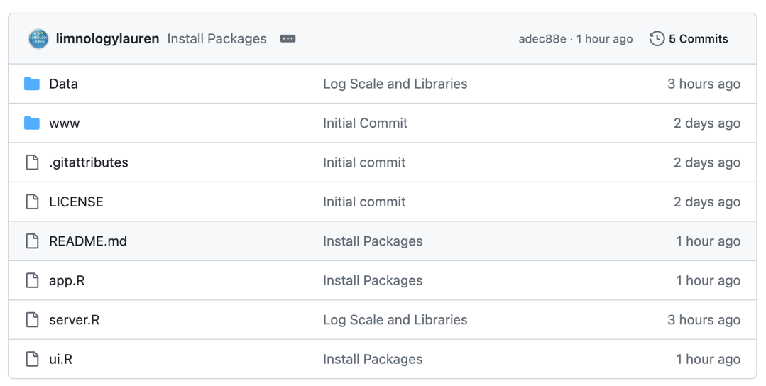
Demo: Open-Source Template for Post-Fire Data Dashboard
How to Download from GitHub
https://github.com/LimnologyLauren /Data_Dashboard_Template

Slide 37
Final Thoughts
Data dashboard template
Meant to be a starting point
Template will continue to be revised as time allows, including accessibility improvements, benthic invertebrate templates, and more
Check back for updates
Suggestions, recommendations, features you want to see? Feel free to reach out!
https://github.com/LimnologyLauren /Data_Dashboard_Template

Slide 38
Final Thoughts
Sharing data facilitates trust, reciprocity, and collective actions that allow for informed decision making and move science forward
Numbers and narratives are better together to improve engagement and understanding
https://github.com/LimnologyLauren /Data_Dashboard_Template

Slide 39
Acknowledgements
PI’s and co-authors:
Dr. Julie Korak¹, Dr. Cresten Mansfeldt¹, Dr. Diane McKnight^{1,2}, Camryn Miller, B.S.^{1,2} & Lane Allen, M.S.^{1,2} ¹CU Boulder, Environmental Engineering Program
²CU Boulder, INSTAAR
Funding Partners & Stakeholders:
39

Slide 40
Brainstorming Session (If Time Allows)
What are some of the most important considerations for the ethical collection and dissemination of post-fire data?
Menti .com Code:
5279
4496
Notes:
https://www.mentimeter.com/app/presentation/alq3xc896uripprfk4b8n8qss9dxuffn/6b7bh93m2wuz

Slide 41
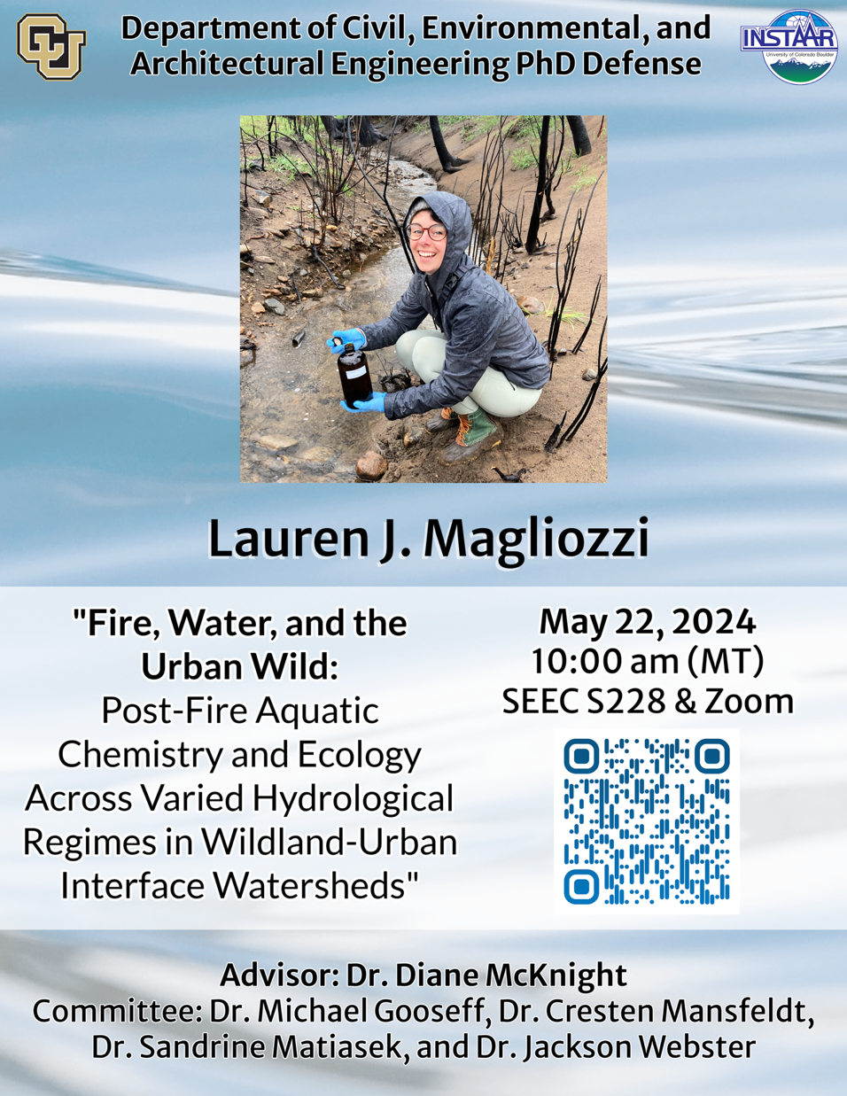
Open to Questions
Lauren Magliozzi, M.S. PhD Candidate CU Boulder Environmental Engineering Program and Institute of Arctic & Alpine Research (INSTAAR)
Advisor: Dr. Diane McKnight
Contact Lauren:
Lauren.Magliozzi@colorado.edu

Slide 42
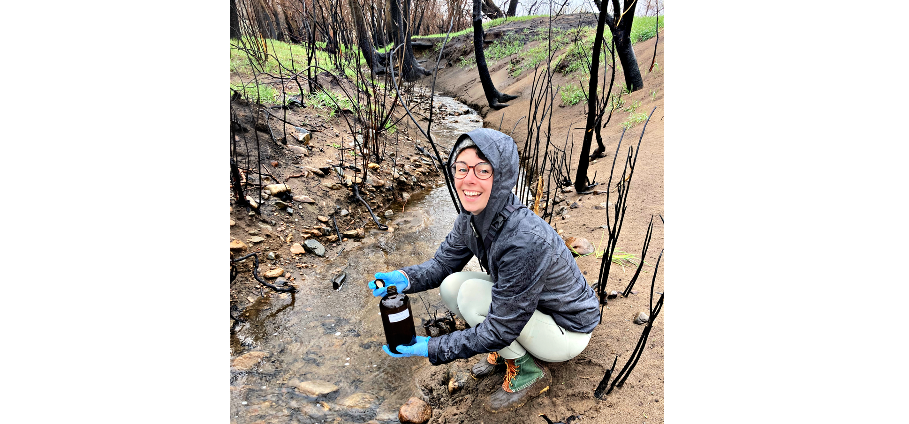
Open to Questions
Lauren Magliozzi, M.S. PhD Candidate CU Boulder Environmental Engineering Program and Institute of Arctic & Alpine Research (INSTAAR)
Advisor: Dr. Diane McKnight
Contact Lauren:
Lauren.Magliozzi@colorado.edu

Slide 43
Supplemental Slides

Slide 44
Potential Origins of Altered Water Chemistry Signatures in Post-Fire WUI Watersheds
Unburned wildland sources
Wildland fire sources
Urban fire sources
Downstream
urban sources
“Background”
Geogenic
Limited highway impacts
Legacy mines
Combusted vegetation
Combusted soil
Combusted infrastructure and vehicles
Road salt/dust
Extensive highway runoff

Slide 45
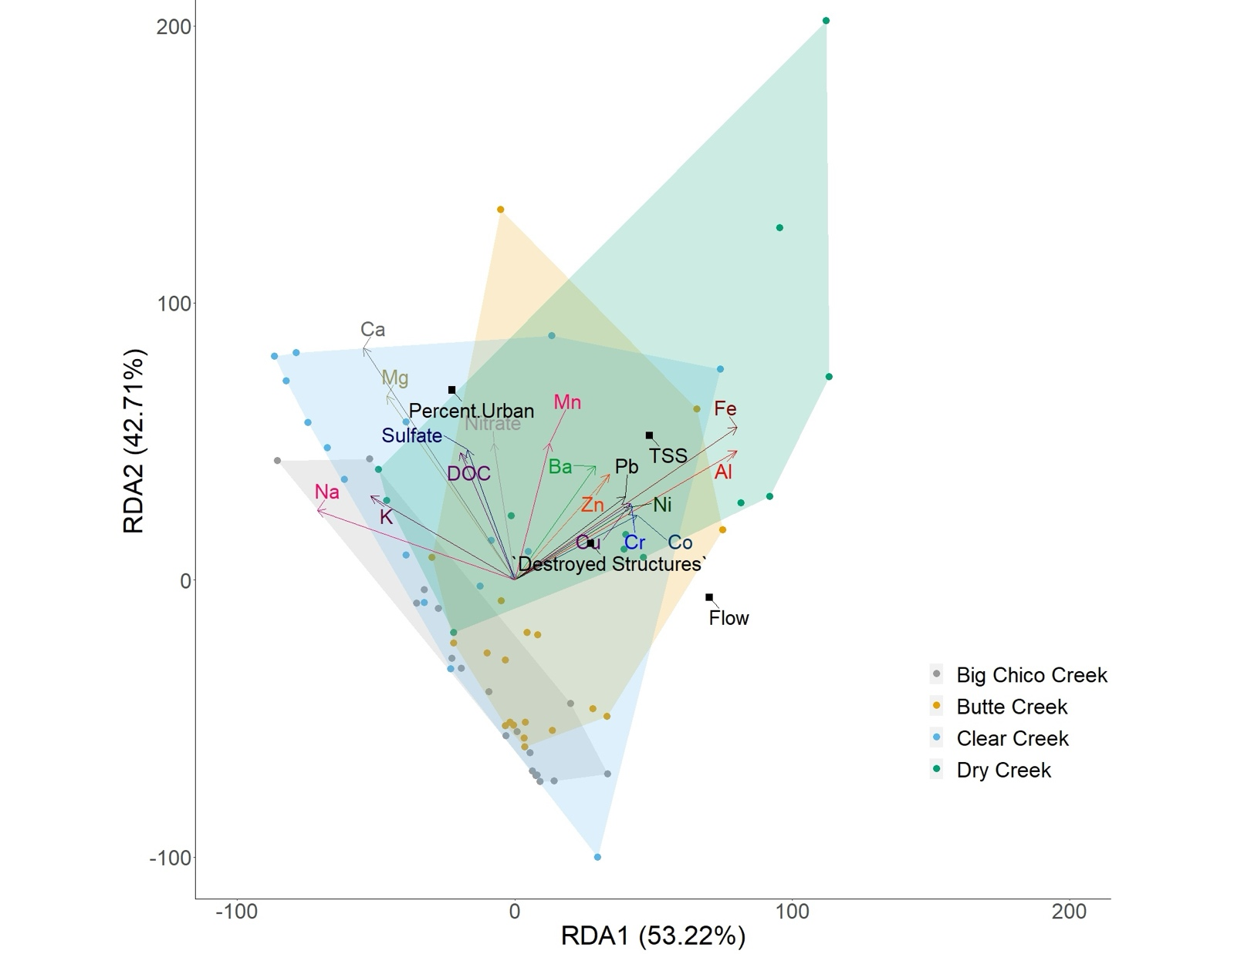
Visualizing Causal Relationships:
RDA
(Magliozzi et al., 2024)
Independent variables: Flow, Percent Urban, # of Destroyed Structures, and TSS
Dependent variables: Total metals, other water quality parameters
Redundancy
Analysis Used to assess relationships between water quality & explanatory variables
Explanatory variables:
Watershed land use, burn characteristics, TSS, flow, precipitation, mine area, geological background, soil type, etc.
95.93% variance explained

