Slide 1
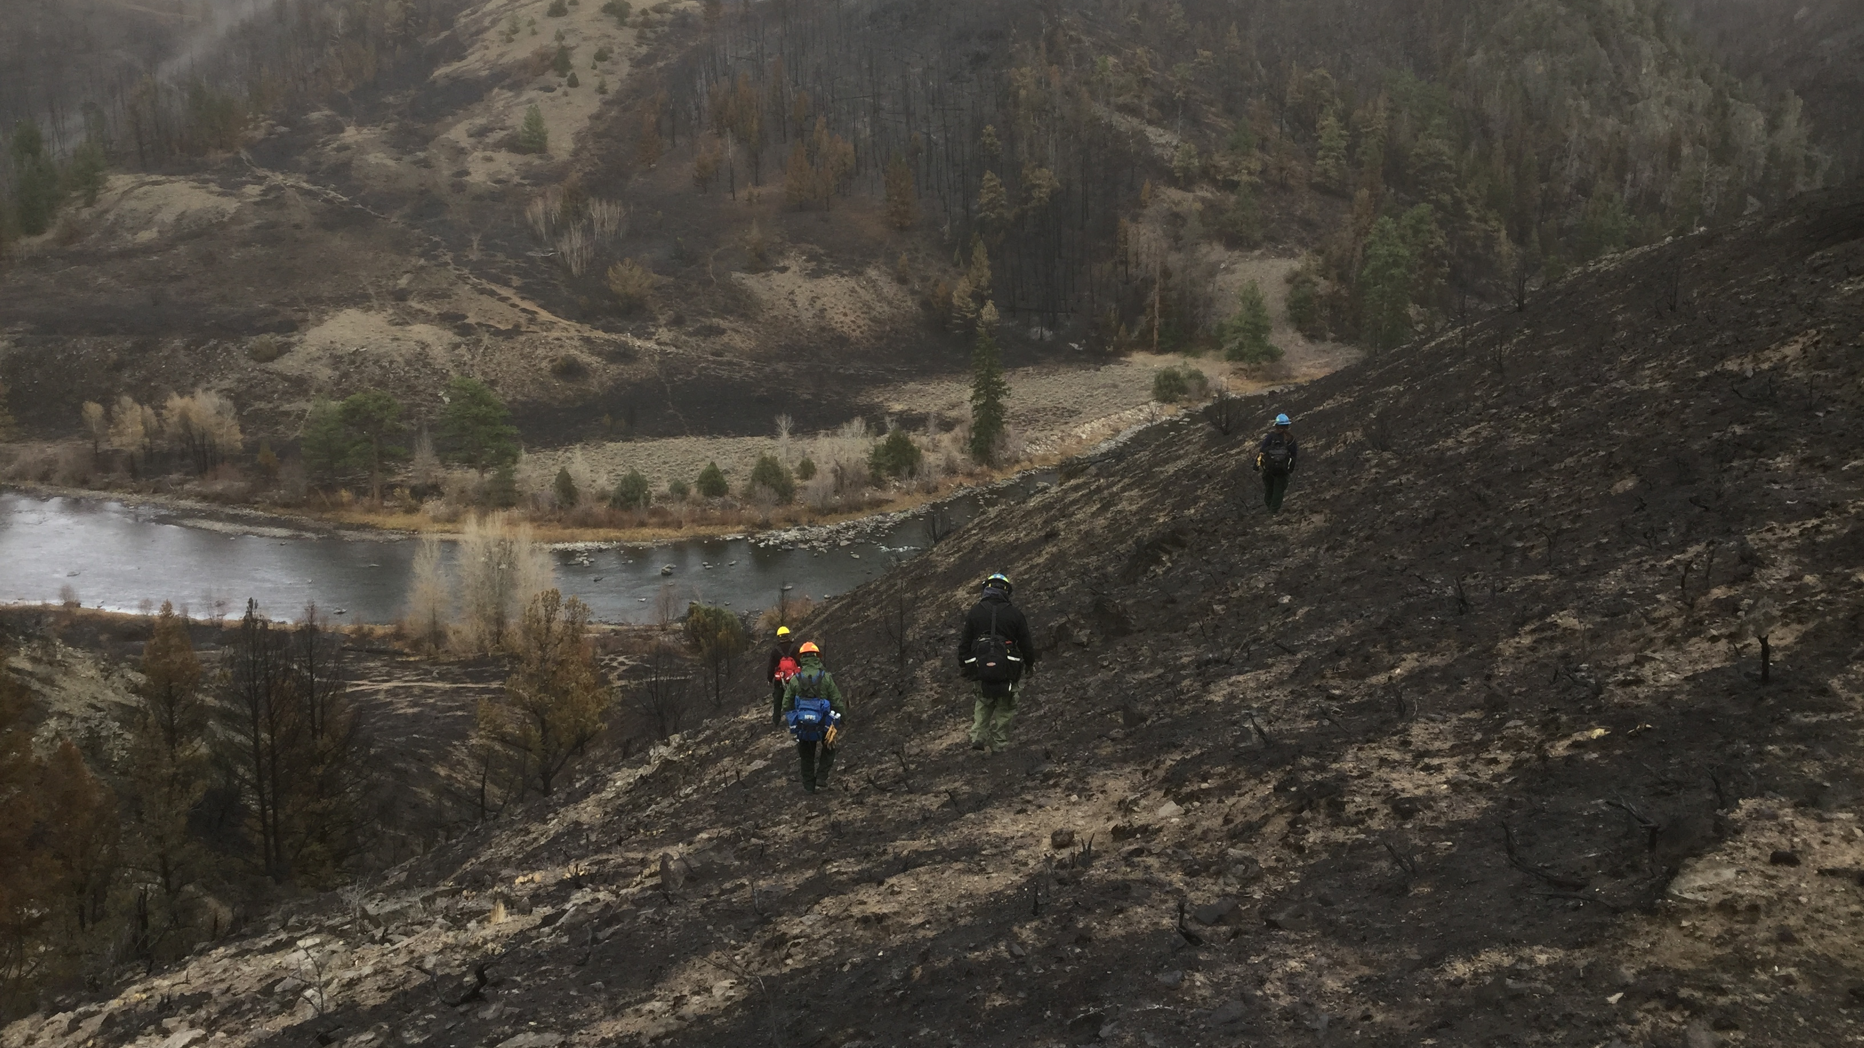
How would we accomplish an all-lands post-fire assessment?
Cara Sponaugle, USDA Forest Service, National Post-Fire Program Lead
Katherine Rowden, US Army Corps of Engineers, National Silver Jackets Program Manager

Slide 2
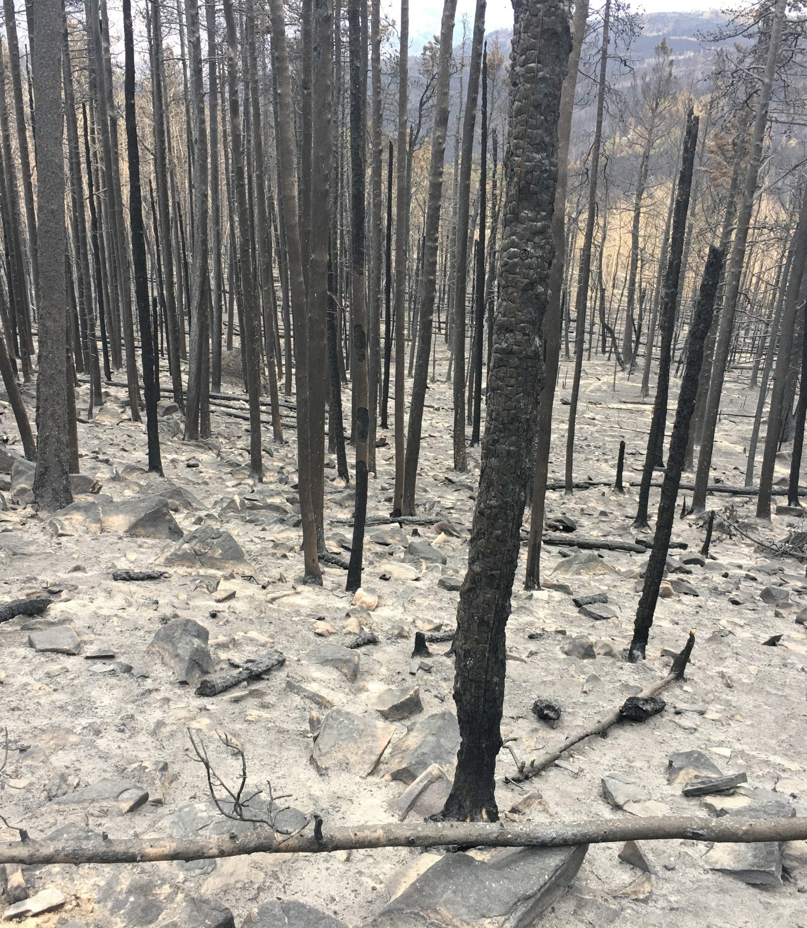
Assuming no new legislation, how do we better work together on post-fire emergency assessments?

Slide 3
It’s winter or springtime, before the fire season.

Slide 4
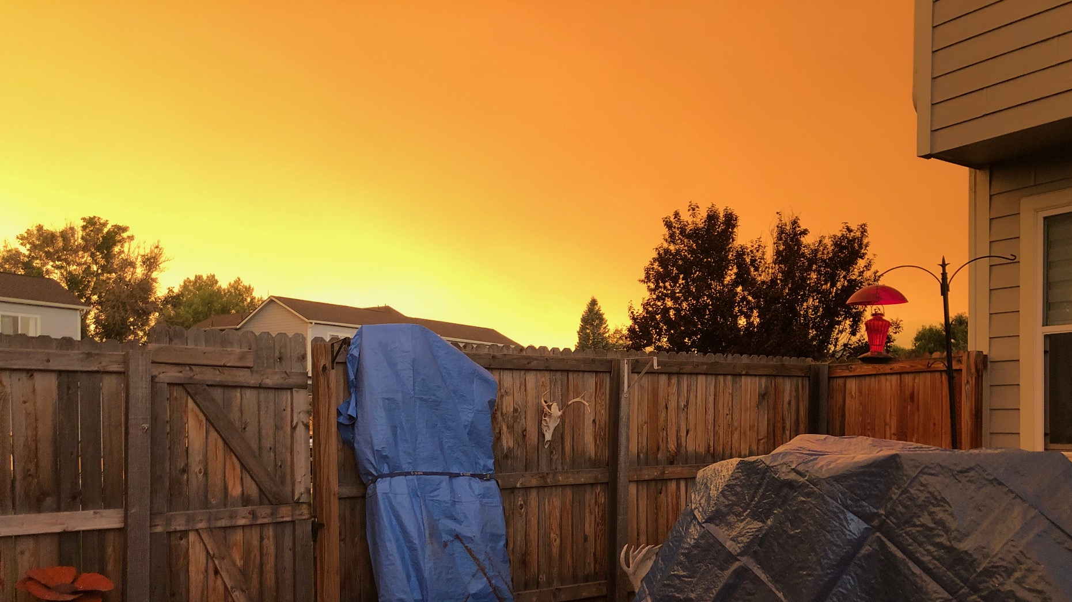
The fire is happening!

Slide 5
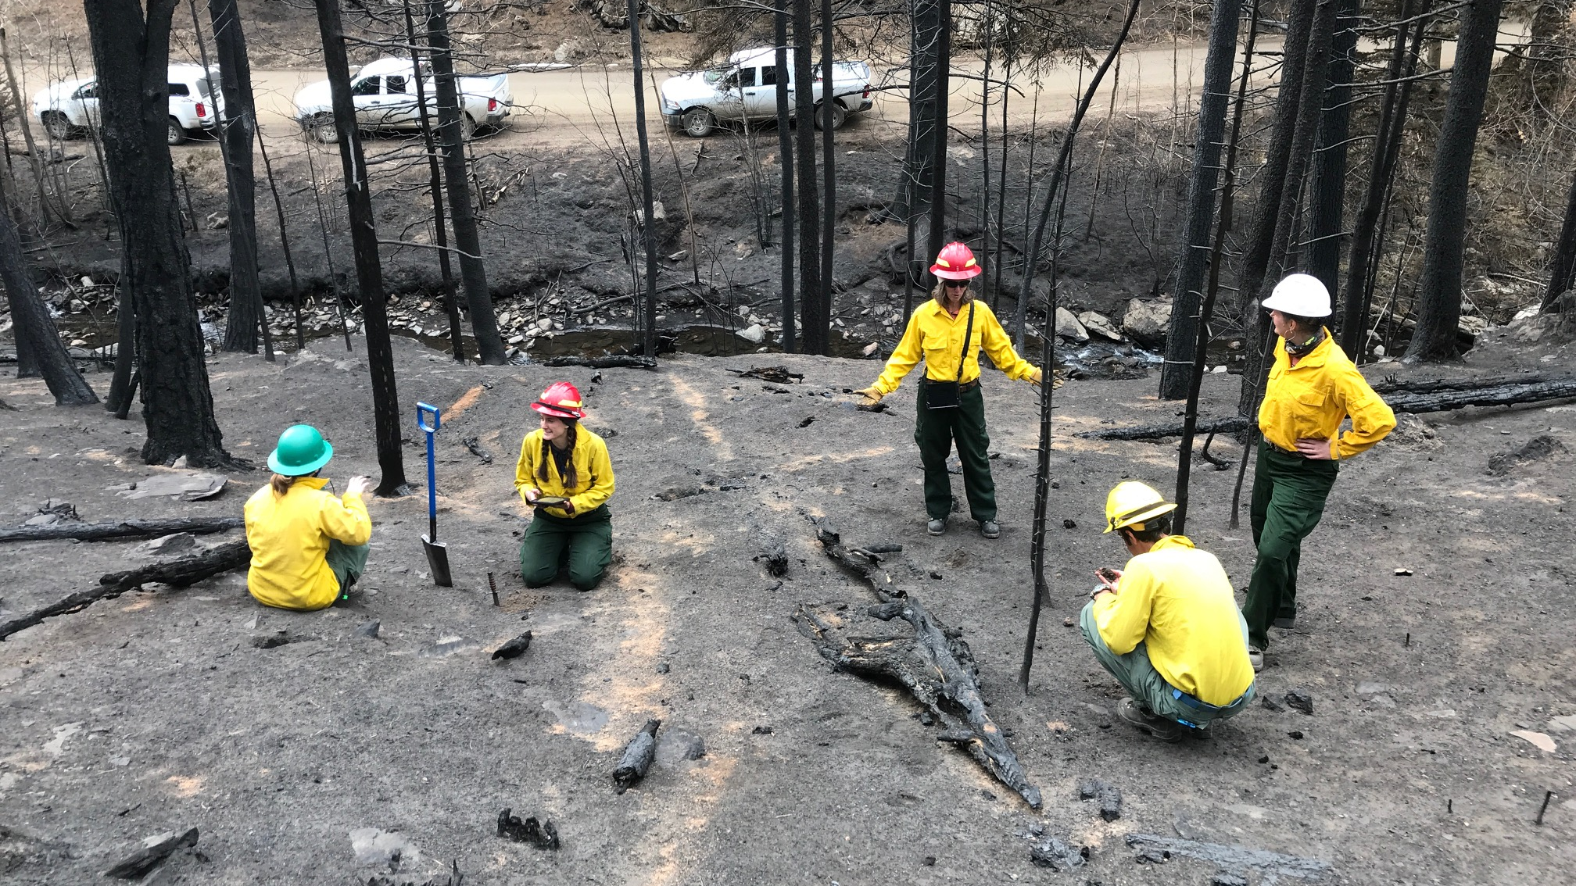
Federal lands assessments

Slide 6
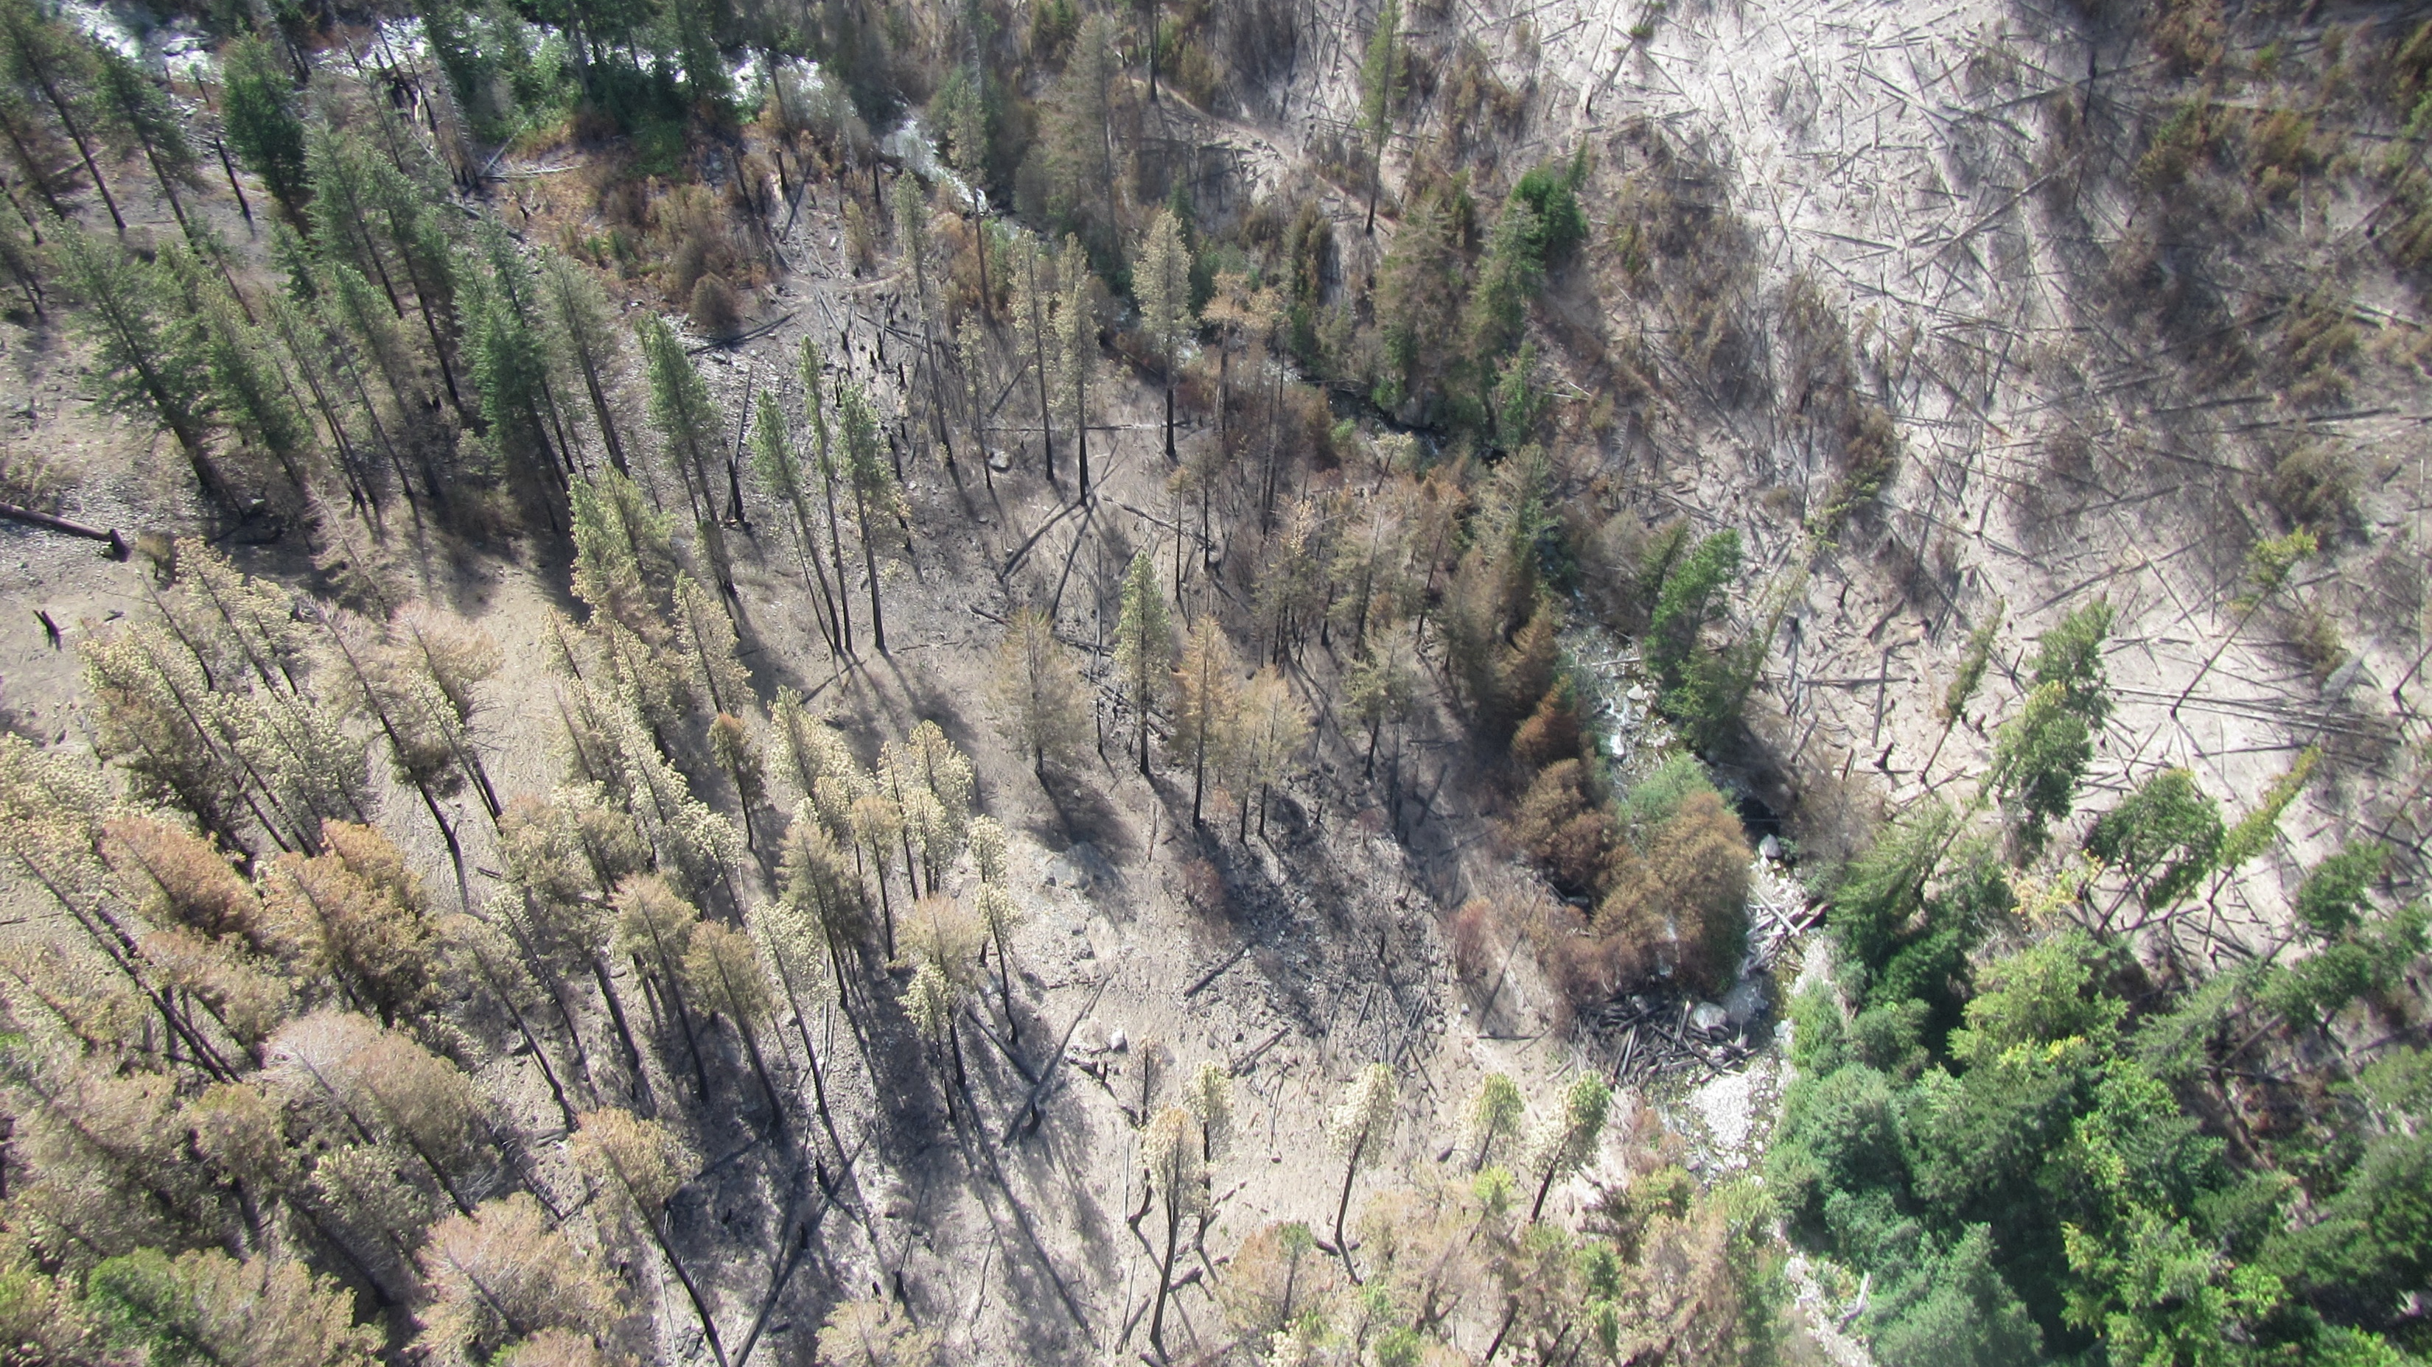
Transitioning from BAER assessment

Slide 7
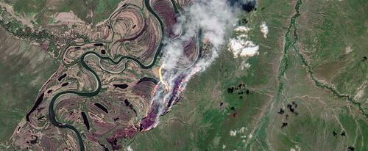
No Federal Lands?
This Photo by Unknown Author is licensed under CC BY

Slide 8
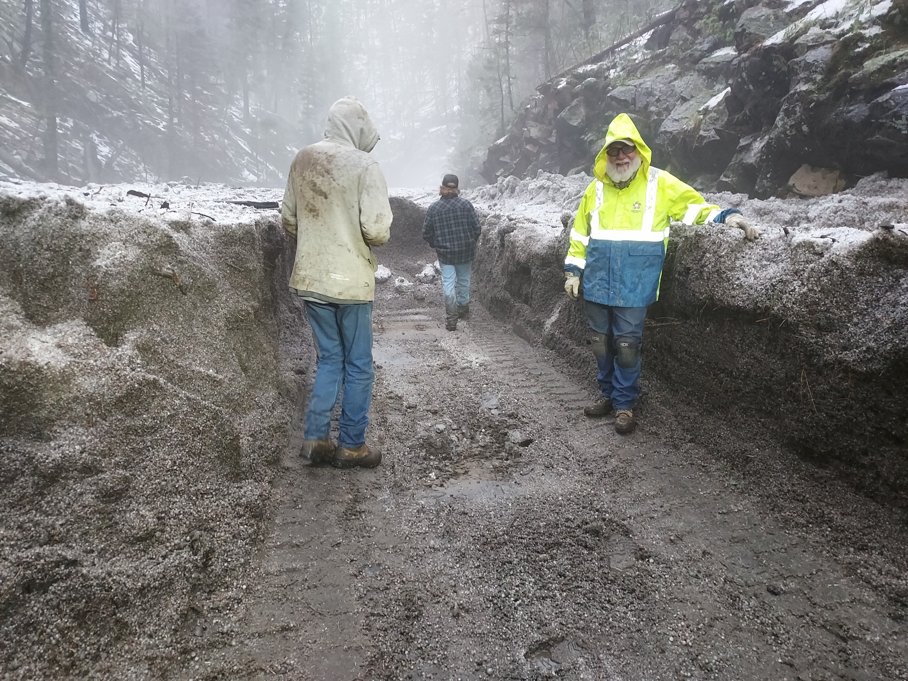
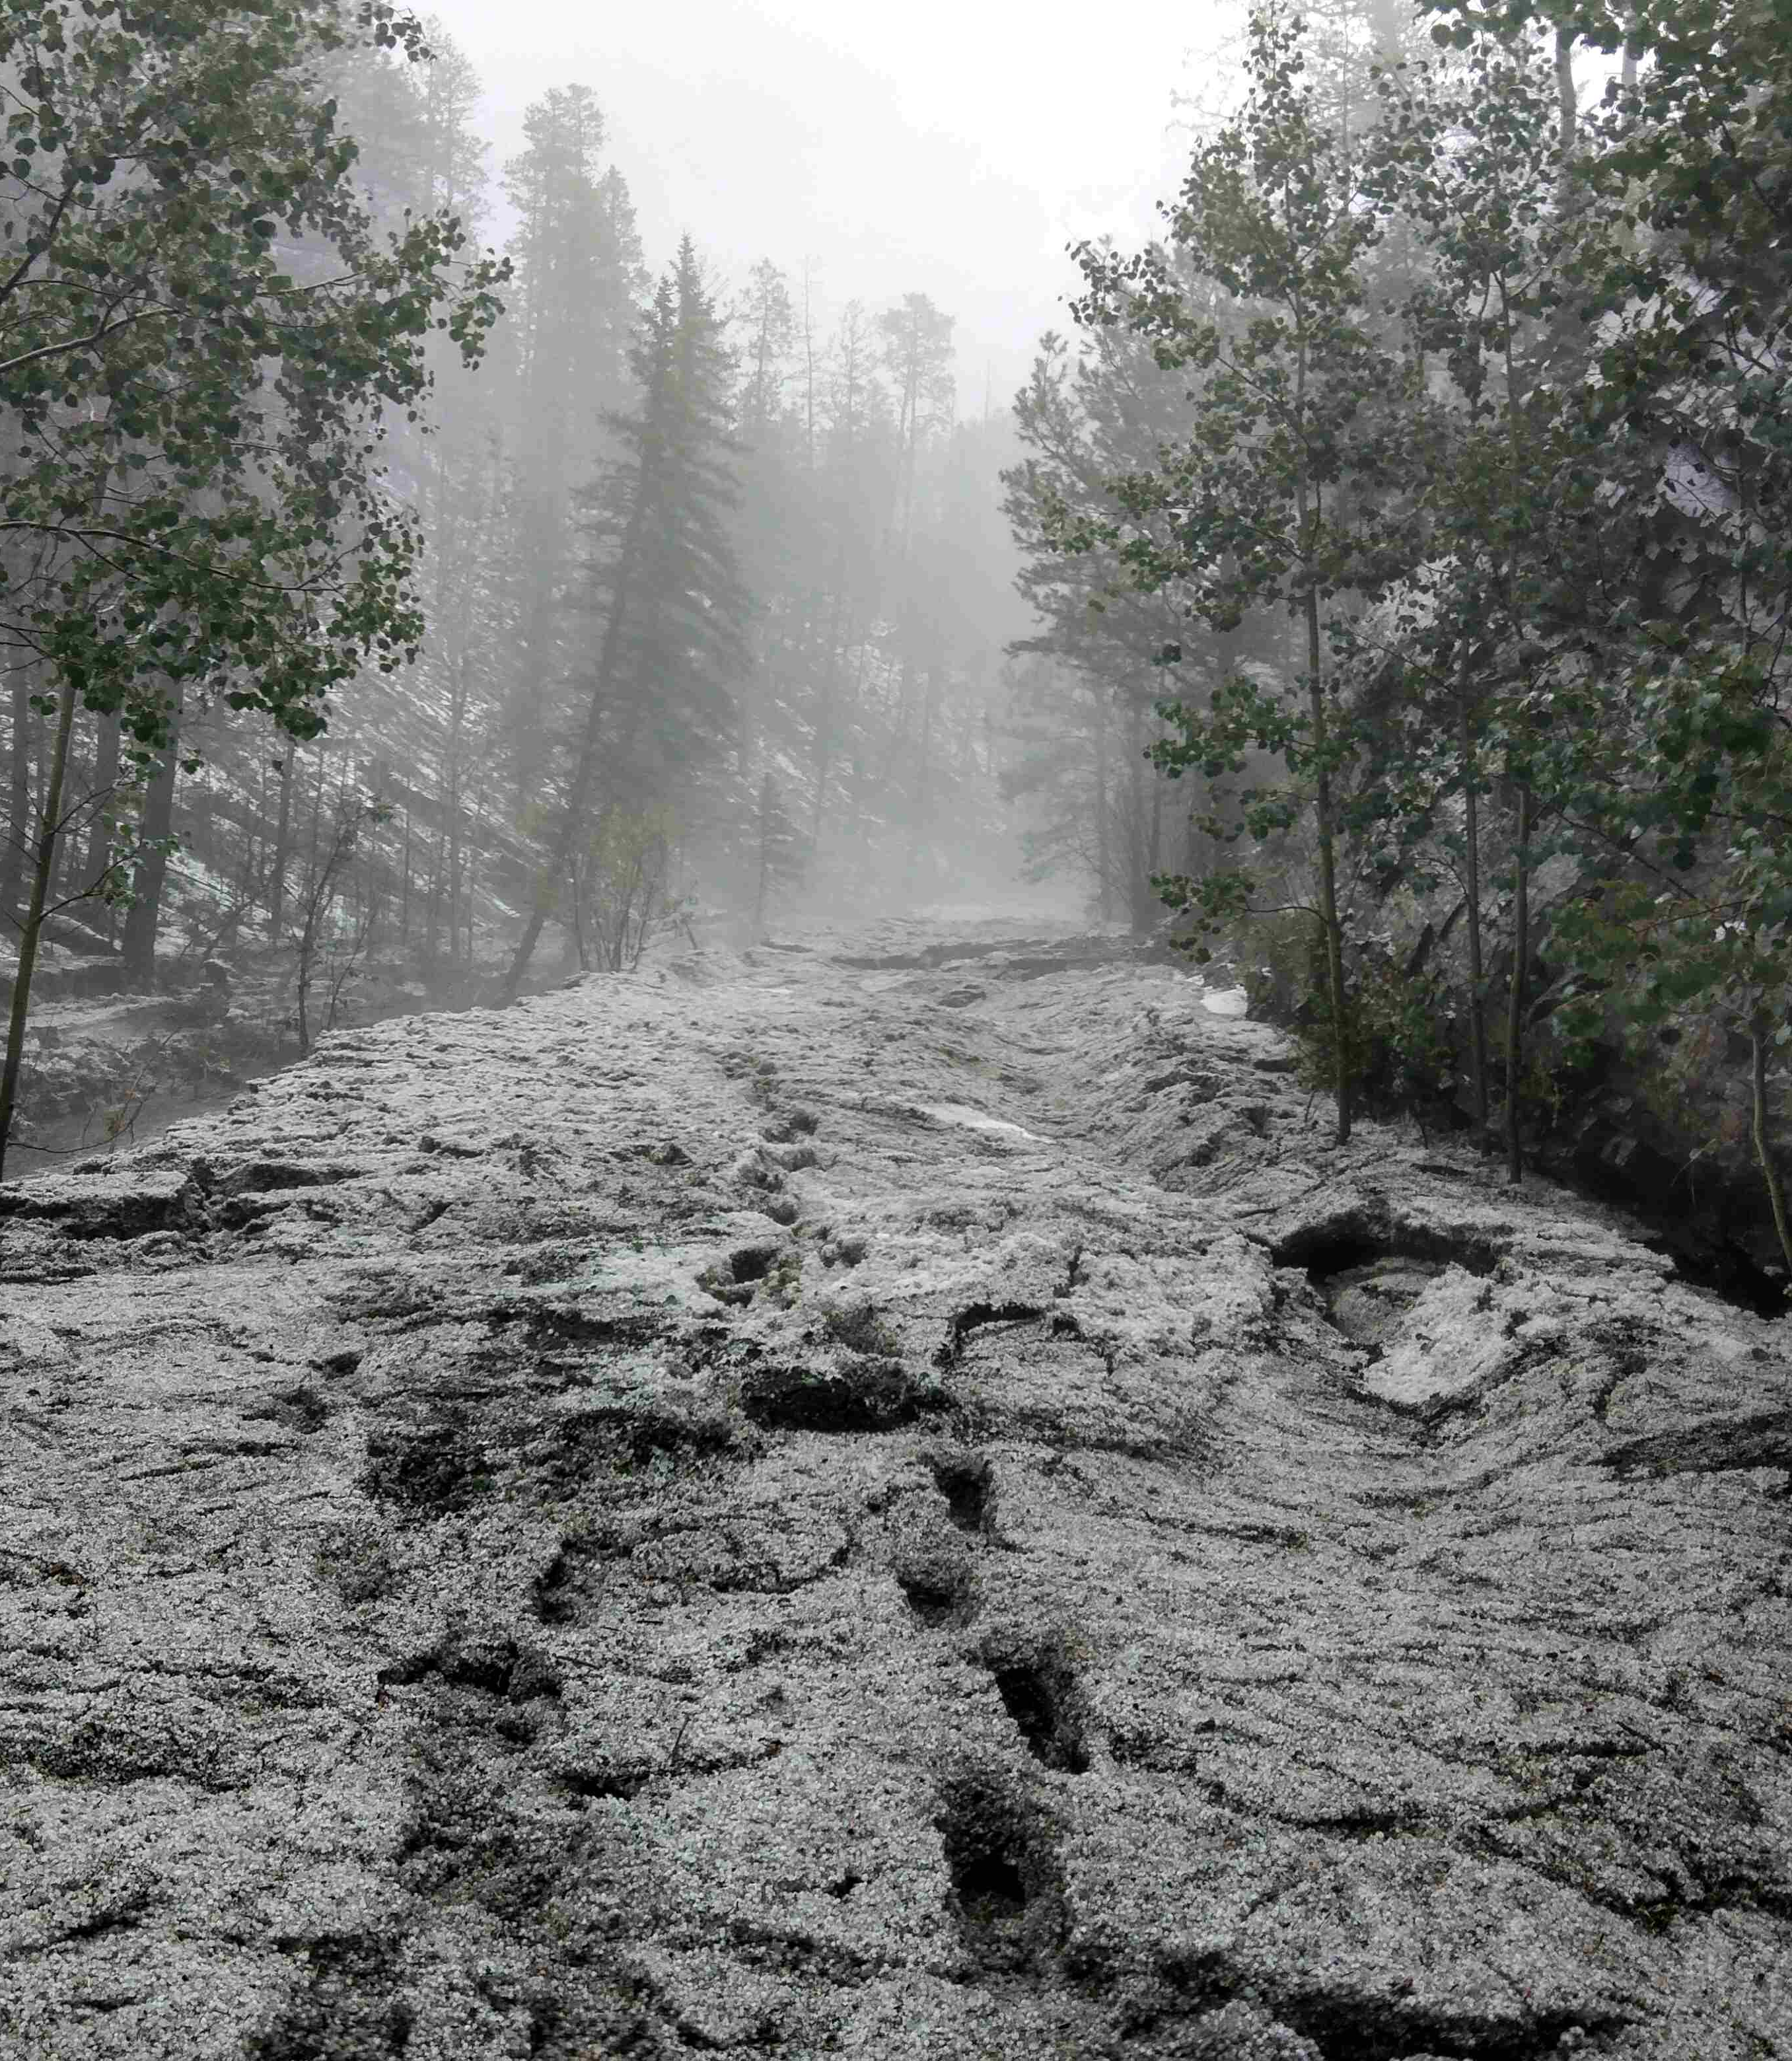
When FEMA is there – Federally declared disaster

Slide 9
If it is one of the season long ones…

Slide 10
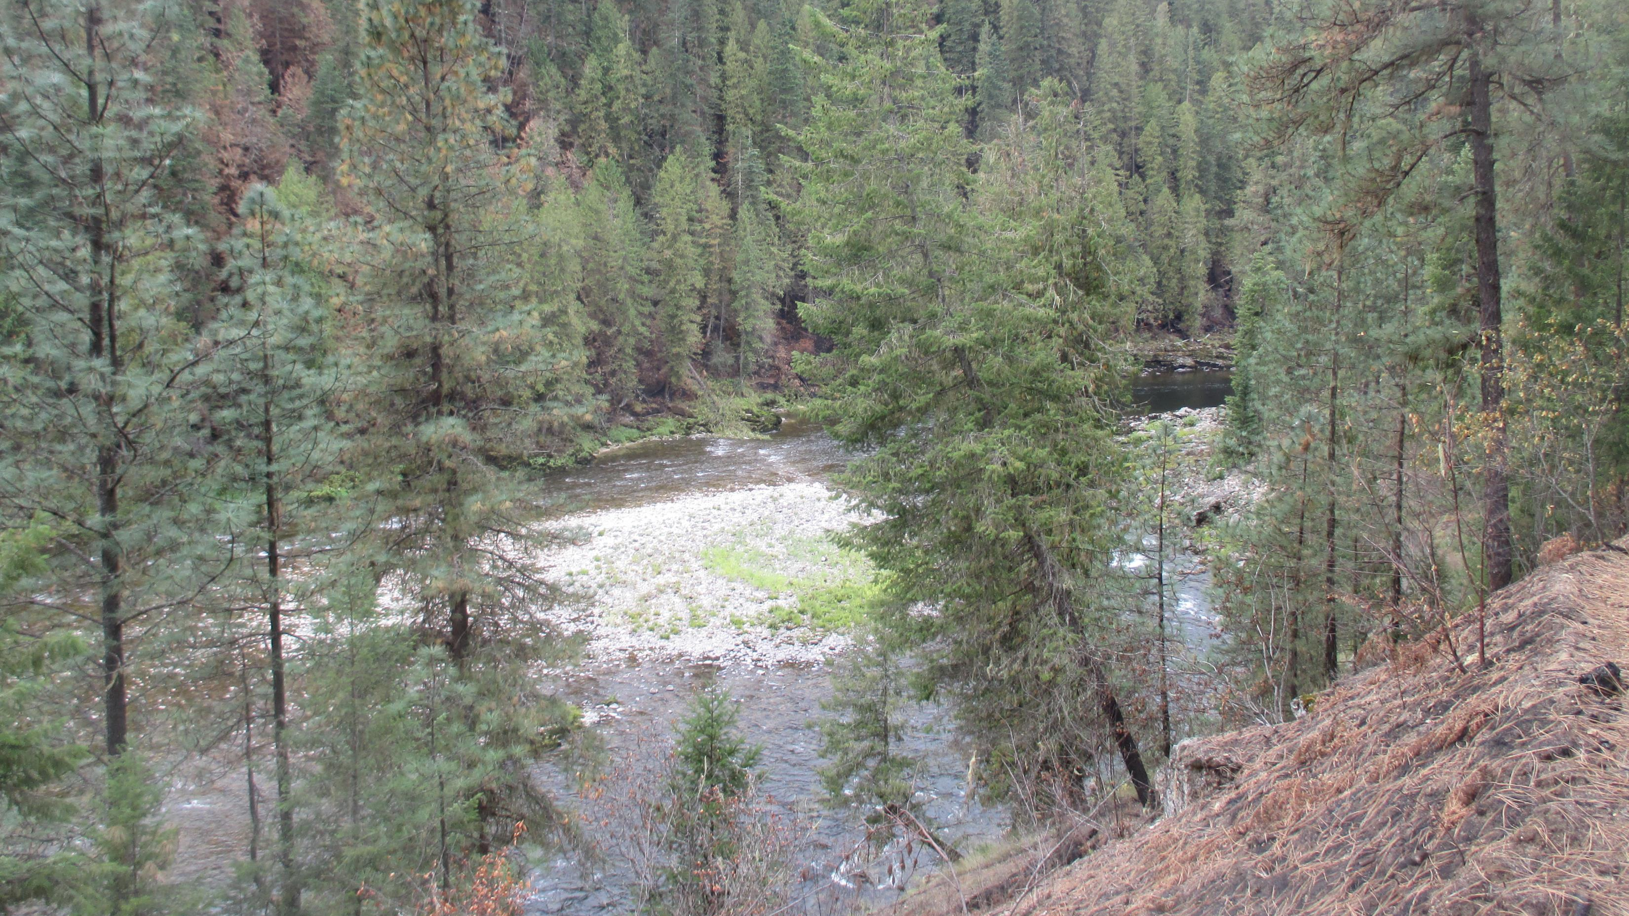
Six months after the fire

Slide 11
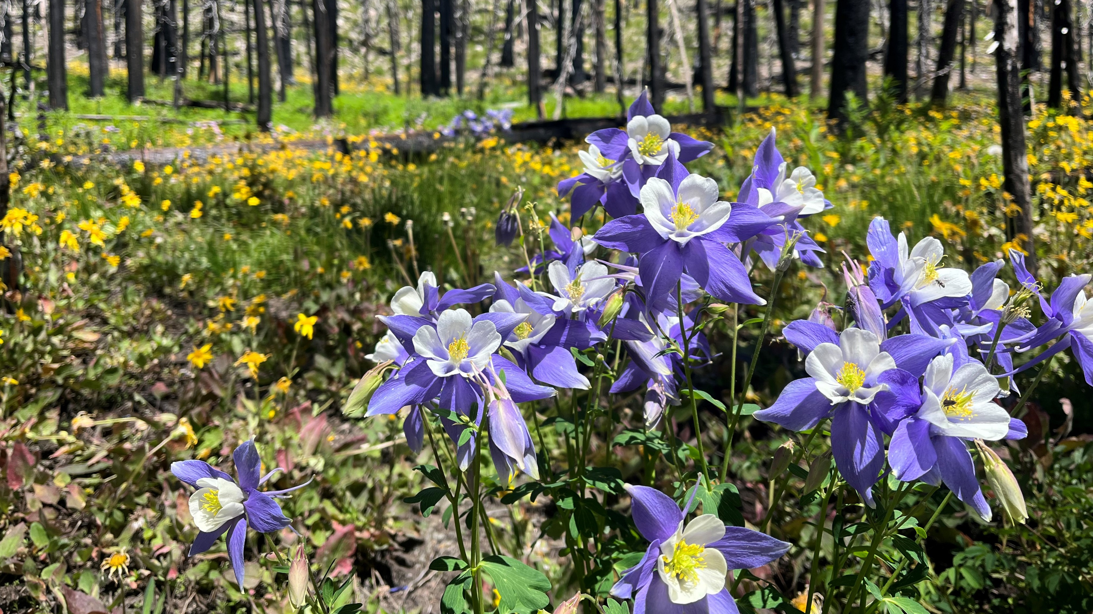
The next year and beyond

Slide 12
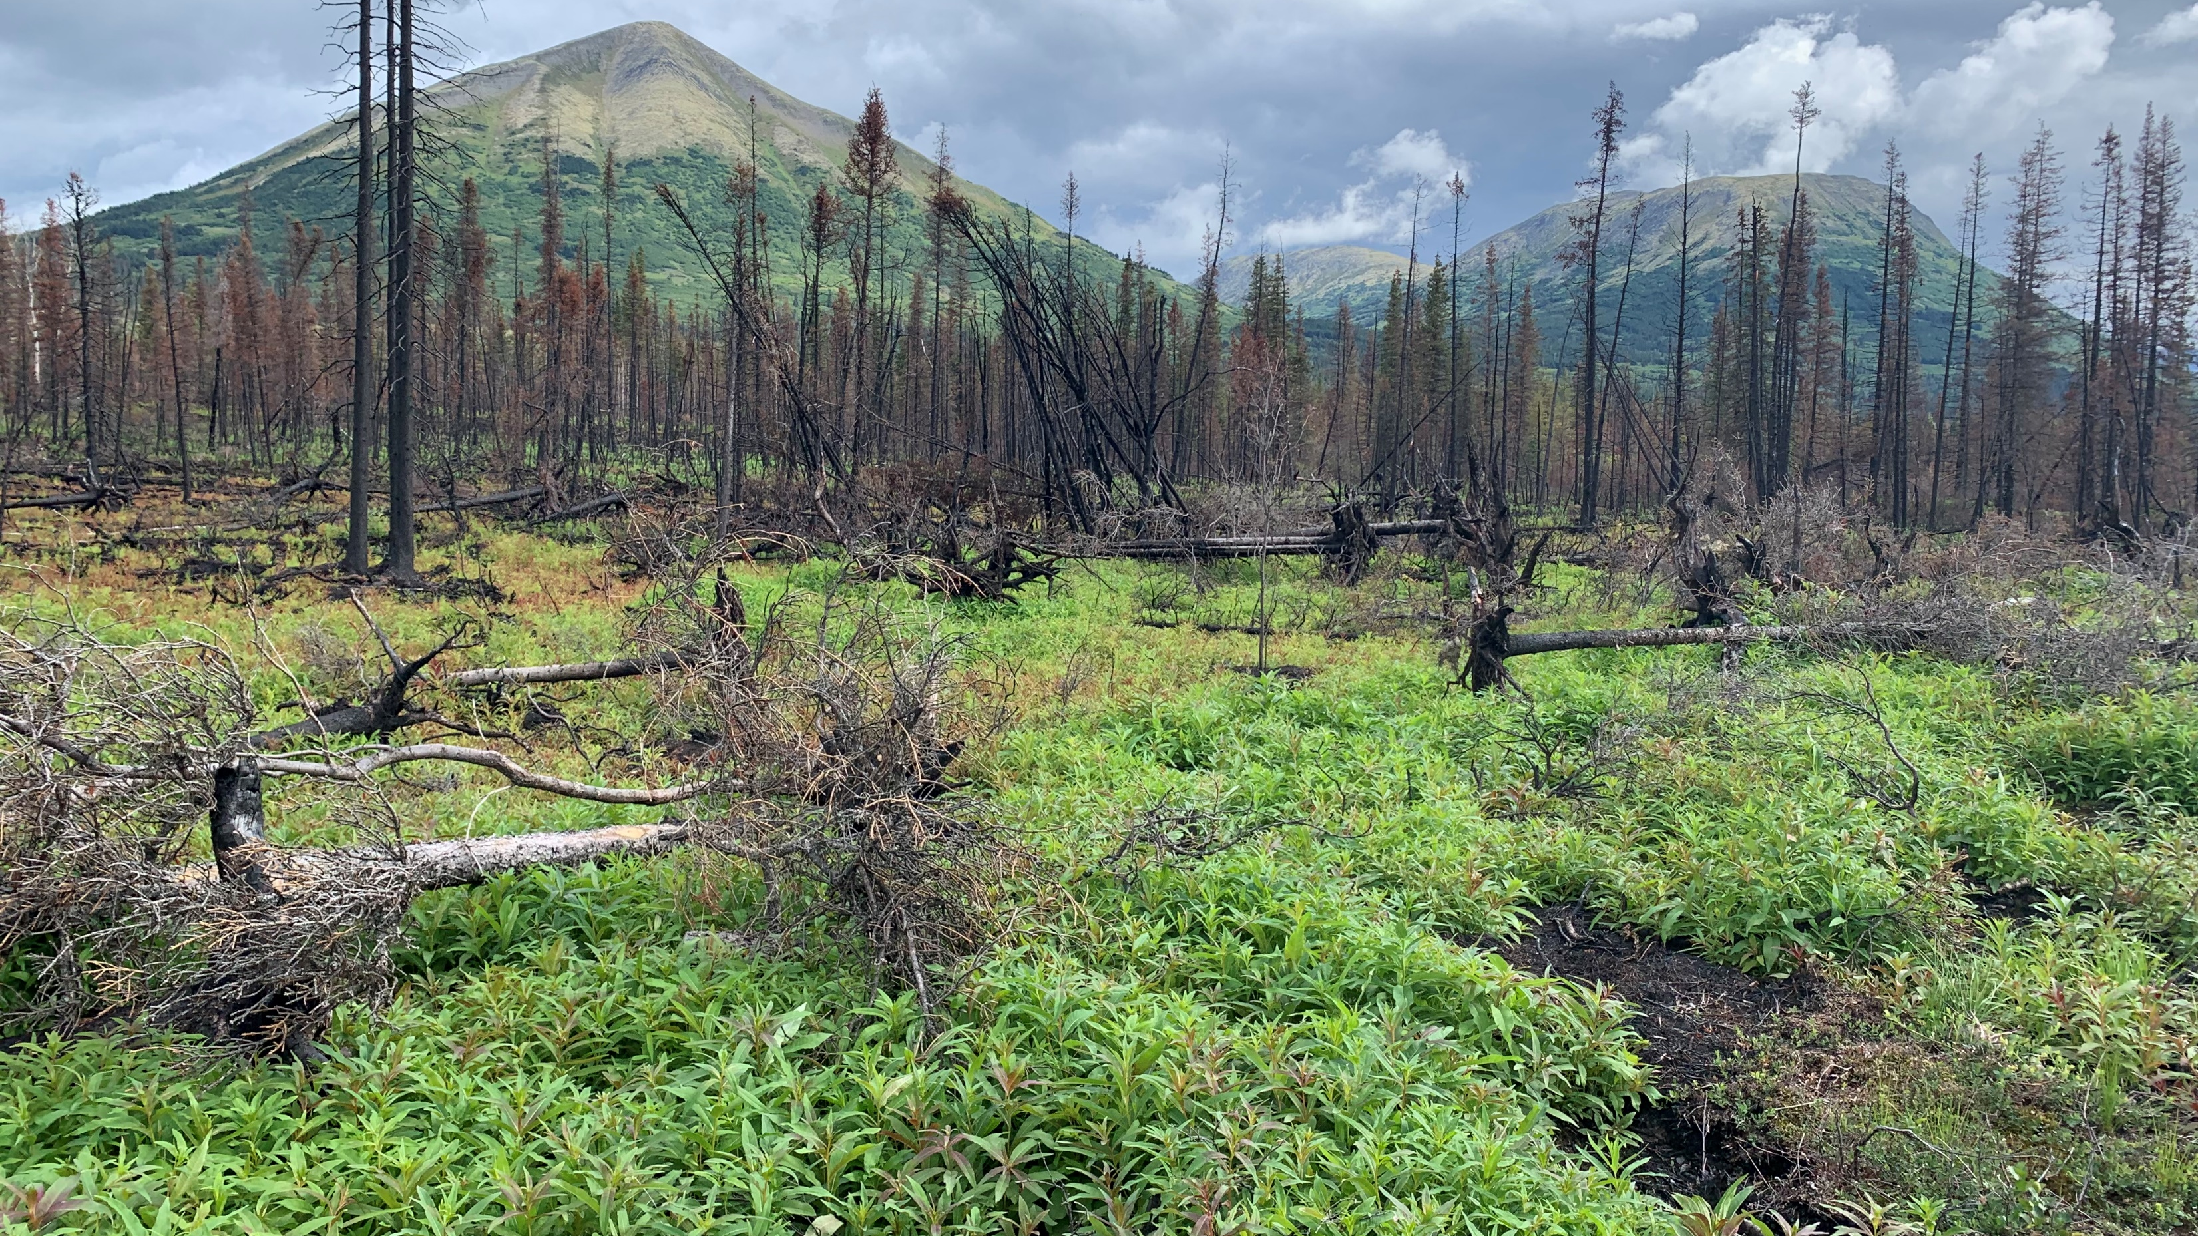
Moving out of emergency and into recovery

Slide 13
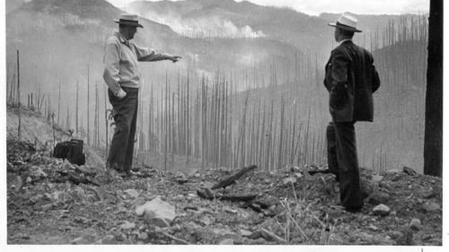
Questions and Discussion

