Slide 1
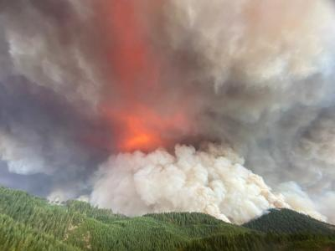

Grow Back Better
Social and ecological factors shaping wildfire recovery on non-industrial private lands
Naomi Serio & Dr. Heidi Huber-Stearns, Ecosystem Workforce Program
University of Oregon
Notes:
Photo is from Archie Creek fire (pulled from google)

Slide 2
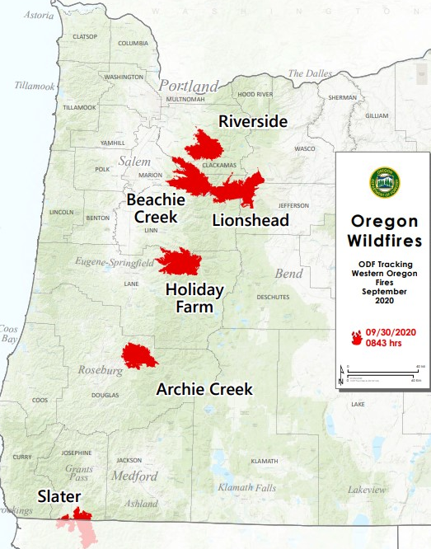
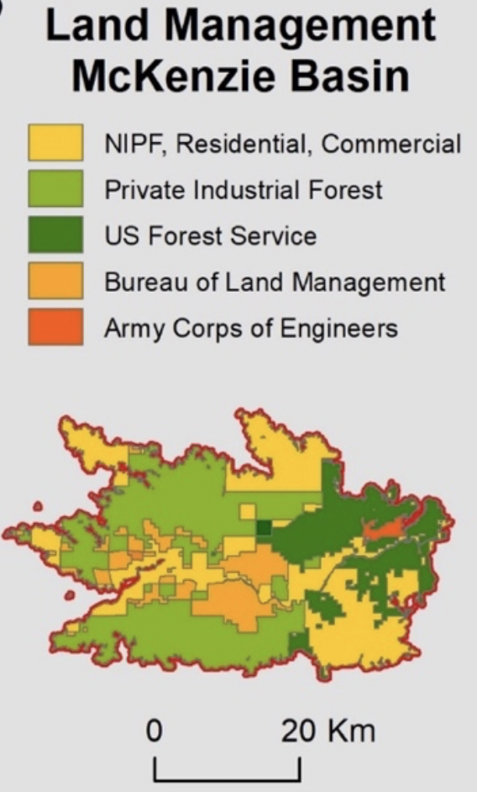
Background & Context
The Labor Day fires claimed ten lives, burned an estimated 4,000 square kilometers of forest and woodland, and destroyed over 4,000 homes.
Wildfire-burned areas are forecasted to increase by an estimated 400% by 2040.
Long-term recovery case study basins: McKenzie, Umpqua, and North Santiam
Focus on non-industrial private forest (NIPF) landowners
  Make up about 12% of the forestlands burned in 2020 fires
  Importance consideration when managing for climate resiliency at the landscape scale.
Notes:
1. Unprecedented nature of the 2020 labor day fires; years later communities are still rebuilding and landowners continue to face difficult decisions regarding post-fire management
2. Due to climate change, wildfire-burned area is forecasted to increase by an estimated 400 percent in the Western Cascade region by 2040
3. We are coupling social and ecological research methods to assess how the communities impacted by our three case study fires-- Beachie Creek, Holiday Farm, and Archie Creek are navigating recovery.
4. We are focusing our project on non-industrial private forest (NIPF) landowners. Roughly 12 percent of the forestlands that burned in western Oregon during the Labor Day fires are classified as NIPF, which includes anything from 10- to 5,000-acre parcels, with most parcels under 50 acres. NIPF owners typically prioritize and manage for different social and ecological objectives than private industrial owners. For example, landscape beauty, biological diversity, water, and recreation all ranked more highly than timber revenue in the 2018 National Woodland Owner Survey Data for Oregon. Because NIPF land is often scattered throughout other land ownerships, and may blend into the WUI, it is critical to consider NIPF land management when planning for climate and fire-resilient landscapes.

Slide 3
Research Questions
Central research question: How does the intersection of individuals, their land, and the local institutional context of recovery support shape emergent social and ecological resilience to wildfire at the landscape level?
Social landscape of recovery support
What organizations, funding sources, and programs are supporting NIPF landowners in their long-term recovery?
Ecological landscape of recovery
What factors are influencing NIPF landowners’ decision to replant or not?
NIPF wildfire recovery toolbox
We will work with our partners to co-produce transferable and actionable resources
How can recovery organizations better support NIPF landowners?
What factors are influencing replanting success?
Format to be informed by needs identified in earlier stages
Notes:
This research will (1) identify and characterize local context of existing governance structures for NIPF recovery in which the public and nonprofit sectors are situated (the social landscape of recovery support). We are interviewing public and non-profit organizations involved in recovery within the 3 case study basins. We have just begun interviews with non-profits.
(2) Next we will assess and evaluate the parcel-level context of NIPF wildfire recovery (the ecological landscape of recovery). This stage will involve interviewing NIPF landowners to better understand factors shaping their decision to replant and how this was impacted by the support they did or did not receive.
(3) At the end of our research process, we will co-produce transferable and actionable recommendations and tools (a Wildfire Recovery Toolbox) to inform more responsive and forward-thinking wildfire recovery strategies for NIPF managers.

Slide 4
Today’s focus: organizations supporting NIPF
To understand the social landscape of recovery, we are conducting semi-structed interviews with organizations involved in long-term recovery in our case studies
  Focusing on organizations supporting NIPF landowners (23 interviewees)
  Identified through snowball sampling and membership in the Western Oregon Cascades Recovery Effort (WOCRE)
  Interview questions focus on:
    Organization’s role in supporting NIPF recovery
    Ecological, social, and policy-based (red tape) challenges to supporting and engaging NIPF
    Understanding who is receiving support and how to make support more accessible

Slide 5
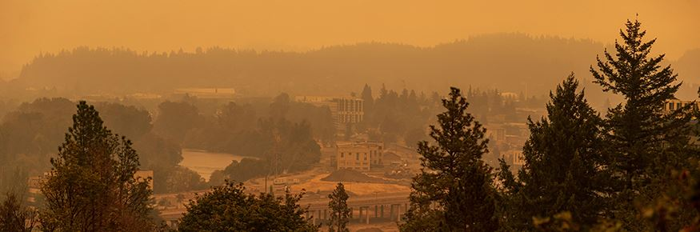
Preliminary emergent themes

Slide 6
What type of support is available?
Funding: Most funding to help landowners with post-fire land management is coming from federal sources, such as the NRCS and the FSA, but also some state funding (OWEB).
Technical support: ODF, OSU extension, SWCDs, watershed councils
Outreach: Long-term recovery groups, non-profits, counties
Most programs are cost-shares and are reimbursement based
Programs cover activities such as brush removal, riparian restoration, site assessments, site prep, and replanting.
Notes:
On smaller properties, some folks are doing the work themselves and then get reimbursed, others hire contractors.

Slide 7
Ecological challenges to reforesting private lands
Tree mortality is high: heat waves, drought, poor seedling quality
Seedling supply: Very few nurseries will sell to the public in small orders
  Some organizations are helping landowners aggregate orders
Lack of science on post-fire reforestation best practices on non-industrial private lands west of the Cascades
Brush build up: need for constant mitigation
Notes:
2. Landowners generally need to aggregate, nurseries won’t sell to individuals because they usually have minimum per order. Washington state’s nursery dedicates a portion of their production to small landowners, but OR doesn’t have anything like that. Most private industrial nurseries have huge minimums and federal nurseries only sell to federal lands. OR doesn’t have a state nursery anymore, which is poses a challenge to getting quality seedlings to small landowners
3. The majority of post-fire reforestation research specific to OR focuses on industrial lands and managing for timber productivity. It also focuses on the east side of the cascades because that’s typically where fire was most common. Folks like SNW are working on this.
4. Brush build up is a major problem and is contributing to die off for replanted trees and is a fuel hazard for the next fire that comes through. Typically reforestation funding ends after planting, but constant mitigation of brush competing with the seedlings is needed for success.

Slide 8
Social and economic challenges to reforesting private lands
Cumbersome application processes
  “They’re so overwhelmed with the 15th set of paperwork we’re having them complete answering the same questions in a slightly different way for a new agency. They’ve given up, they can’t move past the trauma because we’re reinflicting it on them every time we get a new program with new funding.”
Needing to front funding and uncertainty around reimbursement timeline
Distrust of government and hesitance to receive assistance
  “The second we tell people that we need to do an environmental study on their property, people panic… they’re afraid of what that means.”
Notes:
Uncertainty, at the time they apply, it’s often unclear when they will get the funds or how much will be reimbursed or when they’ll be able to replant. The programs that are not reimbursement based are also problematic because no work can be done until funds come through, so landowners are waiting 1-2 years and meanwhile brush is building up.
Nearly all interviewees have expressed that community members in their fire footprint are are hesitant to get help from the government and have a deeply embedded distrust for government. They noted that this distrust was particularly strong among the elderly and undocumented populations.

Slide 9
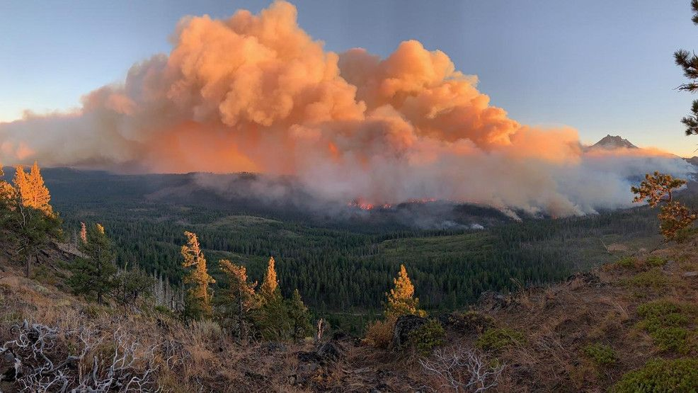
  “Some of the people that have replanted have lost as much as 80% of the trees… I don’t know about you but if somebody was like, hey, I need you to put out $35,000 to replant these trees that have already died twice and I can’t guarantee that I’m going to be able to reimburse you or how long it’s going to take, there’s a good chance they’re not going to do it.”
Notes:
Quote regarding tree mortality. The reimbursement issue I’ll talk about in the next slide. Background is Lionshead fire

Slide 10
Equity Concerns in Recovery
Reforestation can only be a priority after housing, food, etc. is secure
  “The folks who have time and money can look into it [getting support] and maybe call a consultant or those sorts of things. The folks who don’t have these resources, they’re struggling to figure out how they’re going to get clothes. I think there’s some knowledge of it [support], but it’s not equitable…. again it goes back to if you’re trying to figure out how to get clothes on your back, you don’t care about the trees on your property… it starts with making sure they [landowners] have access to everything else so that it [replanting] can become a priority.”
Groups having trouble accessing land management support: individuals still struggling to get basic needs met, middle income, elderly, very rural, families with children
Notes:
Middle income folks are struggling because many programs have an income cap, and many folks are slightly above this cap and can’t qualify, but also can’t afford to pay for land management and reforestation on their own. Very rural and elderly don’t have the technology, so they don’t hear about opportunities and they also have more trouble applying for them. Families with children are too busy to navigate the application process.

Slide 11
Recommendations
Local organizations with pre-existing relationships should be the ones directly working with survivors
Have systems in place ahead of time to get the LTRGs running right after the fire
Long-term recovery is longer than funders and policymakers realize.
Look to pre-existing models in other states and communities
  “Why not lean on other states that have done this? California has been dealing with this, they’re ten years ahead of us in wildfires.”
Notes:
1. Need to have local organizations with pre-existing relationships, rather than government agencies, facilitating recovery.
2. Setting up the LTRGs took a long time, getting funding to hire staff took too long. There should be systems in place so that counties and local organizations can get going right away, rather than waiting for funding to filter down from federal or state entities. Perhaps there could be a statewide LTRG that functions in the absence of disaster and facilitates local LTRGs getting set up quickly after disaster.
3. Many interviewees emphasized that they wanted policymakers and funders to understand that long-term recovery takes longer than most people realize. It’s not over after 2-3 years, it can be 5-10 years, especially for post-fire land management.
4. Interviewees expressed frustration at the state for trying to reinvent the wheel on several long-term recovery programs. They said it’s important to look to pre-existing models in states that have been dealing with wildfire for a long time.

Slide 12
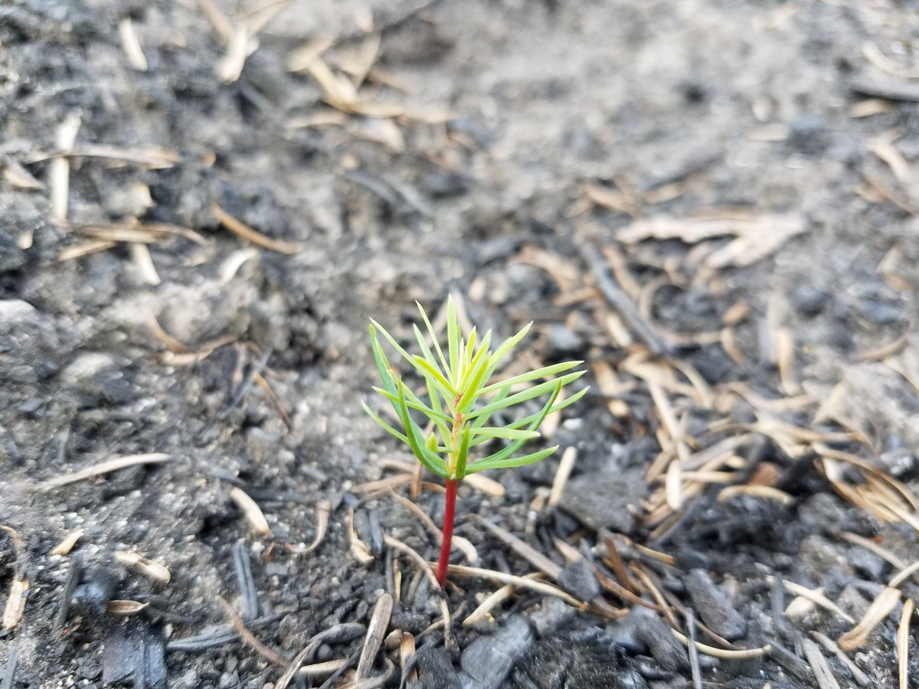
To get in contact with our research team:
Heidi Huber-Stearns, Director of the Ecosystem Workforce, hhuber@uoregon.edu
Naomi Serio, Faculty Researcher, nserio@uoregon.edu
Notes:
Doug fir seedling re-establishing post-fire in the Cascades

