Slide 1
Forest & Water Renewal
Revolving Loan Fund
~
~
~
Notes:
\

Slide 2
Coalitions & Collaboratives
Financial Management
100 years of combined experience managing Millions in Federal, State, Local and Foundation grants.
Action, Implementation and Mitigation (AIM) subawards of USFS funds
Grants of up to $75k
91 organizations supported to date
$9.5 million total project value to date
Community Navigators Program
Collaborative Accelerator
Strong Network/Pipeline
Innovation
Co-developer of the US's largest carbon-based reforestation project with RenewWest
Led development of avoided wildfire Carbon Protocol and Biomass Substitution projects under USDA Wood Innovations Grant Program
On the Ground Experience
Extensive experience in project management
Technical knowledge of conservation, watershed, forest health, wildfire and ecosystem service related programs and projects

Slide 3
Innovation
Invest in People
Increase Pace & Scale
Technical Assistance
Capacity Building
Notes:
. Many of these forested watersheds are on USFS land. Annual wildfire suppression costs billions and when suppression fails, the cost to mitigate impacts on water quality is massive.

Slide 4
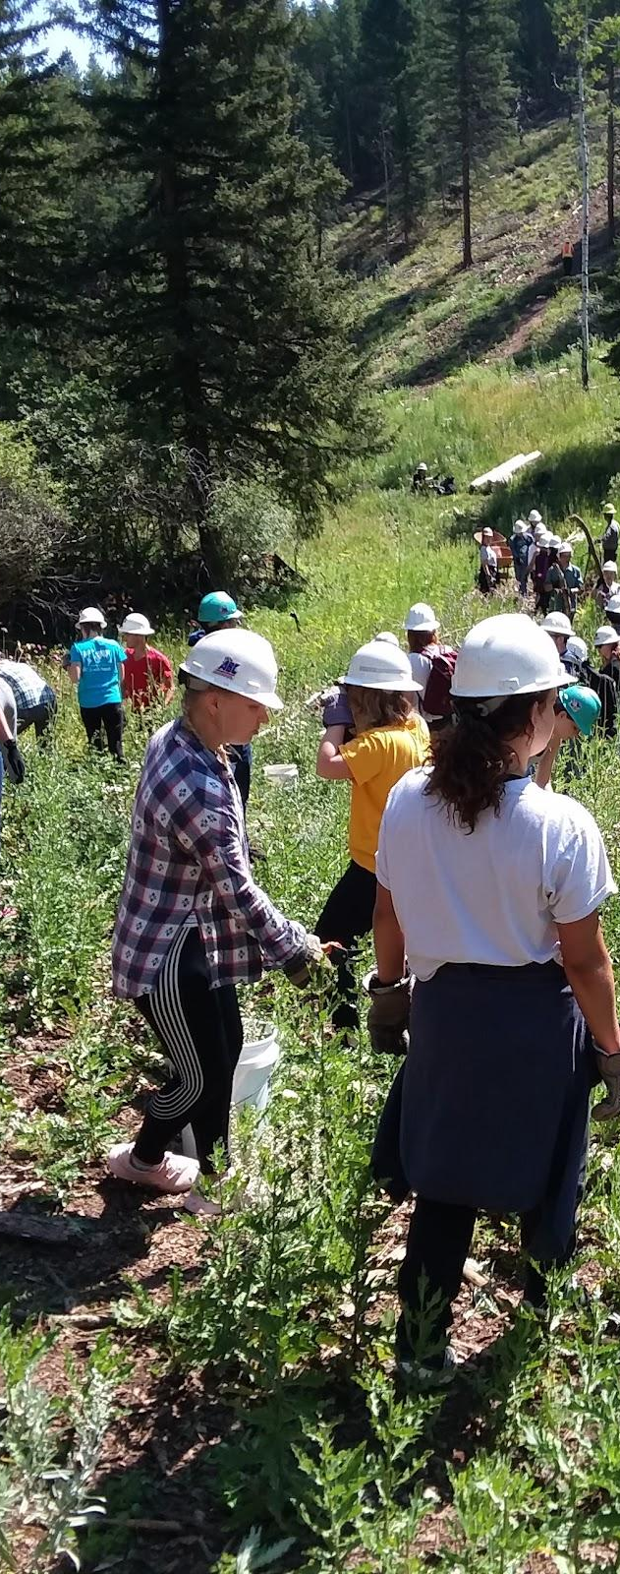
The Need
In 2023, more than 44,011 wildfires burned 2,342,143 acres and regions such as Texas and Hawaii saw the worst wildfires in their history
According to a 2020 USGS report, wildfires pose a significant threat to US water supplies as “[o]ver 50% of the Nation’s drinking water comes from forested areas”
Notes:
In 2023, more than 44,011 wildfires burned 2,342,143 acres and regions such as Texas and Hawaii saw the worst wildfires in their history (International Association of Wildland Fire).
According to a 2020 USGS report, wildfires pose a threat to US water supplies as “[o]ver 50% of the Nation’s drinking water comes from forested areas” (https://labs.waterdata.usgs.gov/visualizations/fire-hydro/index.html#/)

Slide 5
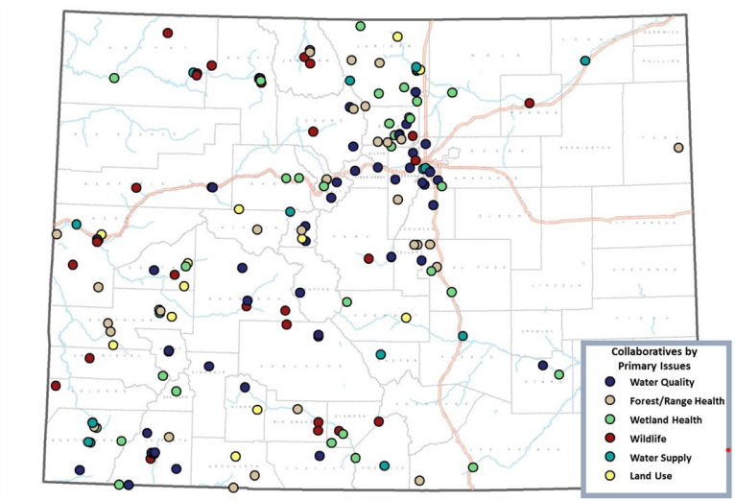
MAKING A DIFFERENCE AT SCALE
To get ahead of forest fires and watershed health, we need to:
Lower admin/overhead costs
Increase acres treated/dollar
Collaborative Initiatives in Colorado
Source: The Atlas of Collaborative Conservation in Colorado, 2019
Notes:
We are talking about 60+ conservation collaboratives in a state like Colorado. If half of them are struggling with financial management then the impacts of this problem impact important forest conservation, watershed restoration, and wildfire mitigation throughout huge portions of the state. Now think about what this problem looks like at the national scale.
Place-based groups rely on state and federal funding; however, there is a misalignment of timelines on when cash is accessible by organizations to efficiently plan and complete projects. This is a significant barrier, especially to groups representing marginalized communities, who cannot leverage finance in other ways. (e.g. loan inaccessibility, limited local philanthropic funding, and/or limited fundraising capacity). Without a mechanism like RiverBANK, funding opportunities available under the Bipartisan Infrastructure Law, US IIJA, and other federal and state funding will be largely unavailable to place-based groups pursuing priority projects, and those funding programs are likely to miss important targets.

Slide 6
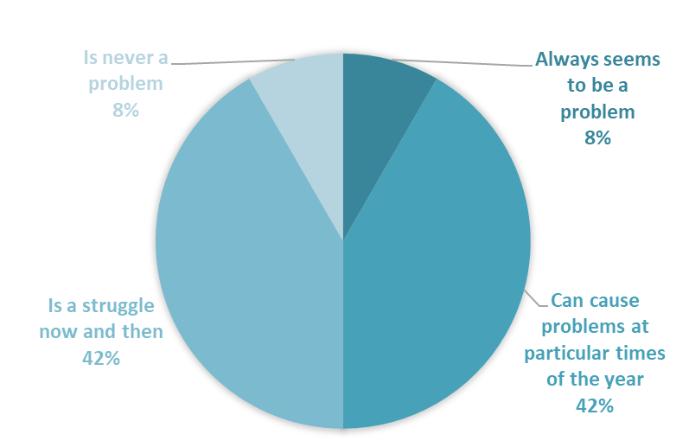
FUNDING GAPS
$
Conservation collaboratives are spending valuable time and resources juggling funds to cover contractors and payroll.
This means that existing funding investments are far less efficient and impactful than they could be.
AT MY ORGANIZATION, MANAGING FINANCES …
Notes:
Coalitions and Collaboratives leadership hears over and over again from place-based conservation collaboratives throughout the state of Colorado and the Nation that they are struggling to pay their staff and contractors between grant reimbursements. This makes funding investments in their work less impactful than they could be.
COCO has both seen this issue recurring across the country with groups we mentor and experienced it more directly when supporting affiliate organizations under our umbrella through multiple payrolls and contractor bills due to this recurring situation
After hearing about this for years, we decided to work to address this systemic issue. We started with a small-scale scoping survey in 2022 to quantify what we have been hearing. Our initial results, based on responses from 12 collaboratives throughout the state of Colorado, found that 92% of organizations felt that managing finances was a problem for them. Over half reported managing finances to be a significant problem.

Slide 7
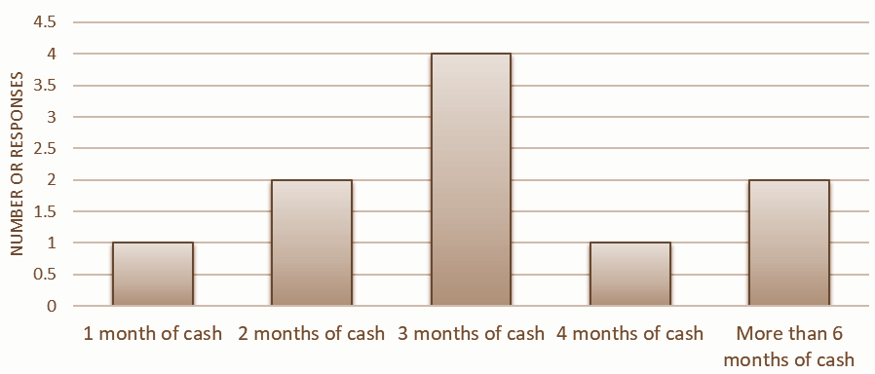
THE BOTTLENECK
Approximately how many months of cash in reserve does your organization have
Waiting periods for post-project grant reimbursements extend out anywhere from 31-90+ days.
?
Notes:
Our conversations with nonprofit groups and our initial survey results also show that grant reimbursements typically take months to come through
Meanwhile, 70% of the groups that responded to our scoping survey have only 3 months of cash in reserve or less.
To meet this gap, they must compete for limited philanthropic funding or resort to high-interest loans and credit. This negatively impacts their ability to realize benefits to society.

Slide 8
Forest & Water Renewal Fund
For healthier forests, watersheds, and communities
Accelerating Outcomes and Bridging Costs
Negotiating power, economies of scale
Capital Recycling - Multiplier effect
Notes:
We all know that investing strategically in forest and watershed health pays big returns in ecosystem services. We can further leverage this ROI by making the funding structure more sustainable…(bullets)

Slide 9
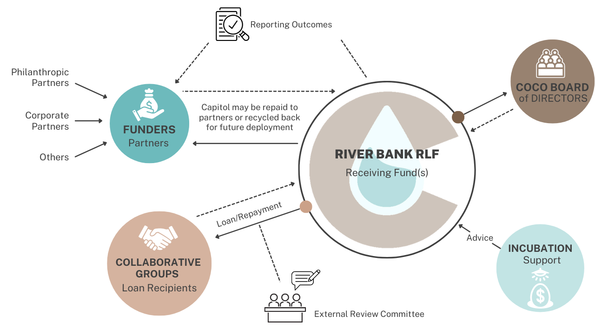
RiverBANK RLF: An Investment Multiplier
Notes:
Watershed and forest health organizations leading projects critical to the environment struggle with cash-in-reserve challenges and the timing of cash cycles under reimbursement-based grants.
A revolving fund that supplies bridge capital to place-based nonprofits at critical stages of project planning and development will help solve these challenges and move projects forward, while leveraging private capital to build forest and watershed health and address the risk of catastrophic wildfire.
We envision the RiverBANK RLF (placeholder name) to be a dependable resource to keep qualified and effective organizations up and running and on task through the ups and downs of state and federal funding.
COCO would manage this fund with oversight form our board of directors, advice/support from partners, and a mix of individual, corporate, and institutional donor supporters.

Slide 10
Feasibility Study/ Program Design
Need Assessment
Financial Tool - Model
Ultimate Payor & Borrower Analysis
Policy/Legal Feasibility Analysis
Program Design

Slide 11
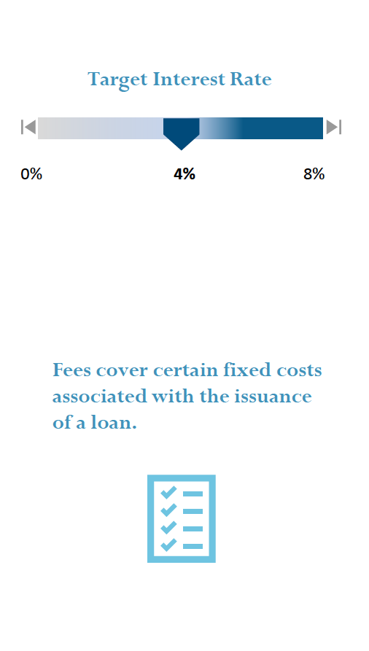
Notes:
A sample of case studies and surveys gathered reveal that revolving fund fees may
range anywhere between 1% to 3%

Slide 12
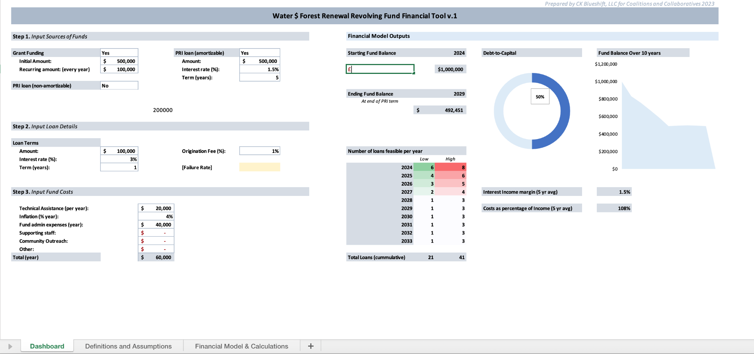
Notes:
The financial model central to our proposal is a revolving loan fund. The fund will be capitalized through an approximately 50/50 mix of 1) grant funding, and 2) Program-related Investment (PRI) and Mission-related Investment (MRI) funding. We have provided supporting documents attached to this application that include an initial financial model for this project. This financial model was developed by conservation finance experts at CK Blueshift working with the COCO team as part of the IFNF grant funded feasibility analysis for this project. Our baseline scenario is to maintain the pilot fund of $1 million with a $100,000 per year influx of grant funding. Our projected cost to run the fund is between $40,000 to $60,000 per year. We expect to provide bridge funding loans at an interest rate of 3%-4% for a period of up to 1 year to anywhere from 4 - 8 borrowers per year. Borrowers can take out back to back loans to fund larger and more expensive projects.

Slide 13
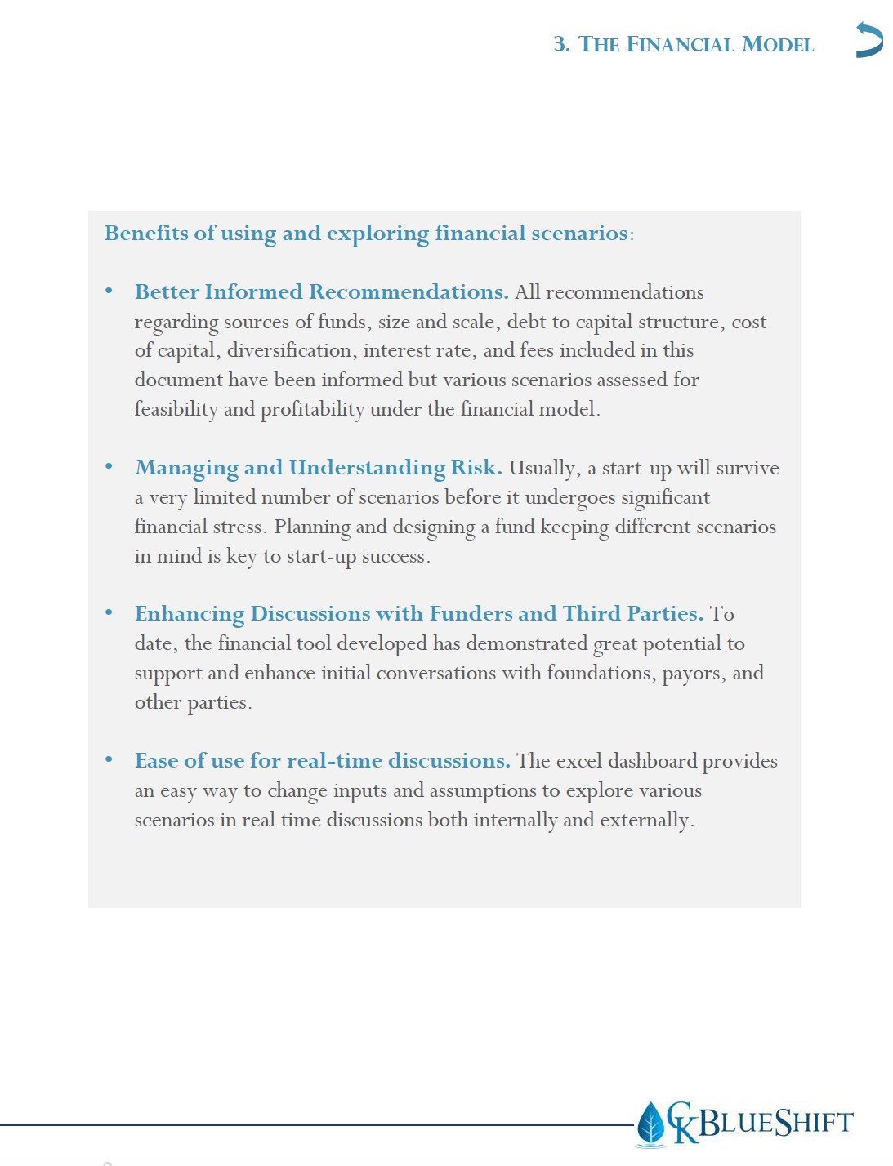

Slide 14
Risk Factors
Risk Factors and Mitigation: Although the risks and challenges associated with the implementation and operation of a revolving fund are expected
to be relatively limited, the following risks are inherent to operating revolving funds:
Insufficient Funding for Operations and Technical Support:
Creating an Initial and On-Going Project Pipeline.
High Initial Perceived Funding Risk.
Continuing Funder Interest
Project Contracting and Compliance Risk
Increased Competition
Challenges Related to Assessment of Outcomes:
Notes:
We all know that investing strategically in forest and watershed health pays big returns in ecosystem services. We can further leverage this ROI by making the funding structure more sustainable…(bullets)

Slide 15
Next Steps
National Porgram Design Trade-offs Survey of Potential Borrowers
Further exploring partnership opportunities ( BlueCommons, Legacy Works, First Southwest Community Fund, etc.)
Pilot Testing in Colorado
Notes:
We all know that investing strategically in forest and watershed health pays big returns in ecosystem services. We can further leverage this ROI by making the funding structure more sustainable…(bullets)

Slide 16
Questions?
Notes:
Our work is foundational
1.Help organizations achieve success
2.Develop resilient communities / landscapes
3.When disturbances occur support recovery
4.Develop out of the box solutions – think big, innovate, focus on the root causes and develop REAL SOLUTIONS NOT BAND AIDS. That is why we are meeting with you today - to learn more, to investigate the opportunities and act as a conduit to developing lasting solutions and tools.

