Slide 1
Conservation Finance
Conservation Finance Overview
Financing Wildfire Resilience (Session 3)
April 12, 2024
Peter W. Culp
Culp & Kelly, LLP -- CK Blueshift, LLC
Notes:
Basic intro on CKB

Slide 2
What is Conservation Finance?
A range of strategies that generate, manage, and deploy financial resources and align incentives to achieve conservation outcomes – sourced from public, philanthropic, private, and/or blended sources of capital.
Finance is different than funding.
Conservation finance solutions focus on developing and structuring the payments/funding available to achieve a particular environmental or conservation outcome – in order to resolve or reduce challenges with getting conservation work done.

Slide 3
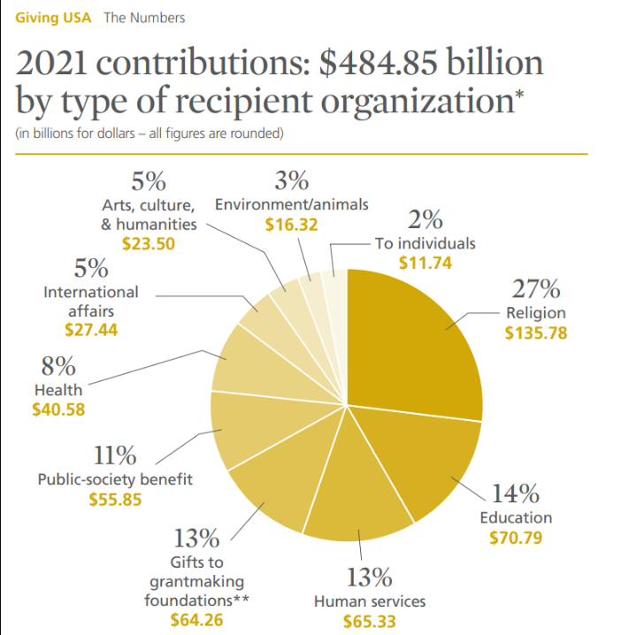
What is Conservation Finance?
What are we solving for?
The conservation sector faces an ongoing lack of adequate, sustainable, and scalable funding.
Public funding for conservation and for-profit investment leaves many gaps that have traditionally been filled by philanthropy – but those funds can only go so far.
Conservation finance is intended to open up new ways to fund conservation, more stable and sustainable sources of funding, magnify the impacts of limited philanthropic and public resources, and create economic incentives that promote conservation outcomes.

Slide 4
Conservation Finance Models
Conservation-oriented real asset investments
Timber, farm, ranch investments; mitigation lands; facilitating conservation purchases; leveraging easements
Environmental credit markets
Market-like transactions that enable payment for environmental assets/outcomes, externalities, or attributes
Commodity/supply chain improvements
Engaging up and down the supply chain to improve practices and achieve better outcomes
Cost savings and risk reduction
Insurance models, green infrastructure/green bonds, outcomes-based or pay for success (or repay for success) models
New or leveraged funding
Creative approaches to philanthropy, extending the reach of public funds, providing bridge loans or revolving funding, assessing damages
Impact Investment
Investment made with intention to generate social and environmental impact alongside financial returns, including private equity and program-related investments
Blended capital
Combining different capital sources to achieve objectives – e.g. combinations of grants, program-related investments, debt, equity investment
Other tools
Certification programs that drive behavioral changes; tax incentives; surcharges; regulatory or reporting requirements; others
An excellent learning resource:
The Conservation Finance Network
www.conservationfinancenetwork.org

Slide 5
A range of complexity
COMPLEX
Impact investments, ecosystem service markets, green bonds, mitigation banking, utility charges, regulatory mandates, NRD, tax credits
HARDER
Business partnerships (e.g. voluntary surcharges, sustainable products marketing), corporate social responsibility and ESG funding, bridge financing/ borrowing
Simple
Public or private grants and donations, earned income, tax deductions, conservation buyers

Slide 6
Key funding challenges in forests, fire, and water
Finance solutions need to start in the places where the greatest difficulties lie. Some key challenges that we’ll discuss today:
Public funding is frequently available primarily on a reimbursement basis
Unrestricted or less-restricted funding is scarce, leaving hard-to-fund but essential activities uncovered
Match requirements and disconnected funding cycles can delay projects and limit scale
Limited funding for projects on private lands
Limited funding for science/outcomes monitoring, despite demand for metrics and reporting
Limited funding to support collaboration between project partners/shared stewardship,
Limited funding for project planning and design needed to build project pipelines, plan bigger and longer, and meet thresholds for public funding.
Meeting some of these challenges will require looking towards more complex financing solutions.

Slide 7
Emerging Examples and Opportunities
Water/Watershed Funds | Cost-Sharing | Revolving Funds | Four Case Studies
Organized efforts that bring together public, private, nonprofit, other stakeholders under a single umbrella, contributing to a watershed-wide fund that can support a range of conservation activities for mutual benefit. | Restoration cost sharing can be developed among multiple partners with closely aligned interests – e.g. forest management agencies, utilities, NGOs, and business interests – to fund the full cycle of restoration work. | Revolving funds can be composed of single-source, multiple-source, or blended capital, and seek to cycle and recycle capital into a series of projects via low-to-no-interest loans, performance contracts, and other kinds of financing. | Presenters today will describe four creative solutions they came up with to navigate through their available funding streams and achieve forest restoration outcomes.

Slide 8
A few observations
Only a few are currently finding places to deploy capital; many are unwilling to risk time, energy, and resources in developing new models.
Bridging this gap will require more creative, deeper, and sustained engagement between funders, project developers, and conservation finance organizations.
Partnerships will be key.
Getting conservation finance done can require substantial organizational capacity.
The capacities to source, design, and develop projects, raise and manage funding, and monitor outcomes will rarely exist in a single organization.
In most cases this work is better achieved through partnerships between on-the-ground partners, funders, and financing entities.
There is far more funder interest in conservation finance than actual investment in it.
Many foundations are interested in PRIs, blended finance, and new ways to leverage public funding.
Many corporate interests are looking for opportunities to meet ESG goals and invest in reputation-building projects.
Many investors are seeking to deploy impact-oriented capital that achieves investment returns.
Many public agencies are looking to NGOs and local partners to fill ongoing gaps – gaps which prevent the deployment of public funding, limit participation in their programs, or inhibit the use of new models and approaches.

