Slide 1
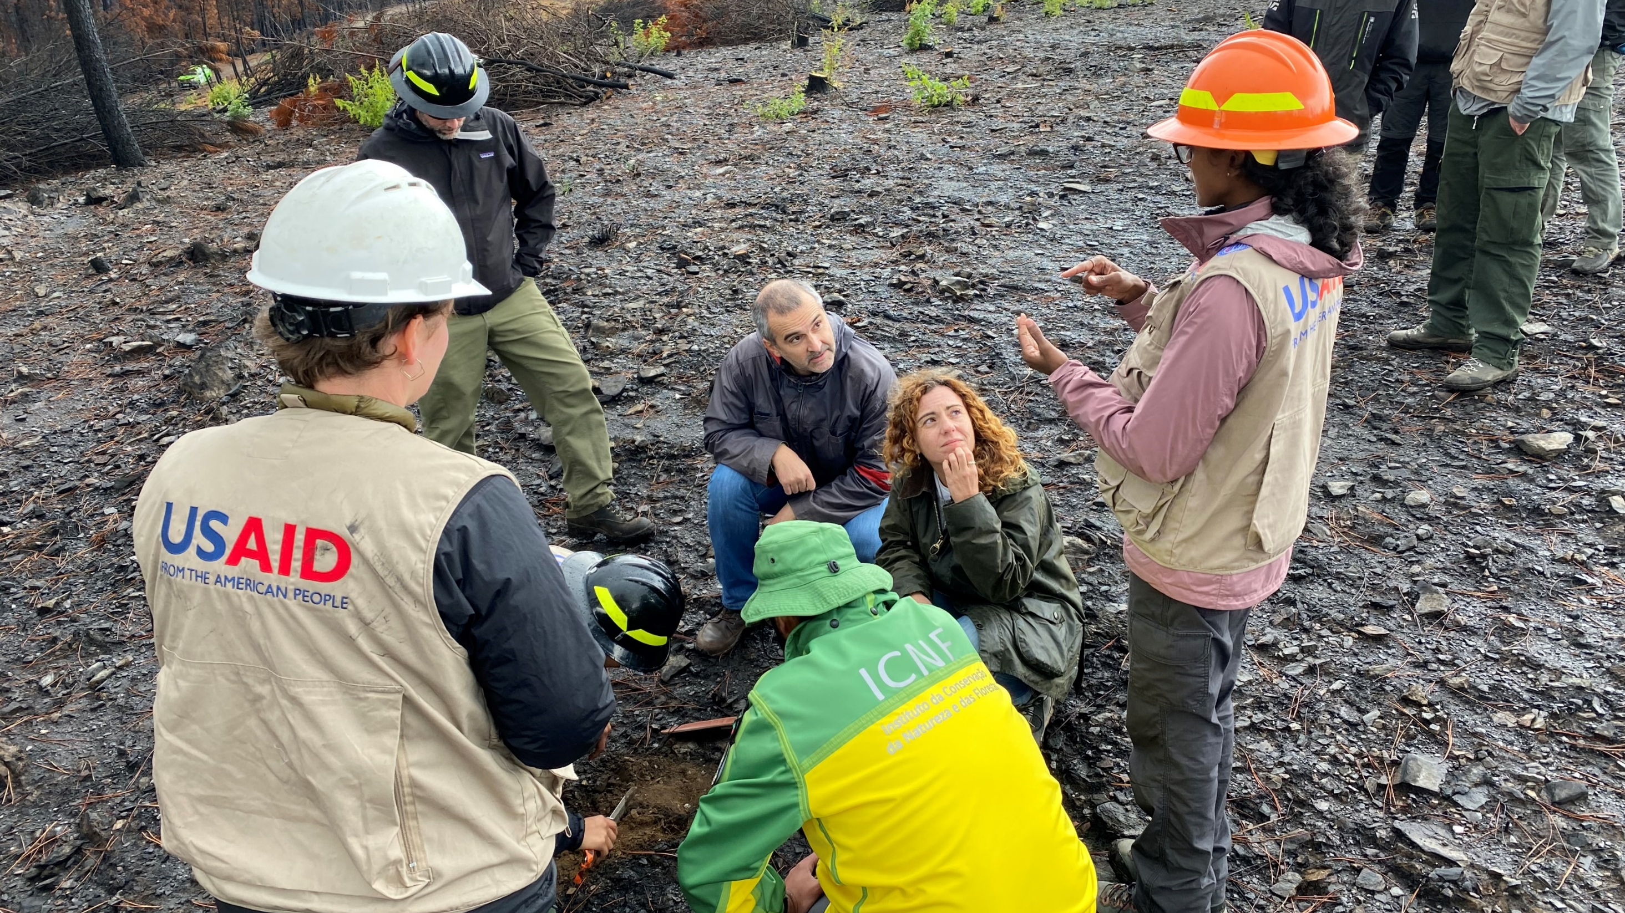
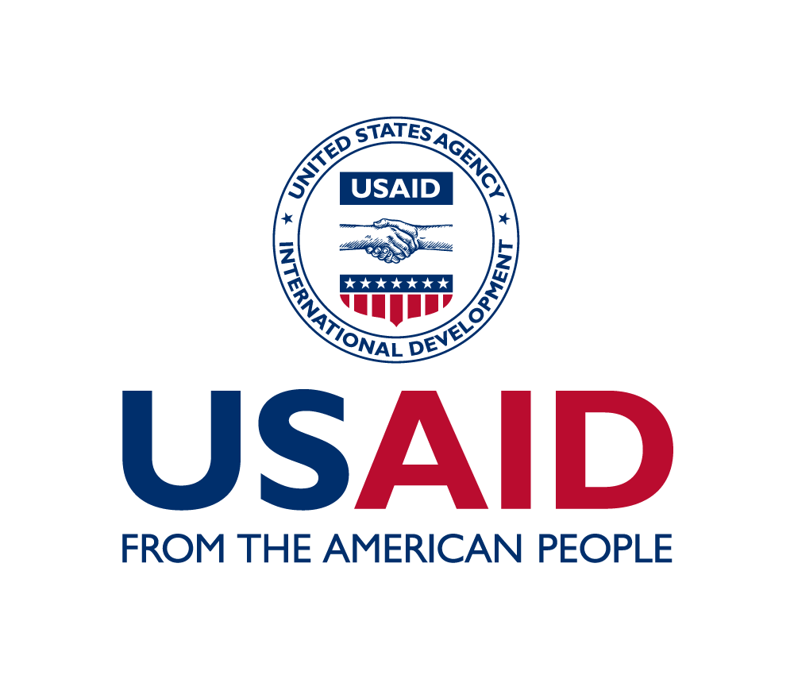
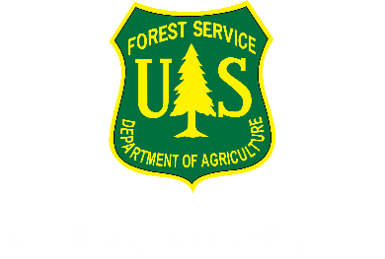
International Collaboration
Leading the world, remaining curious, still learning

Slide 2
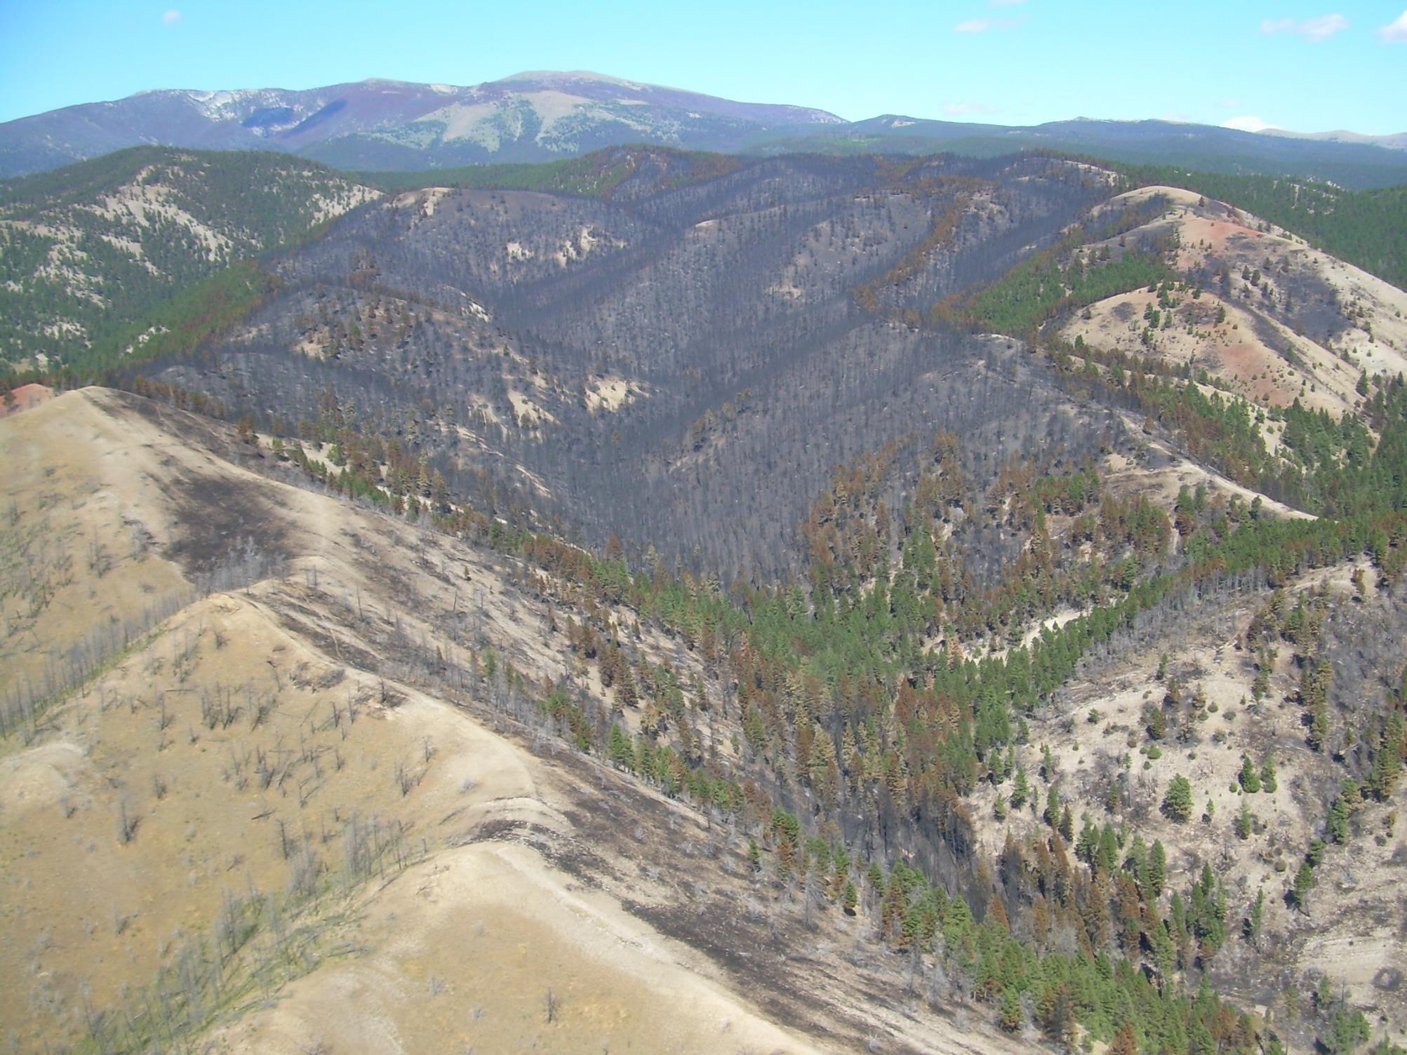
Repair
Emergency Response
Restoration and Recovery
Rehabilitation

Slide 3
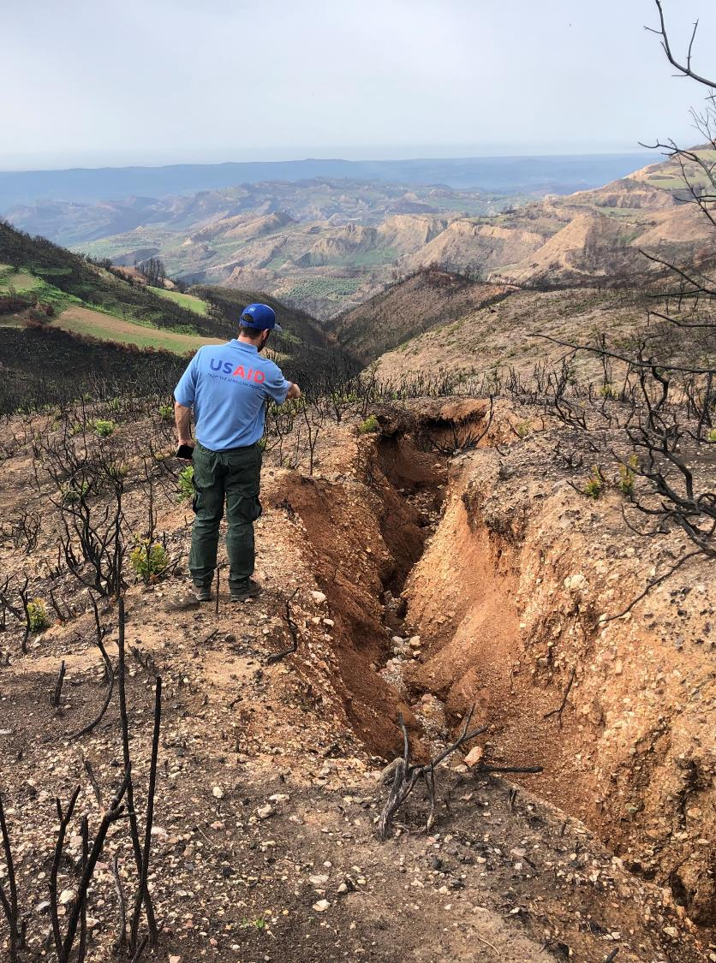
Risk Management
Identify critical values
Assess for threats
Evaluate risk
Develop response strategy
Implement the strategy
Notes:
BAER is a 5 step process. We will go through each of these steps.
BAER teams are staffed by specially trained professionals who rapidly assess the burned area and determine appropriate response actions. Rapid Assessment!! Program objective is to manage risk. Assessment is the means to get to the goal, not the goal itself.
The BAER process starts with identification of critical BAER values. If critical BAER values exist within the fire area next step is to identify post-fire threats to those values and determine the risk. If critical values are found to be at an unacceptable risk , a response strategy is then developed and implemented.

Slide 4
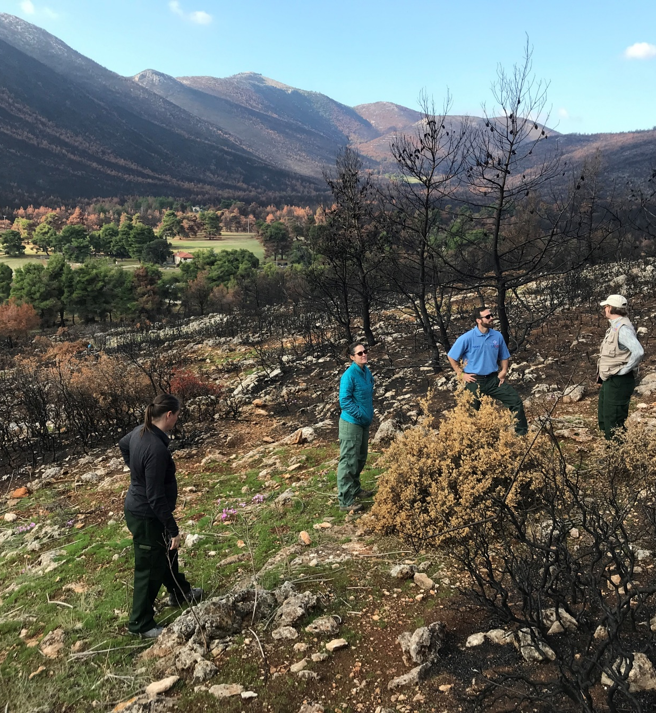
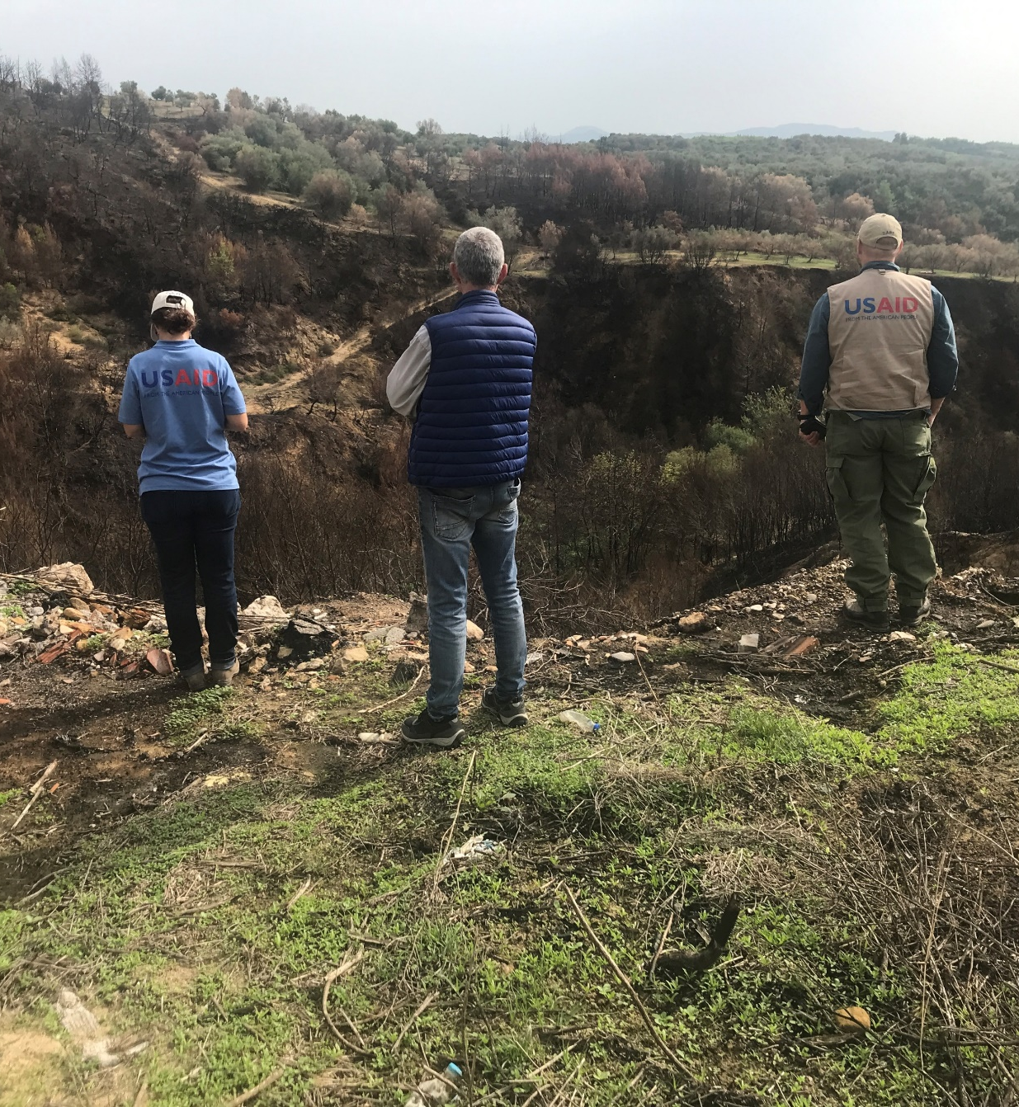

Slide 5
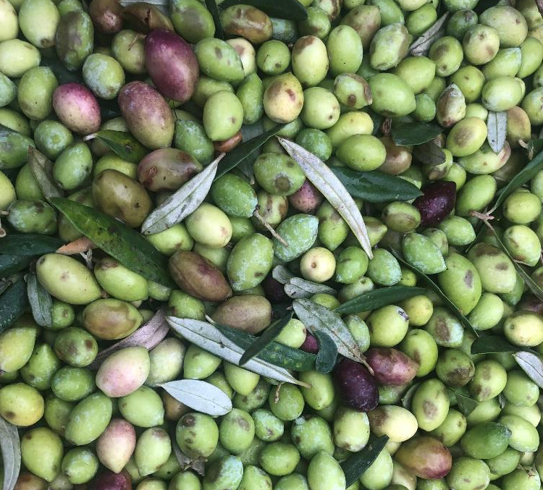
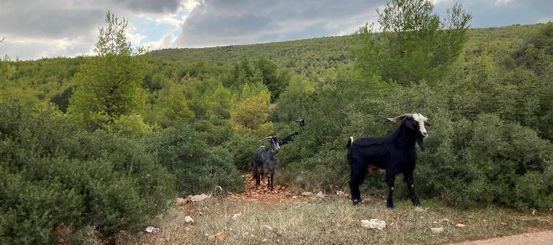
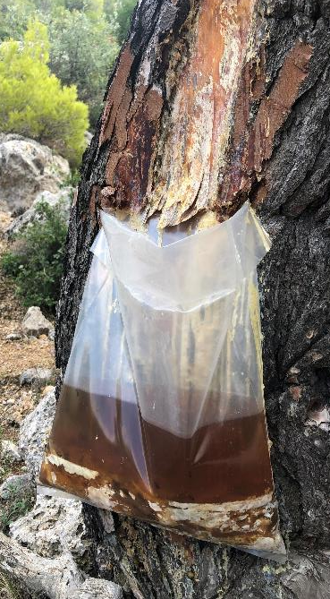
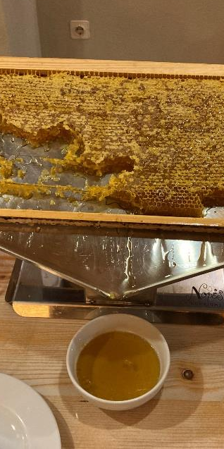
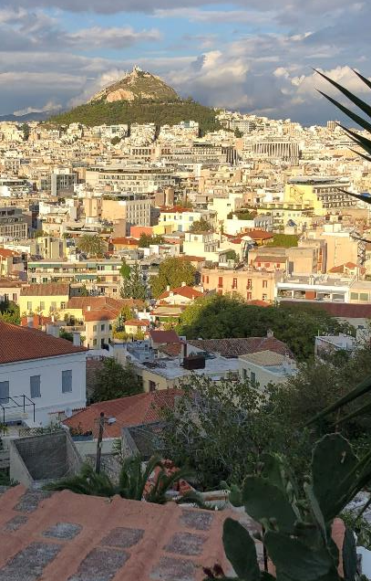
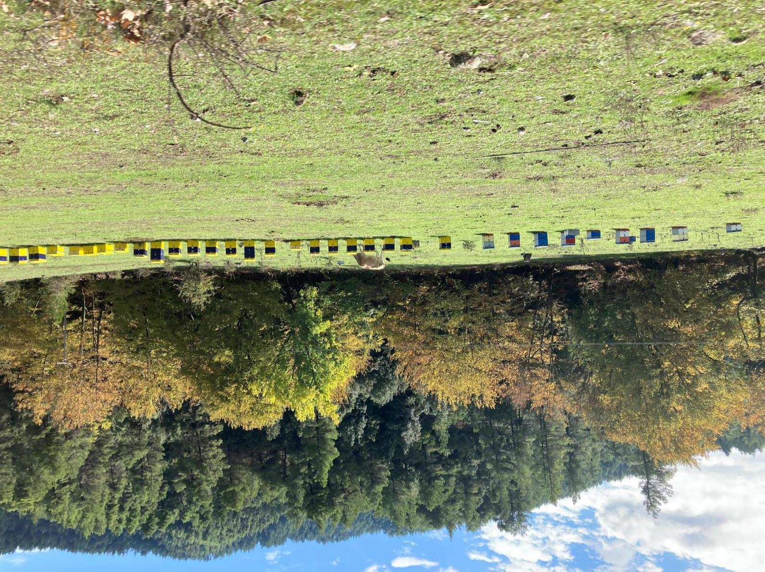
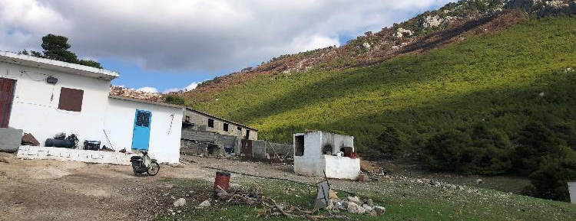

Slide 6
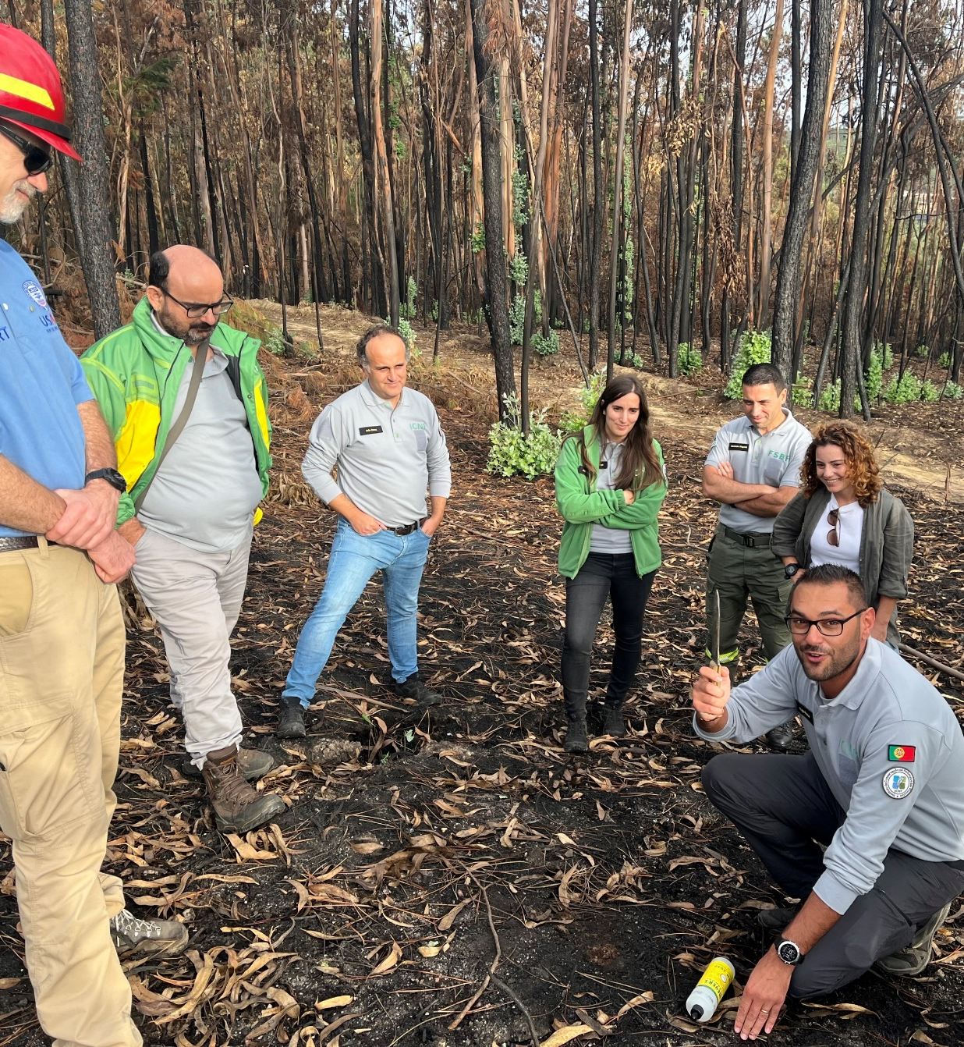
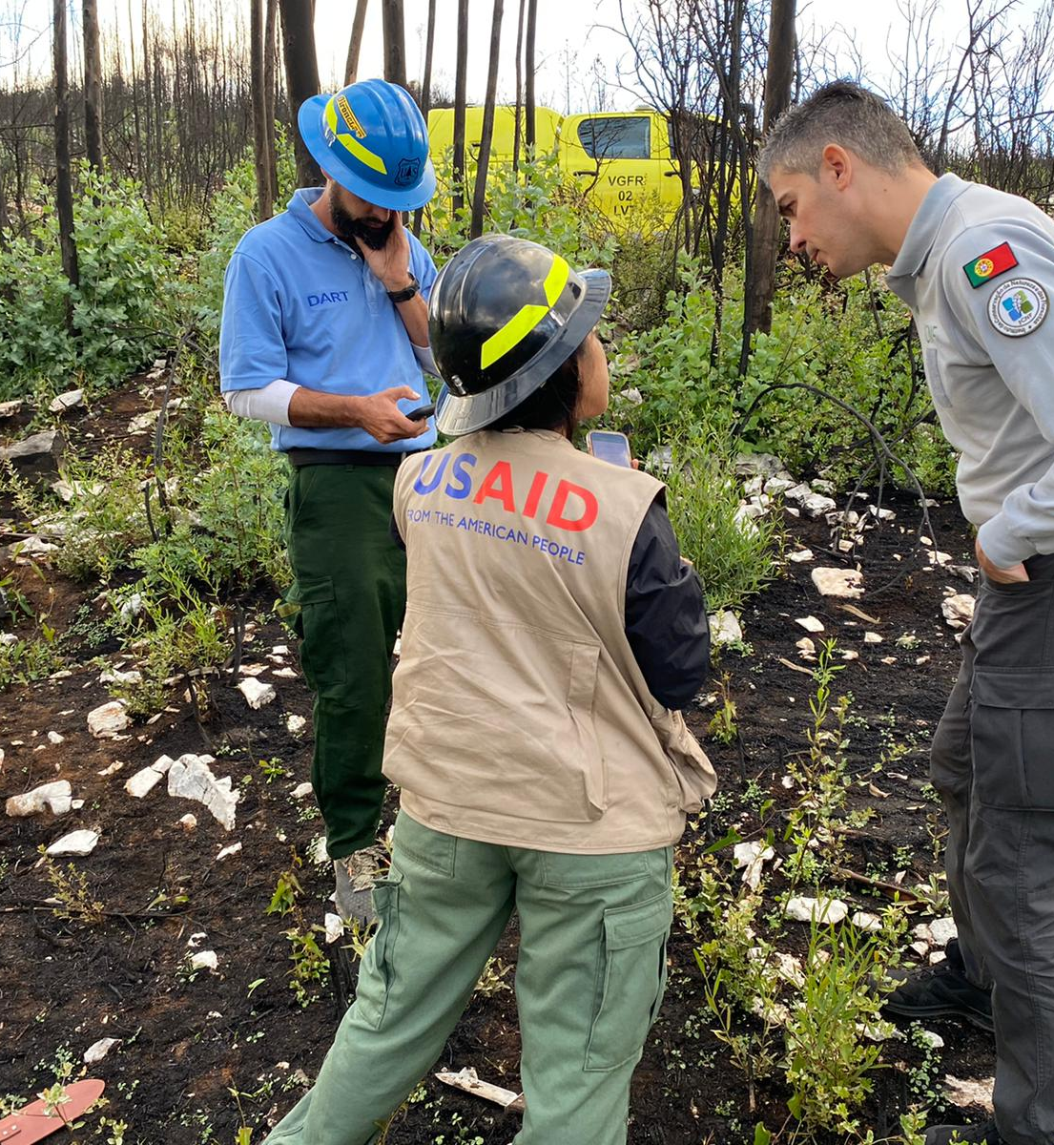

Slide 7
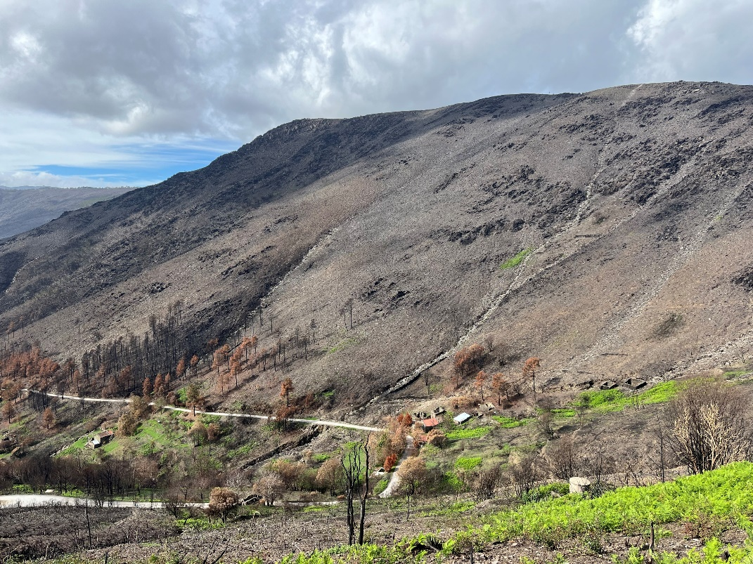
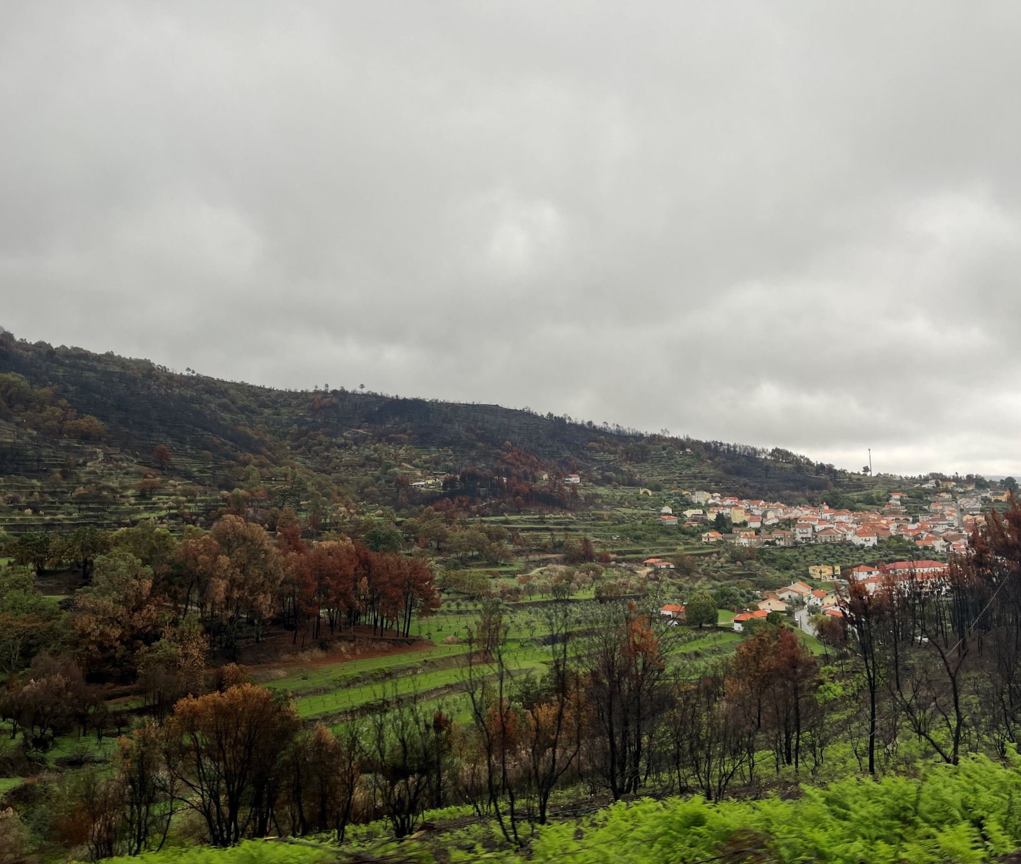
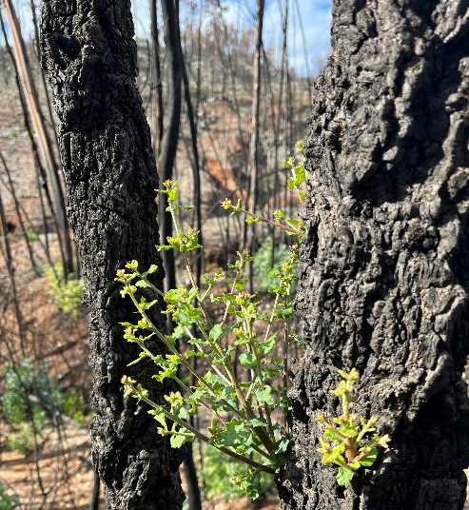
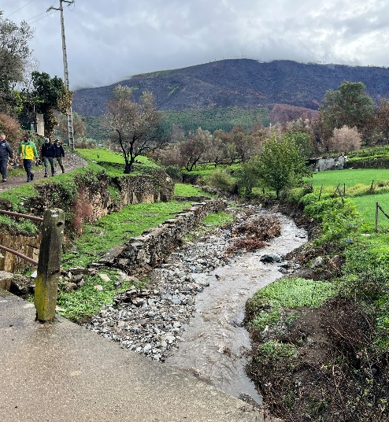

Slide 8
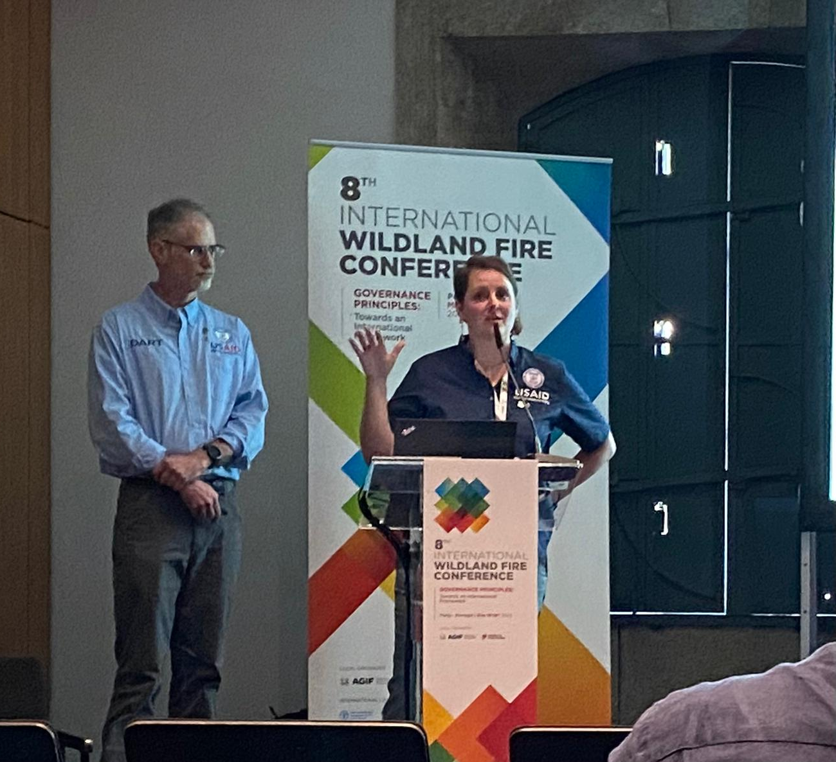
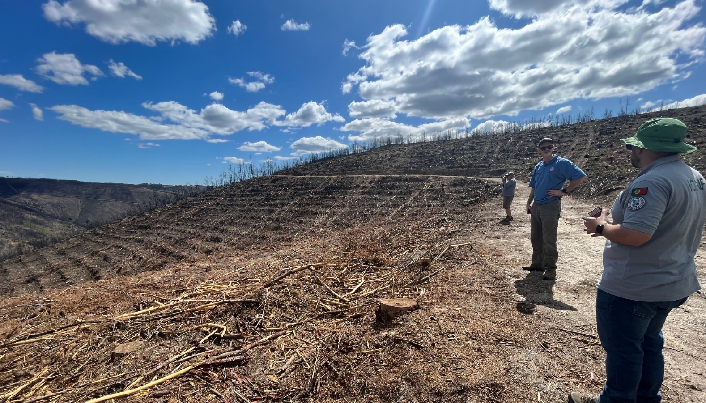
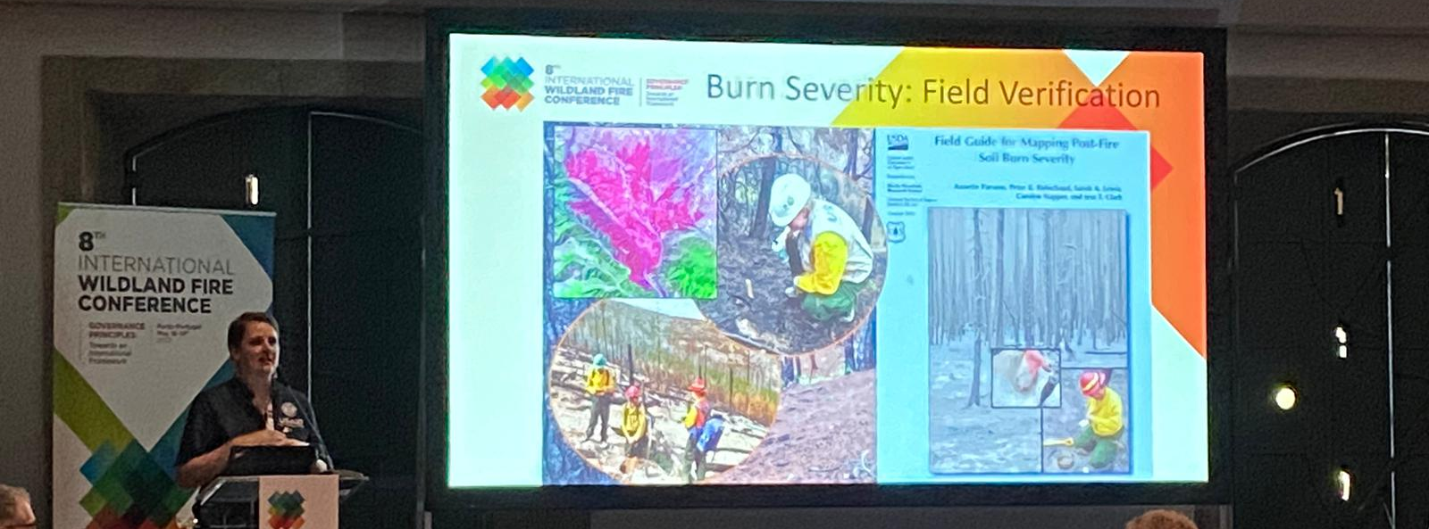

Slide 9
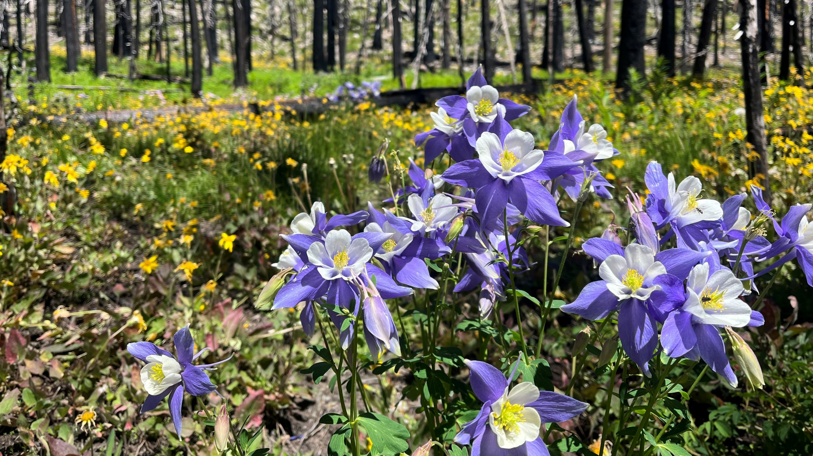
US Forest Service Collaboration
(without USAID)

Slide 10
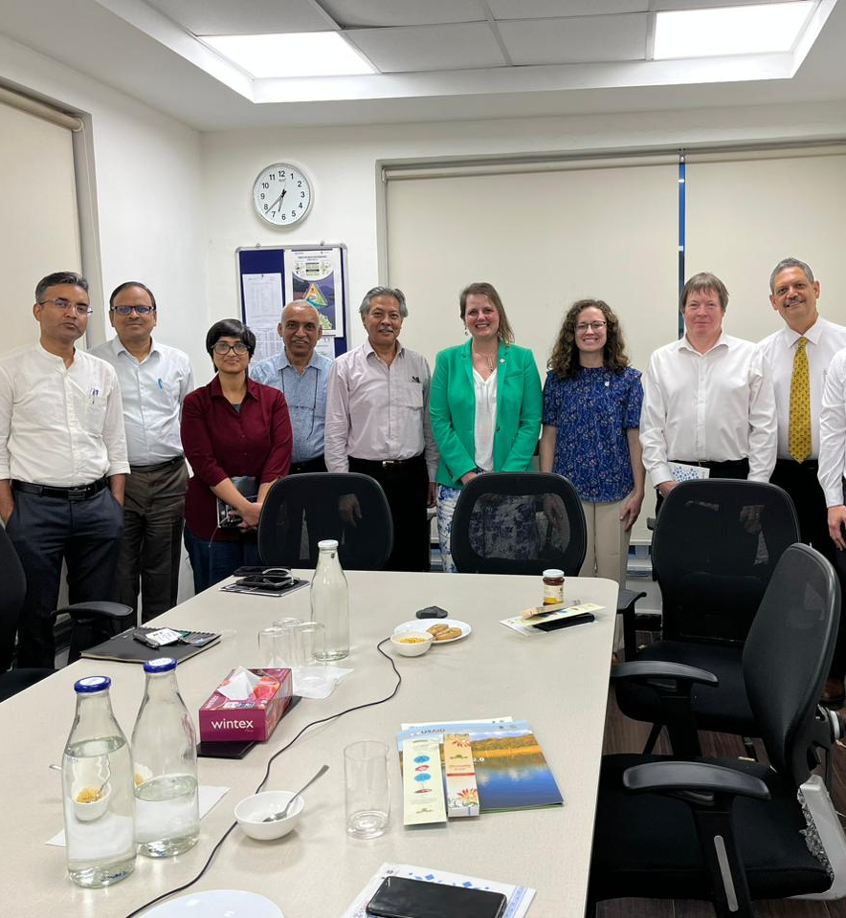
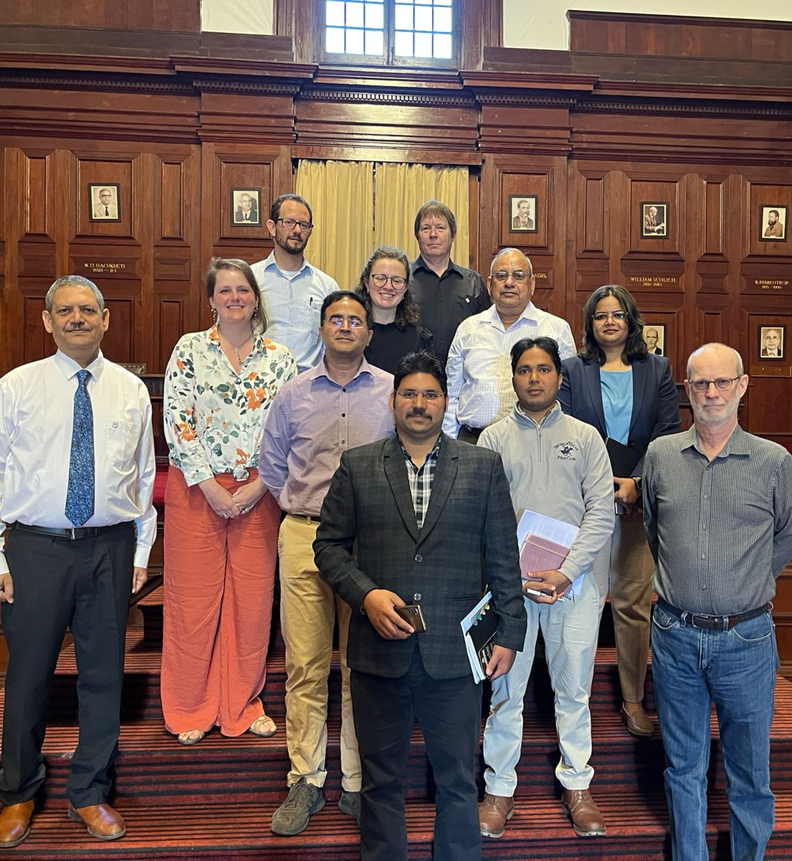

Slide 11
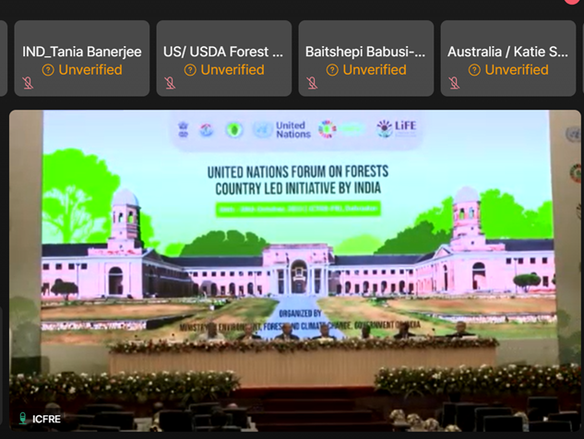
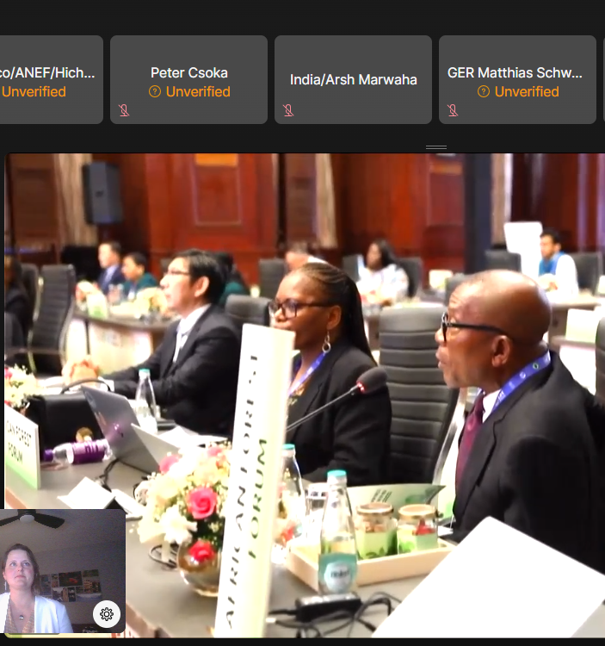
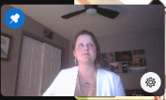

Slide 12
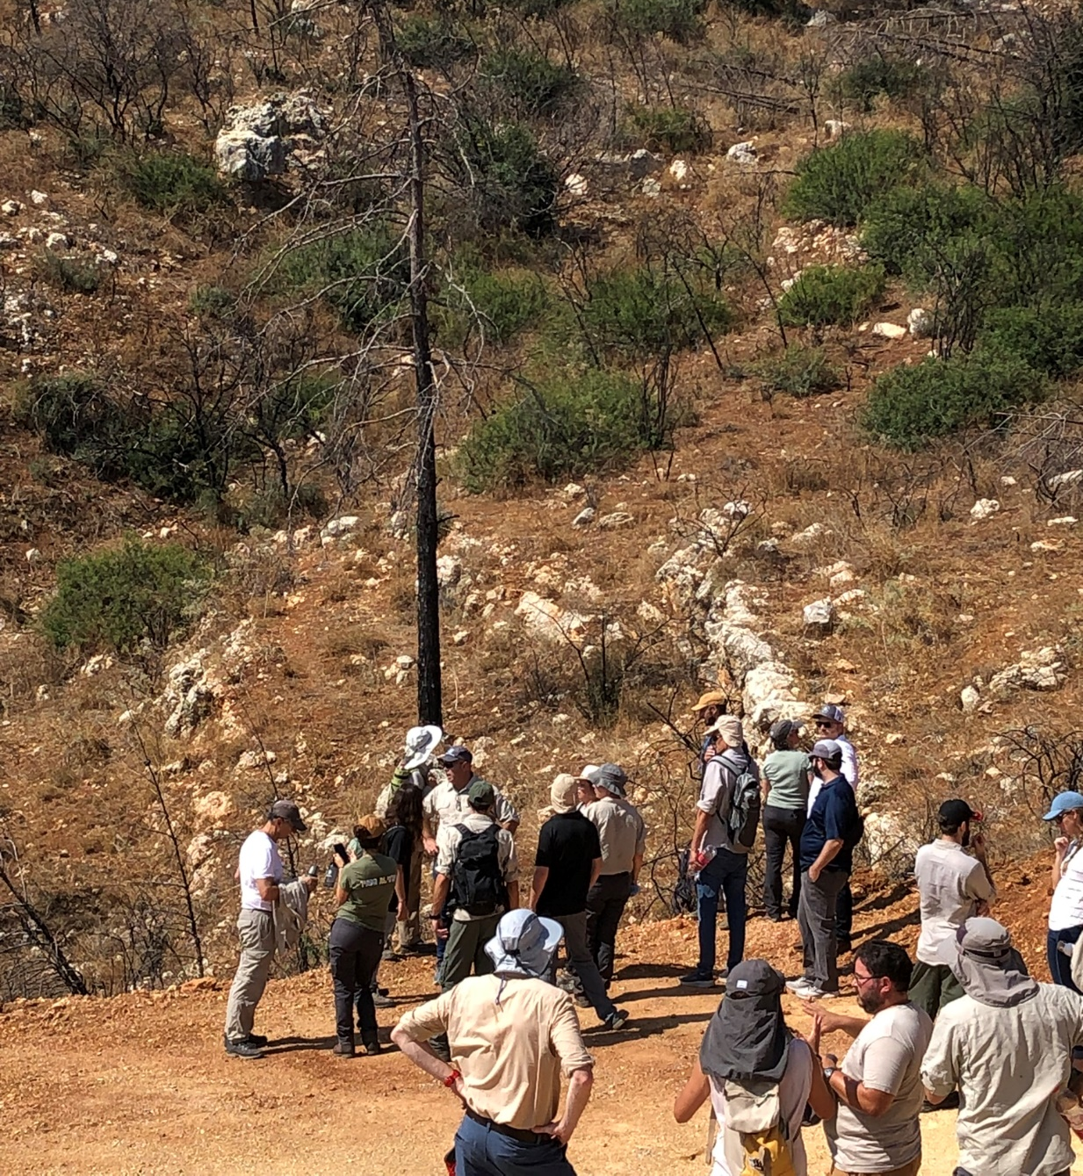
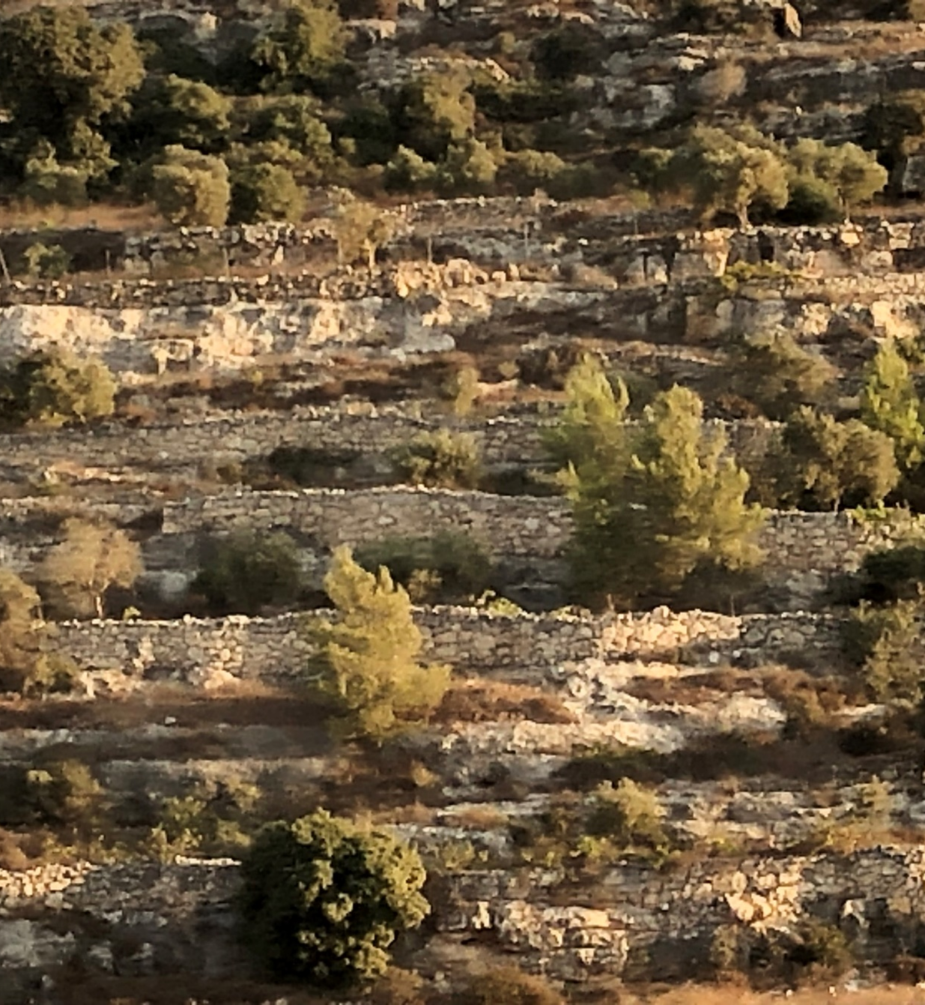

Slide 13
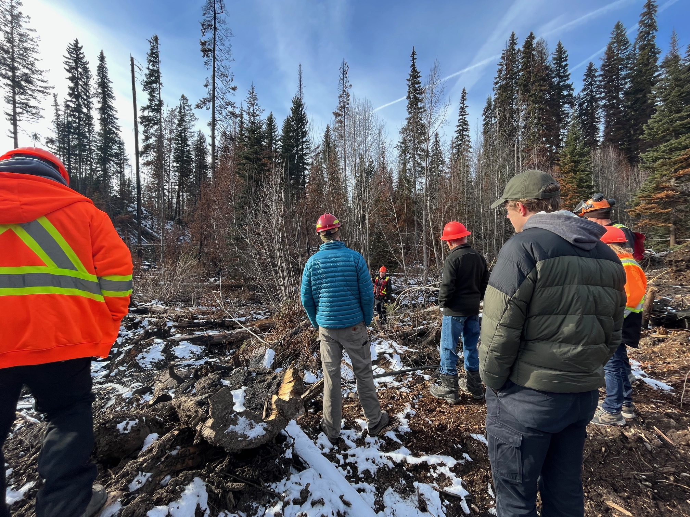
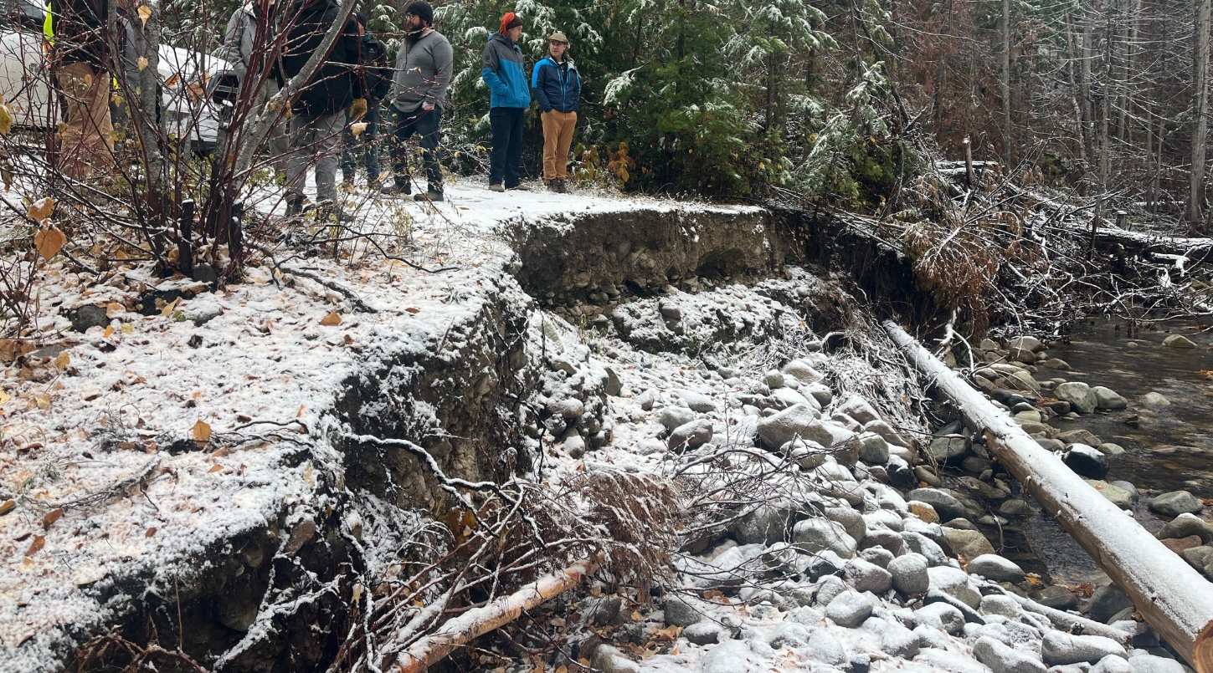
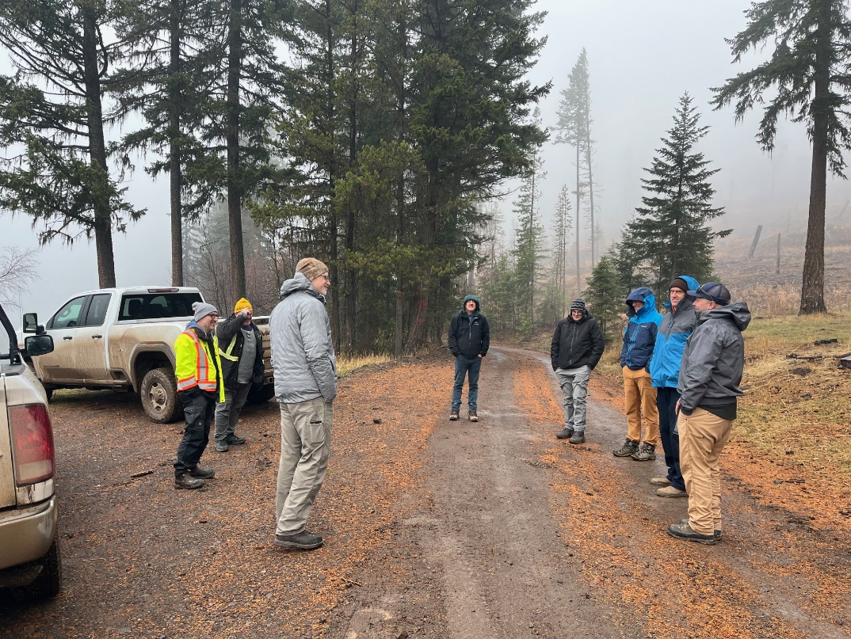

Slide 14
WILDFIRE LAND-BASED RECOVERY IN BRITISH COLUMBIA
APRIL 2024
Notes:
summary of bc wildfire - history
last year worst fire year
drought coniditons
Why the recovery team came about
leading the program
here's the things we're doing
examples oF the colab with globe
juridictional scan
Rikki:
started colab with USFS and USAG
examples: came in nov field tours
this week - scientists came up, put on workshop with recovery and geomorphologists
First Nations - colaborating on recovery plans (OKIB), mushroom permit, cutural/prescribed fire (sarah budd)
Colab w/ project Heather Fuer and Jessica Mack - communities ready for response, indigenous crews.
Agreements > find canned presenations

Slide 15
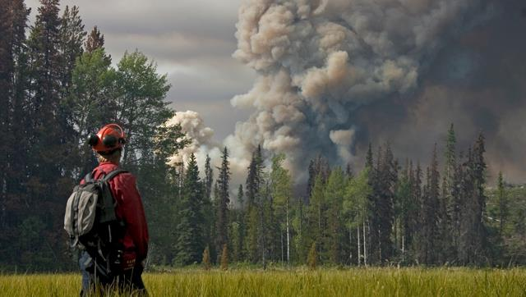
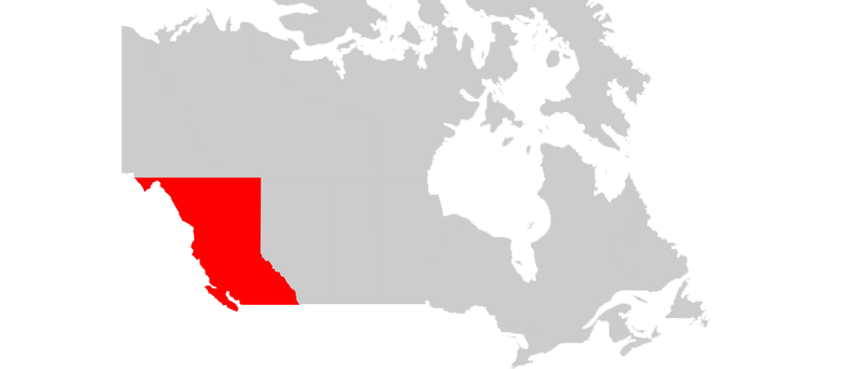
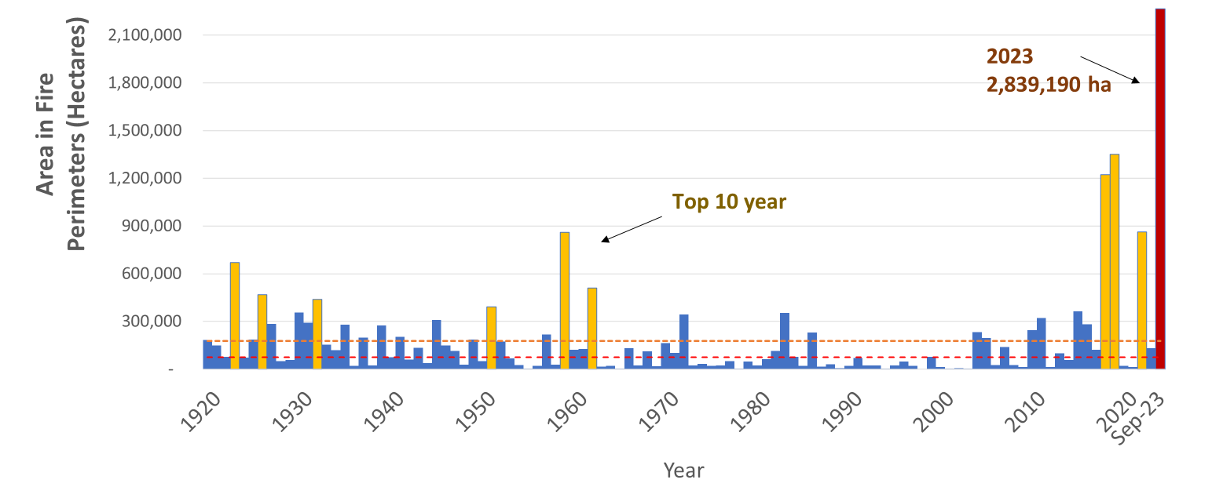
Wildfire in
British Columbia
Diverse topography and longer fire seasons
Past 8 years have seen some of the largest impacts
2023 most destructive fire season in B.C.’s history
Notes:
Setting the stage with an overview of wildfire in BC….
Wildfire has always been present in the province. However, in the last 8 years we’ve experienced some of the worst fire seasons in history.

Slide 16
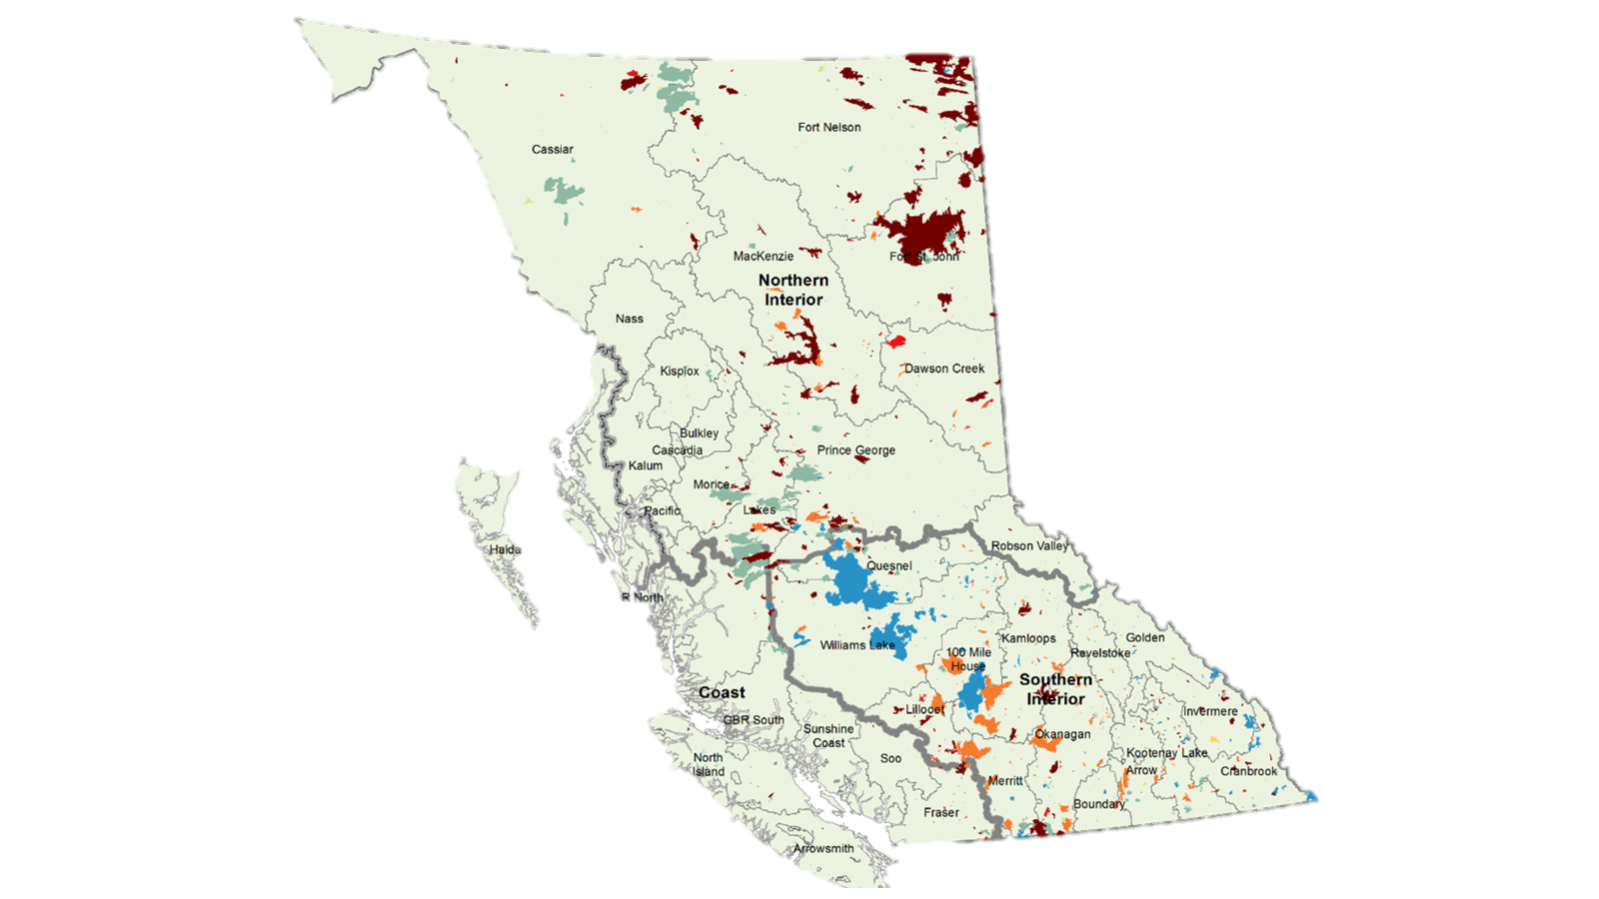
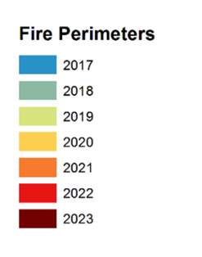
2023 Wildfire Season
2.84 M
Hectares burned
619,000 hectares
Donnie Creek Wildfire
Impacts to cultural values, ecological values, infrastructure and local economies
Notes:
The 2023 wildfire season was the most destructive in British Columbia’s recorded history:
More than 2.84 million hectares of forest and landed burned. This is about the size of the whole of Hawaii.
Tens of thousands of people forced to evacuate
Hundreds of homes and structures lost or damaged
Impacts to cultural values, ecological values, infrastructure and local economies
Indirect economic impacts to agriculture, tourism and other weather-dependent businesses
Unquantifiable impacts to people’s health and wellbeing
The tragic loss of 6 members of BC's wildland firefighting community

Slide 17
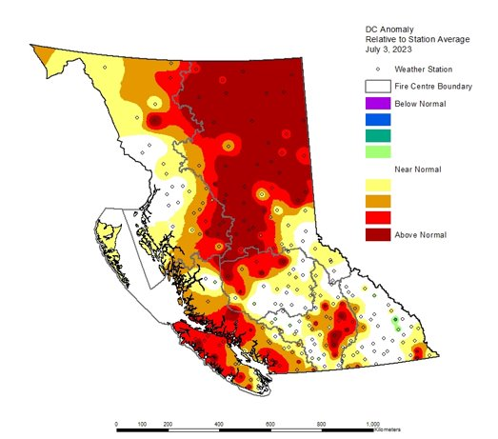
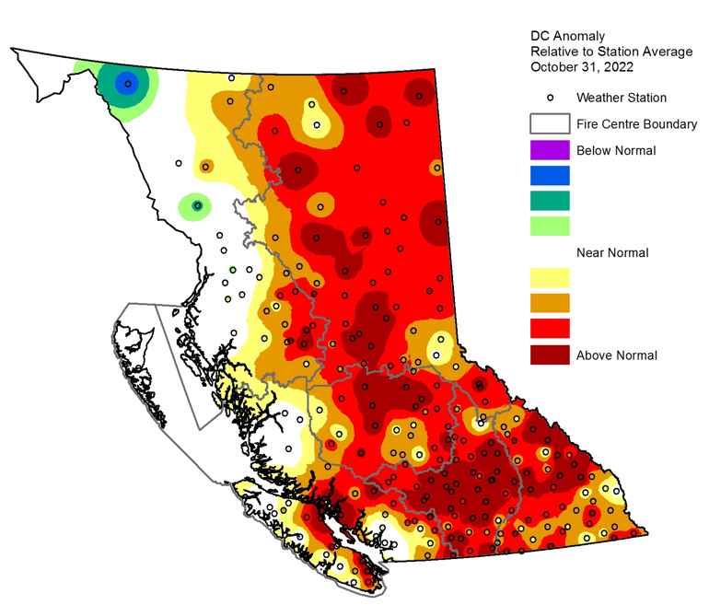
Drought conditions continue into 2024
“Triple-dip” La Niña conditions and climate change have contributed to drier and hotter summers. These conditions have resulted in extended wildfire seasons in recent years.
Drought Code Anomaly
October 31st, 2022
Drought Code (DC) Anomaly – July 3, 2023
Notes:
British Columbia experienced one of the warmest and driest Octobers in 2022.
Daytime highs were consistently four to 10 degrees above normal and there was very limited precipitation for what is typically a cool and wet month.
Due to the limited moisture, drought conditions in the forests were much higher than normal.
The elevated drought codes carried over into spring 2023 and set the stage for a potentially active fire season.
By October, the majority of the province had not recovered, carrying high to extreme drought code values into Spring 2024. Drought conditions could improve in 2024 if June brings semi-continuous, widespread precipitation. However, meteorologists are doubtful that BC will see sufficient rainfall in June 2024 to complete alleviate persistent drought conditions.

Slide 18
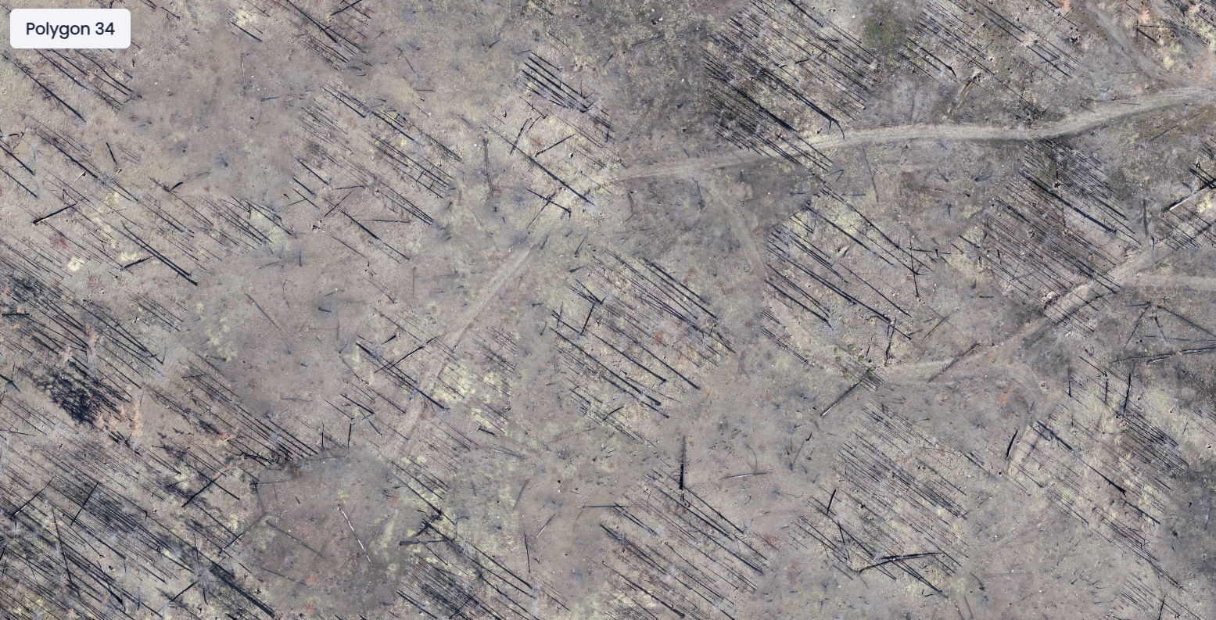
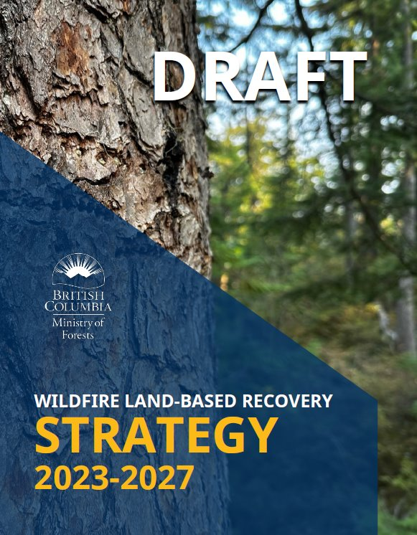
Looking Beyond Response
Wildfire Land-Based Recovery is a phase of emergency management in which steps are taken to repair the land-base affected by a wildfire itself and wildfire suppression activities
Notes:
The 2018 and 2021 fire seasons also had significant impacts to communities around B.C.
Using the Elephant Hill report as guidance, The Ministry of Forests recognized the need to develop a strategy and framework for wildfire land-based recovery
Recovery is one of the 4 pillars of emergency management
Wildfire Land-Based Recovery was established in BC Wildfire in 2023 in the context of post-wildfire landscape management.
Land-based recovery helps to reduce losses associated with fires by expediting the recovery of the landscape while improving resiliency, reducing vulnerability, and mitigating future negative impacts

Slide 19
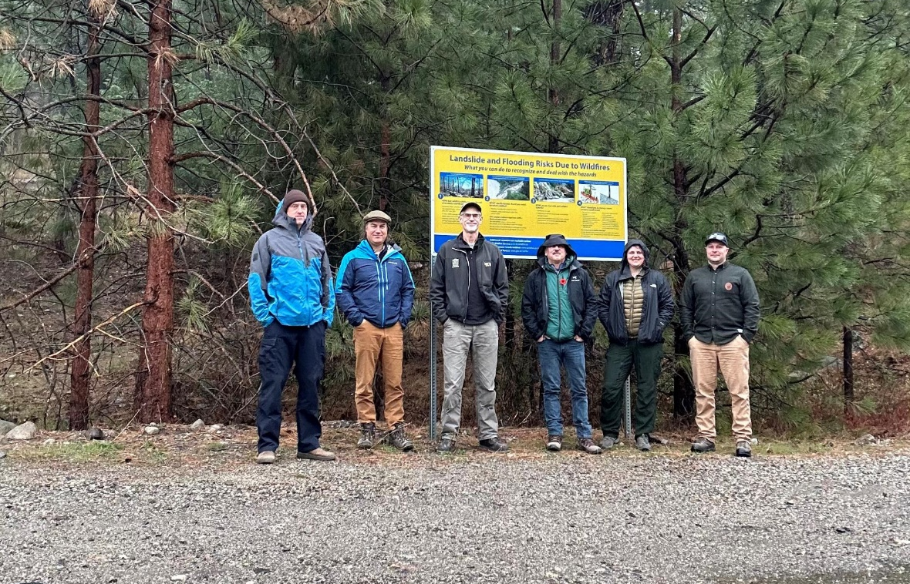
Where we’re at
Growth
Set up the foundations for the new wildfire land-based recovery program within the BC Wildfire Service
Implementation
Establish framework for implementing the wildfire land-based recovery strategy and framework
Guidance
Provide guidance for land managers when rehabilitating and recovering crown land following catastrophic wildfires

Slide 20
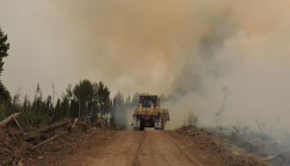
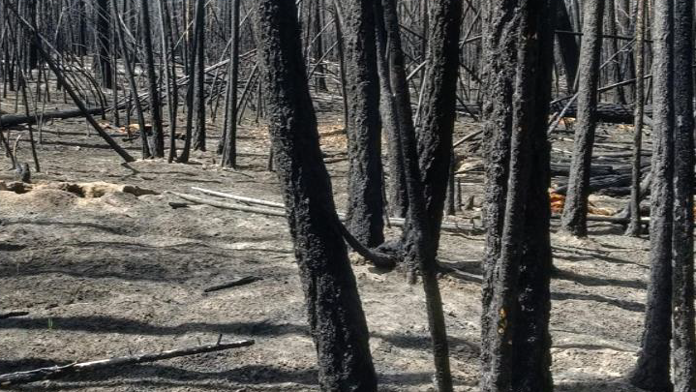
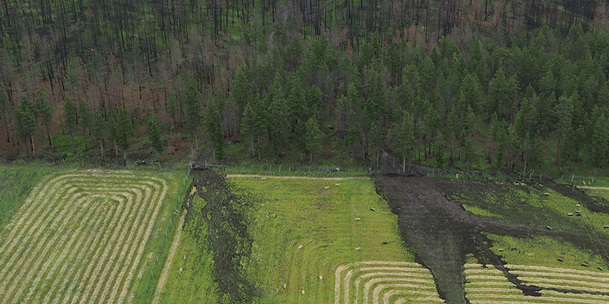
WLBR Program Areas
Wildfire Suppression Rehabilitation
Starts soon after disturbances to the land occur due to fire suppression activities (fireguards, for example).
Post Wildfire Natural Hazard Risk Analysis
Assesses the risk for natural hazards after a wildfire.
Ecological Wildfire Recovery
Suite of actions undertaken to assess, recuperate, restore, reclaim, and/or salvage landscape values that have been disturbed by a wildfire.
Notes:
Wildfire land-based recovery has three business areas
The first being Wildfire Suppression Rehabilitation – this starts soon after the land disturbances caused by wildfire suppression activities occur. A common example of this is rehabbing fire guards.
Of the 5,132.77 kms of fire guard built in the 2023 season, approximately 1,207.13 kms has been rehabilitated. Nine of 15 wildfire suppression rehabilitation project plans have been completed
The second project area is Post wildfire natural hazard risk analysis. We work with professional geomorphologists to assess whether wildfire impacts increase the likelihood of another natural hazard, such as a landslide. The reports are shared with local governments and First Nations to make land management decisions.
Last but not least, Ecological Wildfire Recovery, which is a suite of actions undertaken to assess, recuperate, restore, reclaim and/or salvage landscape values that have been disturbed by a wildfire.

Slide 21
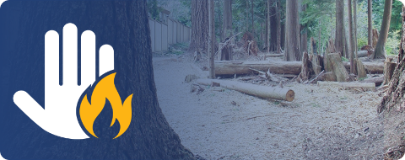
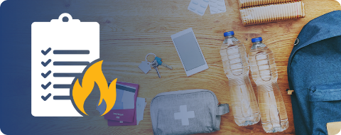
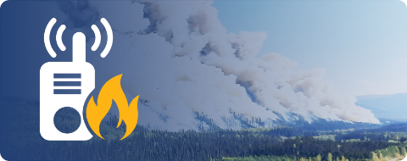

A National & Provincial Perspective
A National Focus – BC is looked at leaders nationally in post-fire management
Government – Canadian Forest Service, Provincial Ministries, Local Governments, Municipalities
Industry and Stakeholders – Forest Sector, Energy Sector, Tourism, Farming & Ranching
First Nations – 204 First Nations, Overlapping Territories, New Legal Frameworks
NGO’s – Invasive Species BC, Habitat Conservation Trust Fund, FESBC
PREVENTION
PREPAREDNESS
EMERGENCY RESPONSE
RESPONSE
RECOVERY
Notes:
In 2023, we contracted an experienced forester to conduct an international jurisdictional scan of ecological recovery.

Slide 22
An International Perspective
International jurisdictional scan looking at post-wildfire programs (4 in Australia, and 2 in the U.S.)
Close collaboration with the US Forest Service and US Geological Survey looking at all aspects of post-wildfire recovery
Notes:
In 2023, we contracted an experienced forester to conduct an international jurisdictional scan of ecological recovery.

Slide 23

Taking a “Values Approach”
Wildfire Land-Based Recovery may address any or all the following values and issues (*denotes a FRPA Resource Value):
Access Management
Biodiversity*
Cultural Heritage / Archaeology*
Fish / Riparian*
Forage & Associated Plant
Communities*
Hydrology
Invasive Species Management
Recreation *
Public Safety
Resource Features*
Soils*
Terrain Stability
Timber*
Visual Quality
Water Quality*
Wildlife*
Climate Change
Other values as identified
Notes:
The non-starred values came from years of district level wildfire recovery discussions with program leads and First Nations.
We take into consideration a number of values when prescribing treatments or funding projects. This set of values was developed in collaboration with First Nations.
Plans consider societal and cultural values with the intent to foster reconciliation with and increase the involvement in forest management of First Nations.
Management of the values are completed through a zonation process where potential conflict between values can be managed and objectives for the zones are identified.

Slide 24



Restoring values for long-term resilience
There are many techniques to help landscapes recover from wildfires, from repairing damaged infrastructure to improving the resiliency of forests so they’re better able to withstand future disasters
Notes:
There are many techniques to help landscapes recover from wildfires, from repairing damaged infrastructure to improving the resiliency of forests so they’re better able to withstand future disasters.
On the left is an example of recontouring which helps stabilize soils
On the right shows stream and natural drainage restoration
The bottom image is an example of timber salvage. Following a wildfire, it’s important to harvest marketable timber in the affected area before the quality of the wood deteriorates.

Slide 25

Collaboration is key
In addition to the Ministry, wildfire land-based recovery work is carried out by local governments, First Nations, industry, stakeholders, and other organizations throughout the province
Notes:
In addition to the provincial government, wildfire land-based recovery work is carried out by local governments, First Nations, industry, stakeholders, and other organizations throughout the province.

Slide 26

Shared learning with the US Forest Service
Enhancing the understanding of the unique challenges faced in different regions
Notes:
We’re also collaborating with the US Forest Service’s National Post-Fire Program to build a shared understanding of post-wildfire recovery.
The Wildfire Land-Based Recovery (WLBR) team recently hosted the Lead and Deputy Lead of the US Forest Service National Post-Fire Program. Over 3 days, we shared information about our programs, visited a variety of field sites to review suppression rehabilitiation, natural hazard risk analysis and ecological recovery, and laid the foundation for a deeper understanding of the complexities involved in wildfire recovery efforts.
WLBR Tour – Kelowna – McDougall Wildfire 2023 (visit in October/Nov. 2023)
Deadman Creek Project – Ongoing – 2021 Sparks Lake Fire & 2017 Elephant Hill Fire – Peter Roubichard and Sarah….
USFS/USGS Online Meeting with BC FOR Geomorphologists and Soil Scientists
Presentations at Rehab Community of Practice – Suppression Repair – Dave Callery
Participation in the READ course with US Parks Service – Andrew and Kyle

Slide 27


2017 Elephant Hill Wildfire
~191,000 hectares burnt throughout Secwepemcúlecw
Significant social, cultural, economic and ecological impacts
Secwépemc communities partnered with the provincial government to forge a new collaborative approach to post-wildfire land-based recovery
Notes:
The 2017 Elephant Hill wildfire was a pivotal incident for the BC Wildfire Service. With significant social, cultural, economic and ecological impacts to Indigenous communities, a partnership formed between the provincial government and these communities to forge a new collaborative approach to post-wildfire land-based recovery.
In a moment, I’ll play a video showing how the BC Wildfire Service collaborated with an Indigenous community in to develop and carry out restoration work.

Slide 28

Notes:
Brown’s Creek Restoration Project – Whiterock Lake Fire 2021
https://www.youtube.com/watch?v=87Re0-kC6zM

Slide 29
Partnership Vision in Action
Expanding First Nations bootcamps.
Continuous improvement of contract opportunities with First Nations, working towards more holistic operational plans.
Improving firefighter recruitment: Extending the hiring period for new recruits and encouraging applicants to indicate work location preference.
Adding cultural awareness training for operational staff.
Incorporating more community relations specialists (Liaison Officers) into operations.
Increasing community pre-organization through BCWS Zones.
Funding training programs for First Nations.
Exploring models for long-term cooperative response with rural and remote communities and local governments.
Notes:
Recovery is just one area we are partnering in with First Nations. The BC Wildfire Service has undertaken a number of initiatives to further reconciliation with Indigenous peoples, including:
Offering a bootcamp that is both more accessible to Indigenous communities and more culturally appropriate.
In a moment, I’ll play a short video showing how we do this
Finding ways to support training and employment, either within the BCWS or as contractors
Increasing cultural awareness across the organization
Adding community relations specialist roles to incident management teams
Engaging communities earlier and more often at the local level
Our vision is to work with Indigenous communities as true partners across all four pillars of emergency management.

Slide 30


Slide 31



