Slide 1
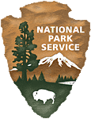
Cultivating Partnerships for Post-Fire Recovery at Lassen Volcanic National Park
National Park Service
U.S. Department of the Interior
Whiskeytown National Recreation Area
Anna Schrenk – BAER Implementation Coordinator
After the Flames Conference and Workshop
Estes Park, CO
April 15-17, 2024
Notes:
Good Afternoon, I am…

Slide 2
Overview
2021 Dixie Fire
Post-Fire Recovery
Cultivating Successful Partnerships
Notes:
Today I’d like to share with you about the 2021 Dixie fire that affected Lassen Volcanic National Park, the enormous work that we have been tasked with post-fire and the All Lands All Hands approach we have taken to implement treatments, share information, collaborate on projects and raise funds through the cultivation of new partnerships but also by expanding existing park partnership

Slide 3
Lassen Volcanic National Park
Park Established in 1916 – 106,372 acres
Designated Wilderness
75% (78,982 acres)
Ancestral lands to the Atsugwei, Maidu, Yana
Lassen Peak
one of the largest plug done in the world
Latest Eruptions 1914 -1921
Notes:
How many of you have visited Lassen Volcanic National Park?
Lassen and is located on the southern tip of the Cascade Range in NE Calif.
The national park was established in 1916 and is the 15th NP established by Congress. This designation incorporated into the Park previously designated Cinder Cone and Lassen Peak National Monuments which were established in 1902 as part of the Lassen Peak Forest Reserve. In 1972 congress designated 75% (78,982 acres) of the park as the Lassen Volcanic Wilderness.
Currently, Lassen Volcanic encompasses 106,372 acres.
The park is ancestorial lands to the Maidu, Yana, Atsugwei peoples. The park currently consults with eight federally recognized tribes and one un-recognized tribe.
Lassen Volcanic is Seismic gem within the NPS, it has all four types of volcanoes, Lassen Peak being one of the largest plug dome volcanoes in the world which last erupted between 1914 and 1921.

Slide 4
2021 Dixie Fire
Fire Started – July 13, 2021
Total burned - 963,309 acres
Lassen Volcanic – 73,240 acres burned
Inter-Agency BAER Team
Notes:
A little Fire Background…
On July 13, 2021 the Dixie Fire was ignited by a tree striking a power line in Feather River Canyon, southeast of the park.
On August 5, the fire entered the SE corner of the park, new Juniper lake. By the containment date, almost a million acres were burned, making it the largest single fire in state history. 73,240 acres were affected within the Lassen Volcanic..
An Inter-Agency Burned Area Emergency Response Team with expertise in hydrology, forestry, cultural resources, recreation, botany, wildlife biology, fisheries biology, GIS, and environmental regulatory
compliance assembled on September 08, 2021 and completed their assessments and planning process by the end of the month.

Slide 5
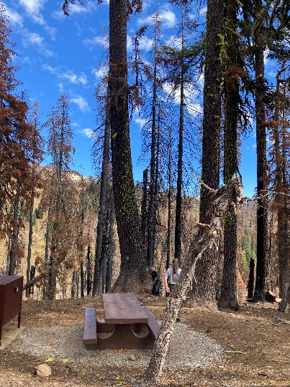
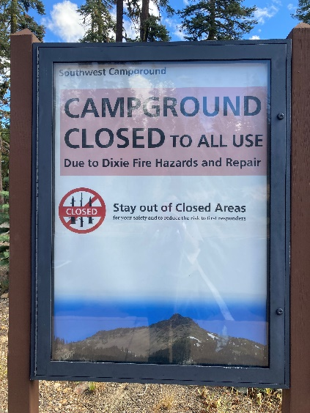
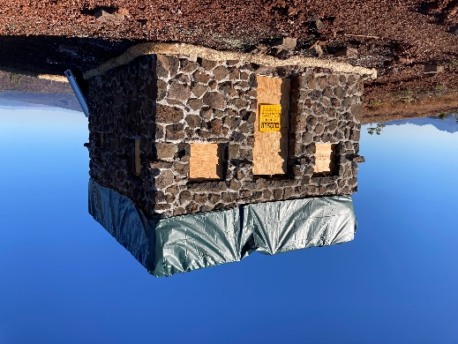
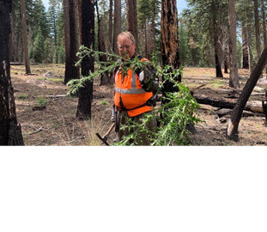
Values at Risk
Infrastructure (roads, trails, facilities)
Cultural Resources (historic landscapes and districts, historic structures, archeological sites)
Natural Resource (Sensitive Species, Native Plant Communities, Long-term Monitoring Plots)
Fish and Wildlife (Special Status Wildlife Populations, Monitoring Equipment, Introduction of Aquatic Invasive Species)
Public Safety and Resource Protection (Damage to NPS Boundary, Treat to Public Safety, Hazardous Waste)
Notes:
What did the find…
The watershed team determined the watershed response to storms associated with the fire would increase the potential for run off and erosion, increased sedimentation and increase the risk of debris flows.
They also advised that this change to the watershed could affect the Drakesbad Historic Guest Ranch structures and fish habitat in creeks. The fire also directly damaged road infrastructure necessary to handle increased flows. Treatments for replacing culverts, pre-season cleaning and patrolling and cleaning up after storms were prescribed.
Thousands of acres of forest were impacted by the fire, resulting in major tree mortality making developed areas including campgrounds, visitor centers, picnic areas, roads, innholder cabins, parking areas unsafe. The Forestry Team prescribed treatments to asses and mitigate hazard trees that could threaten life, facilities and cultural resources.
Many historic and non-historic structures were directly affected. Several were completely destroyed and remains posed a threat to human safety by either collapsing or contain hazardous materials, Archeologist on the BAER Team recommended treatments to protect culturing resource by removing hazard trees, stabilizing historic structures, assessing hazardous waste. The also prescribed treatments to assess all know cultural sites within the burned area to ensure that resources were protected.
The vegetation team prescribed treatments for annual survey and treatment of invasive plants, especially along major vectors used during suppression activities to protect native plant communities and sensitive plant populations. This work includes long term treatment effectiveness monitoring.
The wildlife team recommended documentation of species occurrences and habitats to determine fire effect including aquatic systems where invasive species may have been introduced and determine possible post-fire mitigation needs. Park monitoring equipment was destroyed in the fire was replaced to collect valuable data.
To reduce the threats and mitigate further damage to resources and to protect human life the Public Safety and Resource Protection Team prescribed treatments to re-establish the entire eastern NPS boundary, communicate post-fire risks to the public by installing signage and to get out interpretive messaging, to increase agency presence, replacing our destroyed radio repeaters and stabilizing hazardous waste.
How has Lassen Volcanic implemented these prescribed treatment? Some was and continues to be implemented by park staff. Although much of this work has been completed through our cultivation of existing partnerships and by creating a few new partnerships.

Slide 6
Cultivation of Partnerships
Bureau of Indian Affairs
Sharing Success Stories
Post-Fire Training
Mooretown Rancheria
Muli-Year Agreements
Hazard Tree Mitigation
Future NPS Engagement
Susanville Indian Rancheria
Quarterly Inter-Agency meetings
Elder Firewood Program Donation
Notes:
In this era, partnerships are imperative to getting boots on the ground quickly after disasters.
Lassen Volcanic also has collaborated with partners in pre-fire planning and projects that you’ll hear more about this afternoon from Mike Klimek, Lassen’s FMO.
By building new partnerships and expanding existing partnerships Lassen Volcanic is well on the road to recovery post-Dixie Fire.
We have developed inter-agency agreements to engage tribes in post fire treatments and provide implementation training and support to BIA Post-Fire Program Leads and Tribes.
One of the new partnerships that Lassen has fostered is with the Mooretown Rancheria’s Forestry Program. Within the first six months after Dixie Fire containment, tribal representatives contacted the park asking to assist with post-fire recovery. The Mooretown Band of Maidu Indians have ancestral ties to the park and also have a very successful program that trains tribal members to operate heavy equipment and become fallers. Prior to our engagement with Mooretown Forestry, they had successful completed numerous projects for the USFS and BLM but had never worked with the NPS. While putting tribal members in adjacent communities to work, Lassen Volcanic has cultivated an important partnership with the tribe to mitigate hazard trees associated with the Dixie Fire. The relationship has been a win win for the NPS and the tribe. It has also opened doors for future partnership for the tribe with other NPS units.
Lassen Volcanic, the Plumas and Susanville National Forests and Susanville Indian Rancheria meet quarterly to share information. Recently the Lassen NF conducted a post-fire arch. Surveys and found numerous pre-historic artifacts. Lassen Volcanic will be adding these important artifacts to our museum collection as neither the tribe or FS have capacity to securely store these important finds.
As a result of the hazard tree mitigation, Lassen Volcanic offered to donate logs to tribes as a contribution to tribal firewood program which provide wood to elders. Susanville Rancheria took advantage of this offer and hauled four logging trucks away to support their program.

Slide 7
Cultivation of Partnerships…
Sierra Institute
Wildlife and Vegetation Crews
Facilitate Burney-Hat Creek Collaborative
West Lassen Watershed Group
Planning and Coordination
West Lassen Headwaters Project
Lassen National Forest
Helicopter Support
Lassen Association and Lassen Park Foundation
Lassen Resilience Campaign
Notes:
As it gets increasing challenging to hire seasonal employees, Lassen Volcanics' partnership with the Sierra Institute has been invaluable in recruiting and hiring seasonal crews to implement post-fire treatments to protect native plant communities by surveying for and treating invasive plant species. They have also provided crews to monitor wildlife populations and install destroyed equipment.
The SI also facilitates the Burney-Hat Creek Collaborative that covers the north part of Lassen Volcanic. Pre-fire planning and post-fire recovery are at the forefront of the groups goals.
The West Lassen Watershed Group, is a group of 30 stakeholders that shares information, conducts pre-fire planning and projects that provide overall forest resilience to our public lands and surrounding communities. The group received a grant from the Sierra Nevada Conservancy that will treat 100,000 acres that covers mostly land managed by the Almanor District of the LNF, but also the SW position of LAVO and private lands which this collaborative is facilitating.
The Lassen NF has been assisting the park with post-fire with aviation support. They have flown multiple missions to support the rebuilding of our most visited trails post-Dixie fire and they will support additional flights needs to replace a regionally used radio repeater. This partnership is another win win for both agencies as it gets materials and supplies to our sites for crews to finish treatments and serves as training flights for the Forest Service.
Raising non-federal funds is critical to continuing post-fire recovery after federal funds become limited or are no longer available. Lassen Volcanic, in partnership with Lassen Association and Lassen Park Foundation has launched the Lassen Resilience Campaign that is raising funds for post-fire recovery, monitoring and research needs.

Slide 8
All Hands All Lands Approach
Boots on the Grounds
Job Opportunities
Treatment Accomplishment
Training Opportunities
Tribal Engagement
Aviation Missions
Pre-Fire Planning and Projects
Collaboration
Forest Resilience
Funding Opportunities
Notes:
In conclusion, Lassen Volcanic has used an all hands all lands approach to fire-recovery by working across boundaries to collaborate with partners to…
put boots on the ground to accomplish post-fire treatments and provide job experience to both young adults and tribal members
by creating training opportunities for tribal members and aviation crews while helping the park implement projects.
To plan for that next fire, conduct projects that work towards forest resiliency and to share resources and information
And to fundraise for post-fire recovery.
I hope these examples show you how expanding existing partnerships and cultivating new partnerships are imperative to post-fire recovery and can open doors for future collaboration.
With that I am happy to answer any questions.

Slide 9
Questions?
Anna Schrenk, BAER Implementation Coordinator
Lassen Volcanic National Park
anna_schrenk@nps.gov
(530) 440-6636

