Slide 1
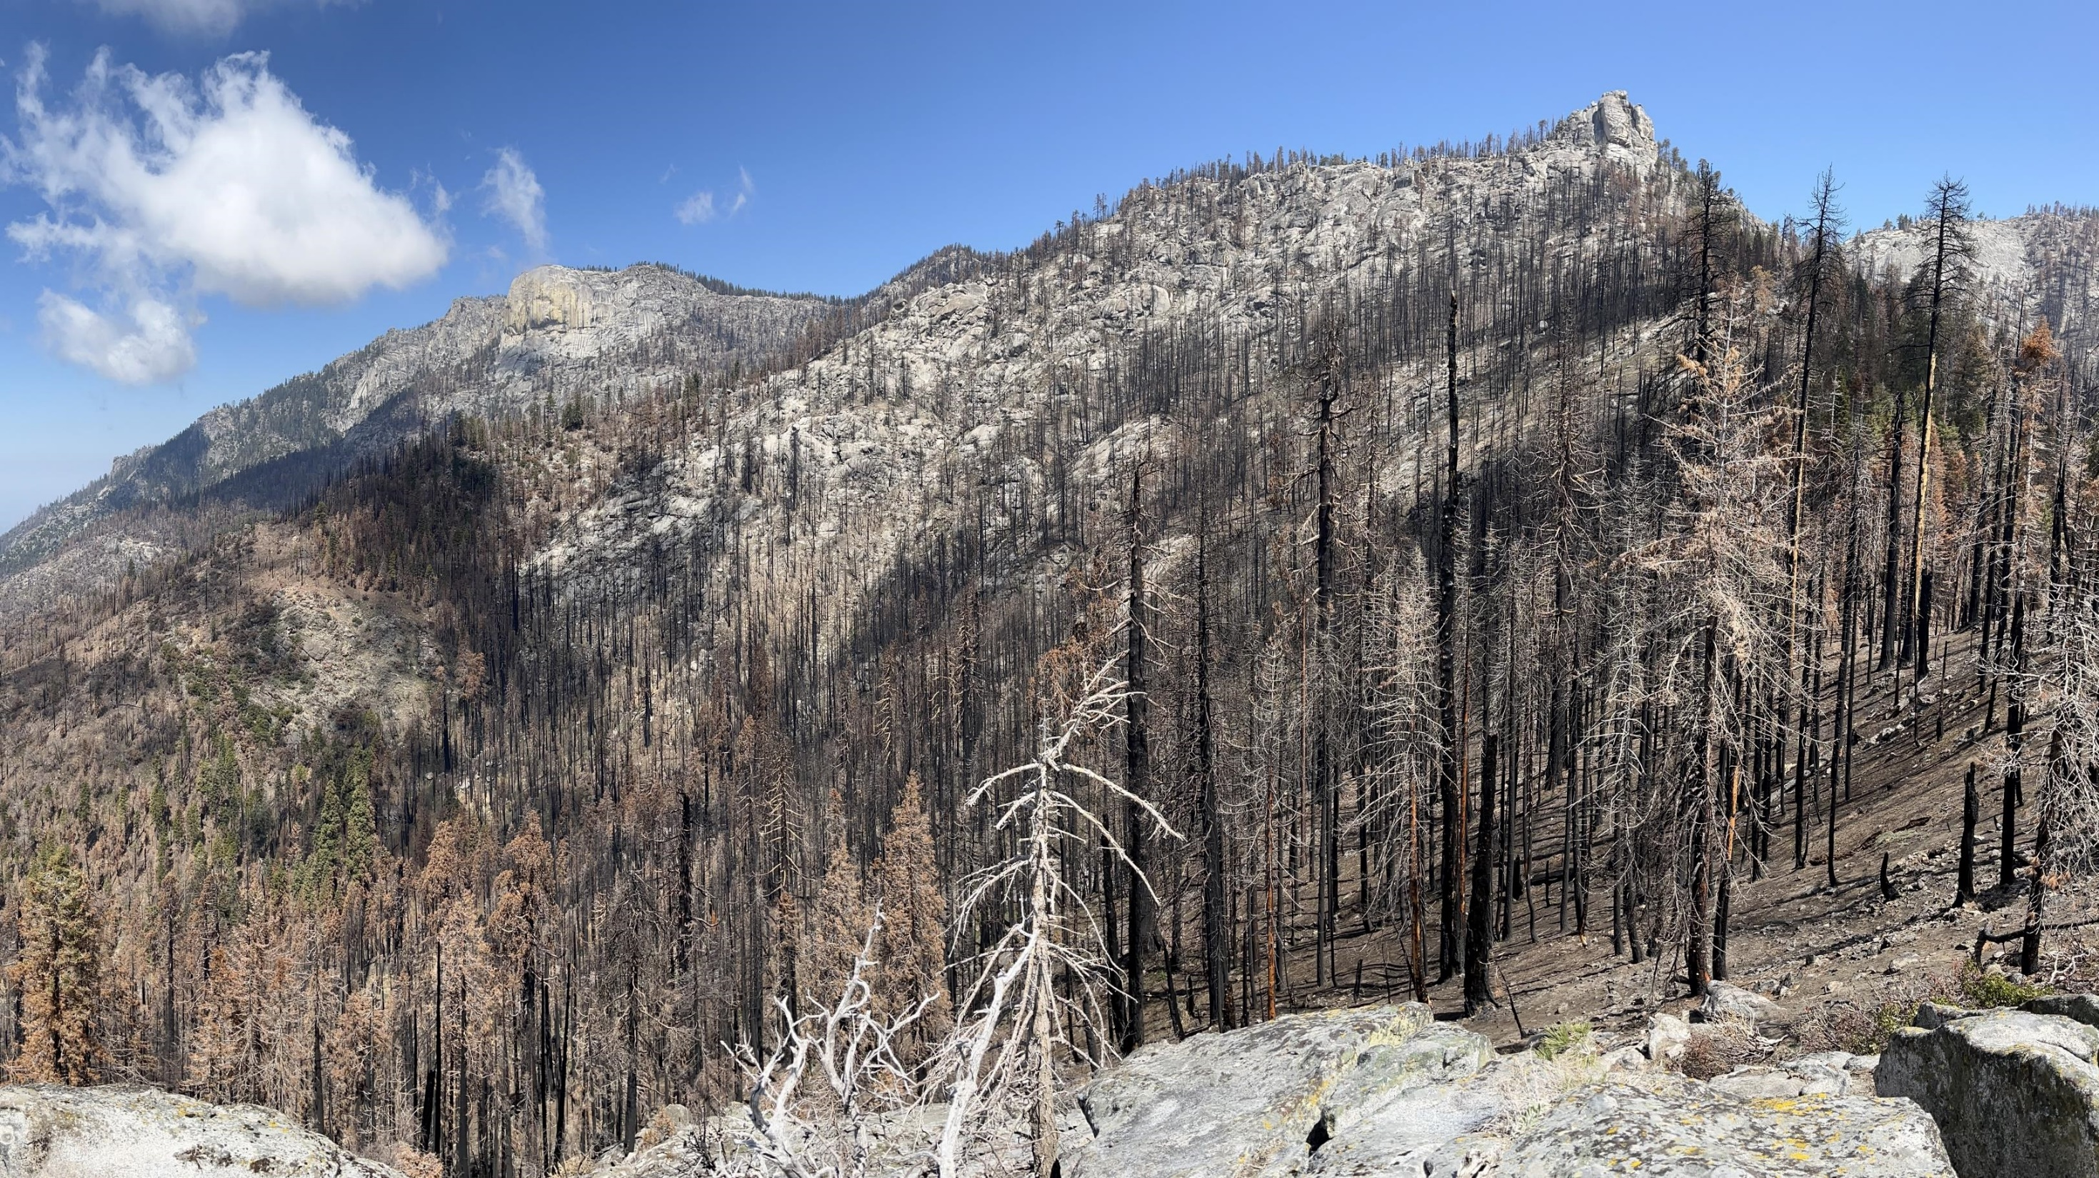

After The Flames
Sequoia and Kings Canyon National Parks
National Park Service
U.S. Department of the Interior
Leveraging Science for Post-Fire Restoration: Help is a Phone Call Away
Andrew Bishop, Restoration Ecologist
Christy Brigham, Chief of Resource Management and Science
David Karplus, SEKI BAER coordinator
Notes:
Emphasize the unprecedented, large areas of high severity fire

Slide 2
Overview
Sequoia and Kings Canyon National Parks
National Park Service
U.S. Department of the Interior
Background | Giant Sequoias Historic management and research 2020 and 2021 fire seasons
Decision Point | Reflecting Questioning Coming Together
How we learned | What happened How does it compare to the past Mental Framework Guiding Action
Looking to the Future | Adaptive Management Unanswered questions Lessons
Theme: Help through out

Slide 3
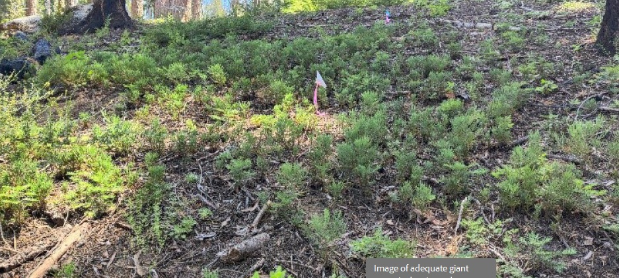
Background – Giant Sequoia
Sequoia and Kings Canyon National Parks
National Park Service
U.S. Department of the Interior
  80 groves within the Sierra Nevada
  Largest single stem trees, up to 3,000 years old
  Centuries of fire
  Fire adapted:
    Thick bark
    High canopy
    Semi serotinous cones
  Early works of San Jose State researchers
  Redwood Mtn birthplace of prescribed fire.
Hartesveldt, R.J., Harvey, H.T., Shellhammer, H.S. and Stecker, R.E. 1975. The giant sequoia of the Sierra Nevada.
3
Notes:
37 groves in SEKI
long study of sequoias
importance of fire
possible threat of fuel accumulation
no previous evidence in lots of fire history studies that wildfire has ever killed large numbers of mature sequoias.

Slide 4
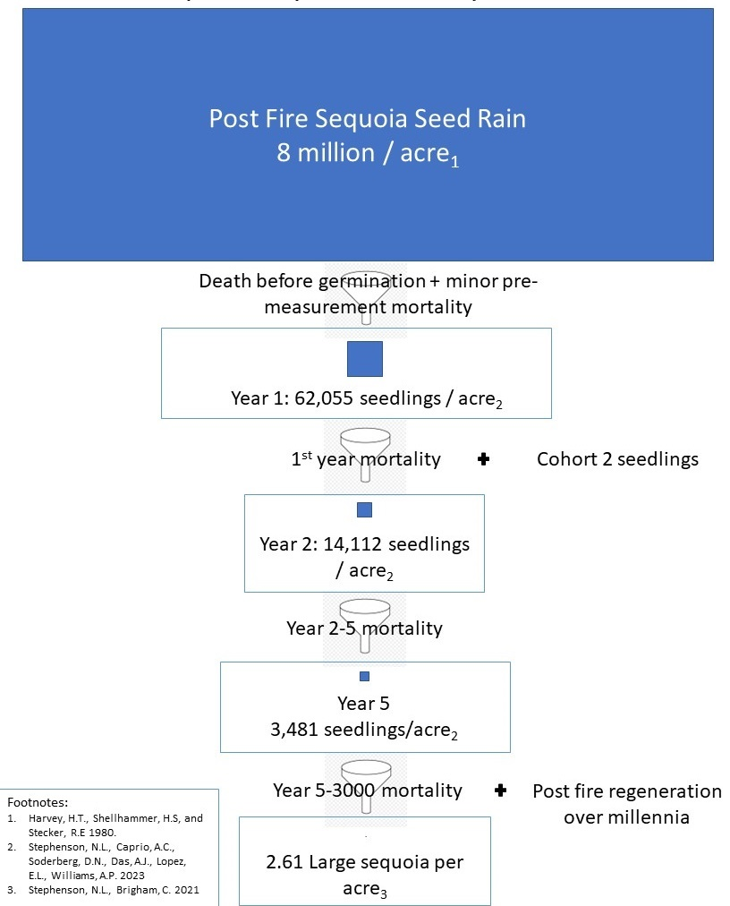
    Background - Sequoia Ecology
Sequoia and Kings Canyon National Parks
National Park Service
U.S. Department of the Interior
    Large sequoias are the most important life stage (like sea turtles).
    Sequoias invest very little in seeds.
    Vast majority of sequoia seedlings only occur after fire.
    Small high severity patches have most sequoia seedlings and slightly higher survivorship than low or moderate severity areas.
    Without fire, sequoia forests decline (not sustainable).
    Sequoias have many opportunities to create the next generation of old trees – every time there is a fire.
    Many opportunities to die between birth and a thousand years old.
4
Notes:
The solid blue boxes are proportional to the numbers of seeds, seedlings, and mature sequoia at each stage. These come from studies and real data ​
8 million seeds: most seed does not germinate.​
Of those that do, most die in 1st and 2nd year from drought stress.​
Even with new germination the second year after fire, the total number of seedlings per acre declines in years 2 and 5. ​
This process has repeated every 6-35 years following fire over millennia to sustain an average of 2.61 large sequoia per acre.​
Another way of saying this is, often, this process does not result in the production of ANY large sequoias.

Slide 5
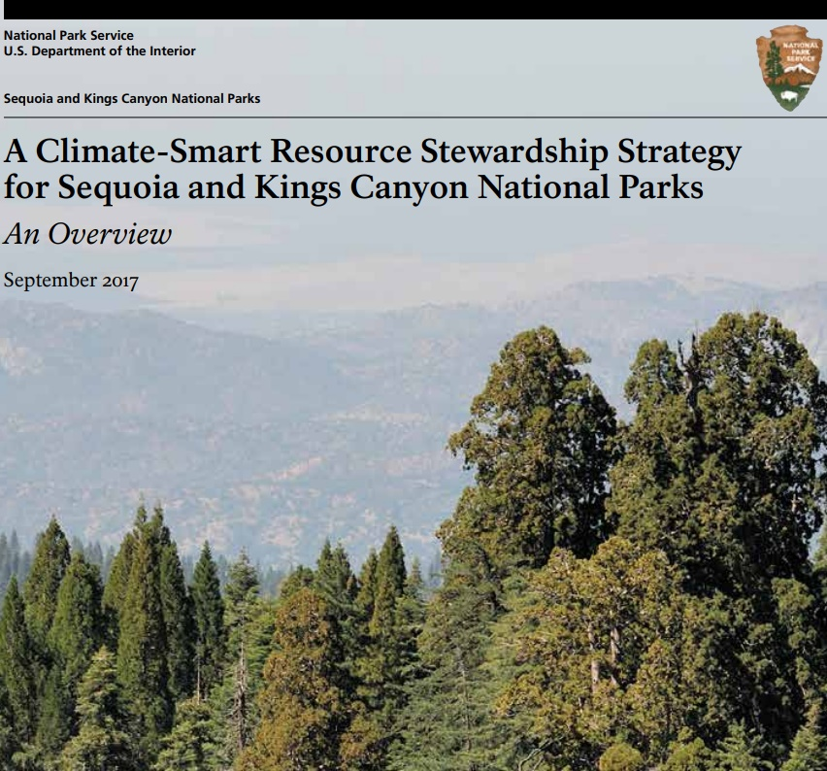
Background – Pre-fire Research
Sequoia and Kings Canyon National Parks
National Park Service
U.S. Department of the Interior
  SEKI is well situated for research:
  USGS Western Ecological Research Center
  USFS Pacific NW AND SW research station
  World Class forestry, ecology, fire ecology researchers
  SEKI RSS
  Focused plan across many taxa, but
  Expected slow changes: drought and beetles
5
Notes:
Bring us into recent history
partnership between USGS, NPS, SRL, and USFS (Nate, Josh and I used data from all these folks to generate the estimate).
Goal was to understand what happened, why did it happen, and how can we prevent it from happening again.
SEPARATE SLIDE? other groves at risk
how to treat those areas and how to complete compliance.
Compliance for a burn because of NEPA, NHPA, ESA, and wilderness act takes us 3-5 years to complete.
Most wilderness groves were untreated but heavily fire suppressed due to a reluctance to use chainsaws and helicopters in wilderness.

Slide 6
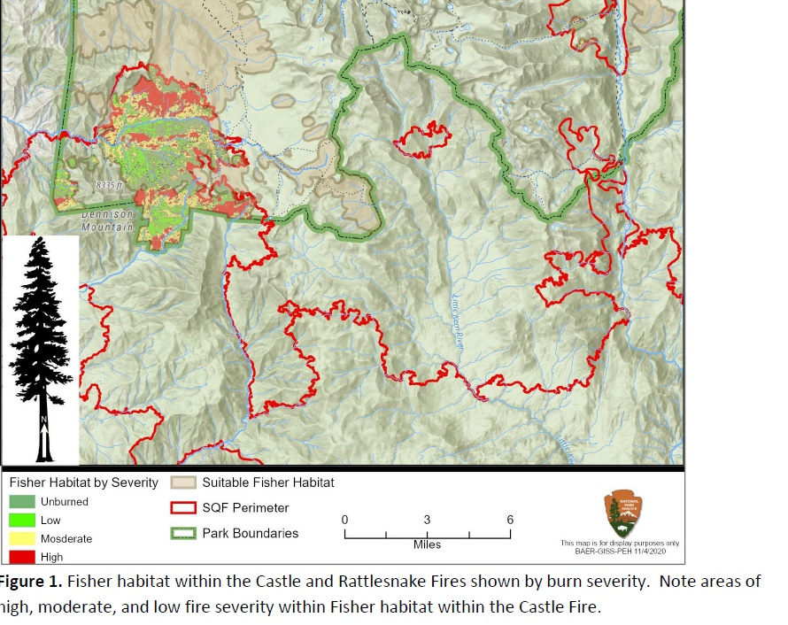
Background – Castle Fire
Sequoia and Kings Canyon National Parks
National Park Service
U.S. Department of the Interior
  Just over 7,000 acres in SEKI. around 25% high severity
  3 Groves
    Homers Nose
    Board Camp
    Dillonwood
  10-14% mortality of natural population of SEGI*
  Completely modern phenomena - Rough, 2015; Railroad, 2017; and Pier, 2017
  Type Conversion
*Stephenson, N. and Brigham, C. 2021. Preliminary estimates of sequoia mortality in the 2020 Castle Fire. National Park Service Natural Resource Report series. Retrieved from: Preliminary Estimates of Sequoia Mortality in the 2020 Castle Fire (U.S. National Park Service) (nps.gov).
6
Notes:
HIT SEQUOIA NATIONAL MONUMENT WORSE
partnership between USGS, NPS, Save the redwoods, and USFS (Nate, Josh and I used data from all these folks to generate the estimate).
Goal was to understand what happened, why did it happen, and how can we prevent it from happening again.
SEPARATE SLIDE? other groves at risk
how to treat those areas and how to complete compliance.
Compliance for a burn because of NEPA, NHPA, ESA, and wilderness act takes us 3-5 years to complete.
Most wilderness groves were untreated but heavily fire suppressed due to a reluctance to use chainsaws and helicopters in wilderness.
Fuel buildup , drought killed trees, extreme fire weather
Overcame SEGI adaptations to ground fire.

Slide 7
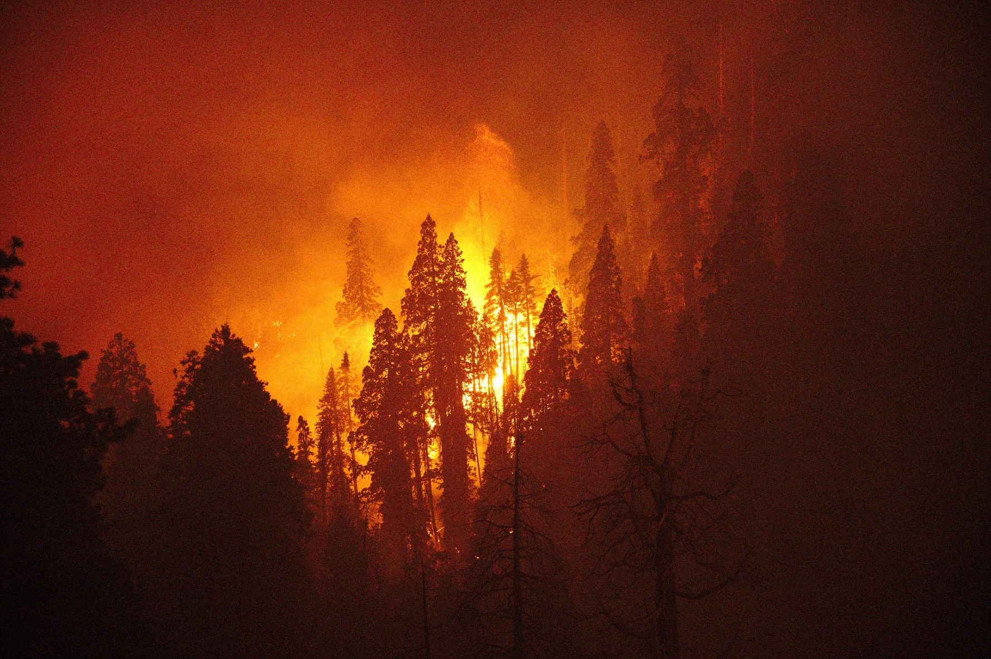
Background – KNP Complex
Sequoia and Kings Canyon National Parks
National Park Service
U.S. Department of the Interior
  88,307 acres, 714 acres at high severity in sequoia groves
  3 Groves
    Redwood Mtn
    Suwanee
    New Oriole Lake
  3-5% mortality of natural population of SEGI
    13-19% mortality of natural population of SEGI
  Type Conversion
Shive, K., Brigham, C., Caprio, T., and Hardwick, P. 2021. 2021 Fire Season Impacts to Giant Sequoias. National Park Service, Sequoia and Kings Canyon National Parks.
7
Notes:
Map of the two fire footprints in SEKI with Rapid Assessment of Vegetation condition after wildfire
Shows outline of the groves that burned within the fires
The groves of concern are

Slide 8
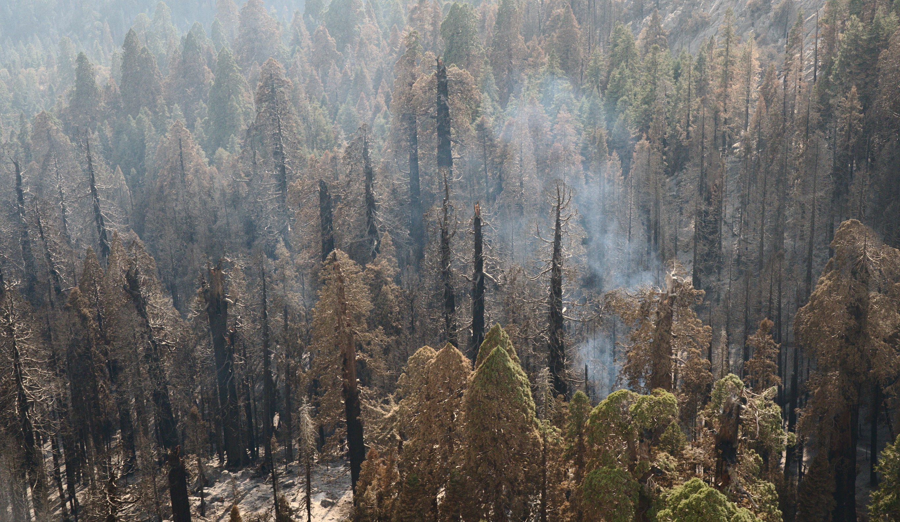
    Decision Point
Sequoia and Kings Canyon National Parks
National Park Service
U.S. Department of the Interior
    Assume this is natural and normal
    OR
    Evaluate assumptions, use science, and partnerships to evaluate what happened and respond appropriately?
8
Notes:
everything happened like always and we should continue to assume and not do (fire doesn't kill large sequoias. Sequoias always regenerate very well after fire. NPS doesn't replant after wildfire. NPS doesn't plant in wilderness. NPS CAN'T plant in wilderness)

Slide 9
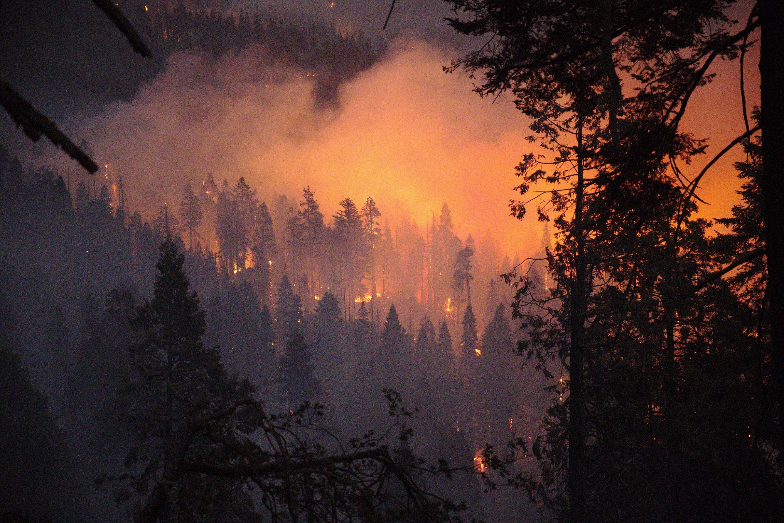
    Prioritize
Sequoia and Kings Canyon National Parks
National Park Service
U.S. Department of the Interior
    Law and policy
    What resources are most at risk
    Capacity
    Existing relationships
    SEKI takeaways
    Giant Sequoias
    Endangered Pacific Fisher Habitat
    Fuels management
    Will they recover without restoration
9
Notes:
everything happened like alway and we should continue to assume and not do (fire doesn't kill large sequoias. Sequoias always regenerate very well after fire. NPS doesn't replant after wildfire. NPS doesn't plant in wilderness. NPS CAN'T plant in wilderness)

Slide 10
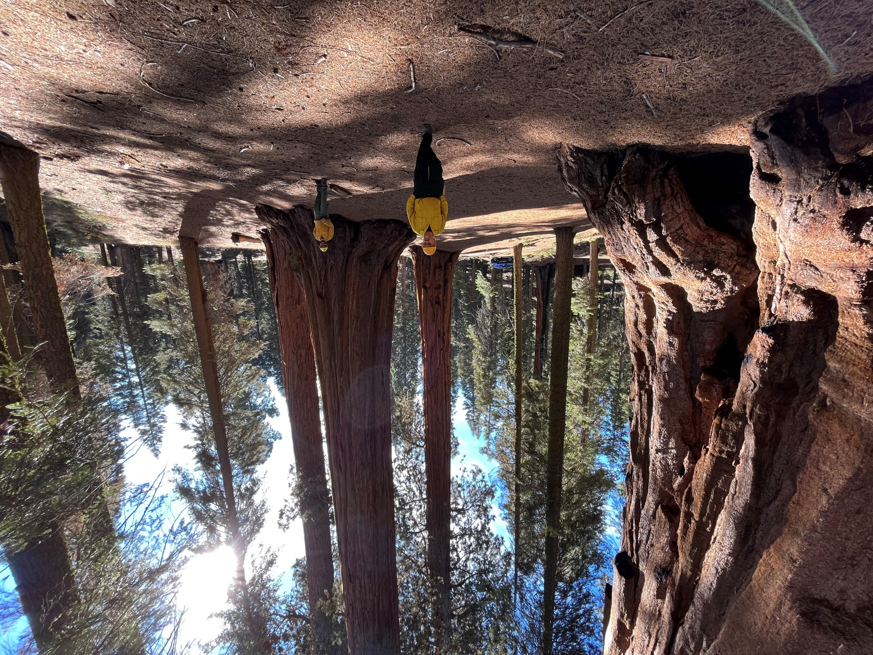
    BAER: Pre-packaged Support
Sequoia and Kings Canyon National Parks
National Park Service
U.S. Department of the Interior
    Burned Area Emergency Response / Burned Area Restoration
    People and expertise
    A plan
    Funding
    Helpful administrators
10
Notes:
Interagency team responds after major fires on federal lands
Incident command for recovery

Slide 11
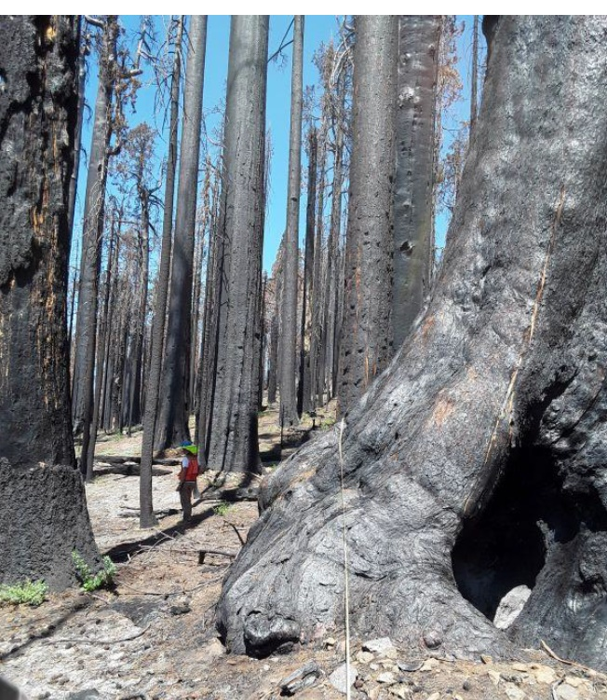
    Digging Deeper: was it all bad?
Sequoia and Kings Canyon National Parks
National Park Service
U.S. Department of the Interior
    USFS PSW RS Marc Meyer
    GTR 270 model:
      Framework
        fire severity: did fire improve or degrade?
          Resource values
          Climate change
        Sequoia Groves
        Fisher habitat corridor
Meyer, M.D., White, A., McGregor, E, Faber, K., Green, R., and Eckert, G. 2022. Post-fire restoration strategy for the 2021
11
Notes:
Interdisciplinary team
If improve: prioritize for future fire treatments
Fisher connectivity modeling (what is it called resistance?)

Slide 12
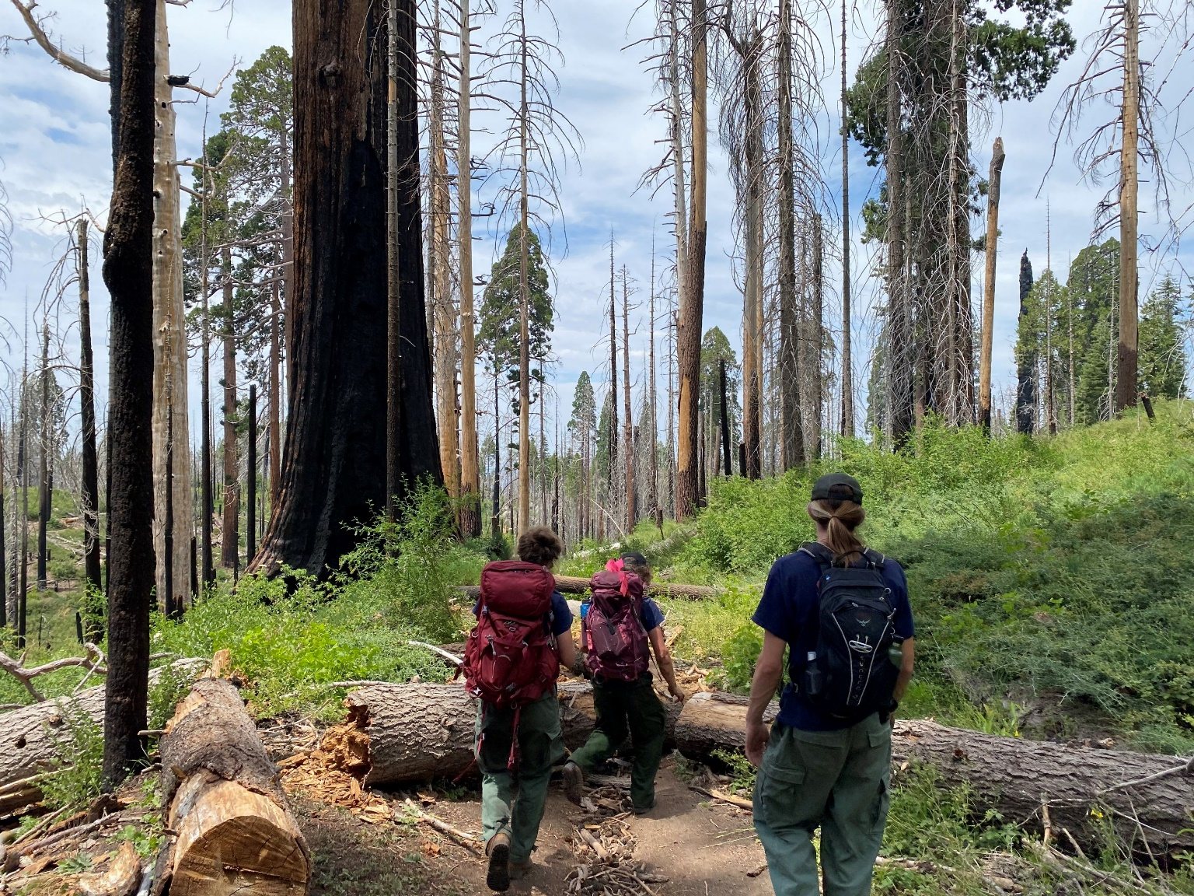
    Fuels Development and Treatments
Sequoia and Kings Canyon National Parks
National Park Service
U.S. Department of the Interior
  Fire Fx and fuels development
    Tony Caprio
    Fire Management Handbook (FMH) plots
    Kristen Shive
  Updating Fire and Fuels Management Plan
Meyer, M.D., White, A., McGregor, E, Faber, K., Green, R., and Eckert, G. 2022. Post-fire restoration strategy for the 2021
12
Notes:
If improve: prioritize for future fire treatments

Slide 13
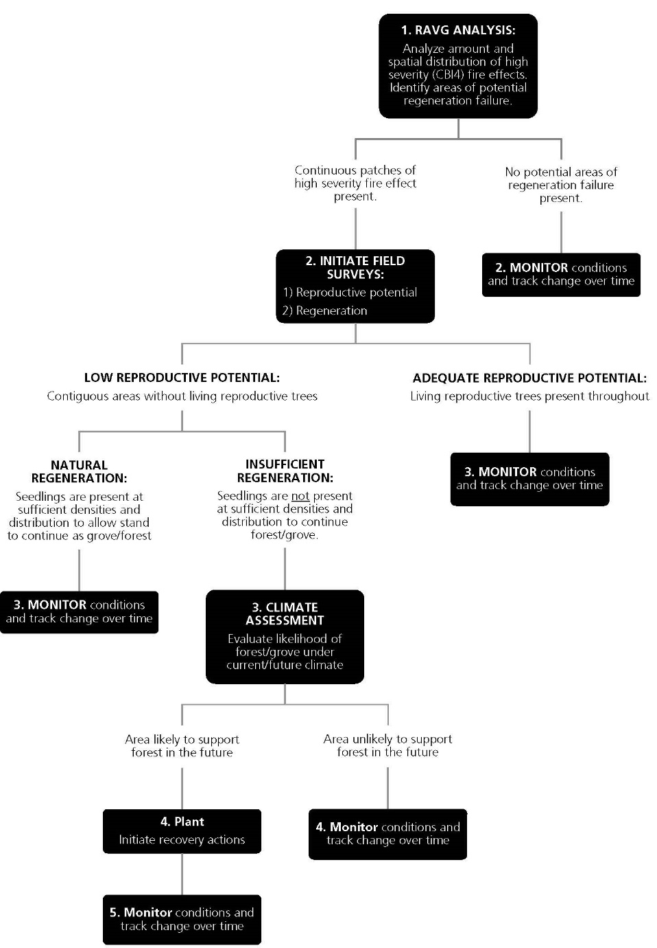
    Decision Tree
Sequoia and Kings Canyon National Parks
National Park Service
U.S. Department of the Interior
    Components:
      RAVG analysis
      Mortality of reproductive SEGI
      Regeneration Surveys
      Climate Assessment
    How many seedlings is enough?
      Compare current condition to reference densities from previous prescribed fires.
    York et al (2013): SEGI with Rx Fire are replacing themselves, therefore…
    Prescribed fire data as year1 & 2 reference densities
13
Notes:
Mortality: as stated on the last slide adults most important, large SEGIs produce the most seed.
If they are dead, this generation of seedlings is the only shot.
We have some regeneration, but how much is enough?
Comparing Current Conditions with Natural Seedling regeneration post fire
York et al (2013) identified that sequoia areas with previous prescribed fires followed a stationary age distribution while unburned areas did not. This indicates these areas are sustainable as giant sequoia groves with the levels of seedlings observed in these areas.
Prescribed fire data was analyzed to identify what seedling densities were associated with a stationary age structure for assistance in deciding whether intervention was needed.
Seedling densities vary widely in space. For this reason, broad surveys of areas identified in step 1
sampled and mean and median seedling densities were calculated
Seedling densities from these surveys were then compared to mean reference densities from previous prescribed fires

Slide 14
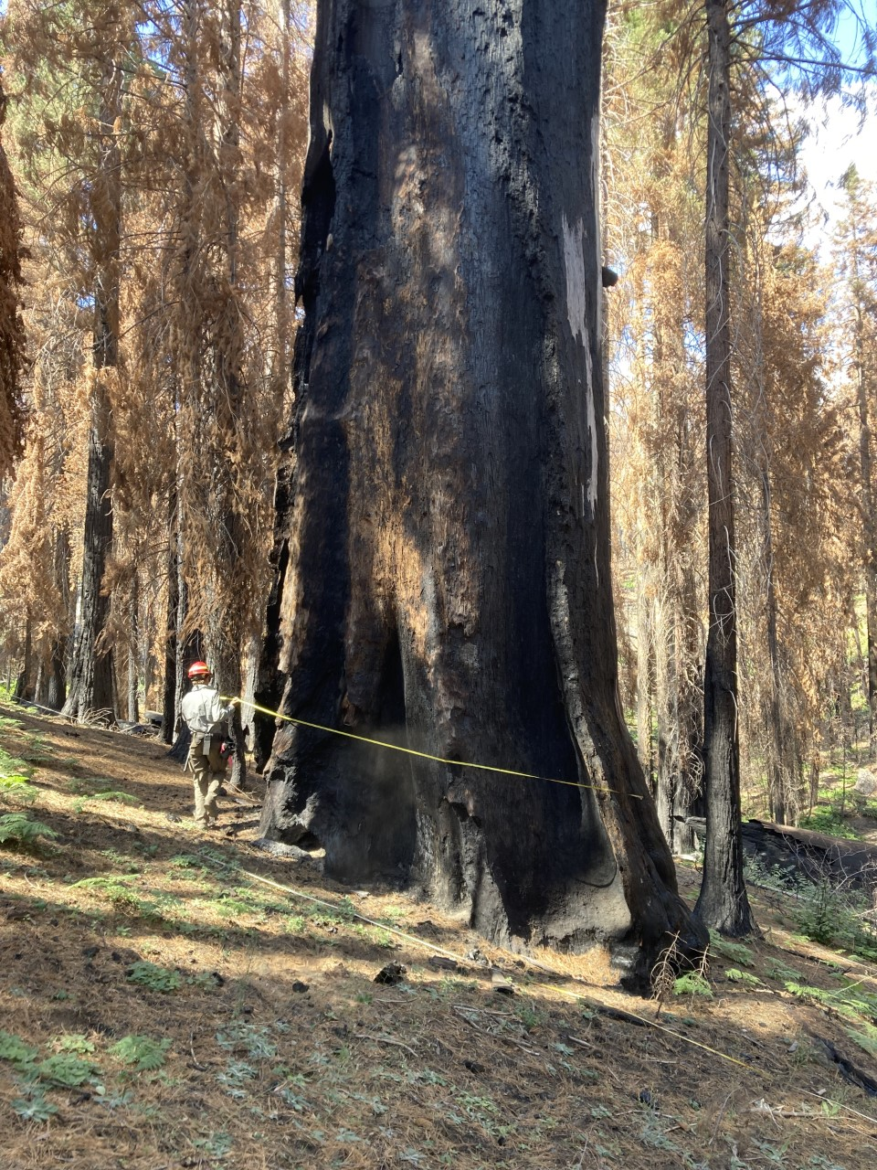
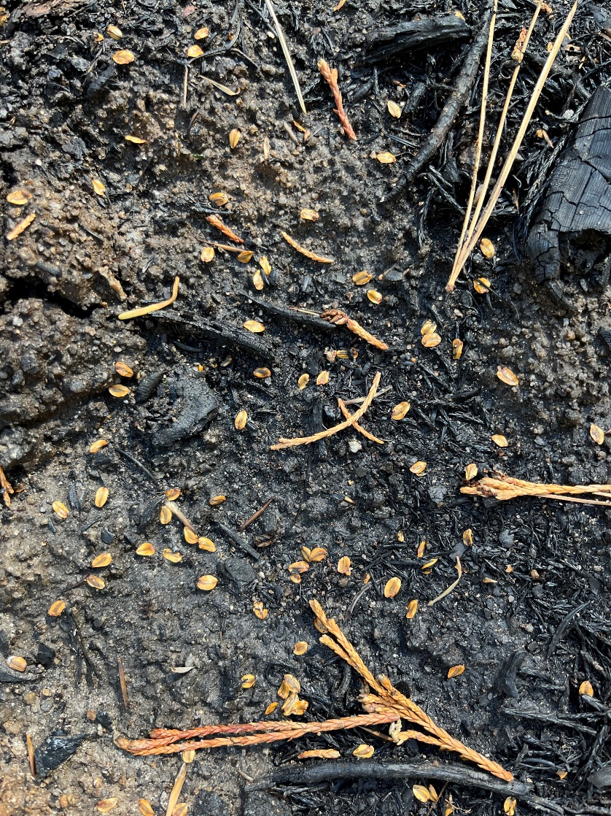
    Sequoia Mortality and Regeneration
Sequoia and Kings Canyon National Parks
National Park Service
U.S. Department of the Interior
    Funding support: NPS Inventory and Monitoring: Inventory program
  giant sequoias and fisher immediately after Castle fire
  and mixed conifer (immediately after KNP complex) and Fisher (immediately after Castle fire)
14
Notes:
Support from USGS, USFS, UC Davis Safford Lab

Slide 15
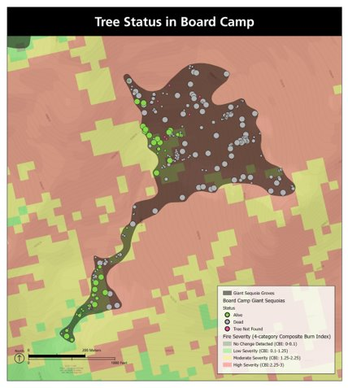
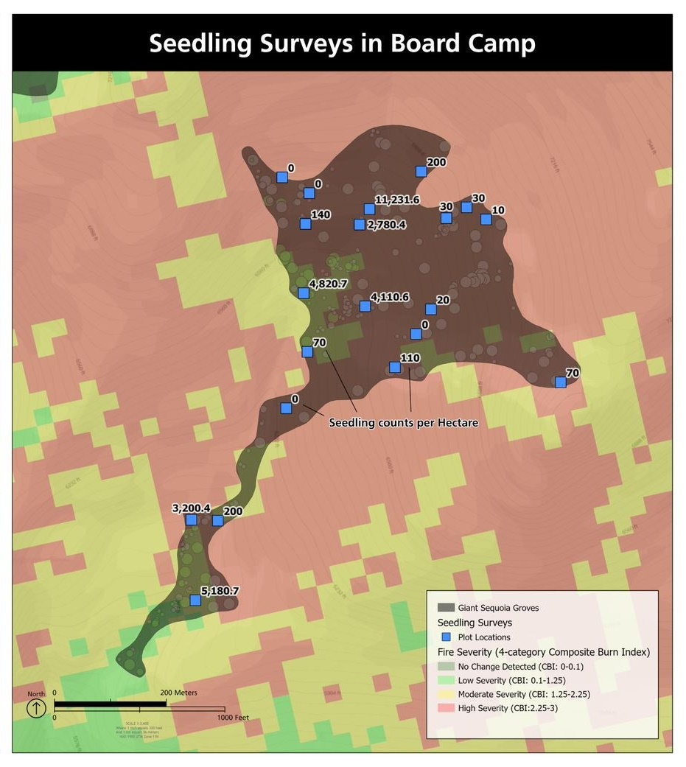
    Sequoia Mortality and Regeneration
Sequoia and Kings Canyon National Parks
National Park Service
U.S. Department of the Interior
Are there living reproductive trees?
  Green: living
  Grey: dead
How Many Seedlings?
Stratified sampling
Meyer, Marc D., David Soderberg, Adrian Das, Christy Brigham, and Rebecca Wayman. 2023. KNP Complex Post-Fire Regeneration Assessment
Soderberg, David, Das, Adrian J., Stephenson, Nathan L., Meyer, Marc D., Brigham, Christy A., and Flickinger, Joshua. 2023. Assessing giant sequoia (Sequoiadendron giganteum) mortality and recruitment
15
Notes:
Full inventory vs stratified sampling

Slide 16
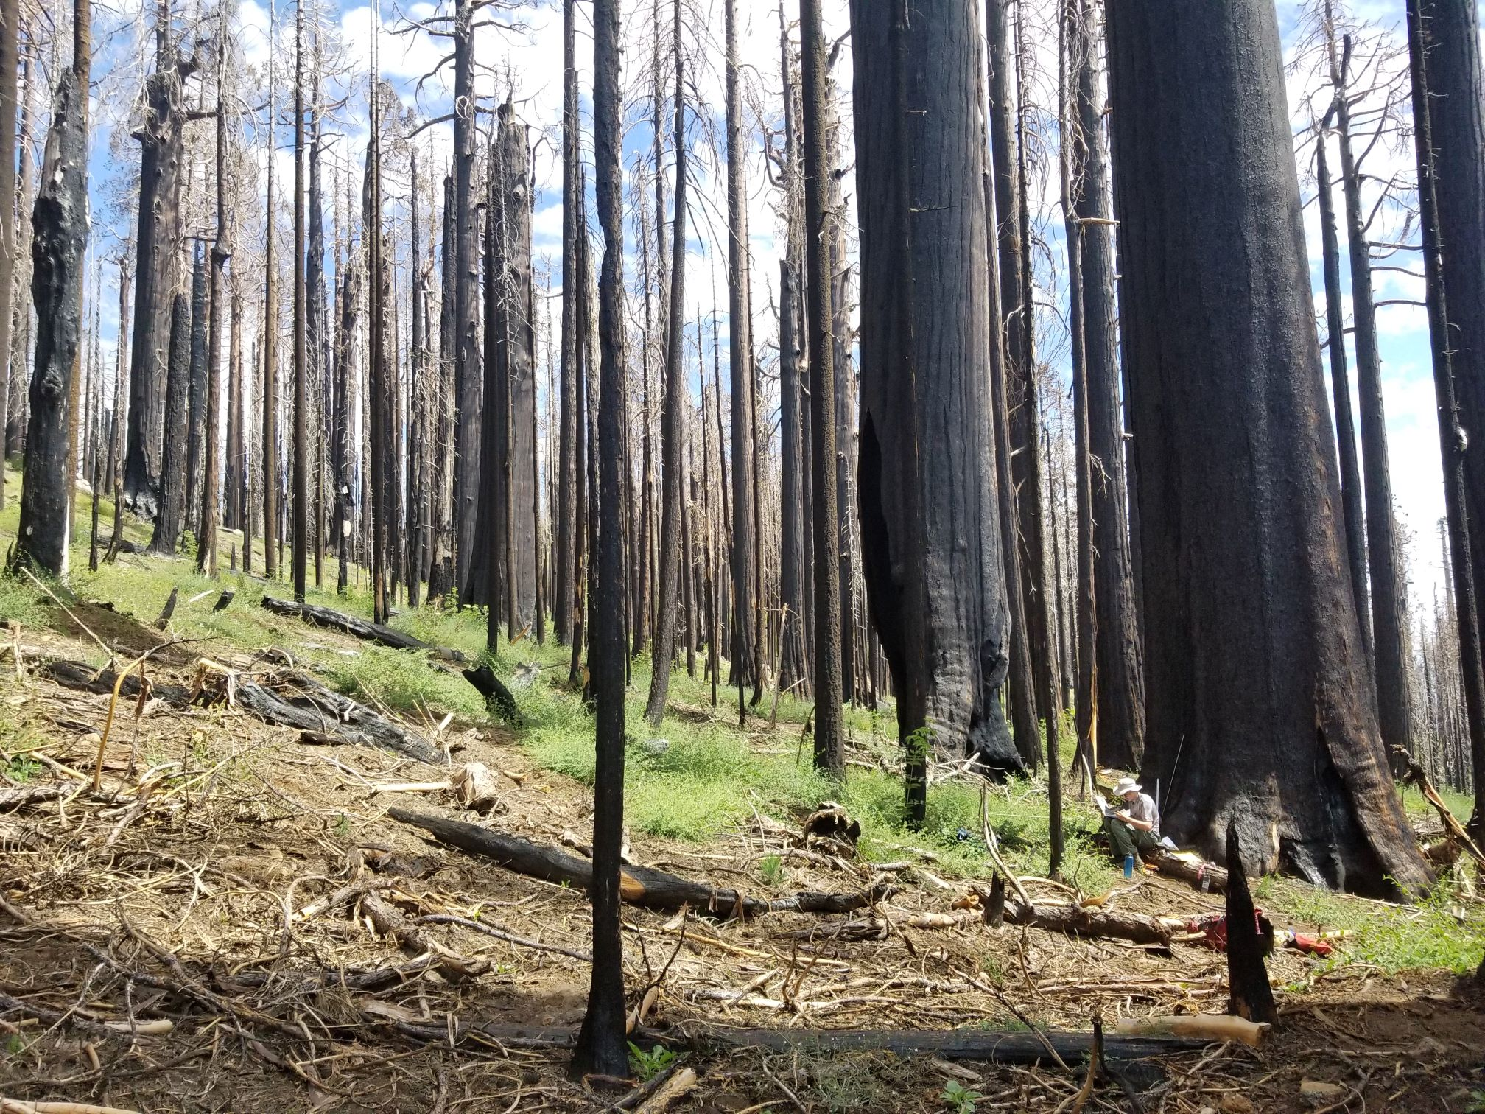
    How Much Regeneration is Enough
Sequoia and Kings Canyon National Parks
National Park Service
U.S. Department of the Interior
    Reminder about Sequoia reproduction
    Natural Resource Condition Assessment: stable age distribution with fire
    Nate Stephenson, USGS emeritus, world expert
    Prescribed Fire FMH data, built reference densities
York, R.A., Stephenson, N.L., Meyer, M., Hanna, S., Moody, T., Caprio, A.C., and Battles, J.J. 2013. A natural resource condition assessment
Stephenson, Nathan L., Caprio, Anthony C., Soderberg, David N., Das, Adrian J., Lopez, Eva L., and Williams, A. Park. 2023. Post-fire Reference Densities for Giant Sequoia Seedlings.
16
Notes:
NRCA was at course temporal scales, we needed 1-year, 2-year, densities

Slide 17
Grove | Timing of Survey | Number of Plots Sampled | Median Sequoia Seedlings/acre | Bayesian Probability of Mean Being Equivalent to Year 2 Reference Density (Mean is 14,112/acre. Bayesian Median Yr 2 16,011)
Board Camp | April 2022 | 20 | 651 | <0.1%
Suwanee | October 2022 | 30 | 4,763 | 2.4%
 | July 2023 | 30 | 3,155* | 1.1%*
New Oriole Lake | Sept/Oct 2022 | 20 | 6,875 | 11.2%
Redwood Mountain | September 2022 | 45 | 4,266 | 1.1%
Redwood Mountain | June/July 2023 | 45 | 3,863* | 0.5%*
Fisher Corridor | Surveyed in 2022 and 2023. | 50 | N/A | N/A
Dillonwood | Analysis ongoing
Homers Nose | Analysis ongoing
*Data and analyses are preliminary as data just came in from the field and has not been QA/QC’d.
Soderberg, David, Das, Adrian J., Stephenson, Nathan L., Meyer, Marc D., Brigham, Christy A., and Flickinger, Joshua. 2023. Assessing giant sequoia (Sequoiadendron giganteum) mortality and recruitment
17
Notes:
We performed surveys in Fisher corridor, and they were even worse
In 2022, Median was 0
40% of plots had 0 seedlings
62% had less than 40 / acres

Slide 18
    Climate Adaptation
Sequoia and Kings Canyon National Parks
National Park Service
U.S. Department of the Interior
    Changing world, limited distribution
      Drought tolerance
      Other stressors (bark beetles)
    Prioritize hot, dry sites
      Climate water deficit
    High diversity
      Larger
      Heterozygosity
    20% non-local to balance increasing genes while prevent outbreeding depression.
DeSilva, R 2023. Utilizing Genomic Insights to Inform Seed Selection for Post-Fire Replanting of Giant Sequoia Groves
18
Notes:
Genetic diversity represents the various cards a population can play in the face of a changing world.
Genomic sequencing:
drought related traits correlated with latitude
Guidance on how model of percentage of nonlocal material to prevent outbreeding depression and maintain local adaptation while increasing genes available for natural selection to act on in the face of rapid future changes

Slide 19
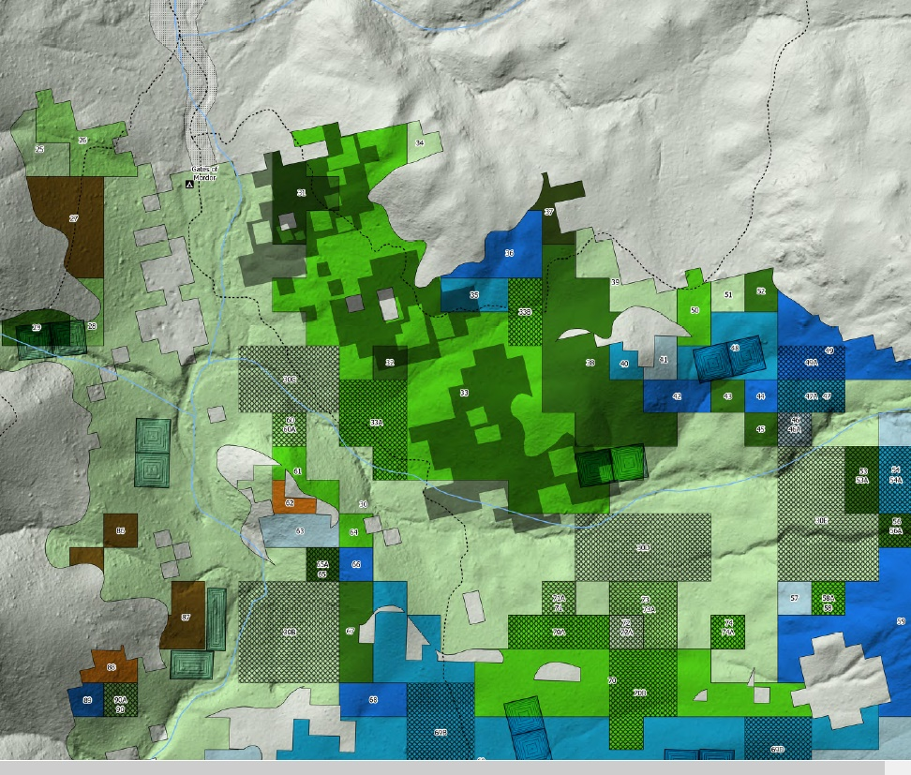
Planting Plan
Sequoia and Kings Canyon National Parks
National Park Service
U.S. Department of the Interior
Gathered experts:
  USFS
  CAL Fire
  Save the Redwoods
  UC Berkley
Guided planting densities
Expected survival rates
Dense enough planting to shade shrubs and break up continuous fuels.
No Plant areas: adequate regeneration.
North, M.P., Stevens, J.T., Greene, D.F., Coppoletta, M., Knapp, E.E., Latimer, A.M., Restaino, C.M., Tompkins, R.E., Welch, K.R., York, R.A. and Young, D.J., 2019. Tamm Review: Reforestation for resilience
19
Notes:
NPS doesn’t have a history of large-scale planting
Develop planting plans with input from USFS, Rob York, Save the redwoods, CAL Fire
Planting density
Survival rates
Individuals clumps and openings
LMUs -GTR 250?
Patchwork quilt
-planting units based on LMUs and vegetation mapping
-overlaid with no plant areas: where there is adequate regeneration (dark grey blocks)
-non-local genotype areas planted into blocks shown as cross hatch

Slide 20
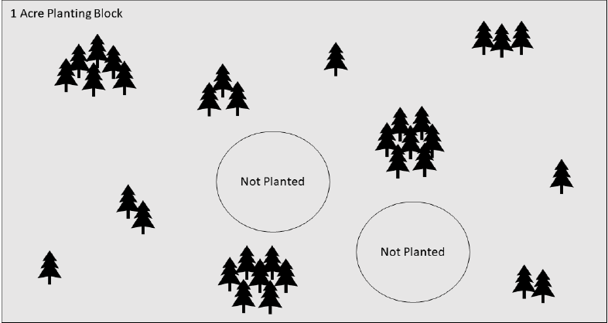
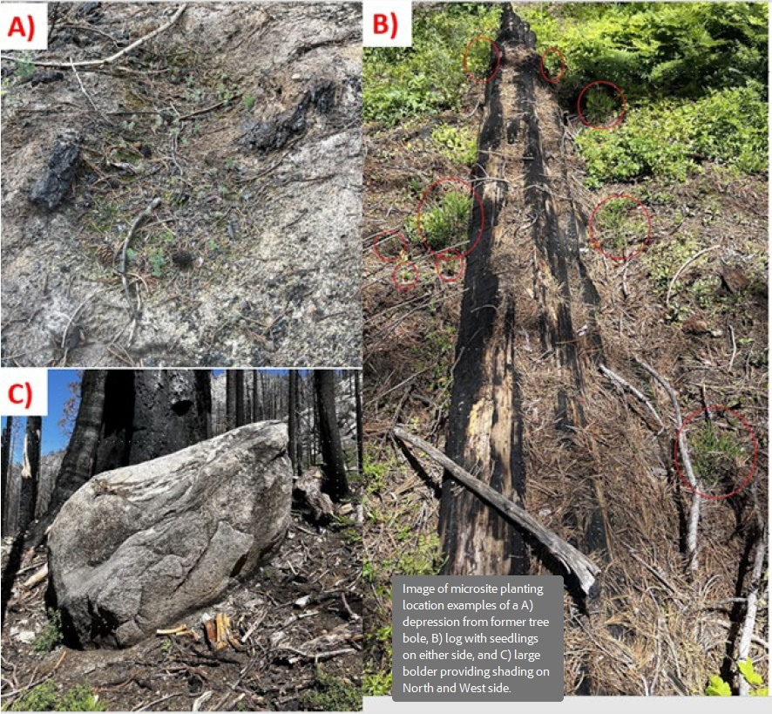
Individuals, Clumps, and Openings
Sequoia and Kings Canyon National Parks
National Park Service
U.S. Department of the Interior
Individuals, Clumps, and Openings:
  Model planting after distribution of trees in mature forest.
  Not a plantation planting.
  Favorable microsites (clumps).
  Less dense: ridges, and steep south and west-facing slopes (individuals).
  Leave occasional gaps
North, M.P., Stevens, J.T., Greene, D.F., Coppoletta, M., Knapp, E.E., Latimer, A.M., Restaino, C.M., Tompkins, R.E., Welch, K.R., York, R.A. and Young, D.J., 2019. Tamm Review: Reforestation for resilience
20
Notes:
This process indicated that board camp, redwood mountain and the fisher corridors do not have sufficient regeneration
There fore we have developed planting plans
Map shows the portions of board that will be replanted.
Color coded representing LMUs…
Map also shows the location of access trail LZ, and camp

Slide 21
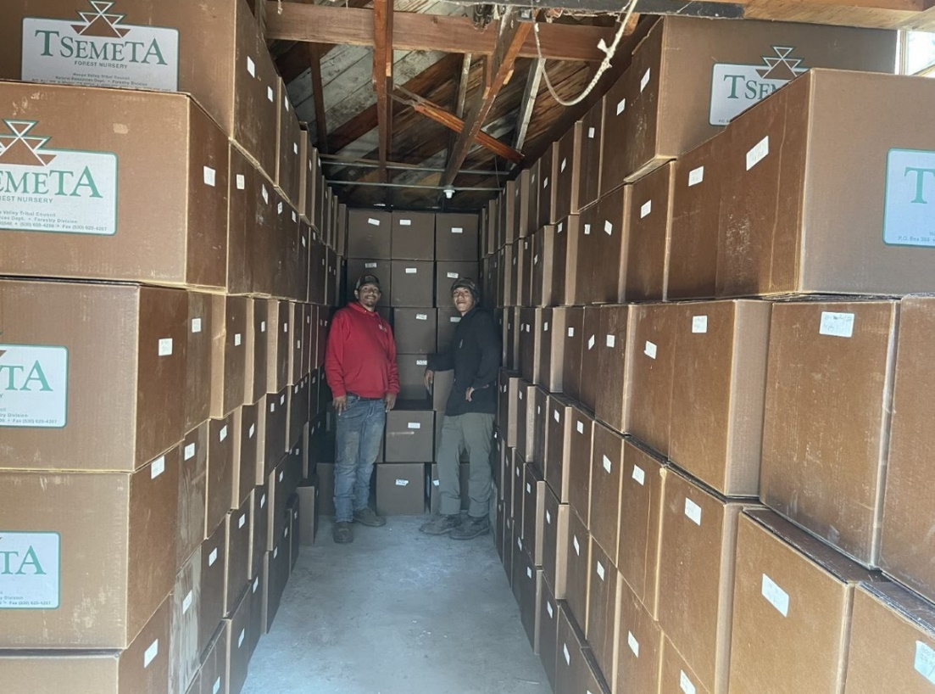
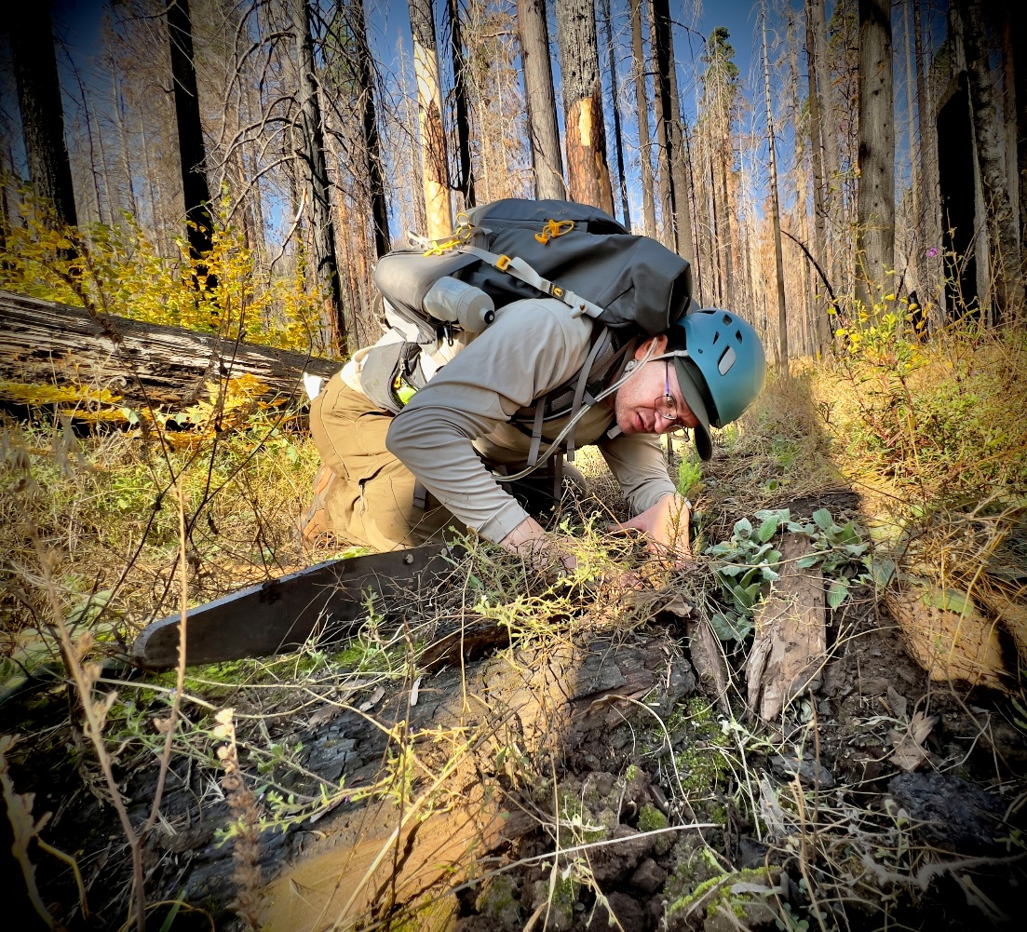
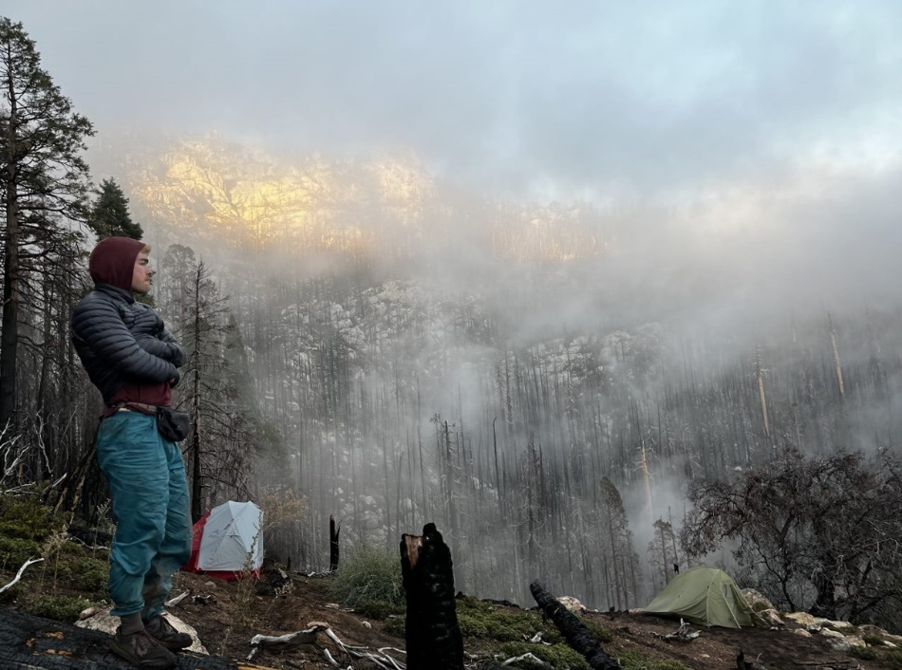
Planting
Sequoia and Kings Canyon National Parks
National Park Service
U.S. Department of the Interior
Oct –Nov 2023
140,000+ seedlings
Redwood Mountain Grove
  609 acres
Fisher Habitat Corridor
  350 acres
Board Camp Grove
  38 acres

Slide 22
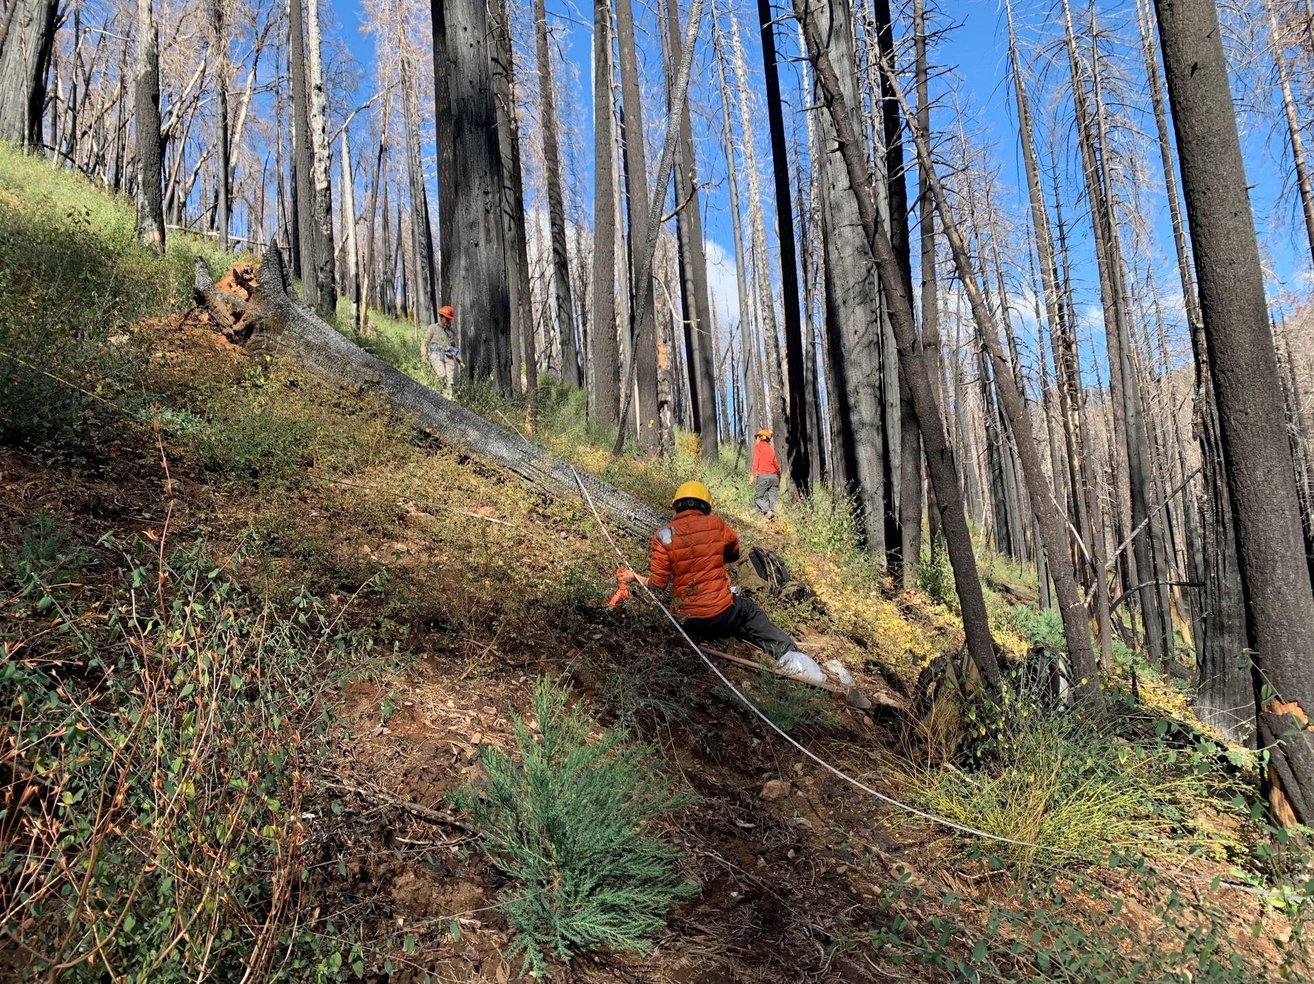
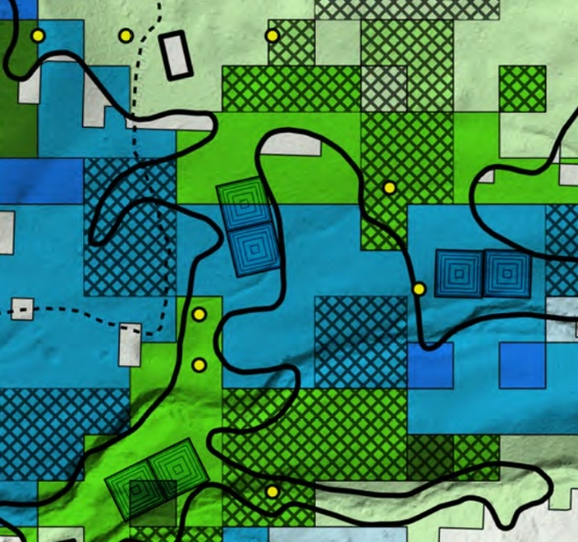
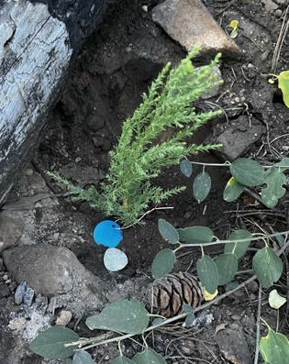
Monitoring – Ongoing Research
Sequoia and Kings Canyon National Parks
National Park Service
U.S. Department of the Interior
Kristen Shive - UC Berkley
Plots to assess survivorship
Research plots
  Assisted gene flow
  Shrubs: competition/facilitation

Slide 23
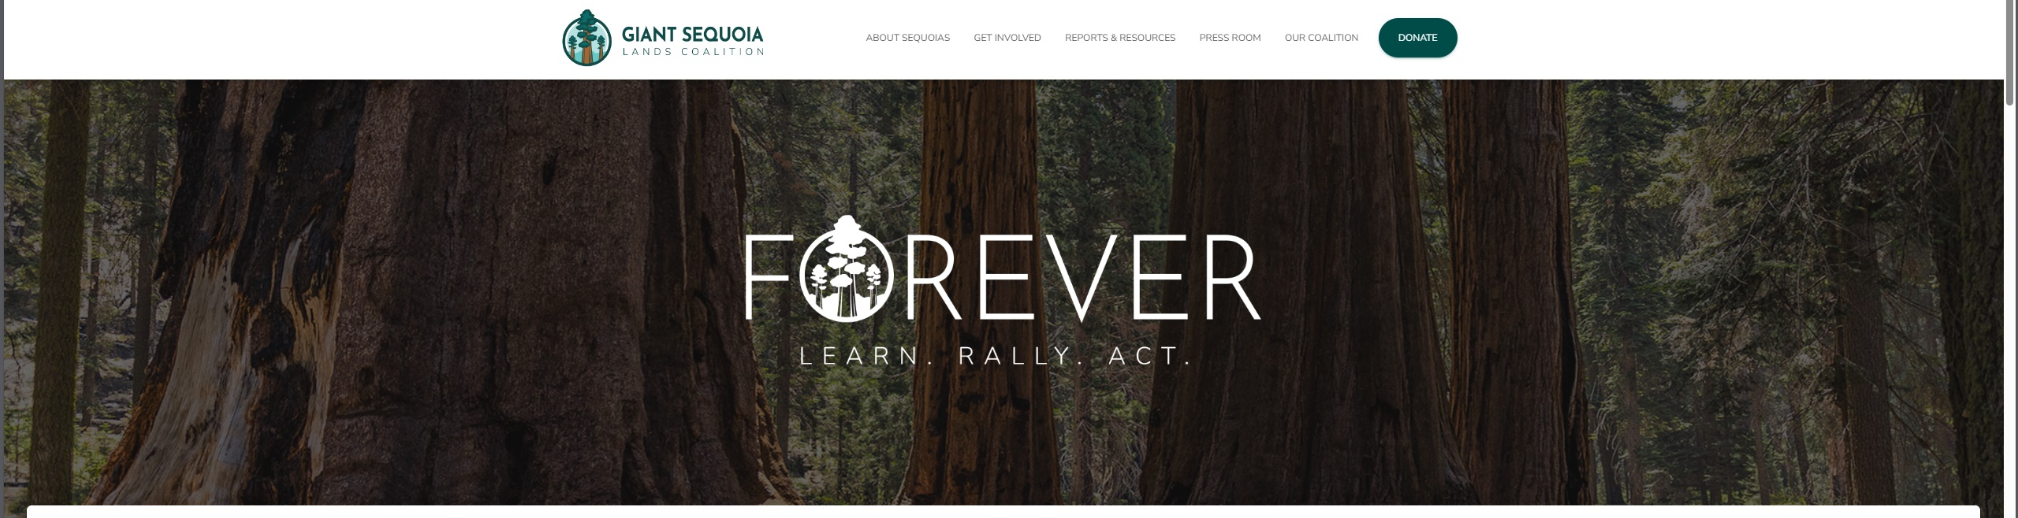
Partnerships
Sequoia and Kings Canyon National Parks
National Park Service
U.S. Department of the Interior
Giant Sequoia Lands Coalition
  Giantsequoias.org
  Learn
  Rally
  Act
Range wide grove conditions
Notes:
Accelerate protection of giant sequoias and their ecosystems, in a new era of emerging threats associated with climate change and human interference of natural wildfire processes on the landscape.

Slide 24
The Future
Sequoia and Kings Canyon National Parks
National Park Service
U.S. Department of the Interior
Assessing Additional Grove Areas
  Dillonwood
  Homers Nose
  New Oriole Lake
  Suwanee
Evaluating survival:
  >20 mortality triggers replanting
  Adding diversity
Soil microbes: intact vs high-severity areas
  Plant with and without microbia
  Funded by SW Climate Adaptation Science Center
Notes:
Assessing additional grove areas
Dillonwood, homers nose, new oriole, suwanee
Will add diversity to Redwood/fisher and board camp
SW CASC funded study to look at soil microbial communities in intact fire regimes and high severity areas, characterize, and plant sequoias with and without soil communities in intact fire regimes to test soil-plant interactions in these novel high severity environments

Slide 25
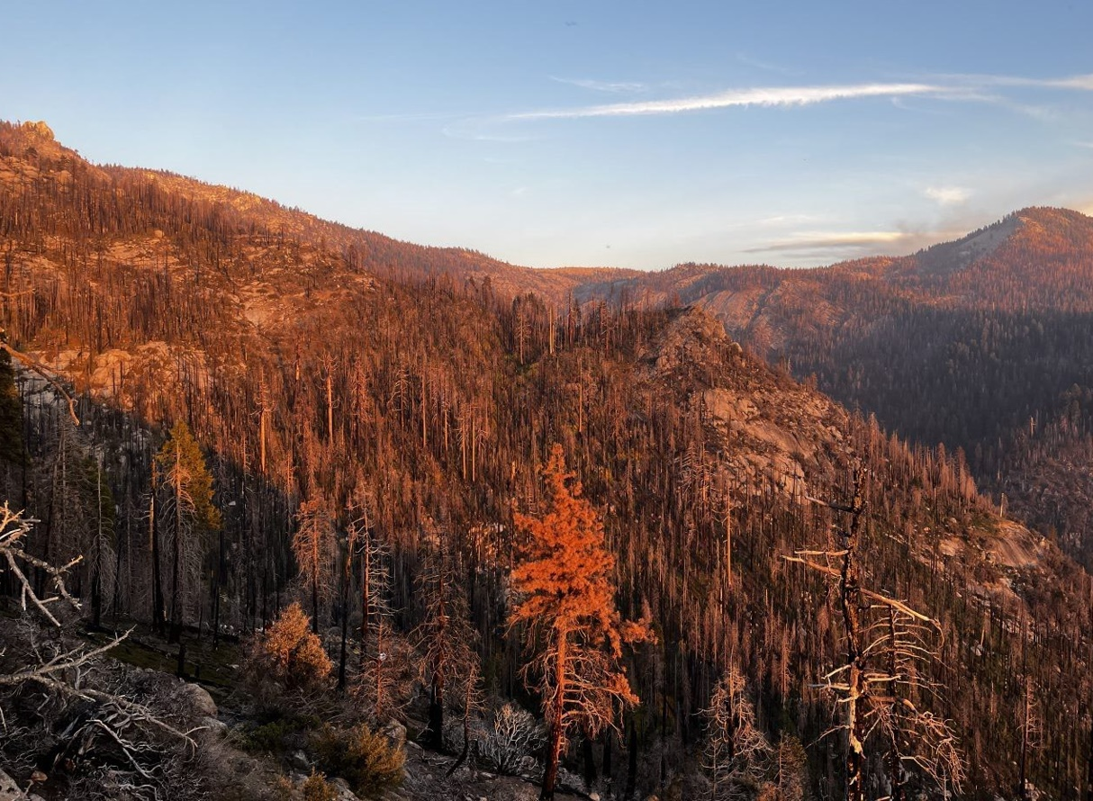
Lawsuit
Sequoia and Kings Canyon National Parks
National Park Service
U.S. Department of the Interior
A few environmental groups filed suit against the National Park Service
First over emergency actions taken to reduce fuels in sequoia groves in wilderness
In added the wilderness planting
Their challenge focuses on the National Environmental Policy Act (NEPA) and the Wilderness Act under Administrative Procedures Act
Notes:
I cannot speak to specific, but, Its impossible to ignore that we are being sued.

Slide 26
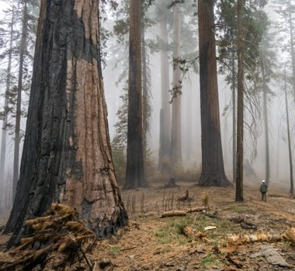
Lessons Learned
Sequoia and Kings Canyon National Parks
National Park Service
U.S. Department of the Interior
Tenacity
Ask for help
Take care of your people
Get even more help
Emphasize administration
Take care of yourself

Slide 27
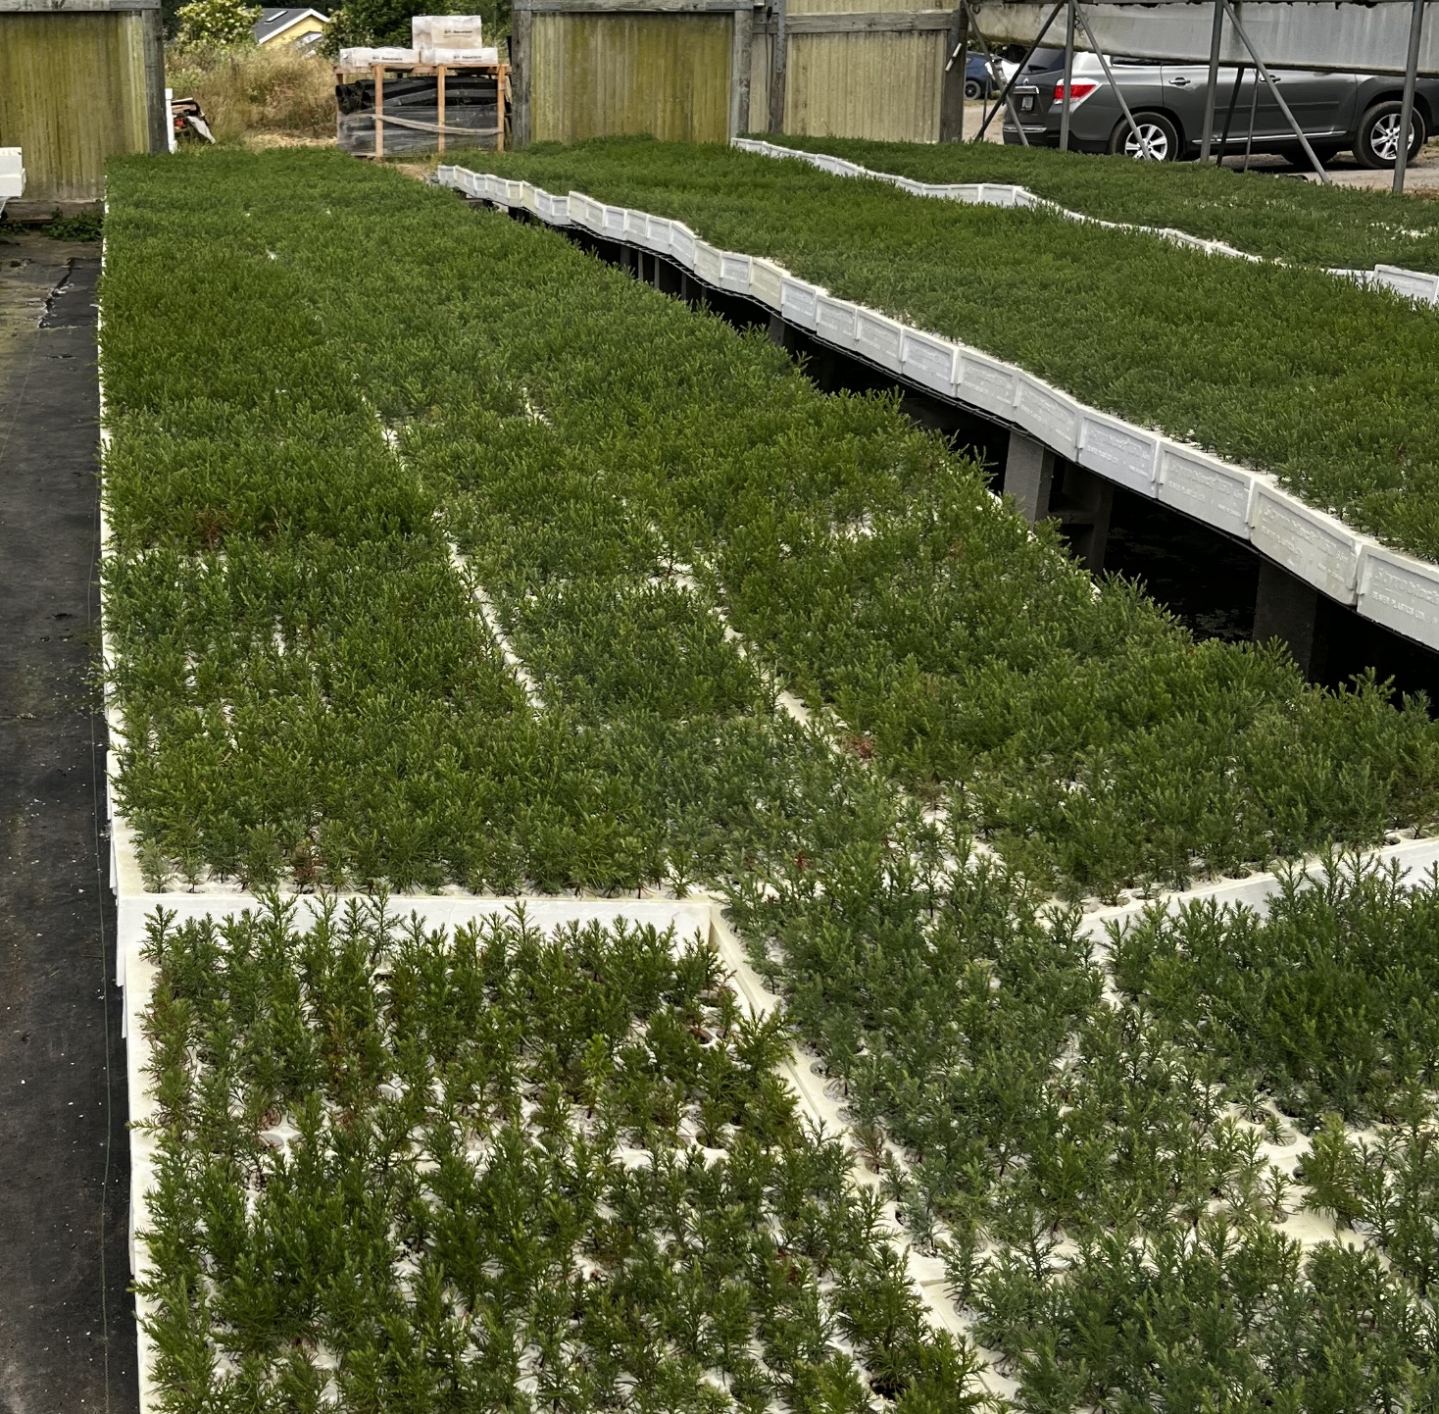
The Upshot
Sequoia and Kings Canyon National Parks
National Park Service
U.S. Department of the Interior
SEKI was well situated to leverage relationships
If you haven't had the big fire
  Consider how it can impact what you care about
  Do you know enough about how you would respond?
  Who are your collaborators?
People will line up to help and answer the call when you need it.
Notes:
Question Norms, the times they are a changin’
We can no longer rely just on what worked in the past, data and science

Slide 28
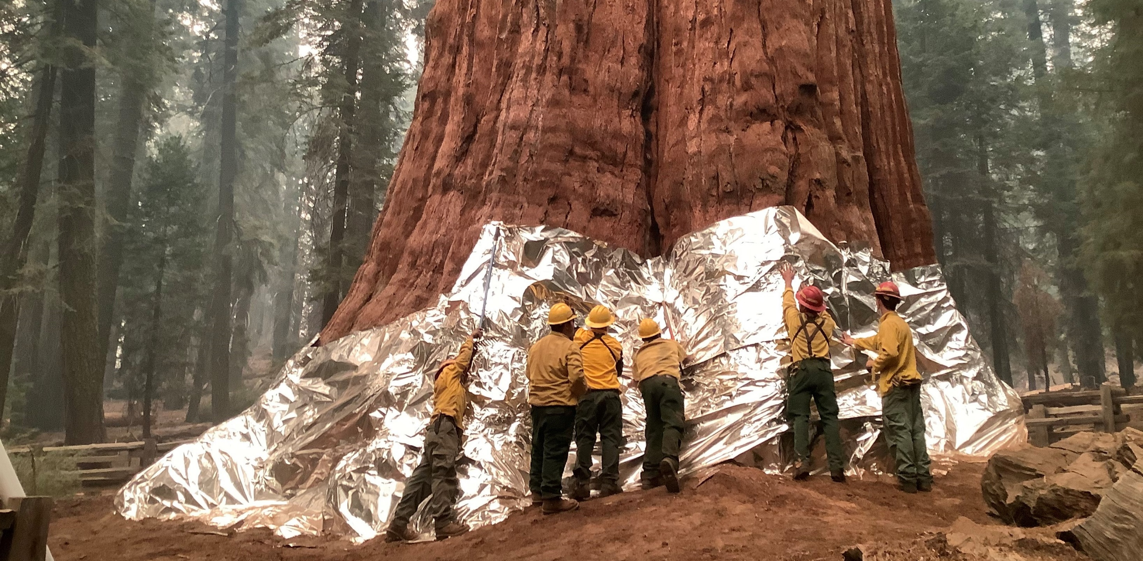
Support & Gratitude
Sequoia and Kings Canyon National Parks
National Park Service
U.S. Department of the Interior
Notes:
Of course a massive thank you to all the firefighters during both fires.

Slide 29
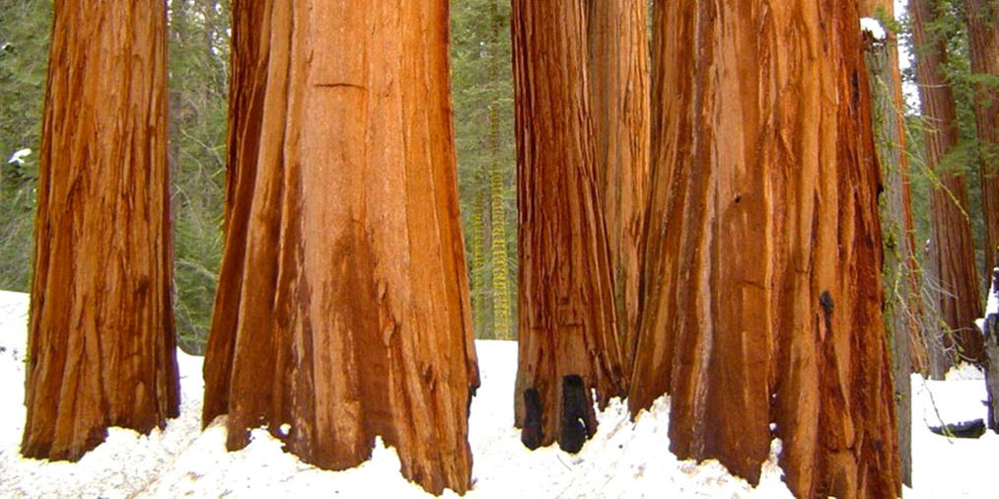
Sequoia and Kings Canyon National Parks
National Park Service
U.S. Department of the Interior
Questions?

