Slide 1
Reverse Engineering the Problem
How Deploying Place-Based Solutions Builds Community Capacity To Reduce Wildfire Risk and Simultaneously Foster Recovery
Alex Keeble-Toll & Alessandra Zambrano
Notes:
AK

Slide 2
Introduction
County of Nevada Office of Emergency Services
Alex Keeble–Toll, Senior Administrative Analyst
Alessandra Zambrano, County Wildfire Coordinator
Notes:
AK

Slide 3
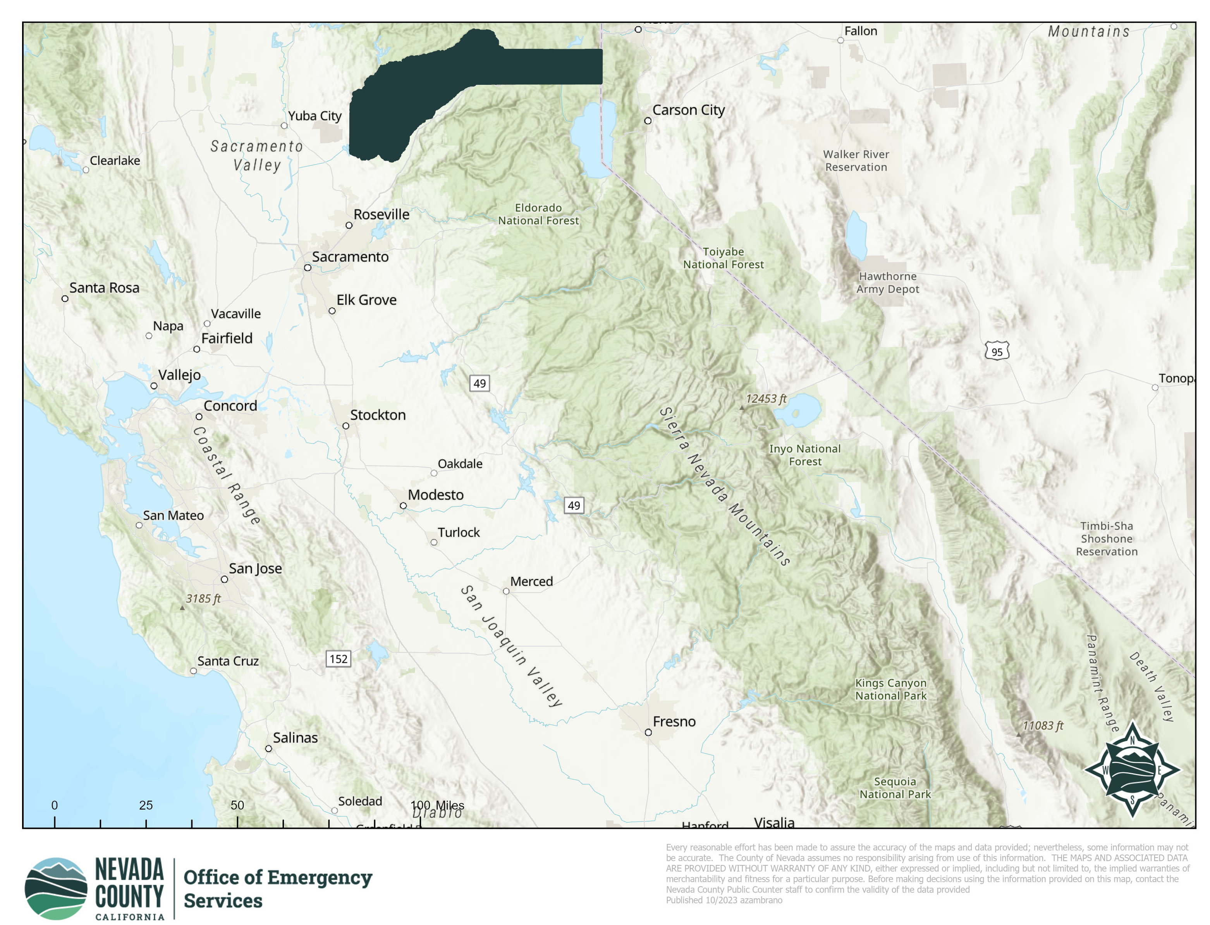
Nevada County
Rural county in Sierra Nevada Foothills
3 cities
Population approximately 100,000
2,520 square kilometers
Elevation from below 300 meters to above 2,700 meters
Notes:
AK

Slide 4
Nevada County’s Community
Very diverse community types
Working Landscape to High Amenity/High Resource
Diverse adaptive capacity
Different tolerance for disasters and recovery
East vs. West divide
Notes:
AK

Slide 5
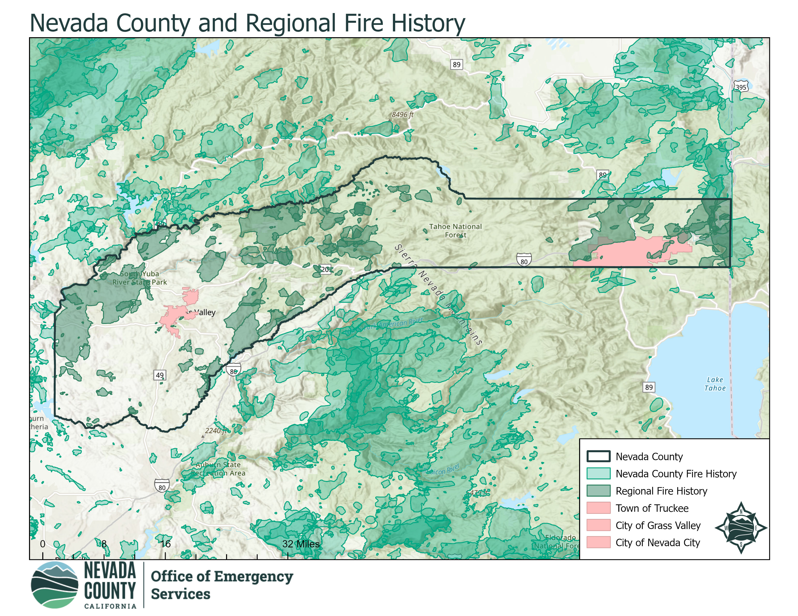
Nevada County’s Fire Problem
Over 90% is Very High Fire Hazard according to CAL FIRE
Over 50% of the County is in the Tahoe National Forest
Significant fuel loading
Fire debt
Infrastructure and homes are very old
Forest health issues
Notes:
AK

Slide 6
2022 Winter Storm
2021/2022 Winter Storms
Snow below 2,000ft elevation
Over 30% of County without power
No heat and limited water
Federally declared disasters
Widespread storm debris and increased risk for fire season
Hit communities below the snowline
Underprepared and limited resources/aid
Low tolerance for snow
Notes:
AK

Slide 7
2022 Winter Storm Recovery
Focused on the removal of storm debris
Free community green waste events
Successful and widely used
Dependent individual capacity and ability
Top-down solution to the problem
Provided recovery relief without adaptation
Notes:
AZ

Slide 8
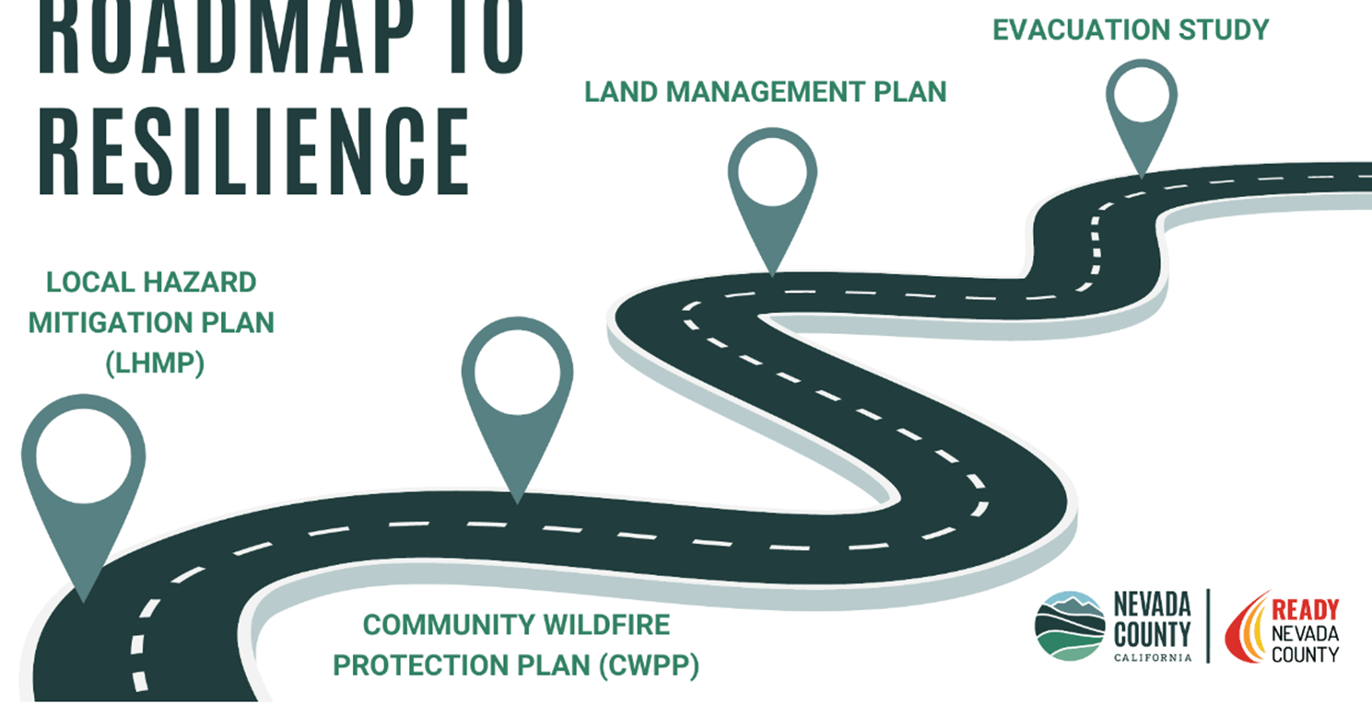
Nevada County Roadmap to Resilience
Launched in May 2023
Strategic planning opportunity
Opportunity to understand community adaptive capacity and risk tolerance
CWPP Survey
Opportunity to build resilience and foster recovery
Evacuation Study
Notes:
AK

Slide 9
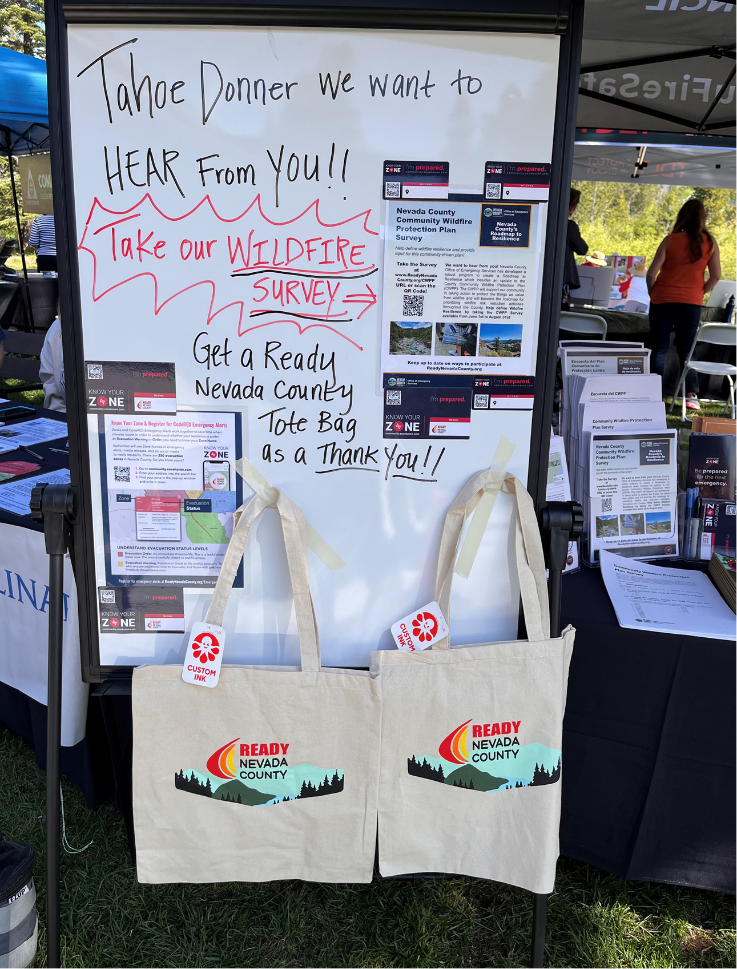
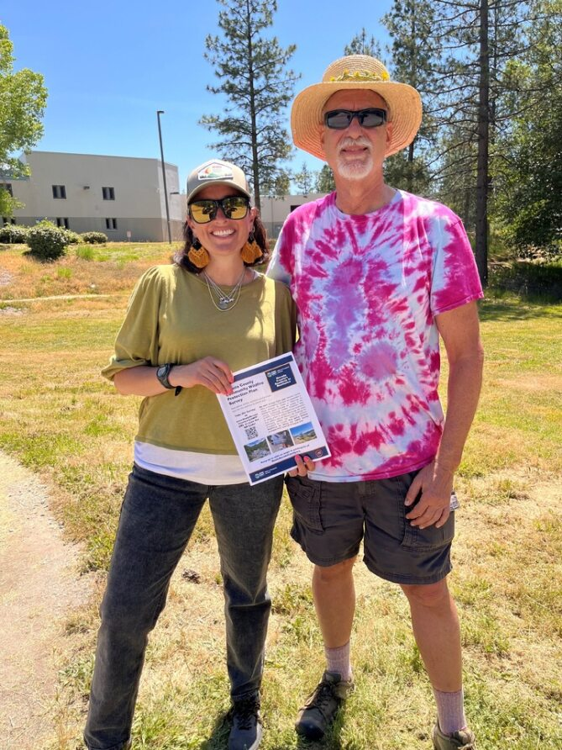
CWPP Survey
Meet wildfire modeling needs
Risk assessment and prioritization
Individual risk tolerance
Experience with wildfire
Evacuation behavior
Results
Minimal fire experience
High need for individual-scale resources
Evacuation ability is a primary concern
Notes:
AK

Slide 10
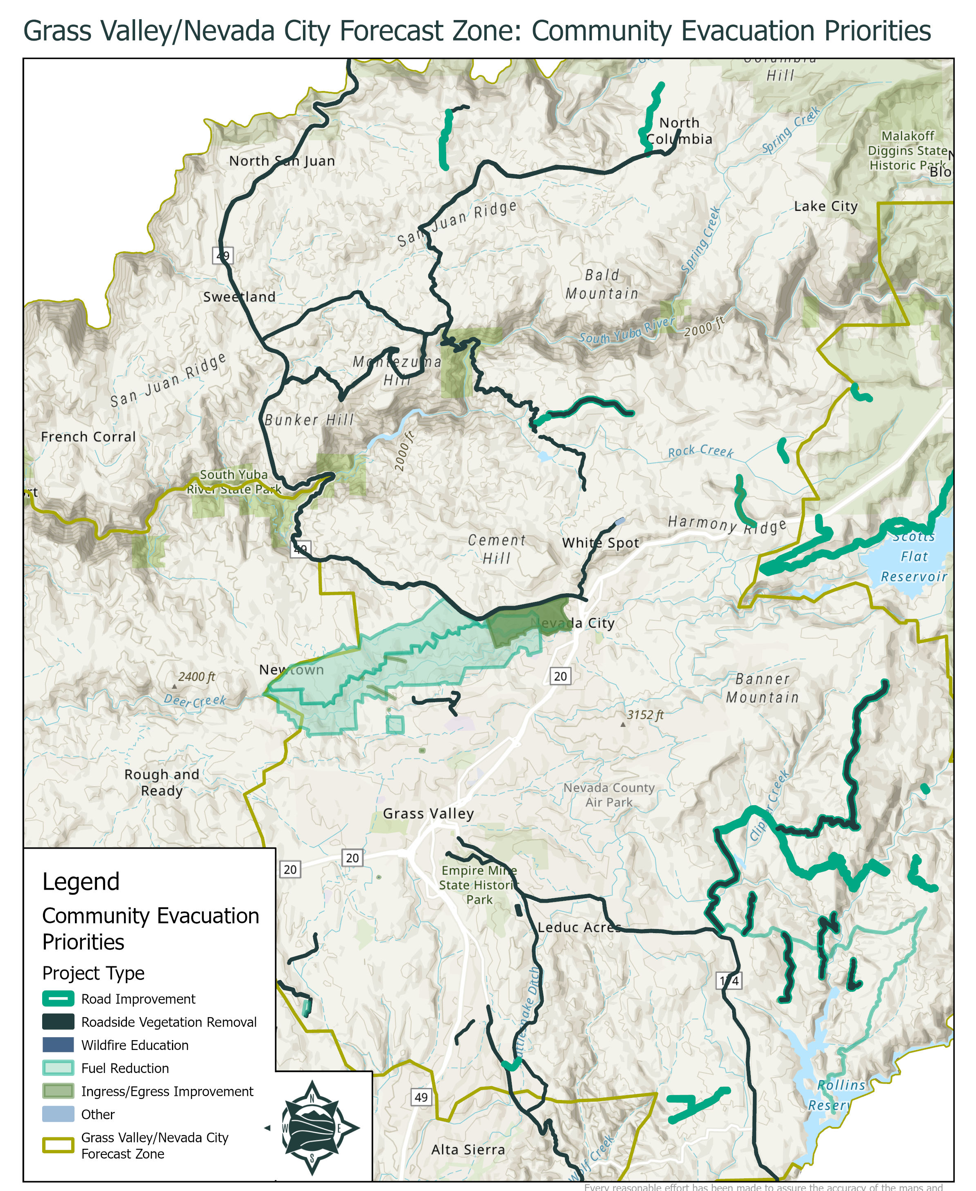
Evacuation Study
Limited funding
Focused on county roads
Top 5 communities
Community Appendix
Expand study scope
Communities identified evacuation concerns and solutions
Mapping tool
Notes:
AK

Slide 11
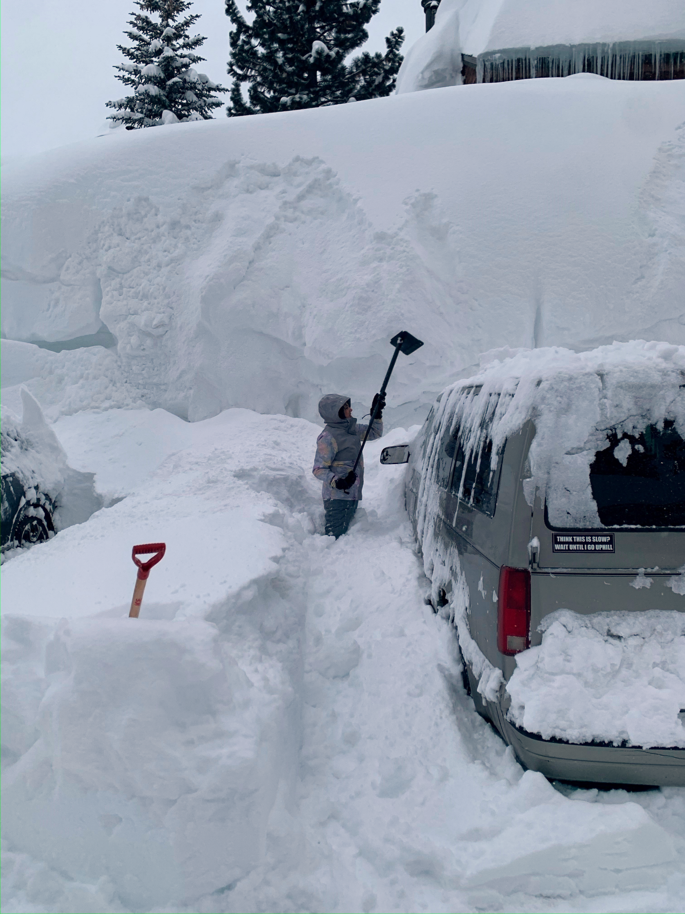
2023 Winter Storms
2023 Winter Storms
Back-to-back atmospheric rivers
February and March
No recovery time
Snow below 500 ft elevation line
Significant infrastructure damage
Major power outages, propane outages, & trapped residents
700 inches of snow at the end of the season
Federally declared disaster
Storm debris/hazardous vegetation
Notes:
AZ

Slide 12
2023 Storm Recovery
Turn knowledge into action
Build capacity
Targeted highest-impact communities
Direct community support
Multi-phased
Communities told us what, where, and how they needed help
Designed response to fit the need
Notes:
AZ

Slide 13
2023 Storm Recovery
Layered approach
Community-wide green waste events
Direct community green waste bins
Community-directed roadside vegetation removal and hand crew deployment
Partnered with Firewise Communities
Expanded to roads in Evacuation Study Community Appendix
Result
Recovery was easier
Notes:
AZ

Slide 14
2024 Green Waste Planning
Lessons learned from 2022 and 2023
Still recovering
Shifting from reactive to proactive
Ready Set Snow!
Putting systems in place for future impacts
Build on capacity developed in 2023
Partnership with Waste Management
Firewise Community Bin Program
2024 Micro Grant Program
Notes:
AZ

Slide 15
Recovery with Adaptive Change
Use Roadmap to Resilience to train the “why”
Future needs to invest in the “what” and “how”
Turn constituents into partners
2023/2024 Congressionally directed spending request
49 $25,000 “Micro” Grants
Intentional, streamlined, and collaborative project development

Slide 16
Takeaway
Wildfire resilience requires an understanding of the whole disaster system
Notes:
AZ

Slide 17
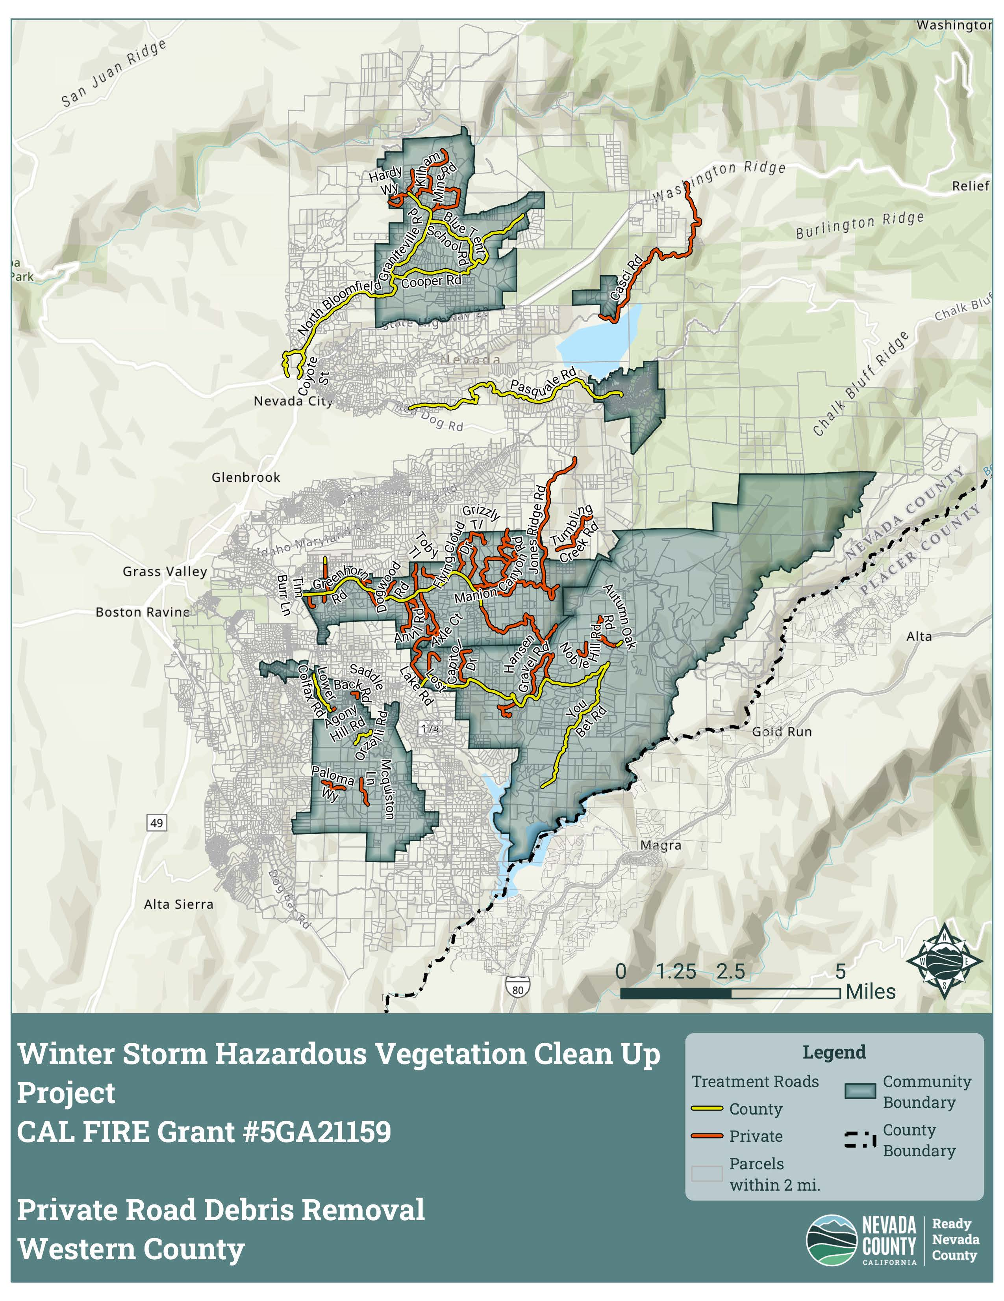
Takeaway
Proactive recovery means building community capacity to foster adaptive change
Notes:
AZ

Slide 18
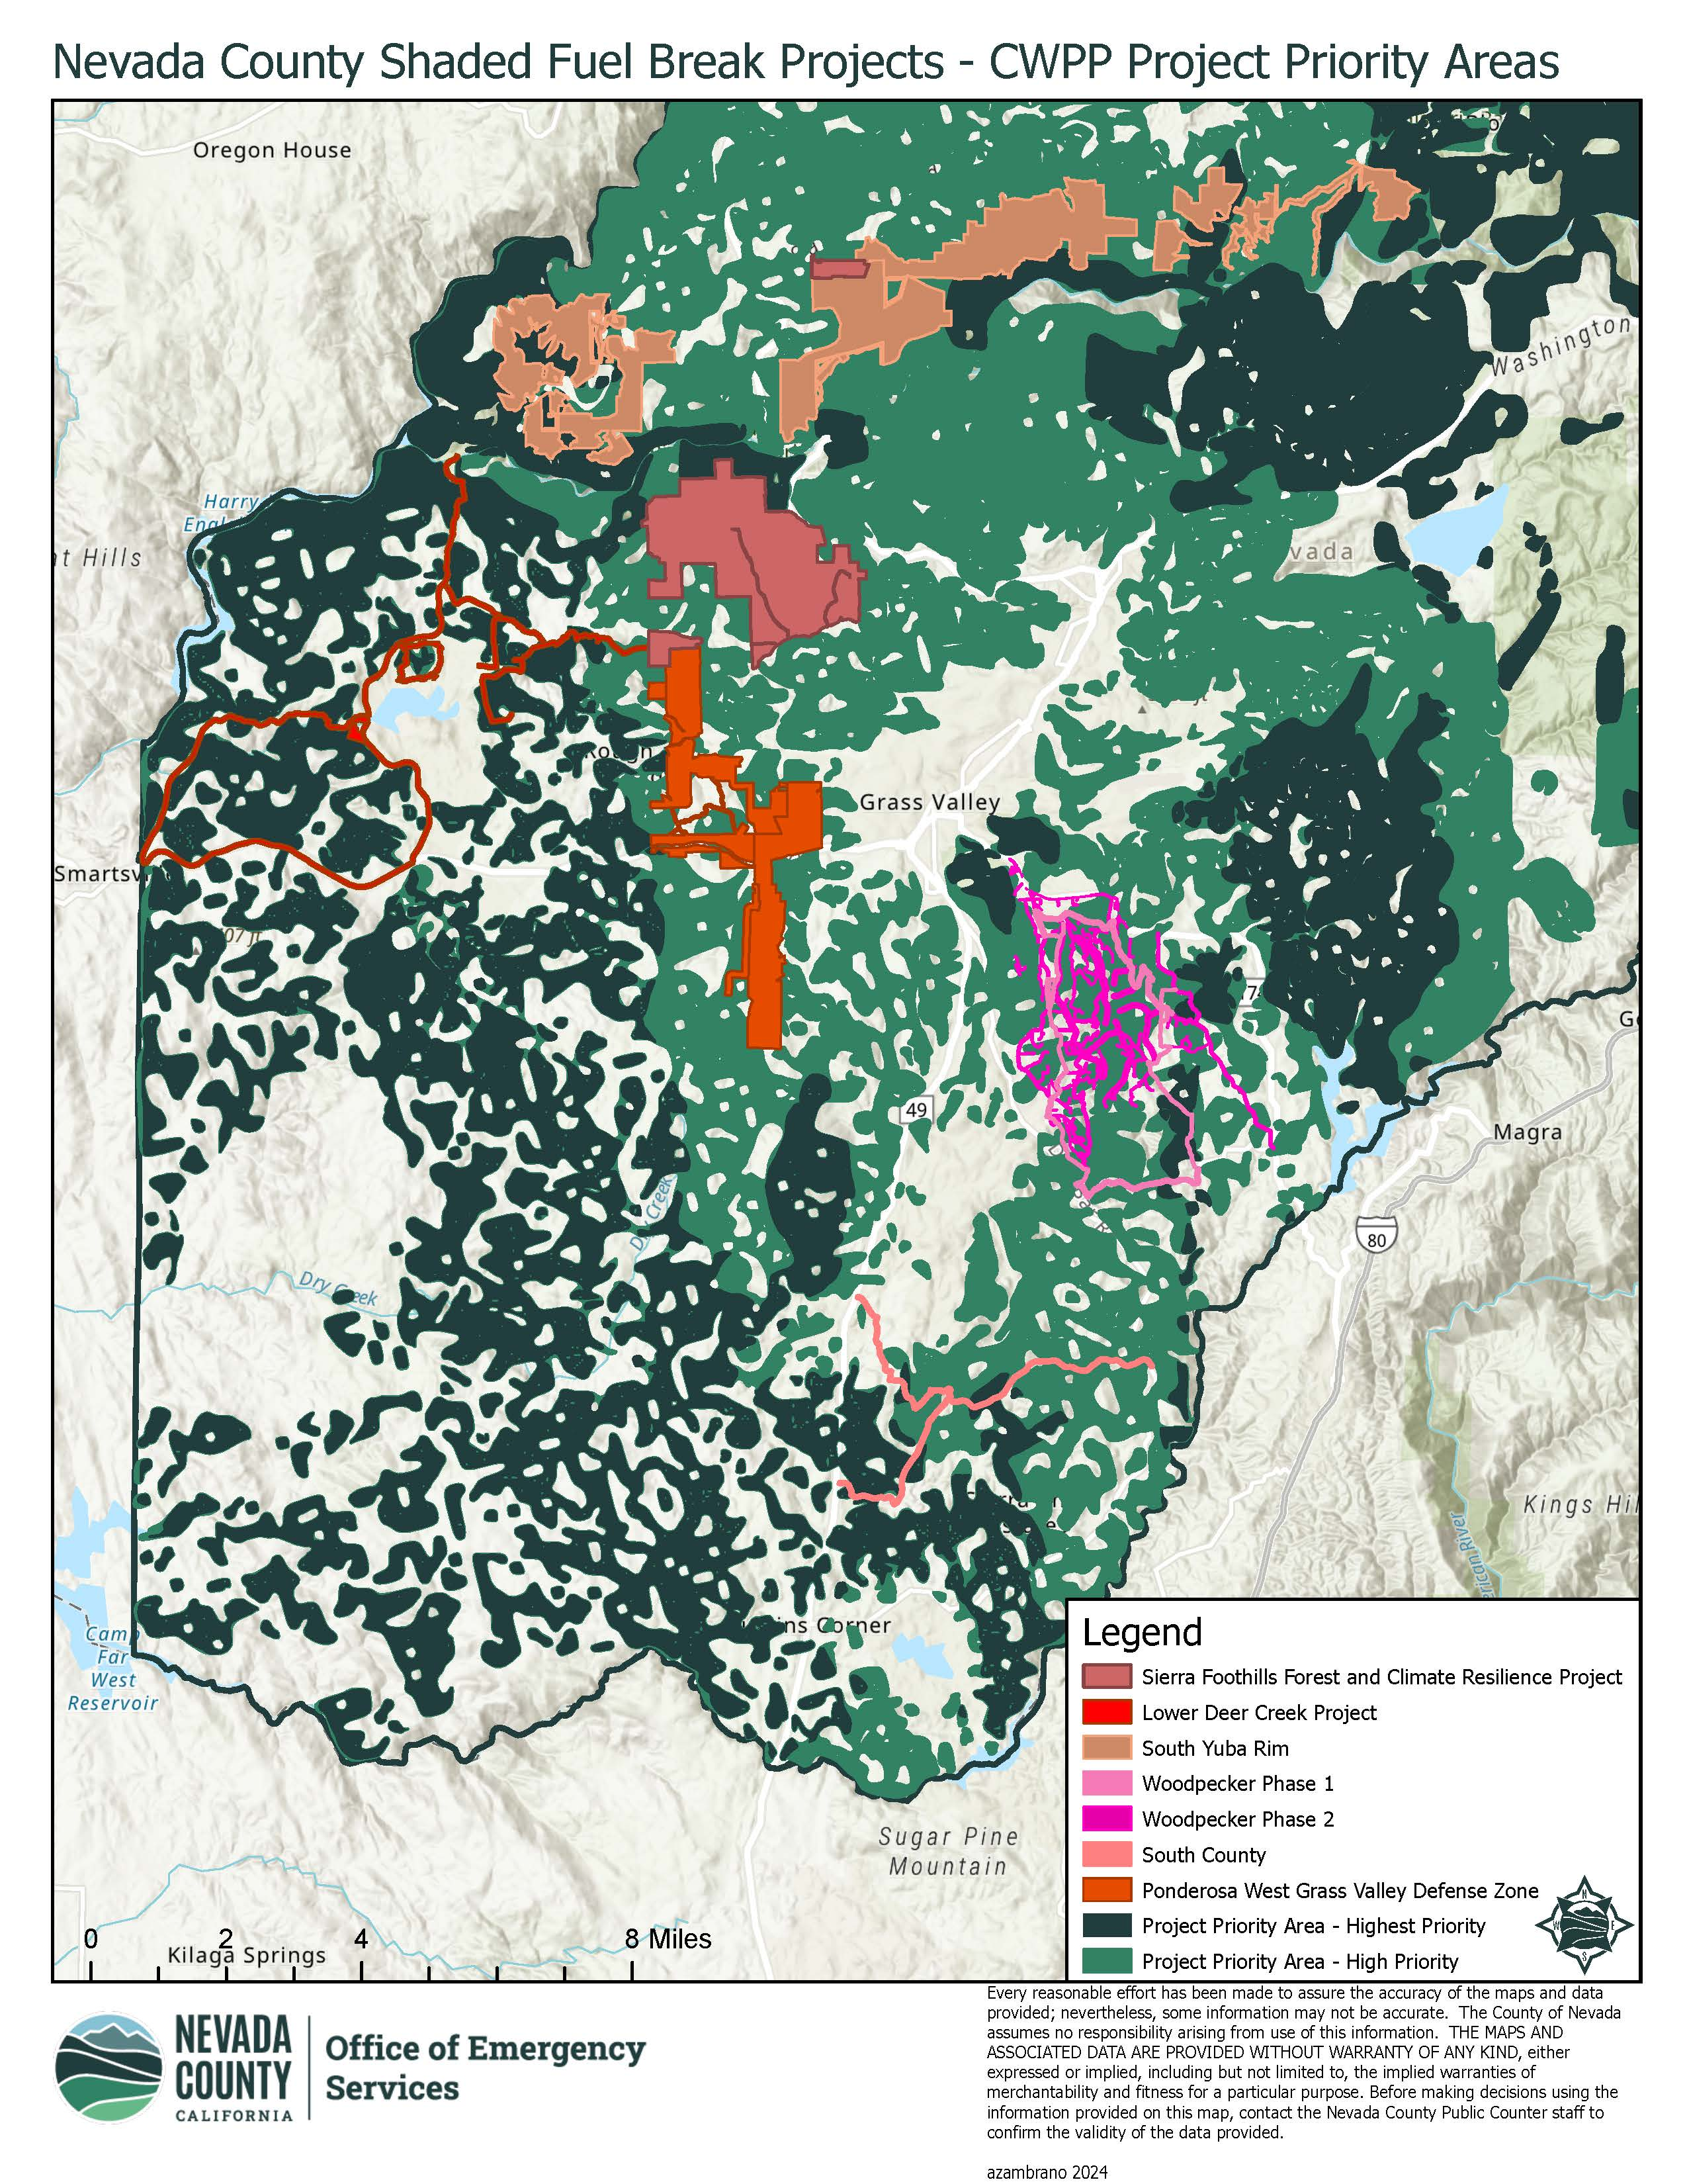
Takeaway
Recovery requires reverse engineering the solution so that recovery starts long before the wildfire with early investments in solutions at all scales
Notes:
AZ

