Slide 1
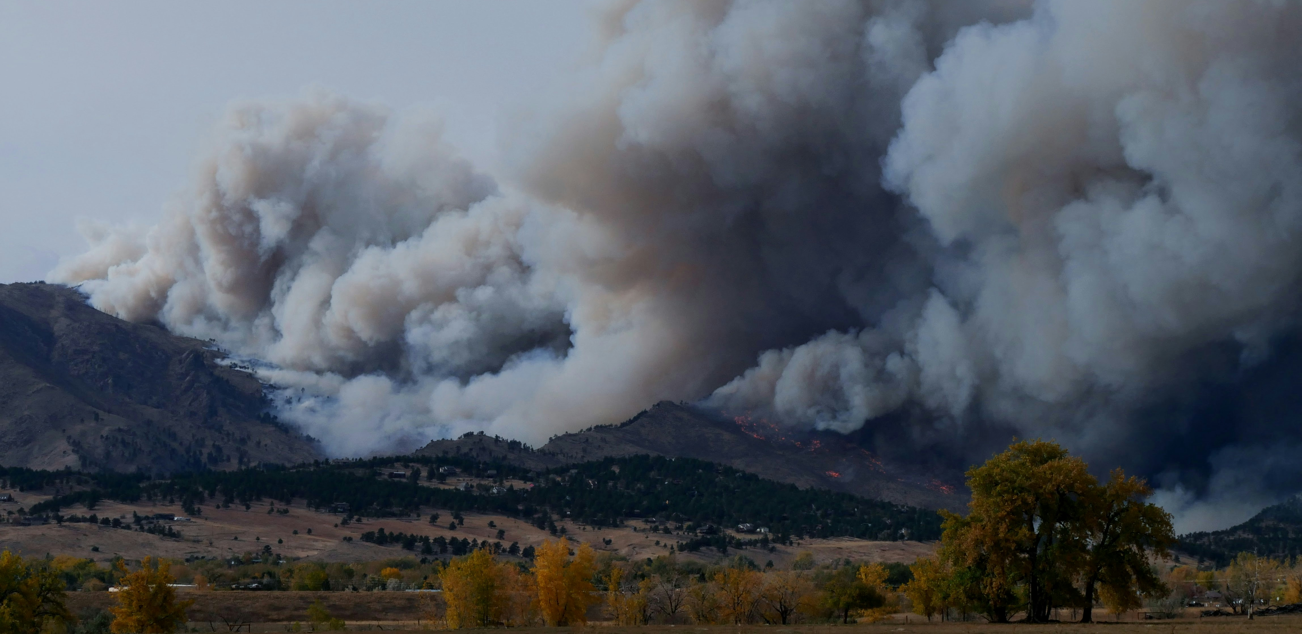
Predicting POST-FIRE DEBRIS FLOW risk APPLYING AN EXISTING MODEL TO A NEW CONTEXT
COCO After the Flames Conference / Estes Park, CO / April 15, 2024
Natalie Collar, Ph.D., CFM (WWE)
Claire Vavrus, E.I.T. (WWE)
CO-AUTHORS:
Andrew Earles, Ph.D., P.E. (WWE)
Madison Gutekunst, P.E. (WWE)
Kristin Karashinski (WWE)
Jeff Sickles, P.E., CFM (Olsson)
Chris Sturm, P.E. (CWCB)

Slide 2
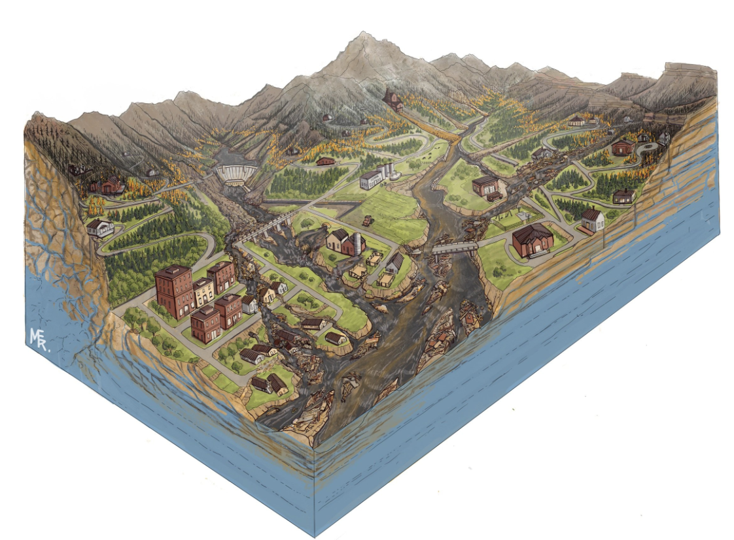
Wildfire Ready Watersheds (WRW) program aims to assess state-wide resources susceptible to post-fire hazards before wildfires occur.
2
Legislative directive from SB21-240.
Mission: Assess the susceptibility of Colorado’s water resources, communities, and critical infrastructure to post-wildfire impacts and advance a framework for communities to plan and implement mitigation strategies to minimize these impacts – before wildfires occur.
Goal: Minimize false positives and false negatives.
Constraints: Time and budget.
WWE was on the technical advisory (TA) team for the statewide analysis.

Slide 3
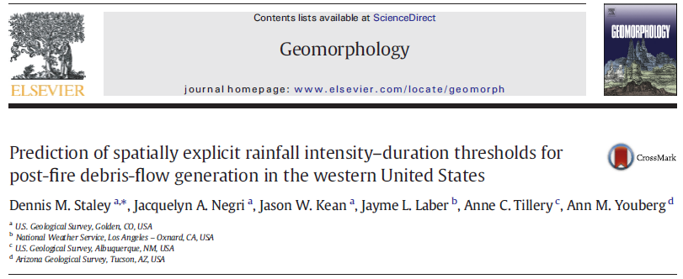
WWE used an existing debris flow prediction model and existing data layers to generate a statewide susceptibility map
WWE
3
1
2
3
MODEL INPUT VARIABLES

Slide 4
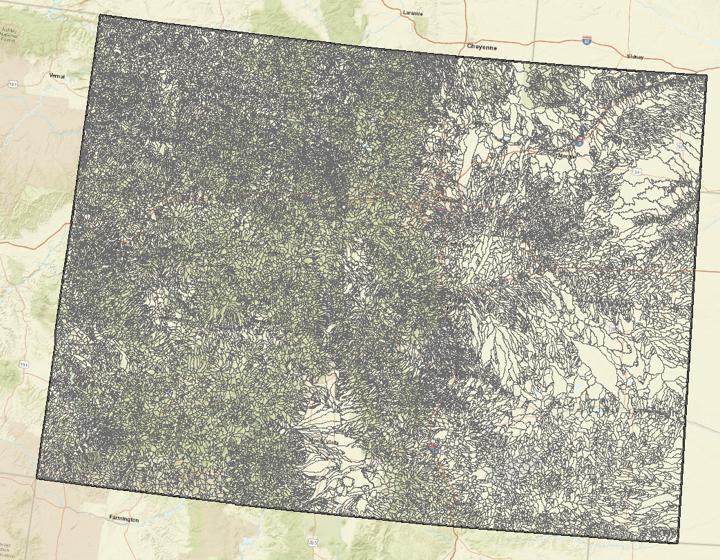
WWE used an existing debris flow prediction model and existing data layers to generate a statewide susceptibility map - Catchments
WWE
3
1
2
3
MODEL INPUT VARIABLES

Slide 5
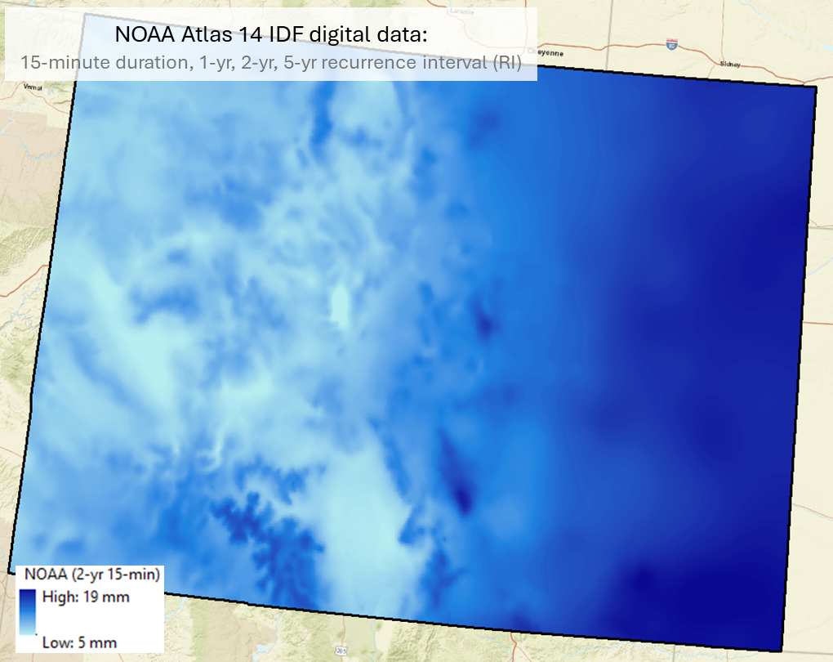
WWE used an existing debris flow prediction model and existing data layers to generate a statewide susceptibility map.
WWE used an existing debris flow prediction model and existing data layers to generate a statewide susceptibility map – 15-min peak rainfall
WWE
4
1
2
3
MODEL INPUT VARIABLES

Slide 6
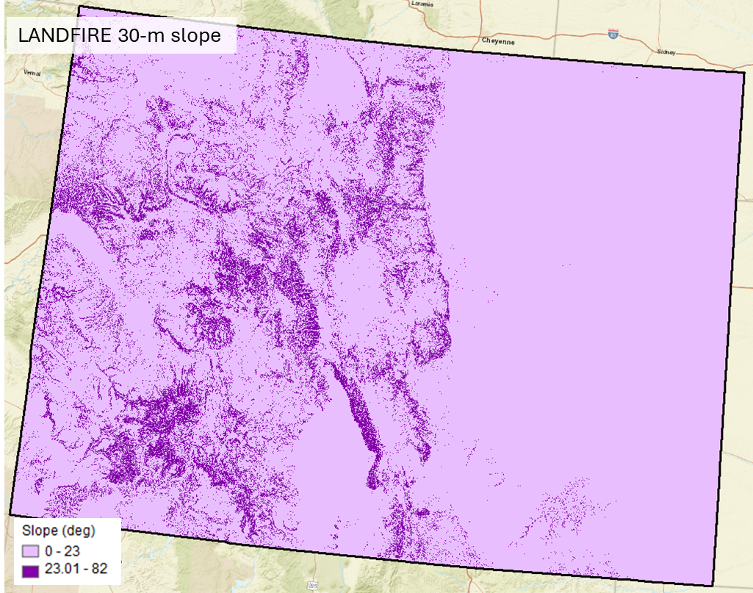
WWE used an existing debris flow prediction model and existing data layers to generate a statewide susceptibility map - Slope
WWE
5
1
MODEL INPUT VARIABLES

Slide 7
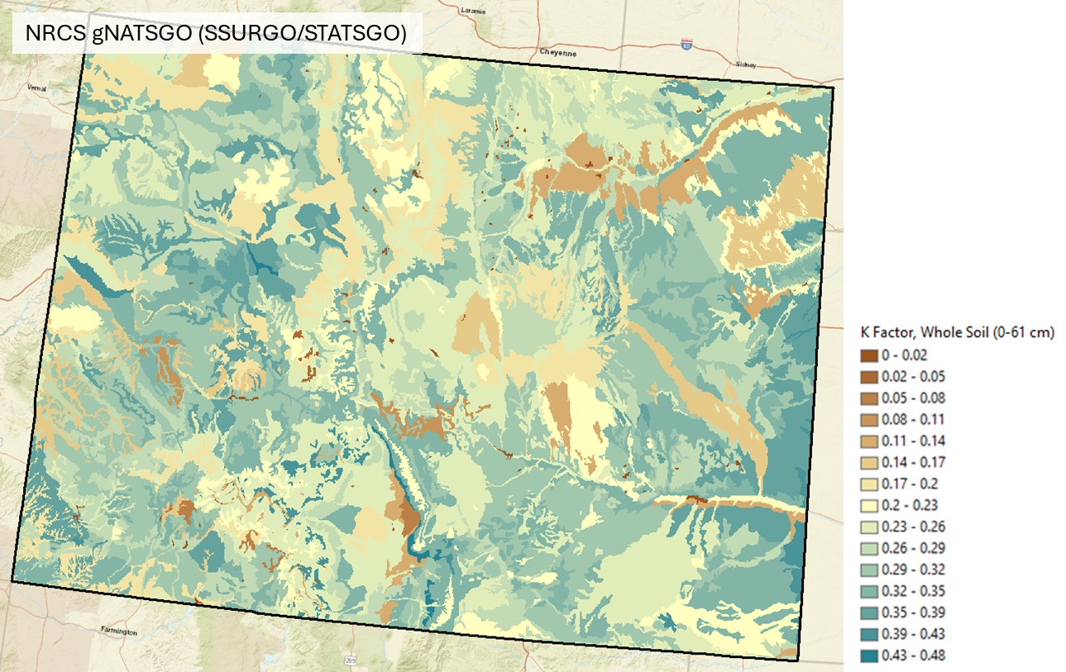
WWE used an existing debris flow prediction model and existing data layers to generate a statewide susceptibility map.
WWE used an existing debris flow prediction model and existing data layers to generate a statewide susceptibility map - Erodibility
WWE
6
3
MODEL INPUT VARIABLES

Slide 8
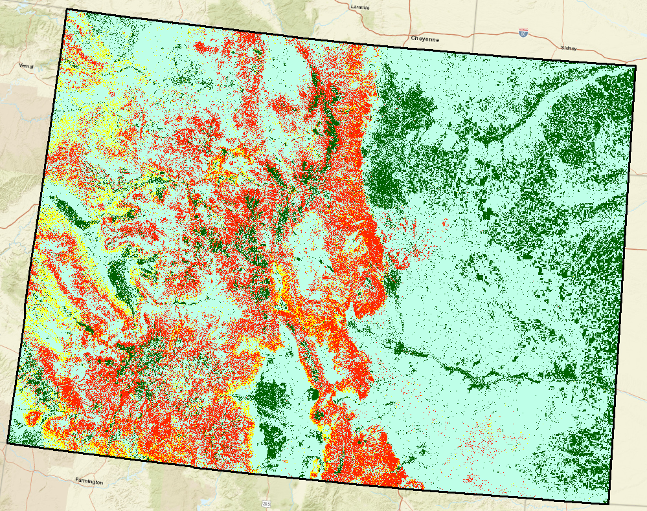
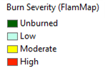
WWE used predictive crown fire activity under the most extreme fire weather conditions as a proxy for predictive burn severity and dNBR data.
WWE used an existing debris flow prediction model and existing data layers to generate a statewide susceptibility map – Burn severity class (predictive)
WWE
7
Burn severity class was inferred from Crown Fire Activity output layer from a fire behavior model (FlamMap) as a part of CFRI Region 2 assessment using 2016 fuels data.
Inferred Burn Severity Class
Crown Fire Activity Class
1
Unburned
2
Surface Fire Activity
Passive Crown Fire Activity
Active Crown Fire Activity

Slide 9
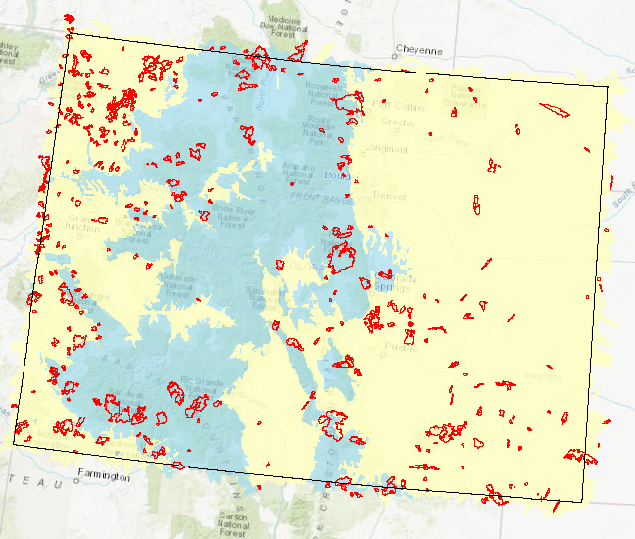
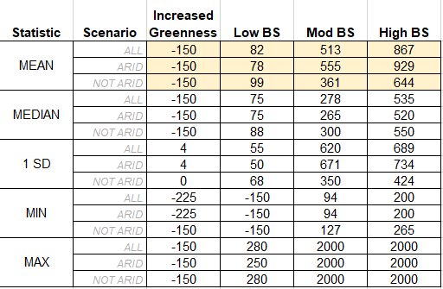
WWE used predictive crown fire activity under the most extreme fire weather conditions as a proxy for predictive burn severity and dNBR data.
WWE used an existing debris flow prediction model and existing data layers to generate a statewide susceptibility map – Burn severity (dNBR) (predictive)
WWE
7
Burn severity class was inferred from Crown Fire Activity output layer from a fire behavior model (FlamMap) as a part of CFRI Region 2 assessment using 2016 fuels data.
Inferred Burn Severity Class
Crown Fire Activity Class
1
Unburned
2
Surface Fire Activity
Passive Crown Fire Activity
Active Crown Fire Activity
Burn Severity dNBR thresholds provided for each perimeter

Slide 10
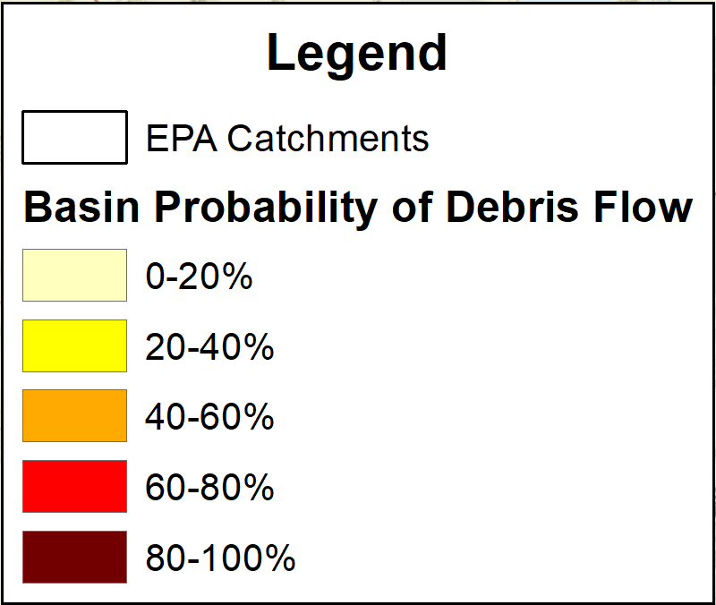
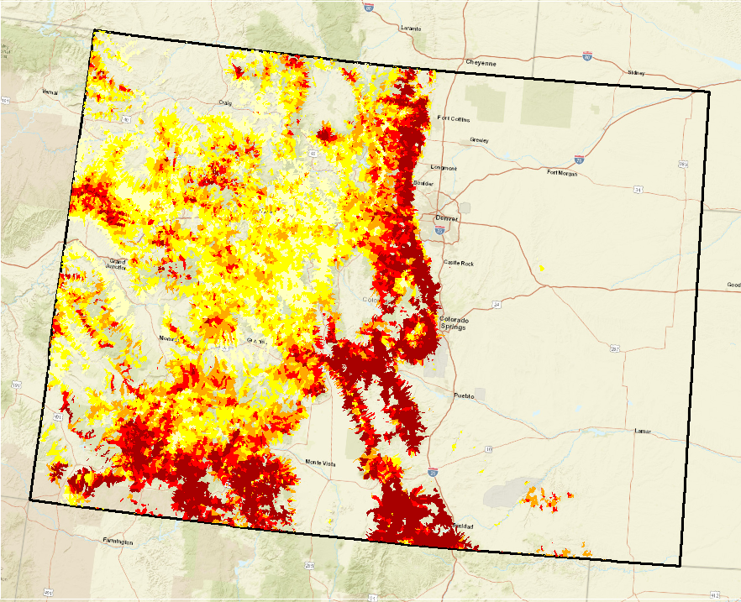
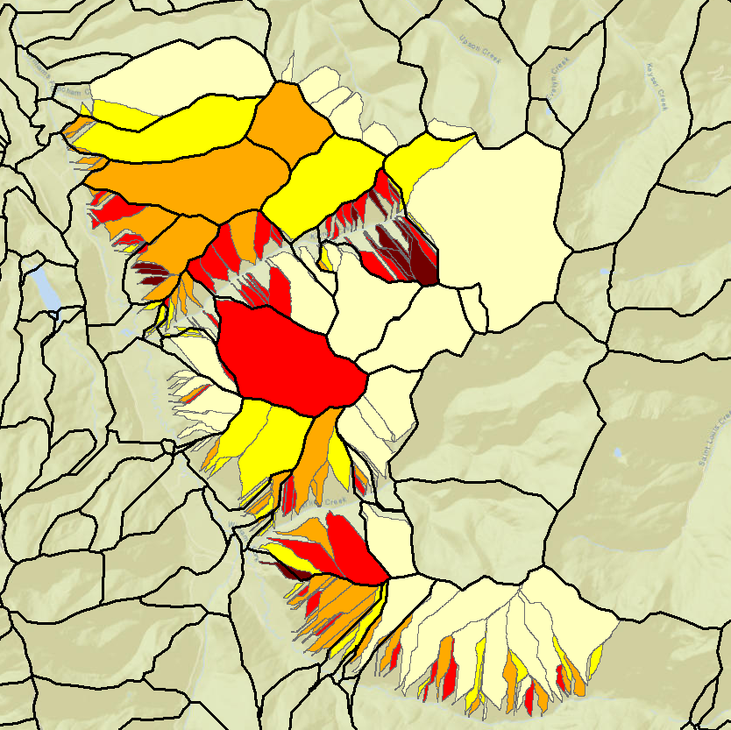
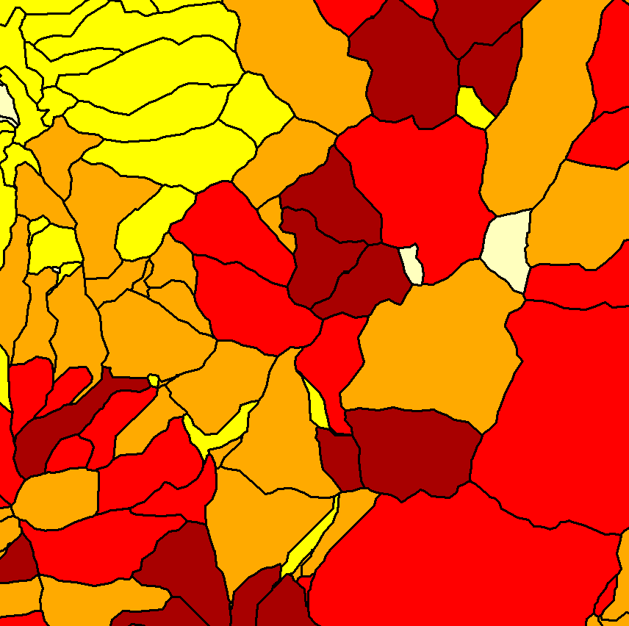
WWE calculated a relative debris flow probability for each EPA Catchment for the 1-year, 2-year, and 5-year recurrence intervals.
WWE
8
DATA LAYERS: Output (1-yr rainfall)
filtered by <°10 mean catchment slope
GOALS OF WRW Statewide Susceptibility Study:
High-level analysis assessing relative post-fire debris flow risk throughout Colorado.
Suppress false negatives.
Stay within budget and time constraints.
Provide useful information.
2020 Williams Fork fire
USGS DF Probability
WWE DF Probability

Slide 11
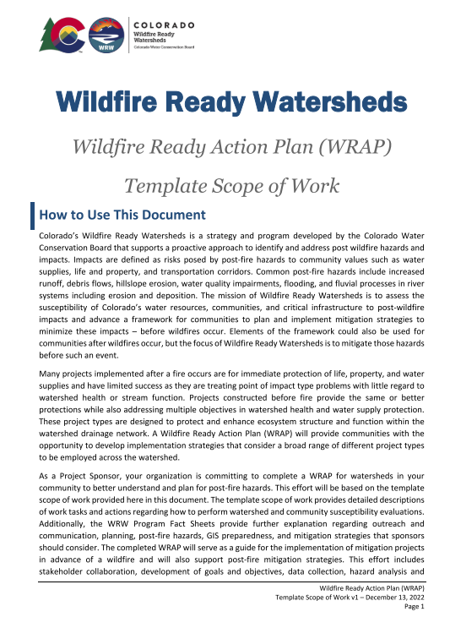
Colorado WRW program identifies the need for Wildfire Ready Action Plans (WRAPs) and defines the major elements of a WRAP.
9
WRAP Scope of Work:
Vision and Establishment of Goals and Objectives
Stakeholder Collaboration, Community Outreach, and Public Meetings
Data Collection, Research, Review, and Gap Analysis
Post-fire Hazard Analysis
Susceptibility Analysis
Pre-disaster Planning and Mitigation Activities
Project Management and Administration

Slide 12
Colorado WRW program identifies the need for Wildfire Ready Action Plans (WRAPs) and defines the major elements of a WRAP.
9
WRAP Scope of Work:
Vision and Establishment of Goals and Objectives
Stakeholder Collaboration, Community Outreach, and Public Meetings
Data Collection, Research, Review, and Gap Analysis
Post-fire Hazard Analysis
Susceptibility Analysis
Pre-disaster Planning and Mitigation Activities
Project Management and Administration

Slide 13
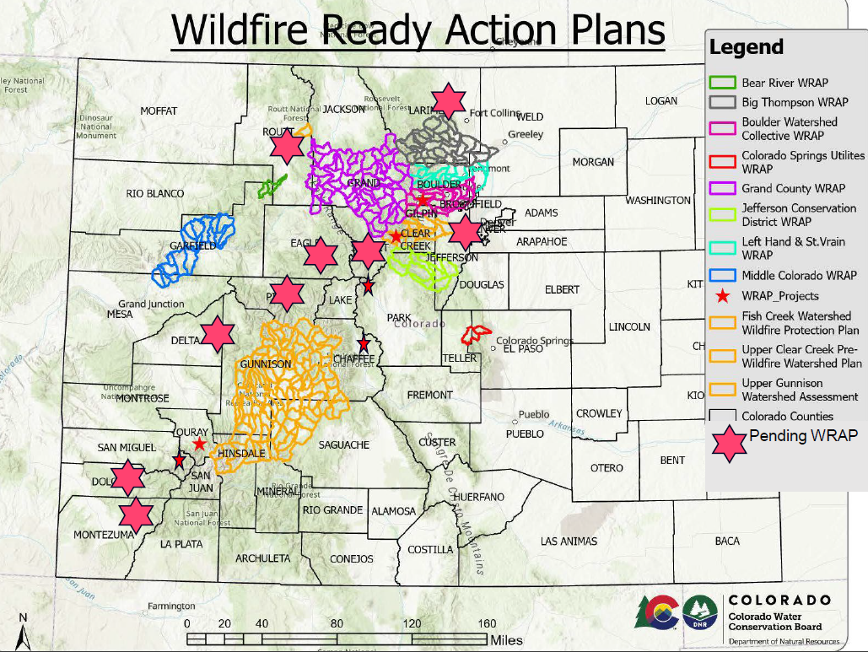
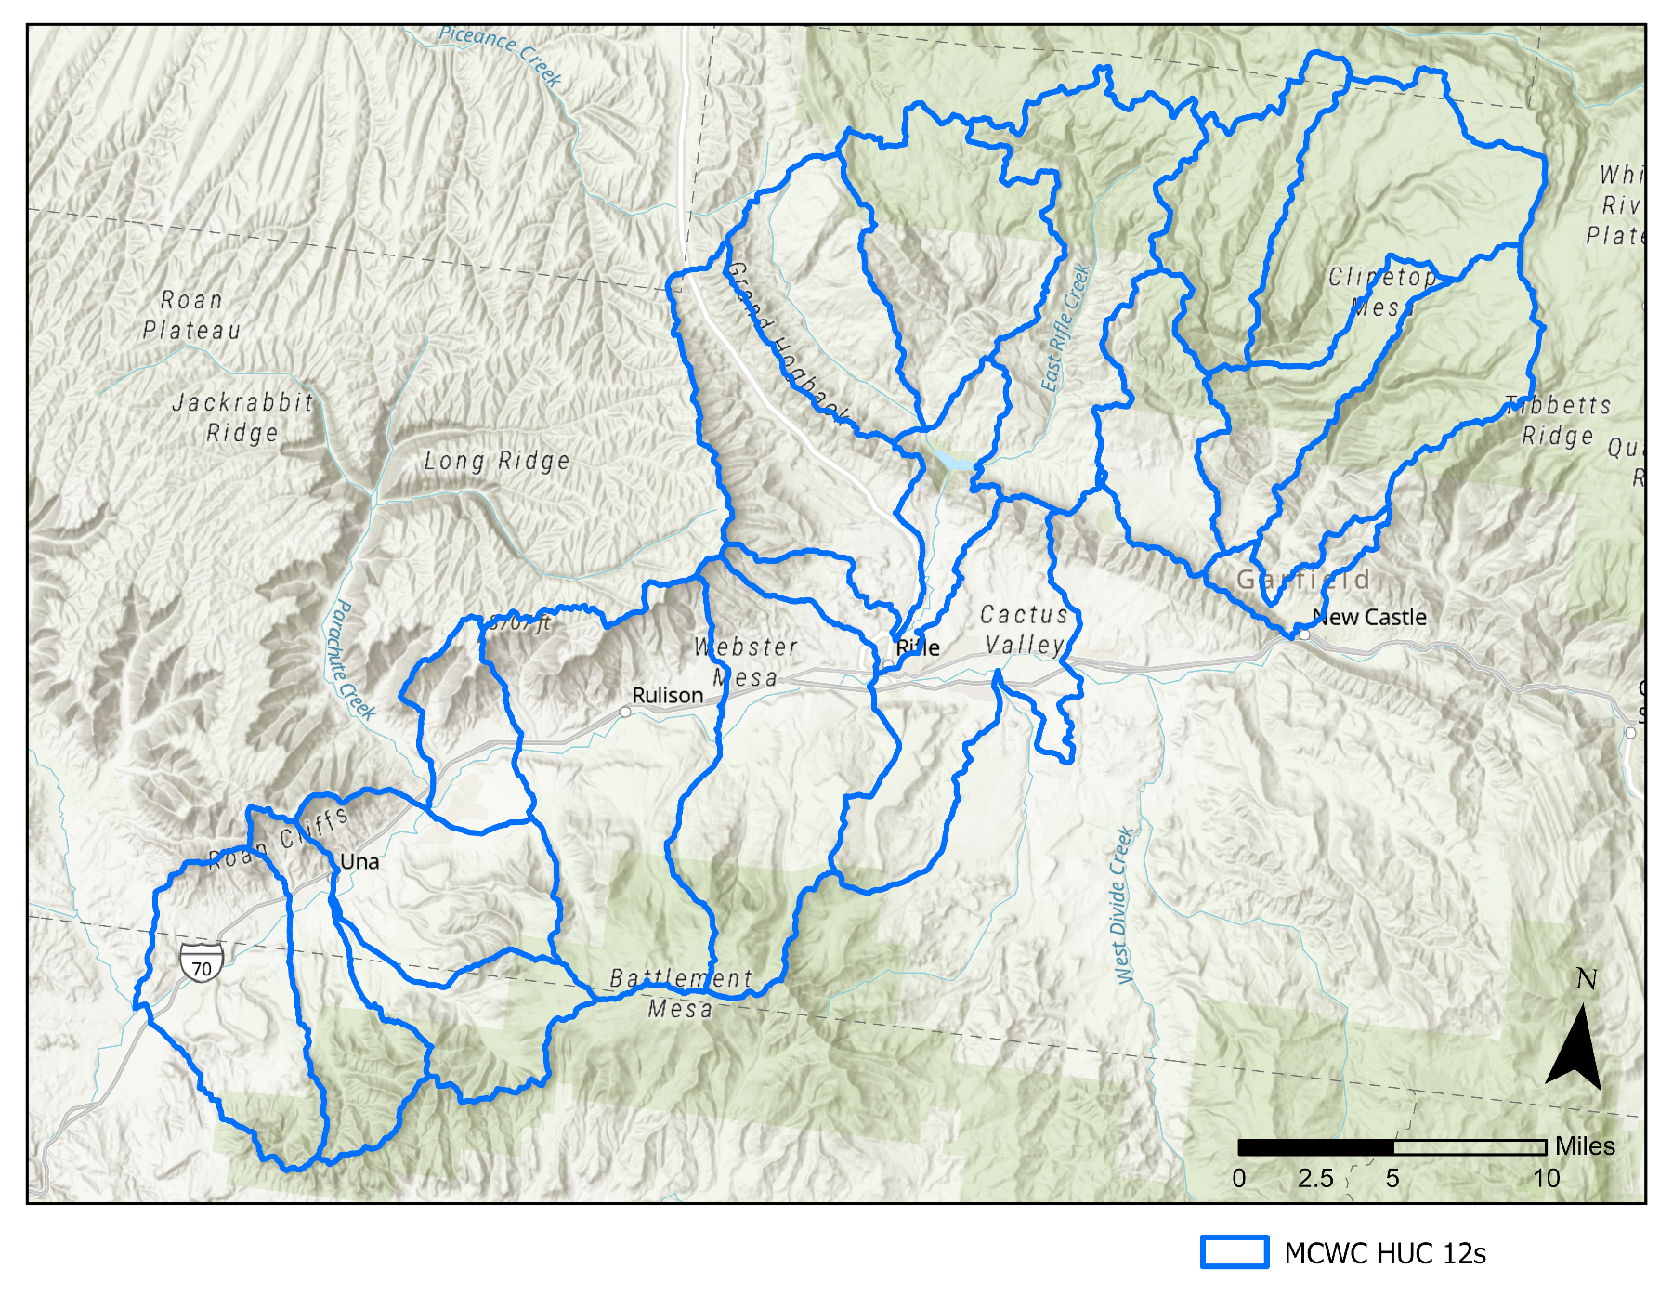
The state-wide technical analysis team is now assisting in the development of WRAPs for local project partners – e.g., MCWC WRAP
10
Location of ongoing WRAP for
Middle Colorado Watershed Council (MCWC)

Slide 14
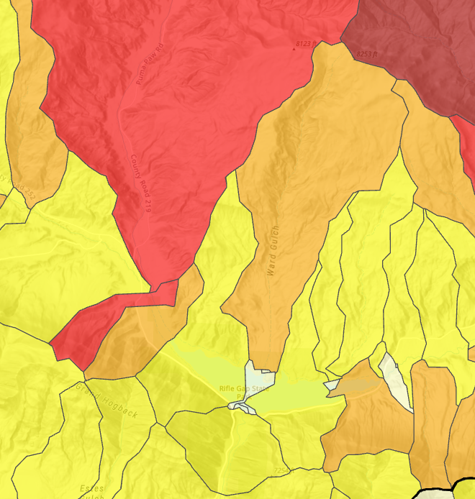
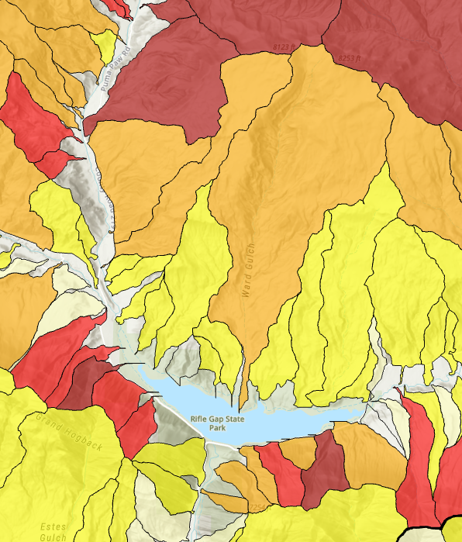
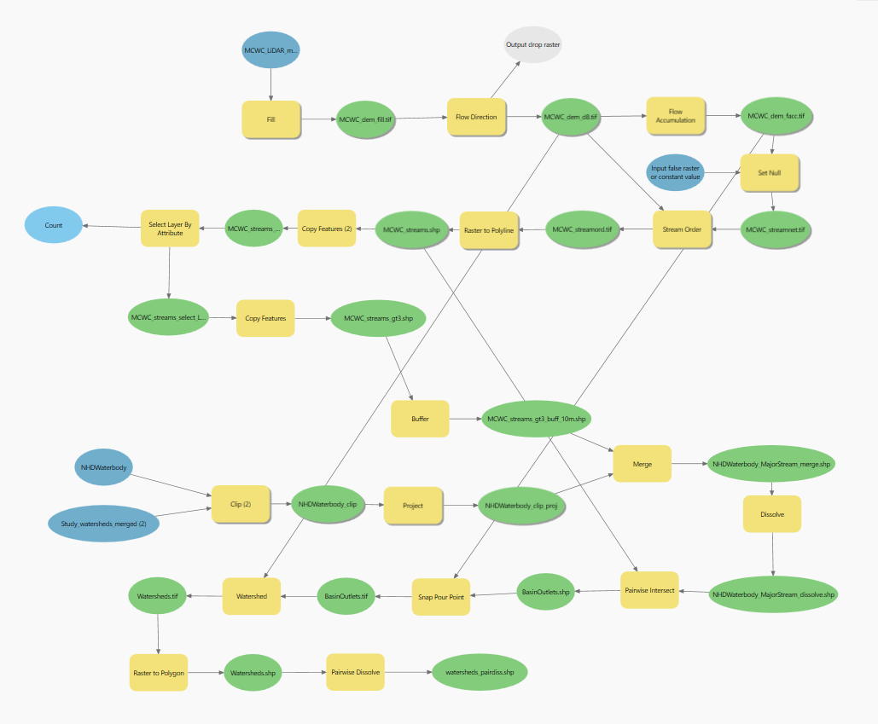
Opportunities for method refinement in WRAPS:
Unique basin delineation method focused on subcatchments and VARs
11
Opportunities for model refinement:
Apply M1 model to basins similar in size and topography to M1 model training dataset.
Statewide
Post-fire Debris Flow Probability
MCWC WRAP
Post-fire Debris Flow Probability
Basin delineation model
Rifle Gap Reservoir
Rifle Gap Reservoir

Slide 15
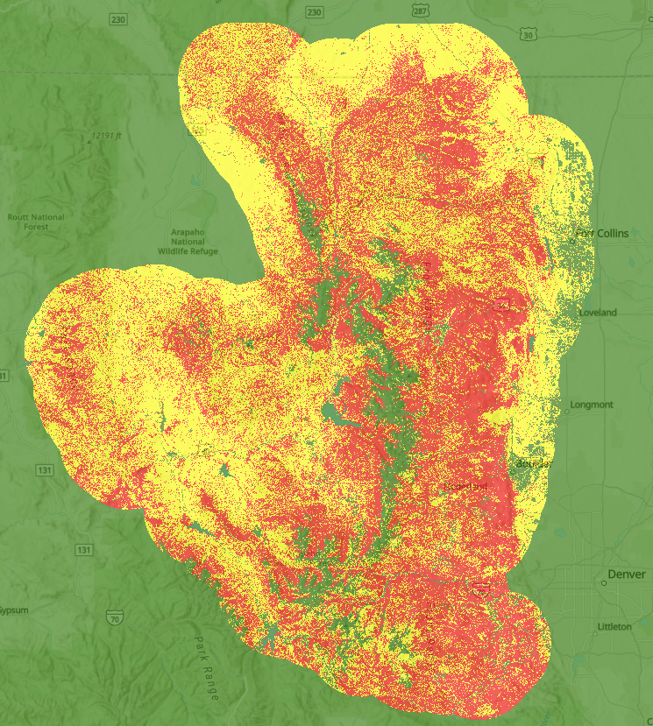
Opportunities for method refinement in WRAPS:
Updating predictive burn severity layer
12
Opportunities for model refinement:
Apply M1 model to basins similar in size and topography to M1 model training dataset.
Consider alternatives for predicting burn severity:
Other fire behavior model outputs that can infer burn severity.
E.g., Flame Length, broken out by vegetation type.
Preliminary: Crown fire activity data layer using 2022 fuel data for WRAP located in the Front Range.
Unburned
Surface Fire Activity
Passive Crown Fire Activity
Active Crown Fire Activity

Slide 16
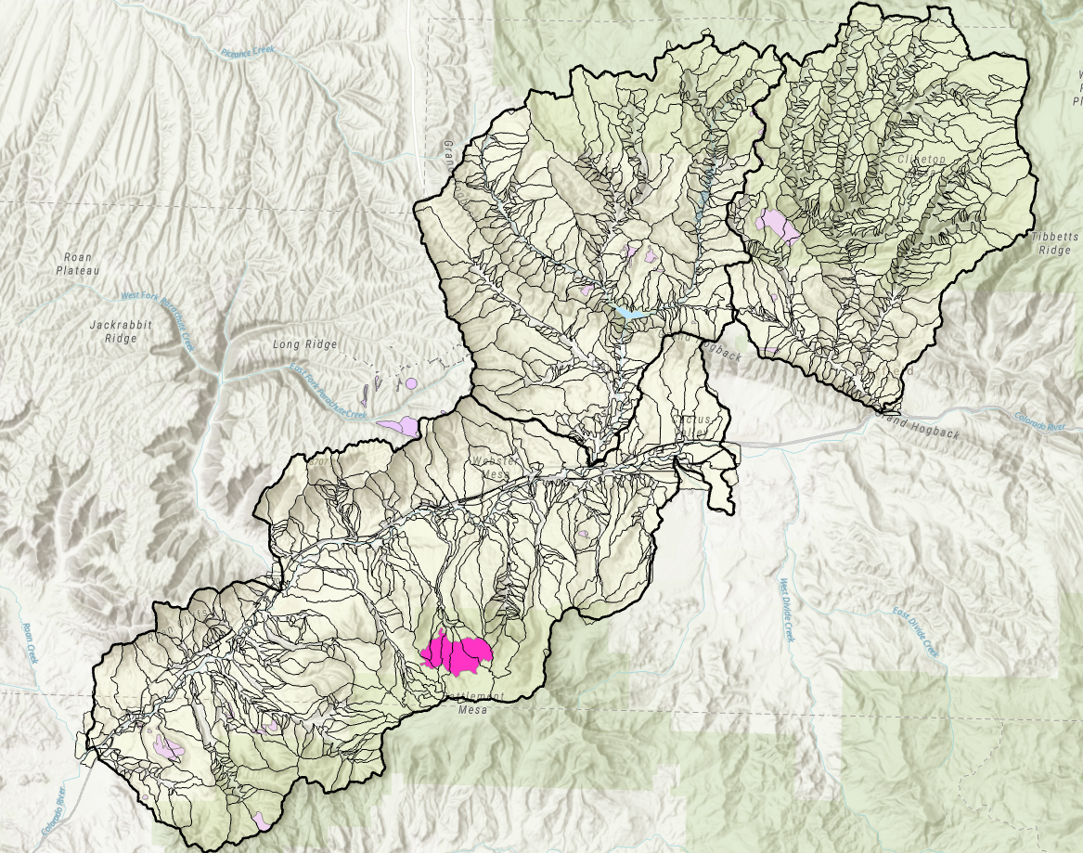
Additional opportunities for method refinement in WRAPS:
Updating predictive burn severity layer
13
Opportunities for model refinement:
Apply M1 model to basins similar in size and topography to M1 model training dataset.
Consider alternatives for predicting burn severity:
Other fire behavior model outputs that can infer burn severity.
E.g., Flame Length, broken out by vegetation type.
Updated Crown Fire Activity data using more recent fuels data.
E.g., LANDFIRE Total Fuel Change Tool (LFTFC).

Slide 17
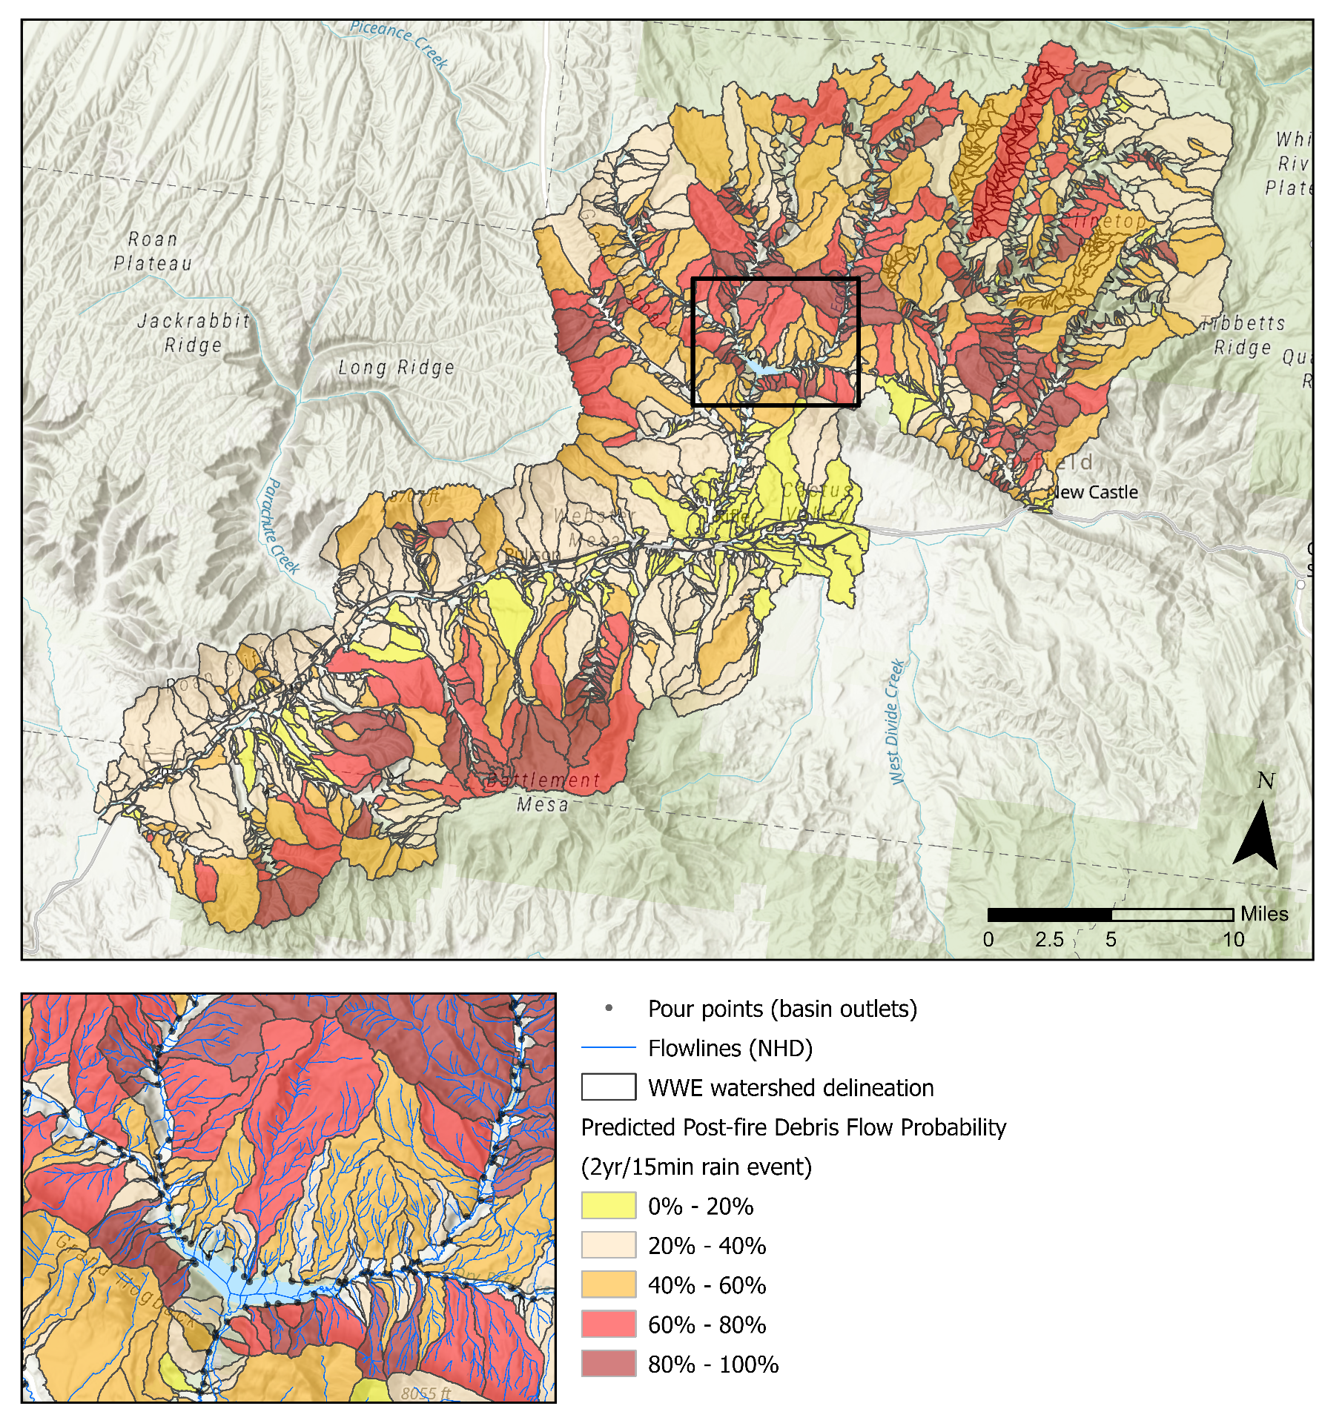
Additional opportunities for method
refinement in WRAPS:
Assessing mainstem risk
14
Opportunities for model refinement:
Apply M1 model to basins similar in size and topography to M1 model training dataset.
Consider alternatives for predicting burn severity:
Other fire behavior model outputs that can infer burn severity.
E.g., Flame Length, broken out by vegetation type.
Updated Crown Fire Activity data using more recent fuels data.
E.g., LANDFIRE Total Fuel Change Tool (LFTFC).
Quantitative or qualitative assessment of risk along mainstems (where majority of VARs are located).

Slide 18
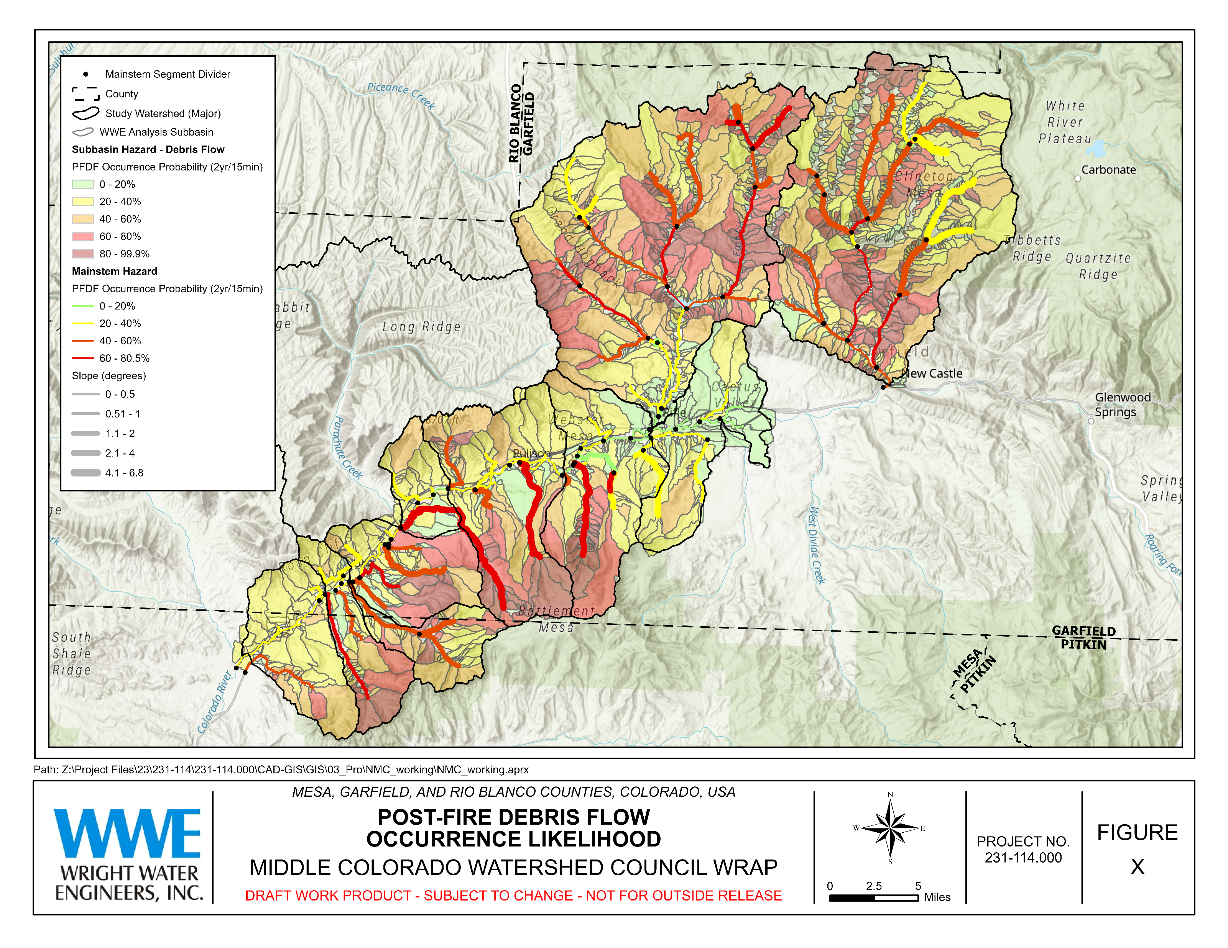

Slide 19
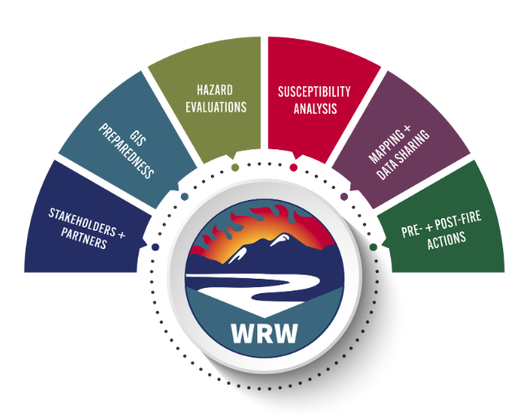
Lessons learned.
15
Repurposing a statistical model:
PROS
Applied widely.
Did not require collection of new data. Enabled project team to abide by budget and time constraints.
Easy to apply.
Provides a measure of relative risk.
Validated for use in Colorado.
CONS
Coefficients fit to data outside Colorado.
For statewide study, had to apply to basins larger than training data sampled.
Required engineering best judgement and mechanistic understanding of debris flow mechanics for where results should not be trusted.
Outside peer review extremely valuable.
Required cognizance of constraints. Otherwise, inappropriate use of outputs.
Required refinement for more detailed, localized WRAP hazard assessments.

Slide 20
Thank you! Questions?
Natalie Collar, Ph.D., CFM
ncollar@wrightwater.com
Claire Vavrus, EIT
cvavrus@wrightwater.com

